Slide 1
Weathering and Mass Movement
Mr Boland
Geography

Slide 2
Weathering refers to the physcial and chemical processes that break down rocks.
The rocks broken down by weathering are carried away by the agents of erosion-water, ice and wind. These forces of erosion shape the land.
The rate at which rocks are weathered depend on the rock type, structure and mineral composition, the regions climate and vegetation and the length of time weathering has been happening.

Slide 3
Weathering can be broken into three catergories
1. Physical weathering
2. Chemical weathering
3. Biotic weathering

Slide 4
Physical/ mechanical weathering
Physical weathering breaks down rocks by applying mechanical pressure. It is active on exposed rock surfaces resulting primarly from temperature changes.
The two main types of mechanical weathering are freeze thaw action and exfoliation.

Slide 6
Physical; freeze thaw action
Freeze thaw action takes place in high areas where temperatures varying above and below freezing. Rainways seeps through fissures in cracks, freezes, expands 10% and then melts. Repeated freezing and thawing of the water causes the cracks expand and rocks to fall off. The fragmented rocks move down the slope due to gravity and gathers in piles called scree.

Slide 7
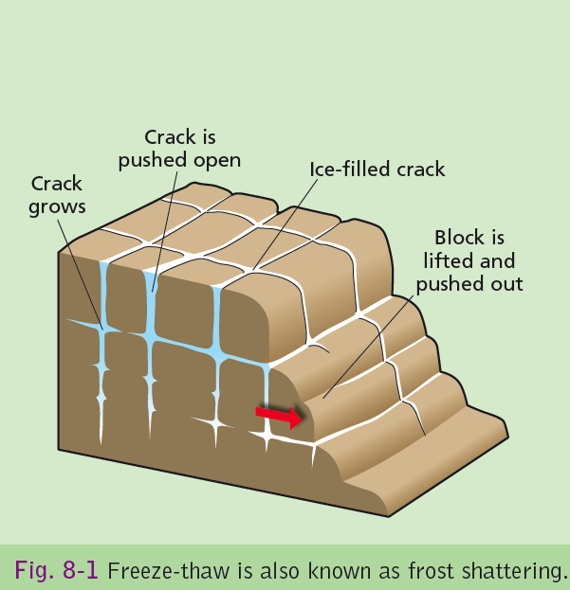

Slide 8
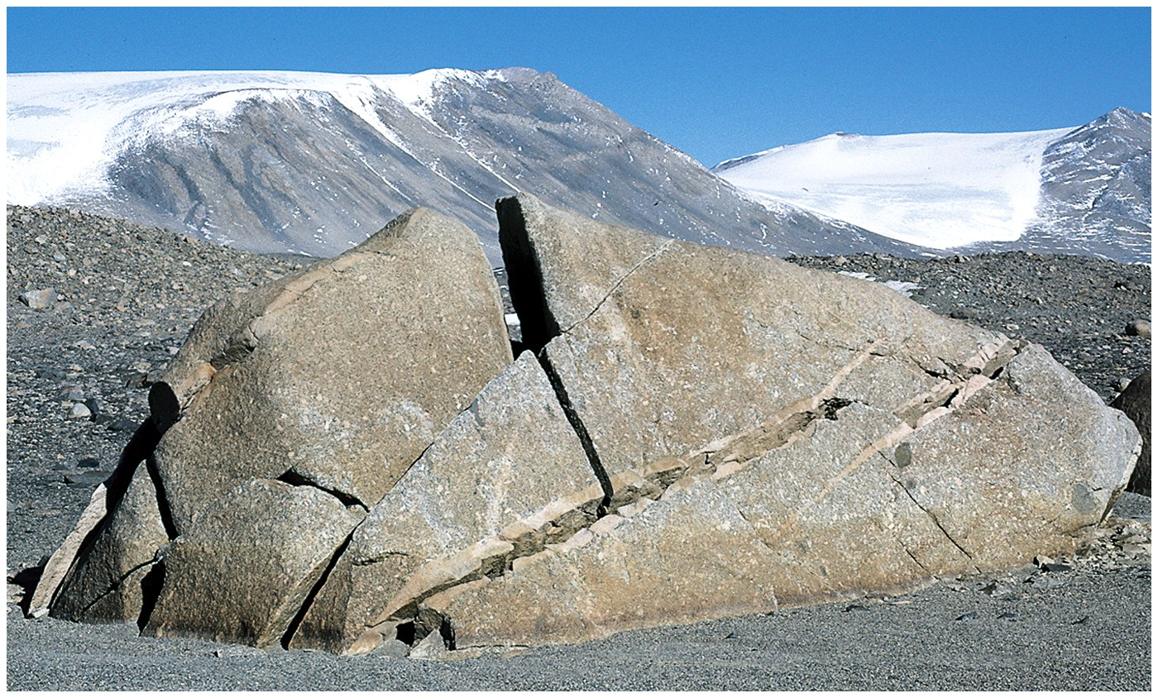

Slide 9
Physical; Exfoliation
Temperature change causes rocks to expand when they are warm and contract when they are cool. If this is repeated for example in hot desserts where the diurnal temperatures vary from 0 to 50 degrees the repeated expanasion and contraction will cause stresses in the rocks

Slide 10
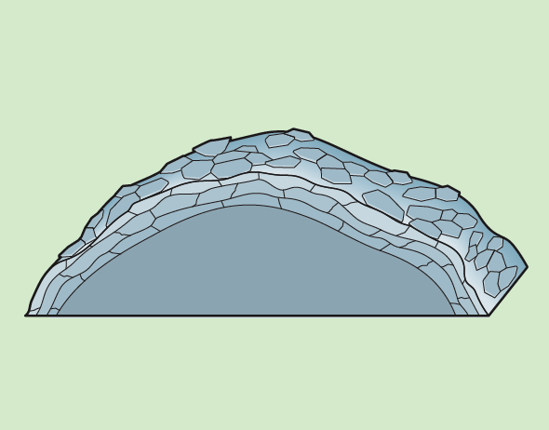

Slide 12
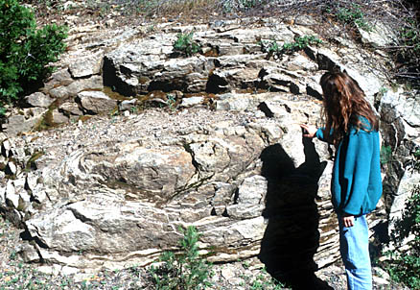

Slide 13
Chemical weathering
This is the breakdown of mineral in the rocks, moisture is essential for the chemical breakdown of rocks. The main types of chemical weathering are
1. Oxidation
2. Hydration
3. Hydrolysis
4. Carbonation

Slide 14
Oxidation
In humid enviroments rainwater reacts with iron compounds in rocks. This gives rocks a bright red/ brown look as the landscape is all rusted away

Slide 15
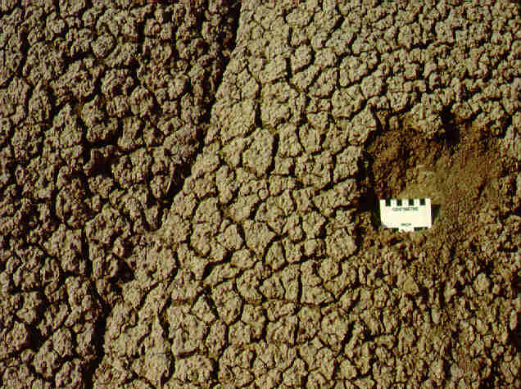
Hydration
Rocks with a high clay amount expand as they absorb water. When they dry the rocks contract and crack. This is known as hydration.

Slide 16
Hydrolysis
When water reacts with minerals such as feldspar chemically it can weather rocks such as granite. The mineral feldspar turns to clay breaking up into , mica and quartz. These rocks are usually well rounded and can rise up to 6 meters above the surrounding lands known as tors. The horizontal joints result from pressure release while the vertical joints from weathering.

Slide 17
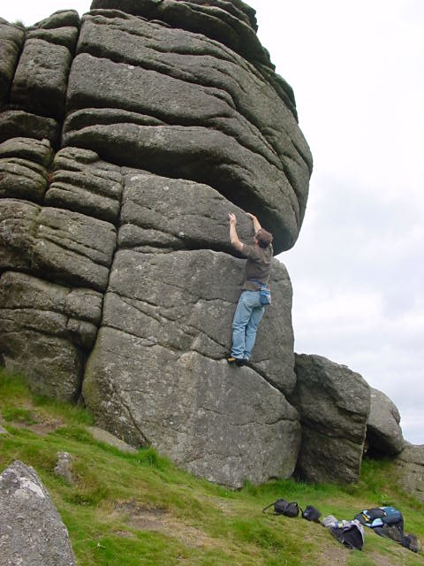
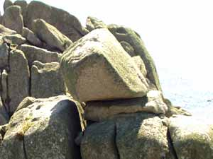

Slide 18
Carbonation
This is the form of weathering where carbonic acid reacts with calcium carbonate in limestone. Rainwater absorbs carbon dioxide and becomes a weak carbonic acid. This is strengthened by absorbing carbon dioxide from decaying vegetation. Eventually the calcium carbonate is converted to calcium bicarbonate and carried away by solution.

Slide 20
Biotic Weathering
Biotic weathering is the breaking down of the earths surface by plants, animals and humans.

Slide 21
Plants
Plants such as lichens decompose certain rocks by extracting soluble untrients and iron from them. Plant roots widen rock joints or fissures. The natural process accelerates chemical weathering. Rainwater and air can penetrate deep within the bedrock to cause chemical weathering by carbonation and oxidation.

Slide 22
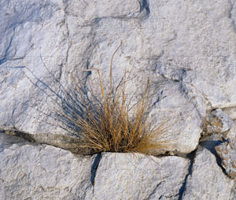
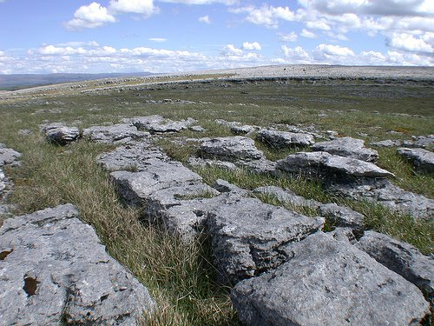

Slide 23
Trees Breaking rocks

Slide 24
Animals
When animals burrow they carry fresh material to the surface which gets exposed to chemical weathering

Slide 25
Human Activities
Humans contribute to the over exploitation of the land by deforestation, over-cropping and over-cultivation. These in turn can lead to desertification like the Sahara.

Slide 26
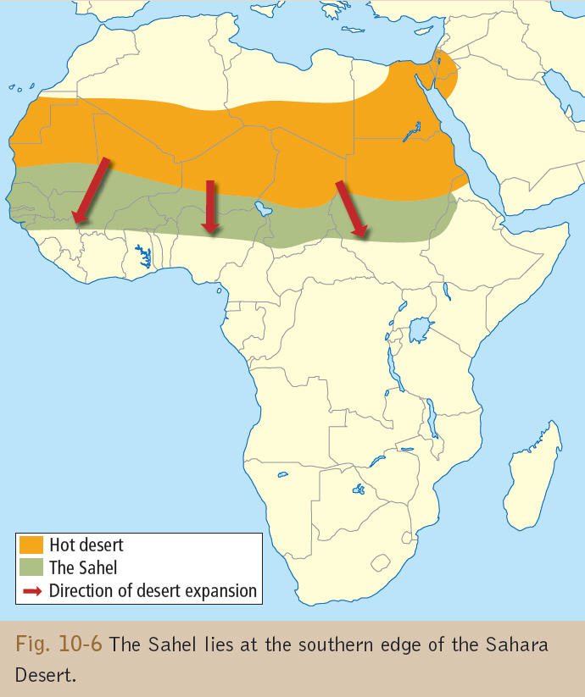

Slide 27
MASS MOVEMENT

Slide 28
Mass Movement
Mass movement is the movement of regolith down slope due to gravity. It gives the landscape a smoother surface.
Factors that affect mass movement can be such things as
Water content,
Steepness of slope,
Amount of vegetation present on a slope
Human interference.

Slide 29
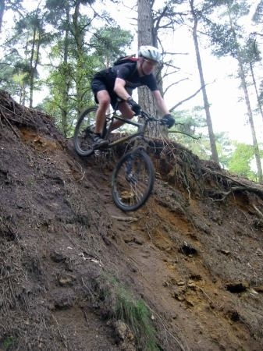
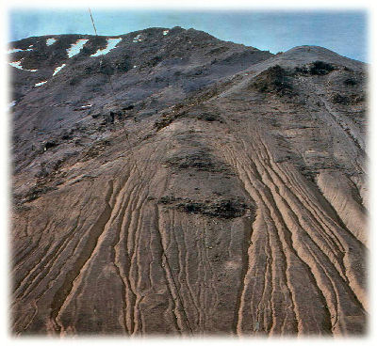
Factors that affect mass movement.
How steep the slope is.
The amount of water present.
The presence of vegetation.
Human activity.

Slide 30
Soil Creep
Soil creep is the slowest type of mass movement. It happens on gentle slopes. It may be noticed when posts, fences or trees are tilted downhill's, material gathering behind walls or as a ribbed or step patterns.
Anything that loosens the soil assists the movement of soil downwards.

Slide 31
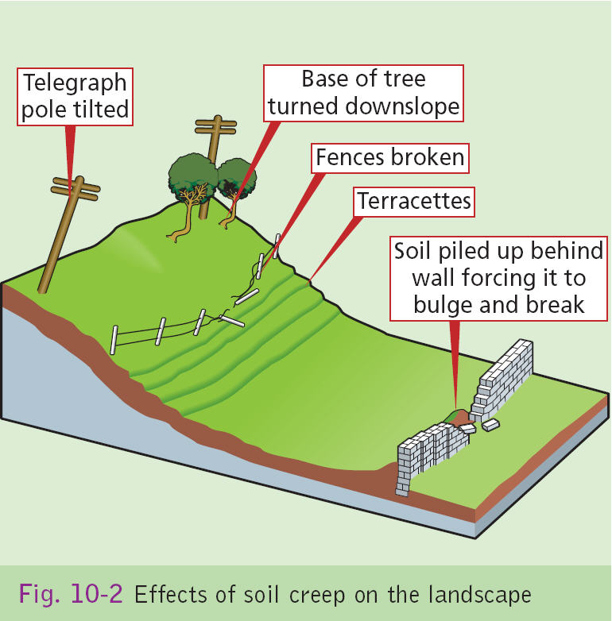

Slide 32
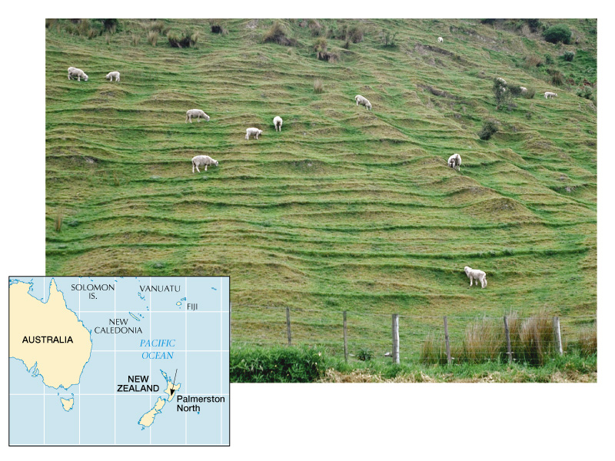

Slide 33
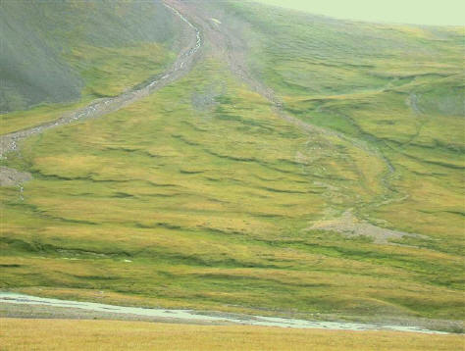
Solifluction
In areas like the tundra the subsoil remains frozen for most of the year. But, in the summer when the soil thaws this could result in soil flowing downhill

Slide 34
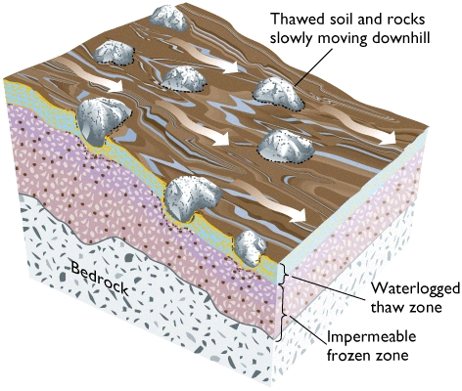

Slide 35
Earthflow
After heavy period of rain on an unprotected loose slope, the soil on the slope could become unstable and flow downhill. This would leave a crescent-shaped scar on the hill.

Slide 36
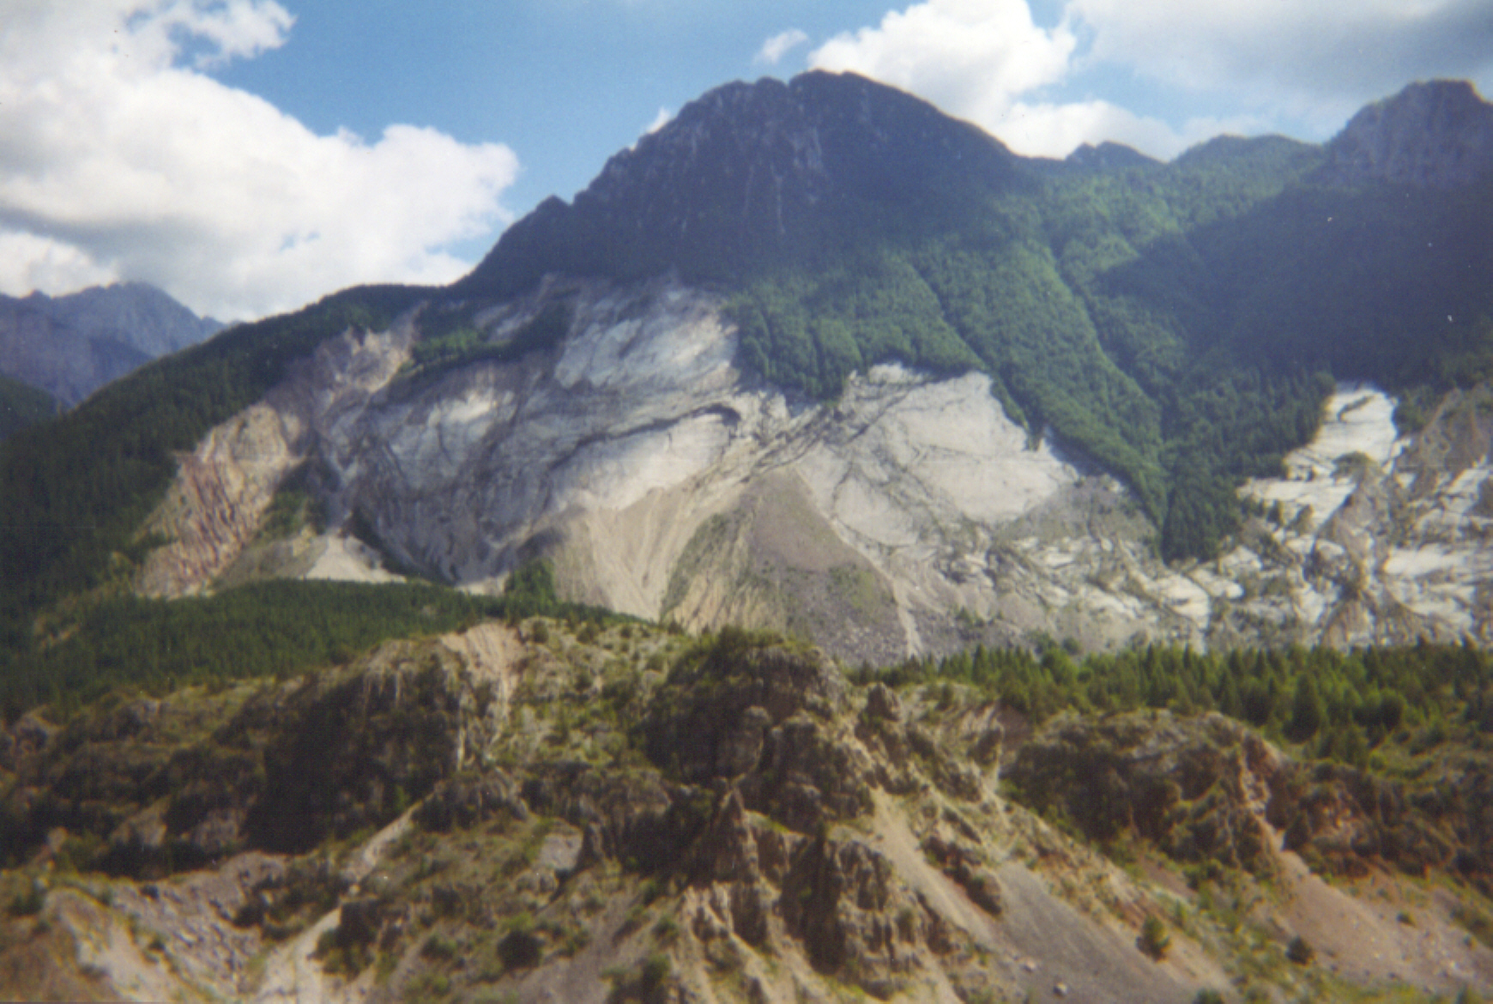

Slide 37
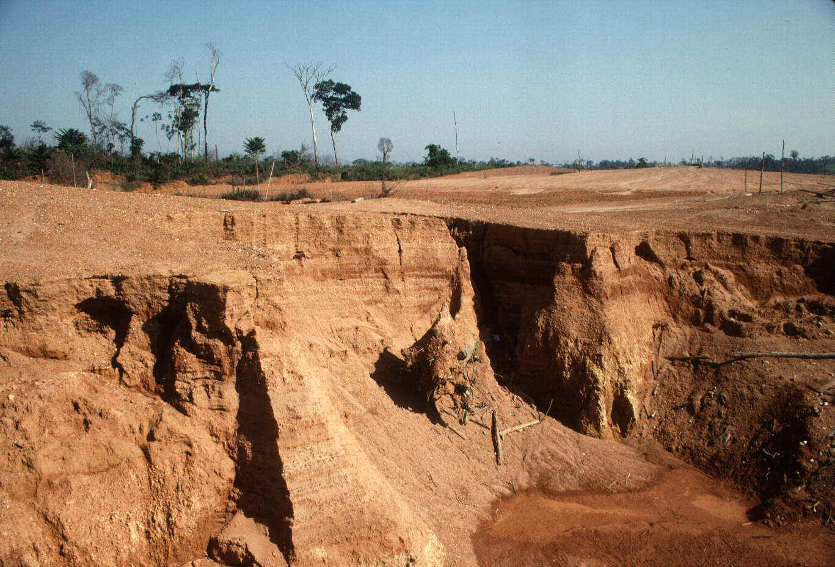

Slide 38
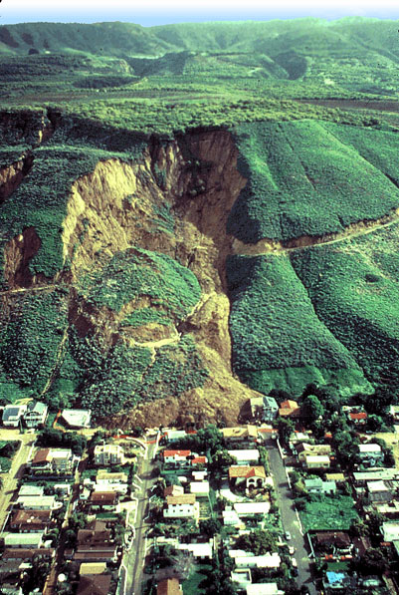

Slide 39
Mudflow
A mudflow has more water than an earth flow. It usually occurs on river channels where slopes are covered with clay, silt and sand are saturated.
Mudflow can also be caused by a volcanic eruption where the hot ash and lava mix with the mud on the steep slope (Lahar)

Slide 40
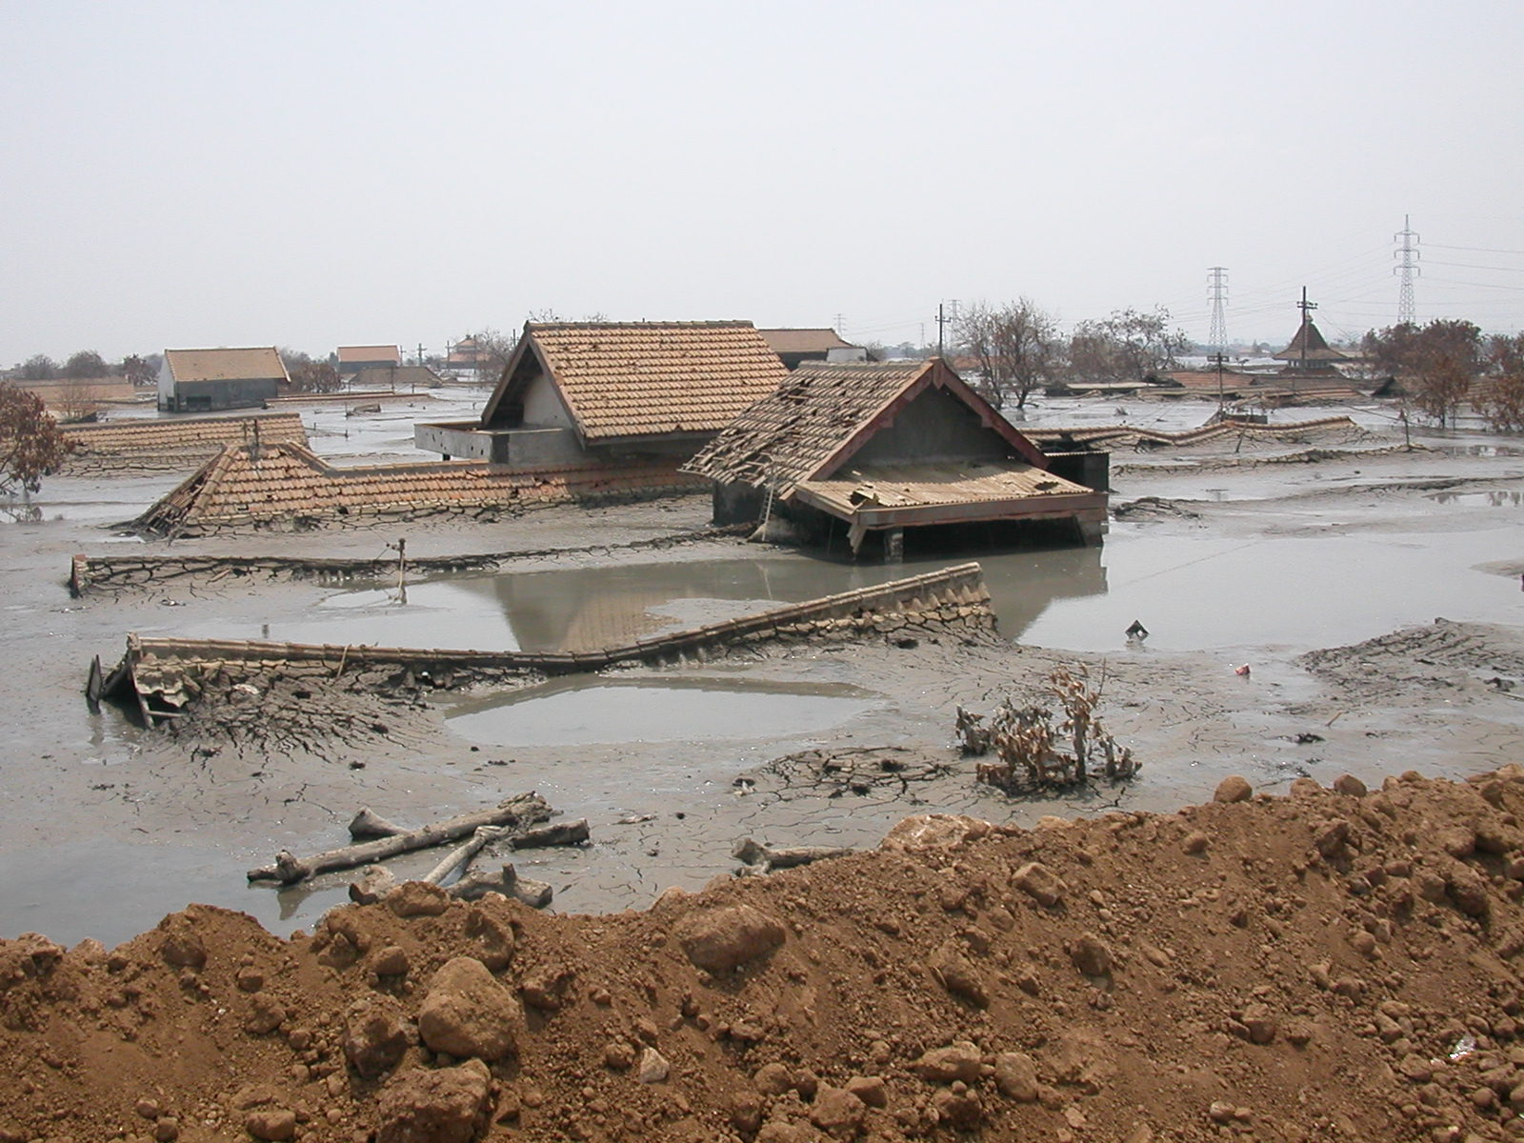

Slide 41
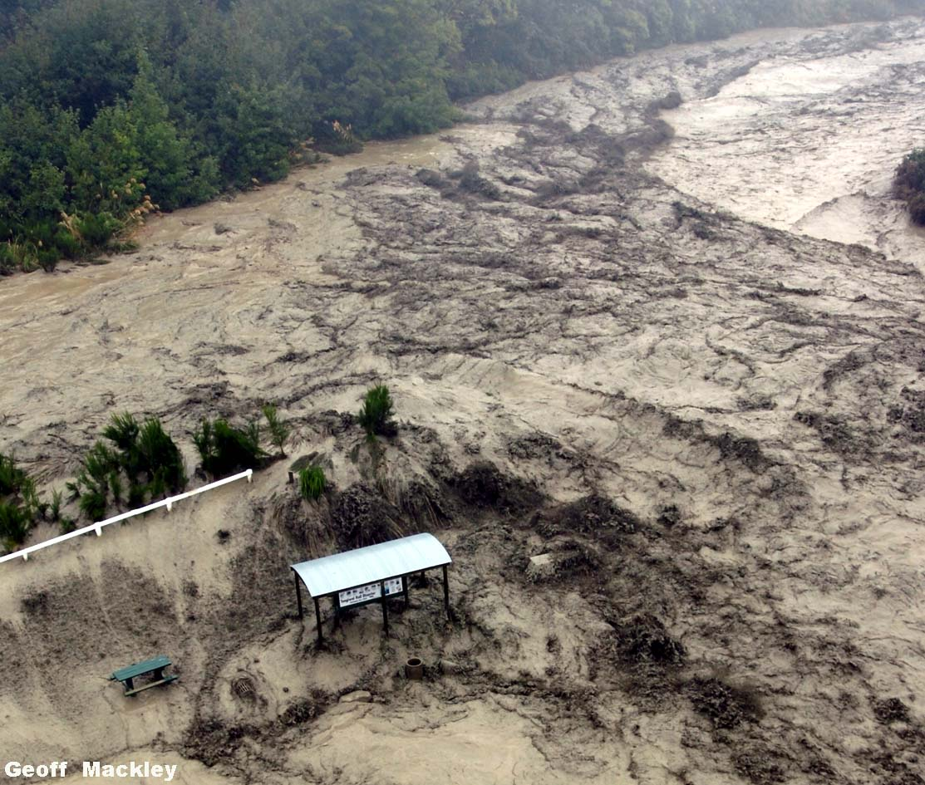

Slide 42
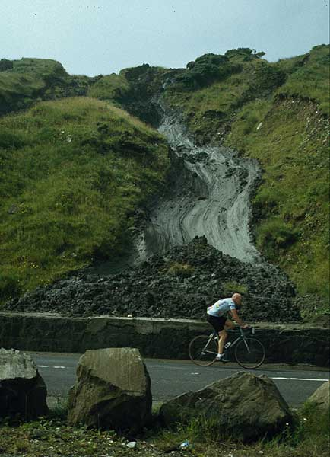

Slide 43
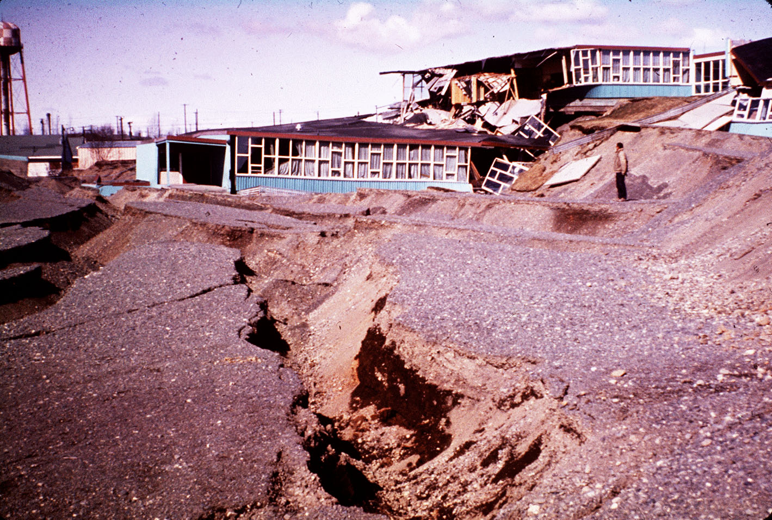

Slide 44
Nevada Del Ruiz, Columbia.
When this volcano erupted in 1985, it resulted in the death of over 21,000 people. The emissions from the volcano melted the mountain top’s snow and ice resulting in a torrent of waterlogged mud.

Slide 45
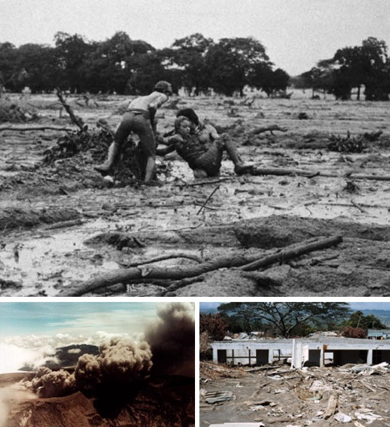

Slide 46
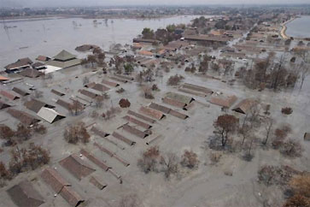

Slide 47
Debris Avalanche
A debris avalanche is the sudden and rapid sliding of rocks and gravel down a steep slope. After heavy rainfall the rocks break up and slide downslope. It is usually the bedding plane that dips downward.
An example of this is the bogburst at Dooncarton, Mayo.

Slide 48
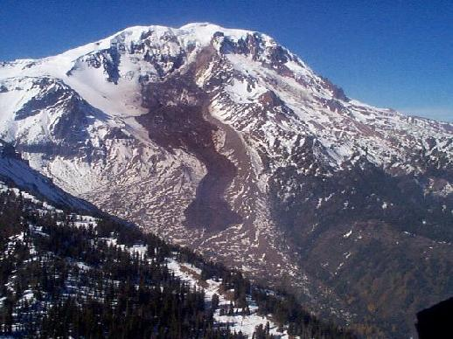

Slide 49
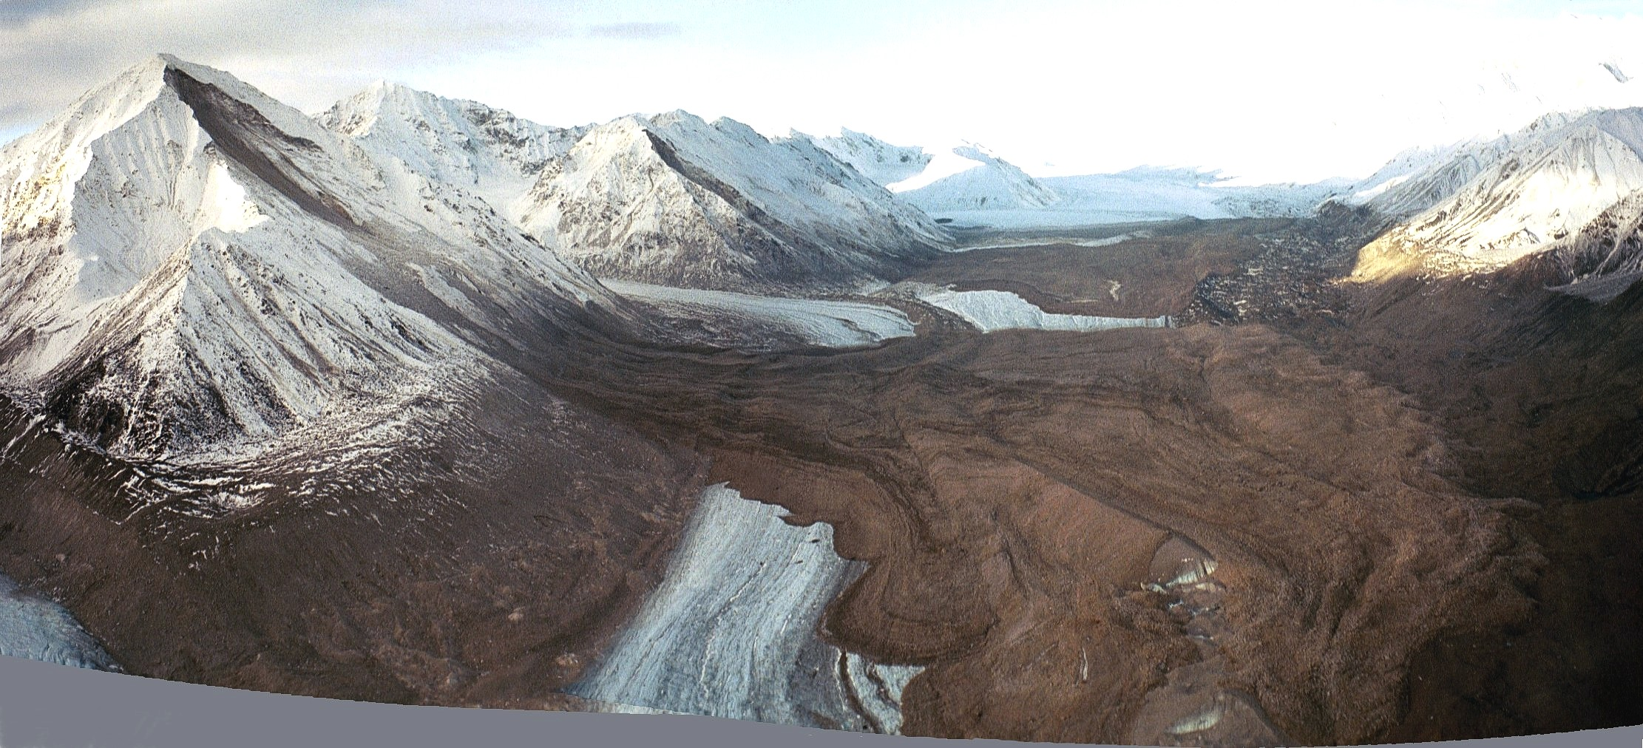

Slide 50
Avalanche
An avalanche is the rapid movement of snow down slope. This can be caused by the melting snows in spring or heavy noise vibrations

Slide 51
Rockfall
Rockfalls occur on steep cliffs in mountainous regions, due to processes such as freeze thaw action. This results in the build up of scree at the bottom of the cliffs. Examples of rockfalls in Ireland can be see on steep cliffs such as Ben Bulben.

Slide 52
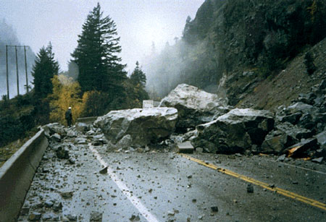

Slide 53
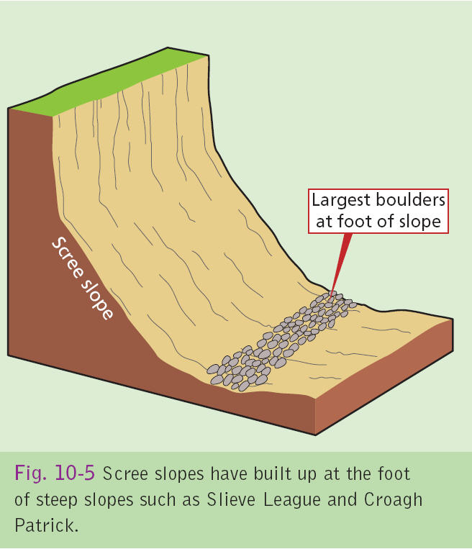

Slide 54
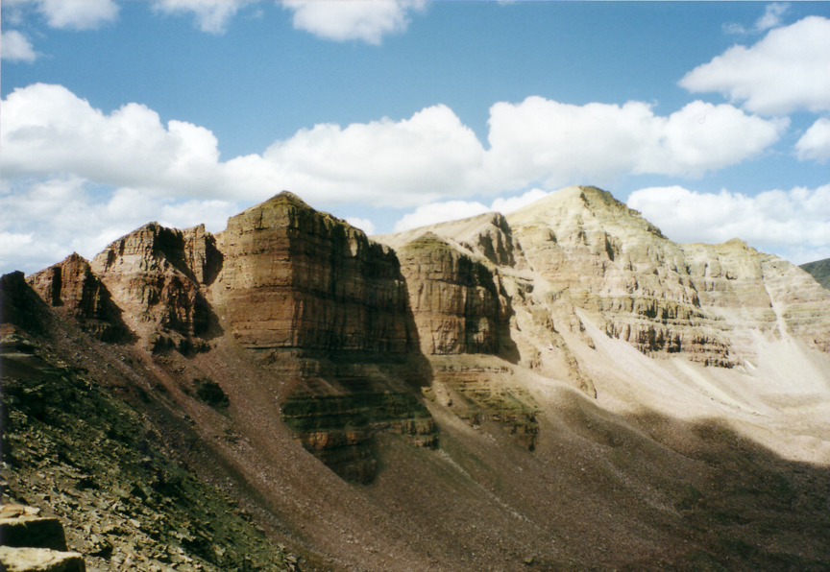

Slide 55
Rotational slumping
This is the sudden movement of debris down a concave slope. The soil tilts backwards and rotates as it slides downslope. This is very common along coastlines which are eroded by breaking waves. In Antrim chalk slumps under the weight of the heavier basalt.

Slide 56
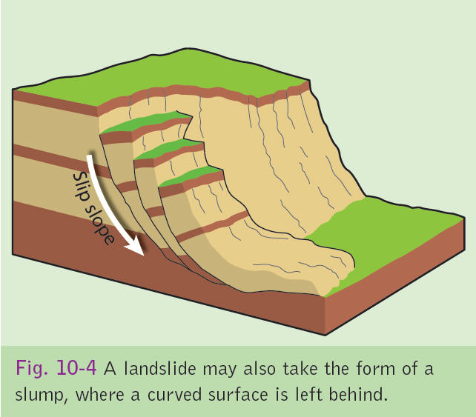

Slide 57
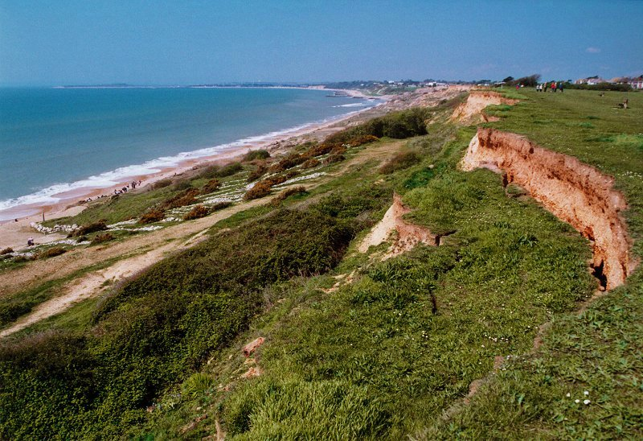

Slide 58
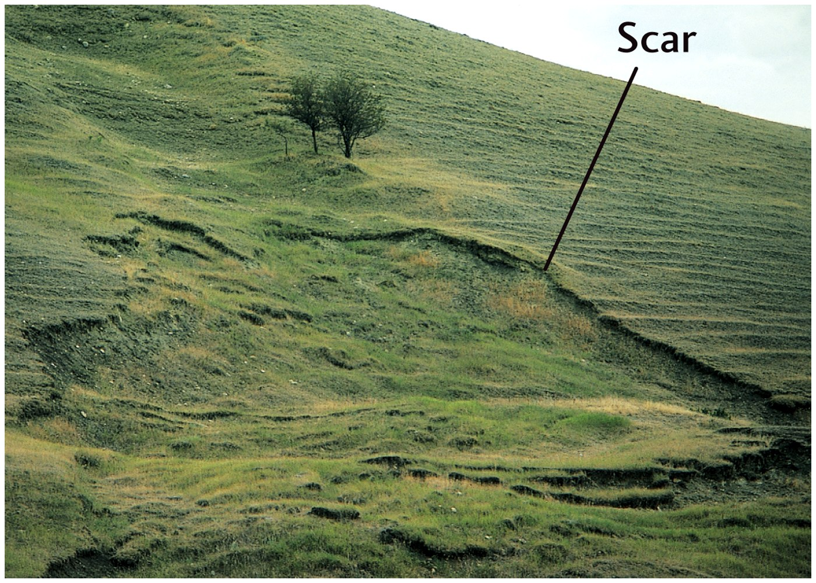

Slide 59
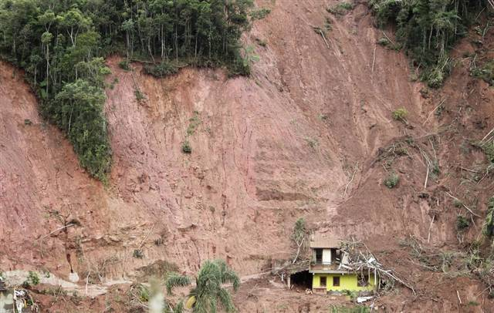
Brazilian Mudslide

Slide 60
http://today.msnbc.msn.com/id/41052937/ns/today-weather/

Slide 61
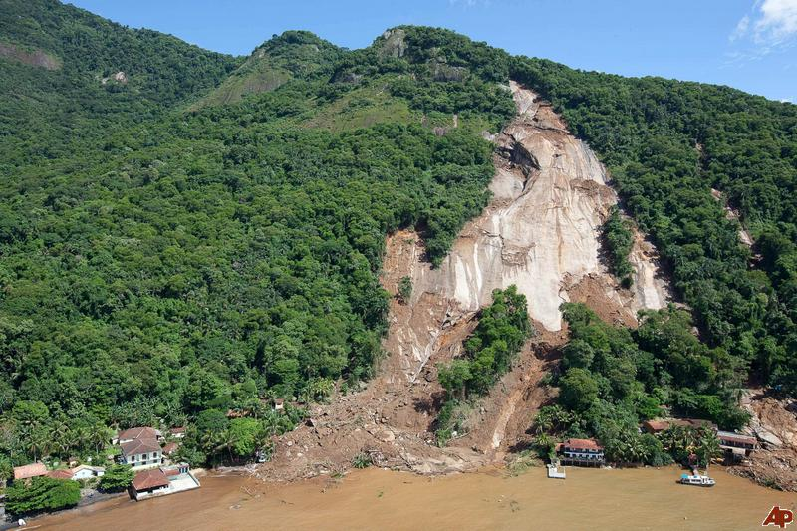

Slide 62
Brazil Mudslide
The previous confirmed toll from the flash floods and mudslides that struck the Serrana mountain region near Rio de Janeiro on January 12 was 759
Such disasters hit Brazil annually in its rainy summer season and unduly punish the poor, who often live in rickety shacks perched perilously on steep hillsides with little or no foundations.

Slide 63
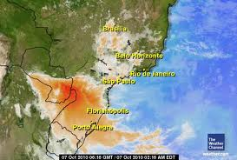

Slide 64
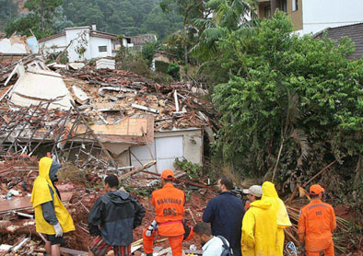

Slide 65
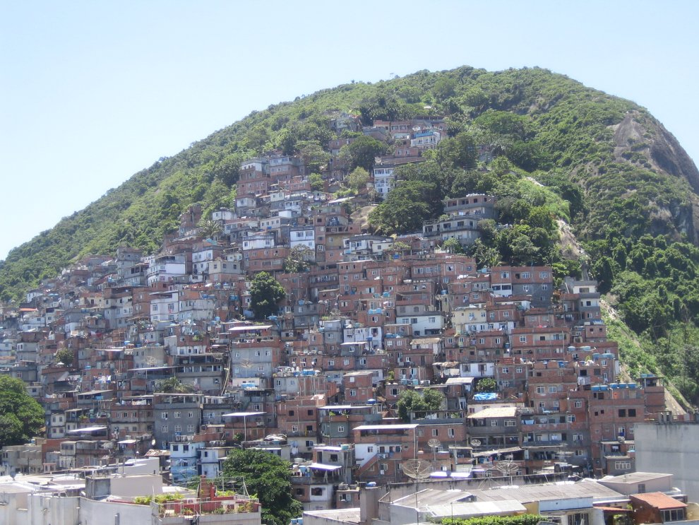

Slide 66
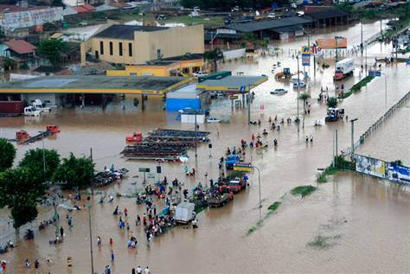

Slide 67
A total of 13,830 people were forced to abandon their homes in the region, either because they were destroyed or deemed unsafe, Rio's health service said.
The area was hit by 26 centimeters of rain fall in less than 24 hours

Slide 68
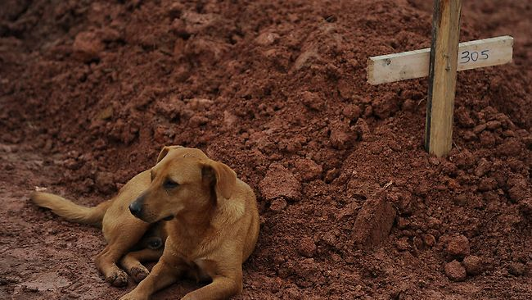
The previous confirmed toll from the flash floods and mudslides that struck the Serrana mountain region near Rio de Janeiro on January 12 was 759

Slide 69
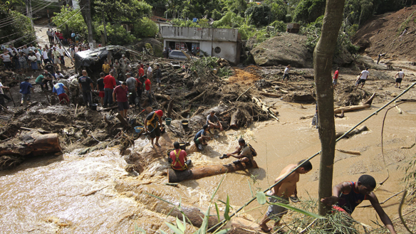

Slide 70
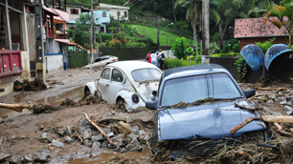

Slide 71
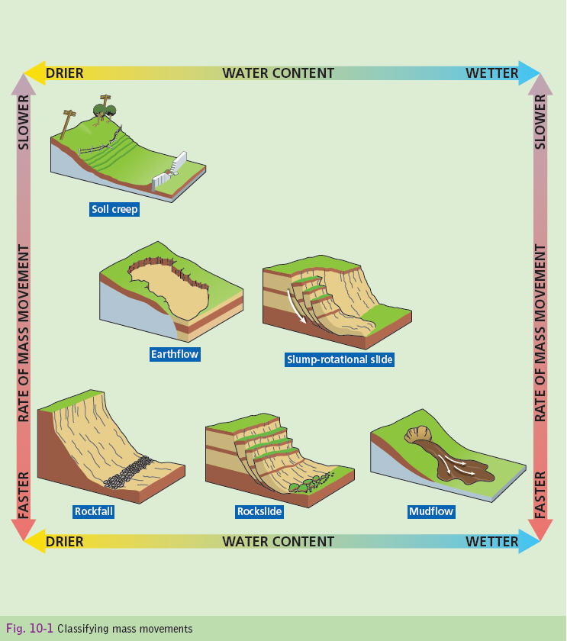

Slide 72
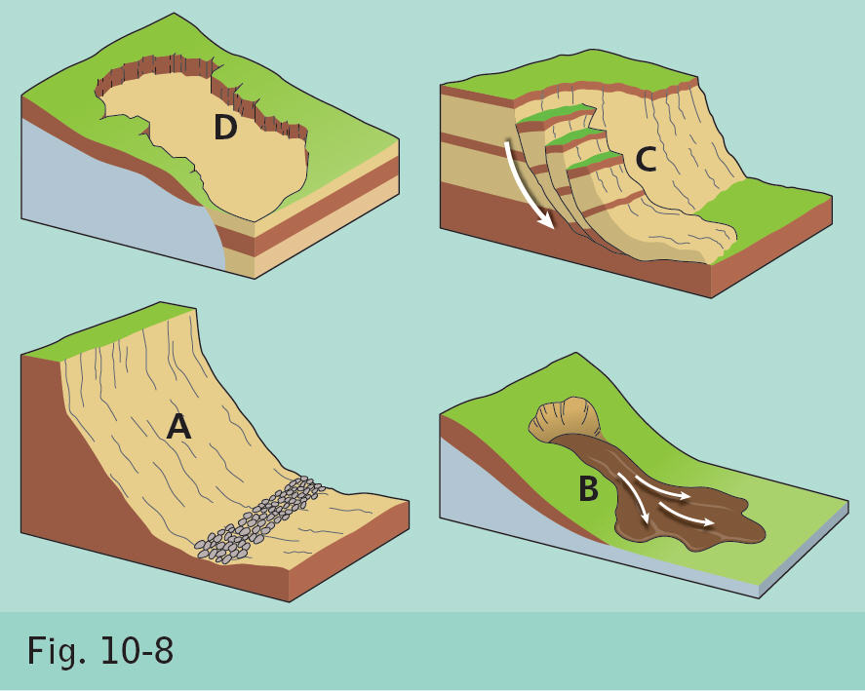

Slide 73
EXAM QUESTIONS

Slide 77
30 Mark Questions
Examine how human process can have an impact on the operation of mass movement process.
Describe and explain one mass movement process that you have studied.
With reference to the Irish Landscape, examine how the processes of weathering have influenced the development of one limestone feature.

