Slide 1
 Natural Vegetation & Climate 

Slide 2
What is Natural Vegetation?
Natural Vegetation is plant life that hasn’t been planted or changed by humans, it has grown naturally or wildly as nature intended.
Humans however still plant & remove vegetation and so few areas in the world where natural vegetation remains.
Irelands natural vegetation was deciduous forest .This has been dramatically altered
for agriculture & recreation.

Slide 3
Ireland’s Natural Vegetation
Irelands forest cover is believed to be about 8-10% of the country with less than 1% of this being natural vegetation.
After the last Ice Age, about 10,000 years ago, Ireland gradually became covered with trees.
The arrival of early farmers heralded the beginning of the steady decline of Ireland's natural woodland cover as they felled trees for timber and cleared the land for agricultural use.
Uses for timber varied from the construction of bog roads, crannógs and dugout canoes, to ship-building
and charcoal for smelting.

Slide 5
How Natural Vegetation is Related to Climate
Climate
Precipitation Heat
-Provides moisture for -Needed for plant growth.
plants.
-Wet Regions may be -Hotter regions usually have
covered in thick forest. more lush vegetation than
-Moderately wet regions may be cooler regions.
covered in natural grasslands. – Few plants will grow in
-Dry Regions usually contain temperatures below 4°c.
scrub-like vegetation. -Very warm conditions effect the type of plants that grow.
Natural Vegetation

Slide 6
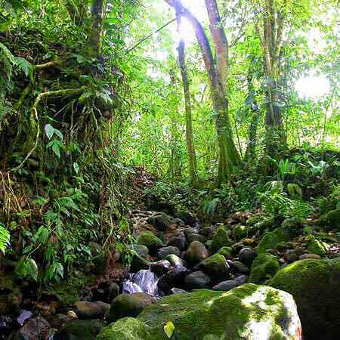
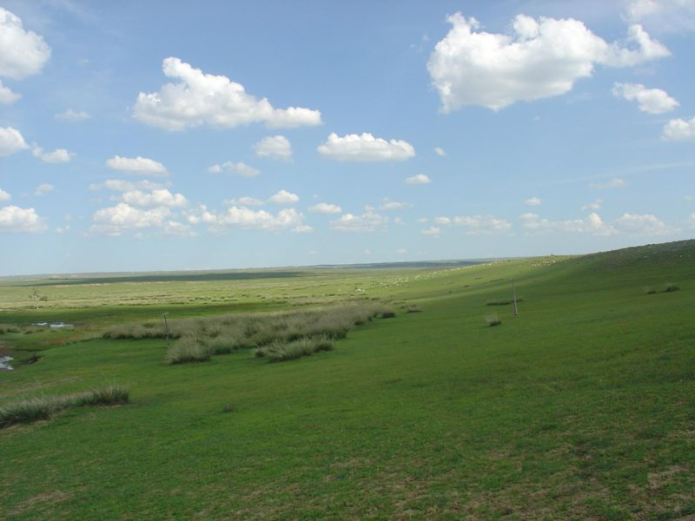
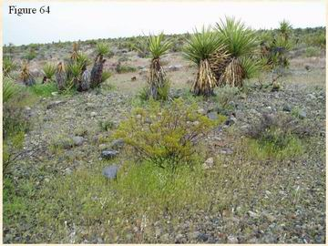
Precipitation
Different amounts of precipitation affect the type of natural vegetation in an area.
Wet regions- will be covered in thick forests
Moderately wet regions will have grasslands
Dry regions contain shrub like vegetation.

Slide 7
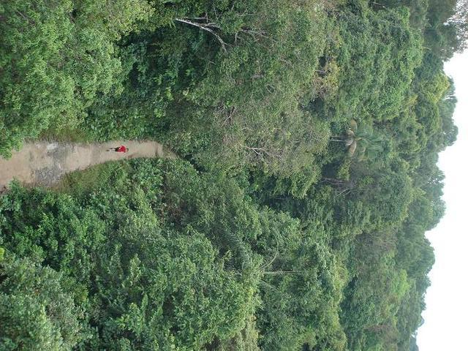
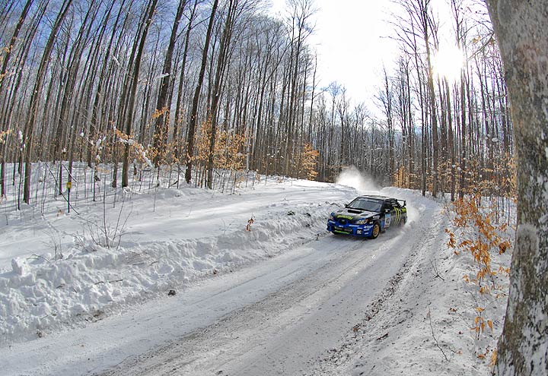
Heat
Hotter regions have lush vegetations.
Vegetation wont in abundance in temperatures in 4 degrees.

Slide 9
Natural Vegetation & Soil
Máistir Ó Míocháin
An Tíreolas

Slide 11
Compare the forested area
in the background to the
cleared land in the
foreground.
--------------------------
Explain possible reasons
for the differing
landscapes?

Slide 13
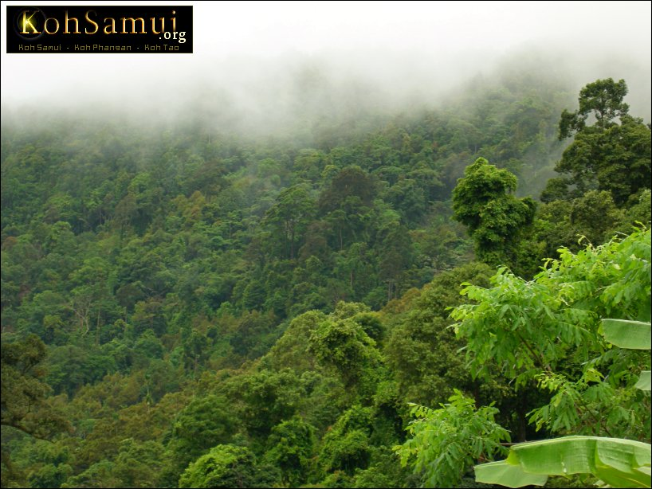
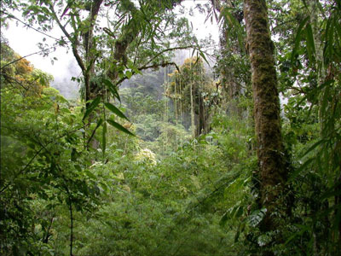
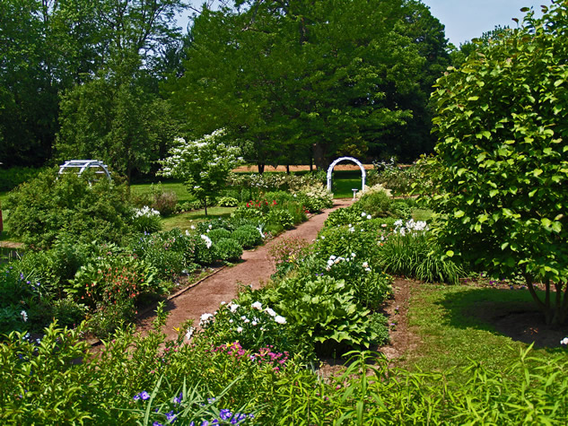
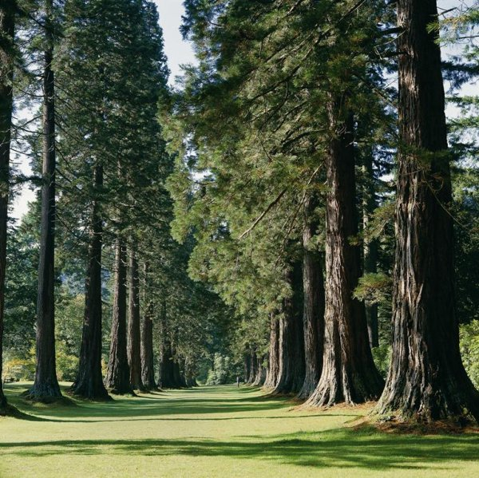

Slide 14
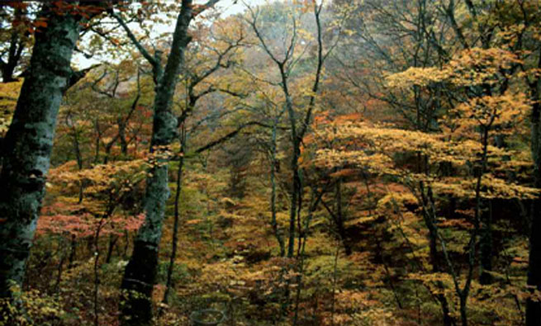
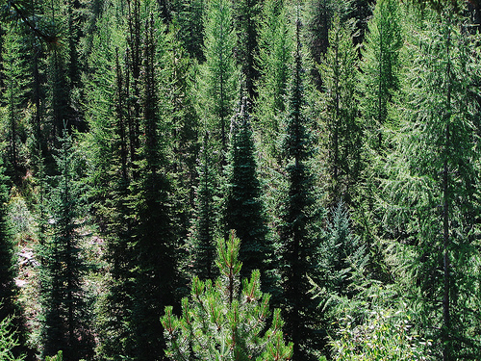
Soil conditions affect Vegetation and Vegetation also affects Soil conditions.

Slide 16
Soil conditions influence vegetation
Soil nourishes vegetation by giving it essential nutrients. These nutrients such as nitrogen and calcium make the soil fertile and a plentiful variety of plants. Without nutrients soil is infertile.
The depth of soil also influences growth. Oak trees need deep soils found in river valleys. Grass and shallow rooted trees can only survive in shallow soil. Shallow soil are common on
mountains.

Slide 17
Vegetation Influences Soil Condition
Vegetation provides fertile humus which nourishes the soil. Humus is formed from deciduous trees. Coniferous trees give off small plant litter results in no humus.
Vegetation can effect leaching by returning nutrients to the surface.
Vegetation can protect soil erosion by forming a protective cover over the soil. Where natural vegetation is removed soil
erosion happens.

