Slide 1
Types of industries Heavy and Light
Denis Boland

Slide 2
Multinational corporations- MNCs
MNCs make products in many different countries.
Their headquarters are located in one country and they have branches in other countries.
How many can you name???????

Slide 3
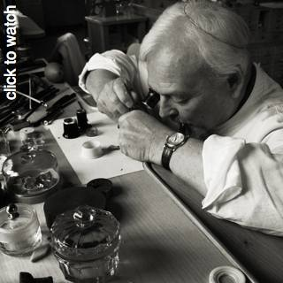
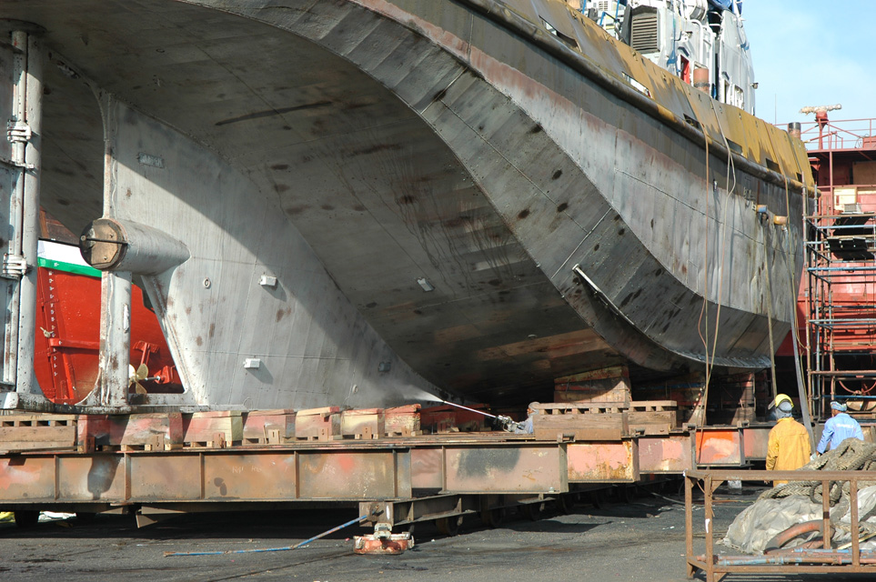
Light industries make small and light products.
Heavy industries make big, heavy bulky products.

Slide 4
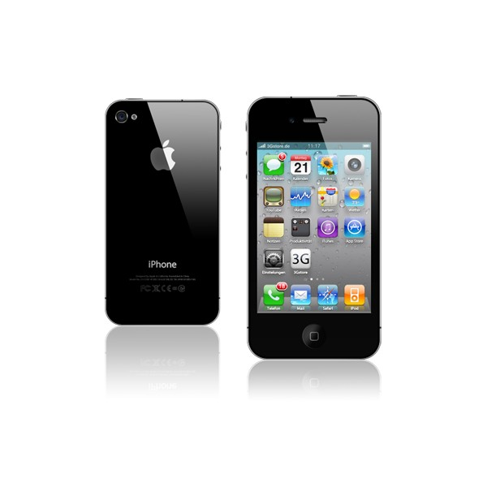
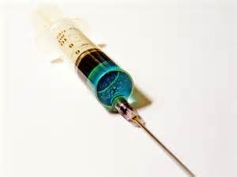
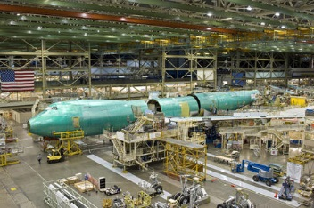
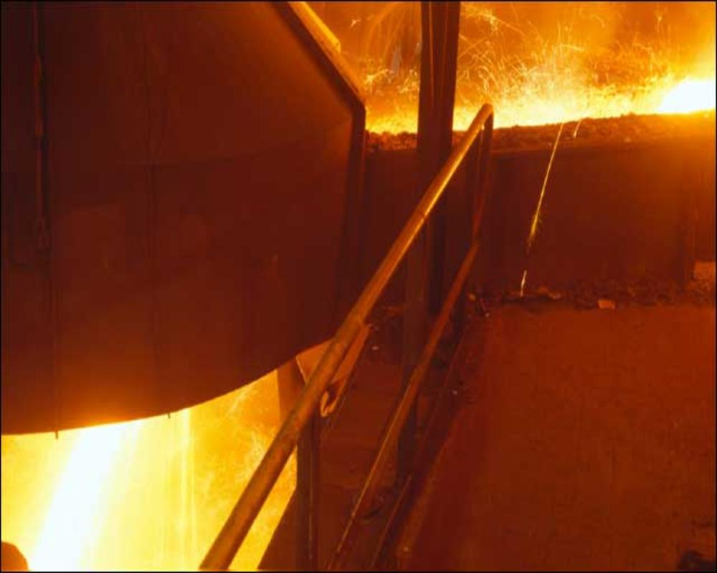
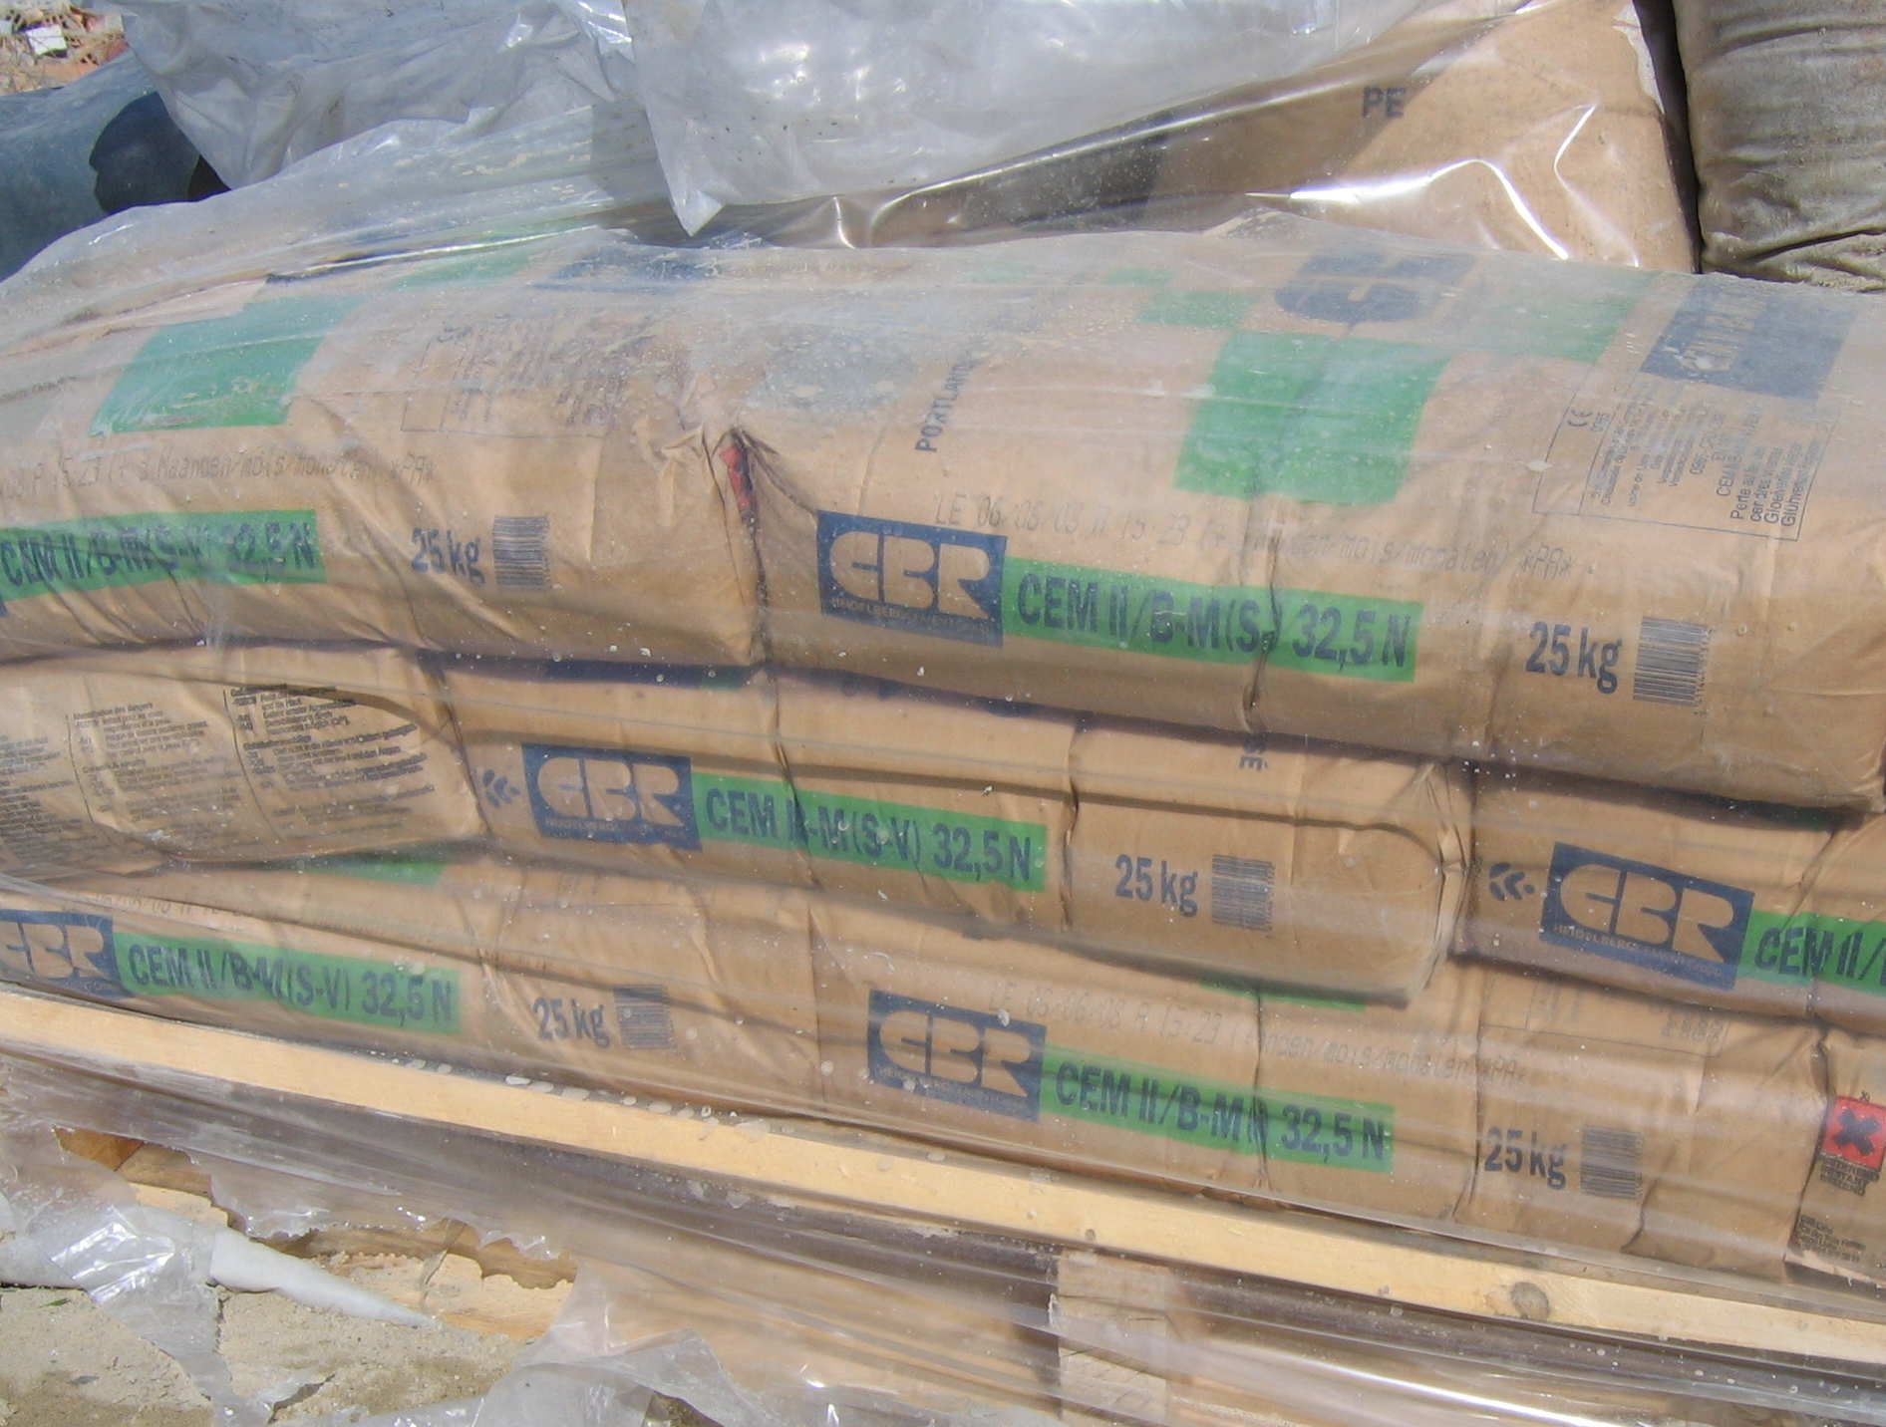
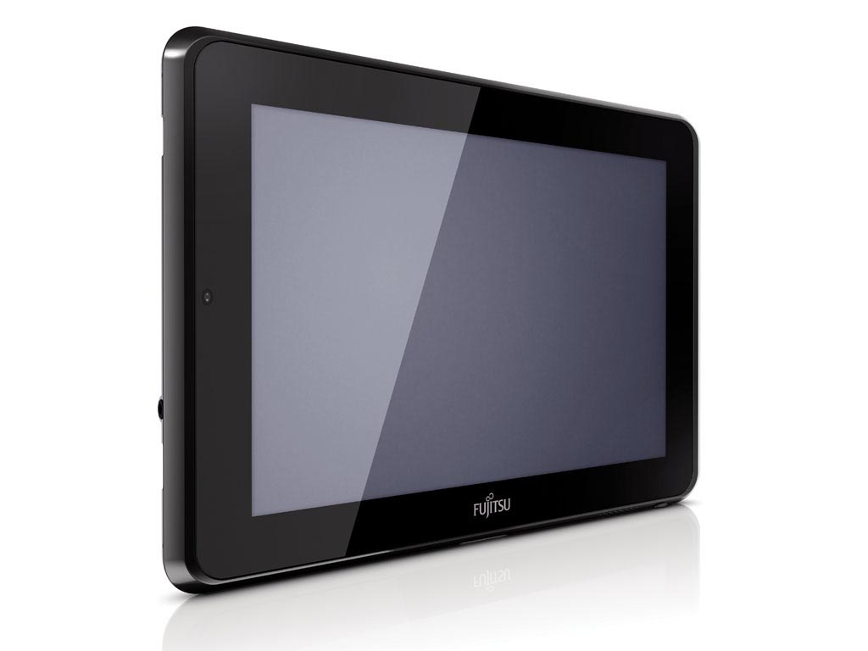
Heavy or light industries?????

Slide 5
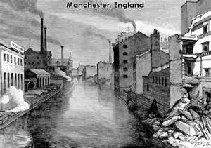
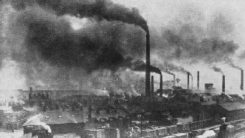
“In the good auld days”
Industries were tied, for example in the 19th century many were built near coalmines as coal was used for power/ steam and helped in the production of iron and steel.
Many industries had to locate in the hearts of towns or cities to be near workers when transport systems weren’t so well developed.

Slide 6
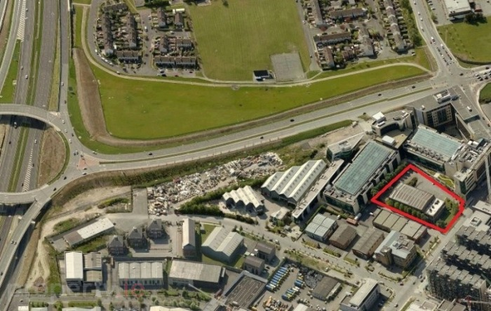
Today- Footloose Industry
Footloose industry is one which can be situated successfully in a variety of locations.
It isn’t dependent on one locational factor.
Footloose industries are usually light industries that located in industrial estates close to large cities (Sandyford Industrial estate)

Slide 7
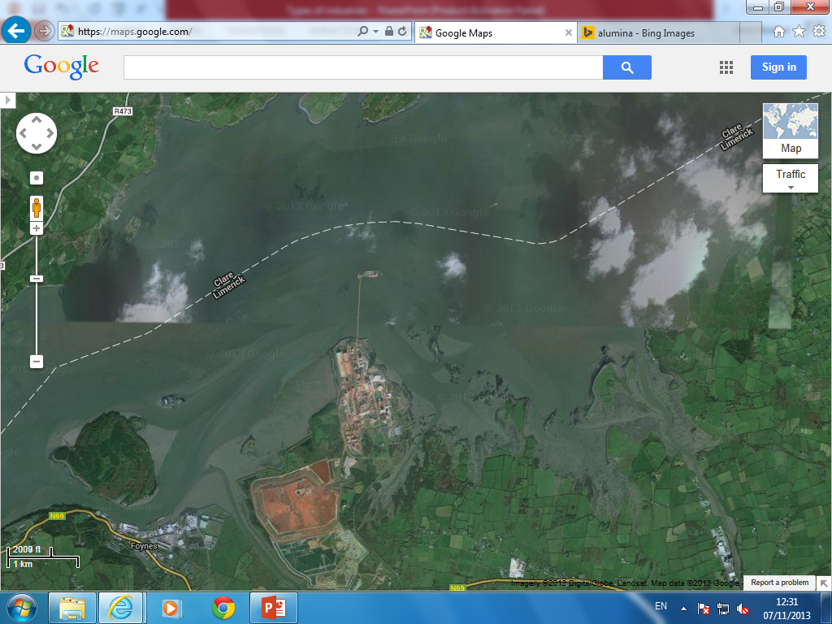
Heavy Industry RUSAL’s Aughinish Alumina

Slide 8
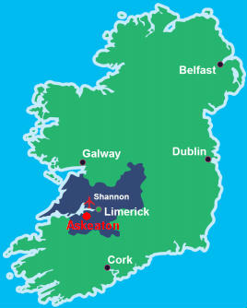
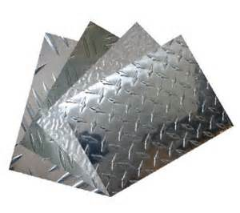
RUSAL the worlds largest aluminium producer has a alumina factory on a Island in the Shannon Estuary.
Alimina is a semi finished product. It is a white powder used to make aluminium

Slide 9
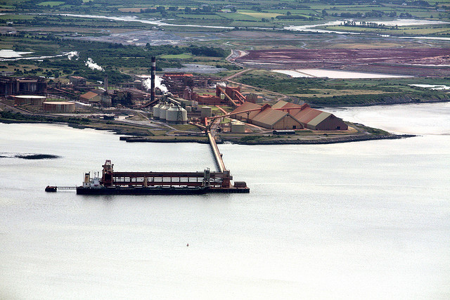
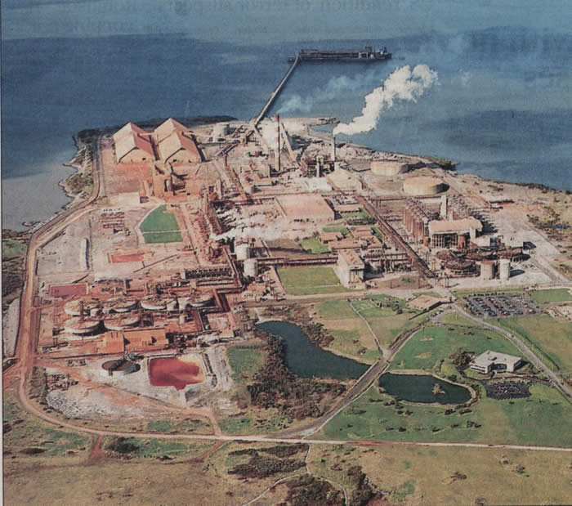
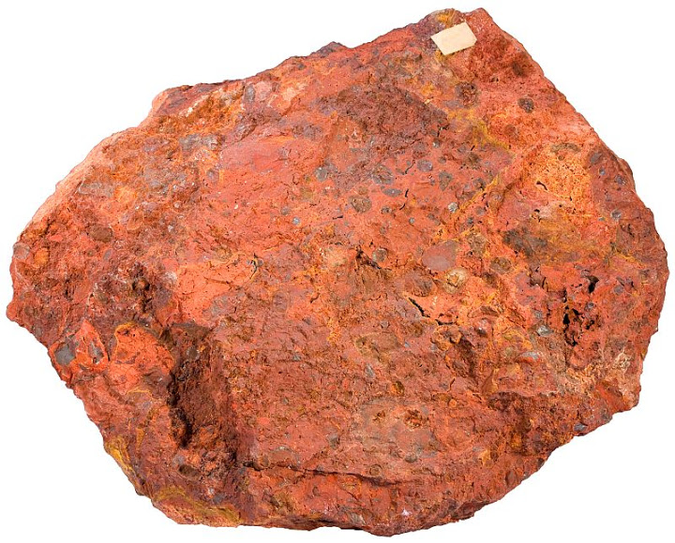
Bauxite the main raw material used to make alumina is transported here from Guinea.
The factory is the largest of its kind in Europe, and was build in 1983.
It transports the alumina to smelter in Europe
The factory provides over 450 jobs for the local area.

Slide 10
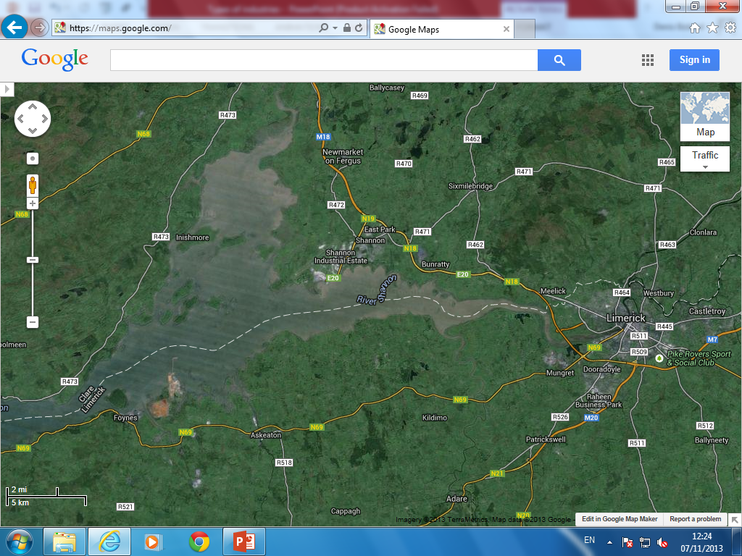
Why is the island red????

Slide 11
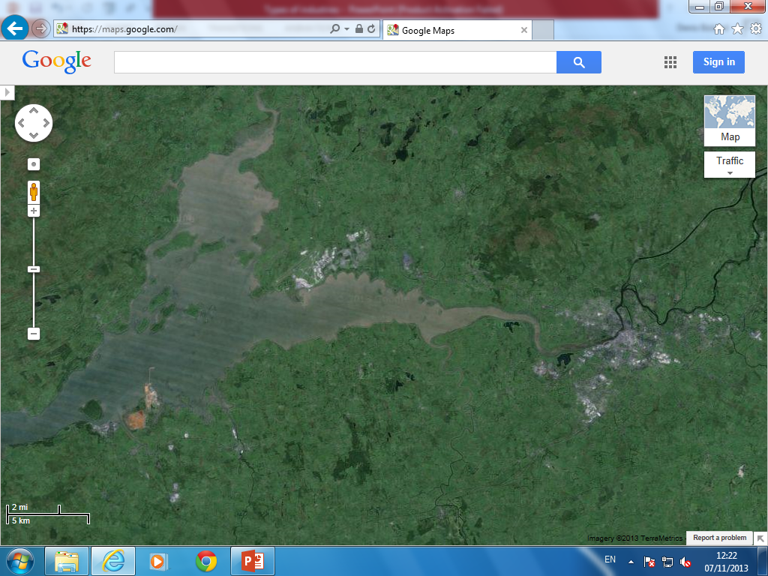
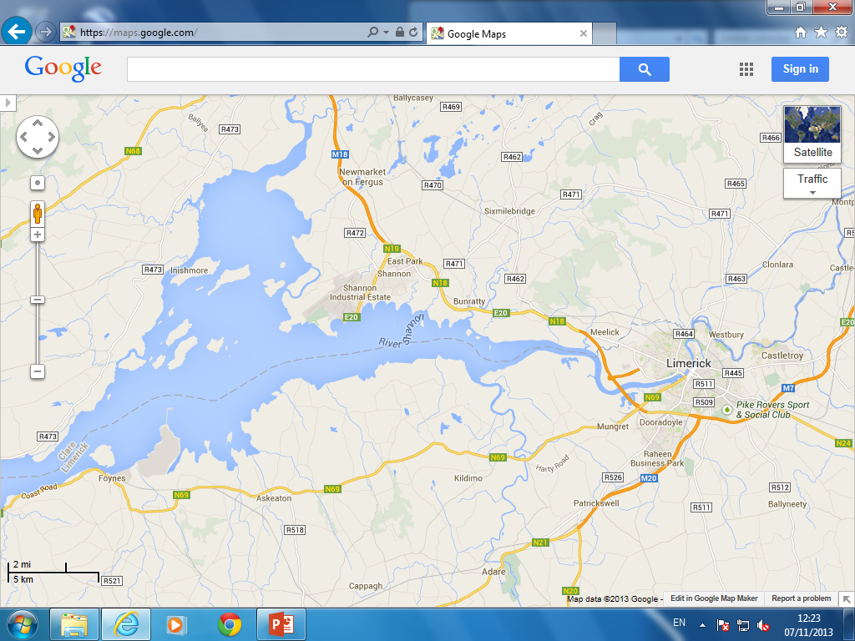

Slide 12
CAN YOU COME UP WITH ANY REASONS WHY THIS SITE WAS CHOSEN FOR THE FACTORY.

Slide 13
Reasons for Location
Raw Materials
Deep Estuary is suitable for boats bring bauxite in. Big island to store bauxite.
Market
Ireland is an EU member and close to the EU market
Transport
Deep water port and main road connects the city to the factory.
Labour
450 workers come from the large towns surrounds the factory
Capital
It is a multinational company, so can easily provide the capital for the factory to function

Slide 14
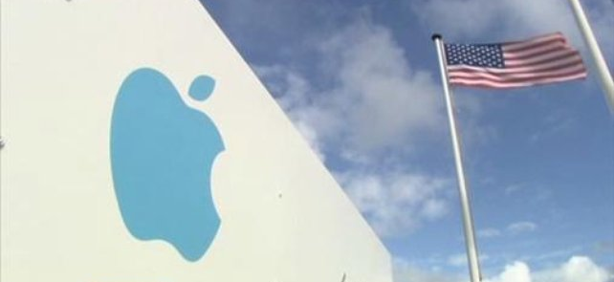
A Light Industry- Apple computers

Slide 15
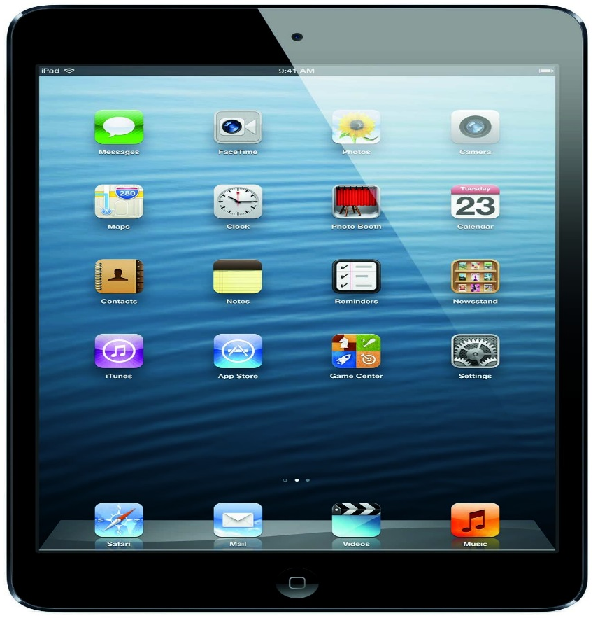
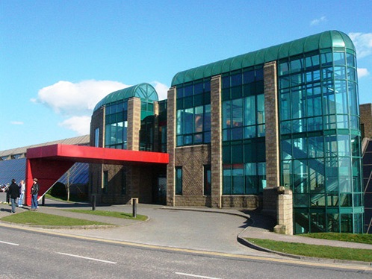
Apple
Apple makes iPads, iPods and iPhones.
It set up in Hollywood industrial estate in Cork and now employs 3300 workers in Cork city
The cork city plant is the operational headquarters for Europe, Asia and the Middle East

Slide 16
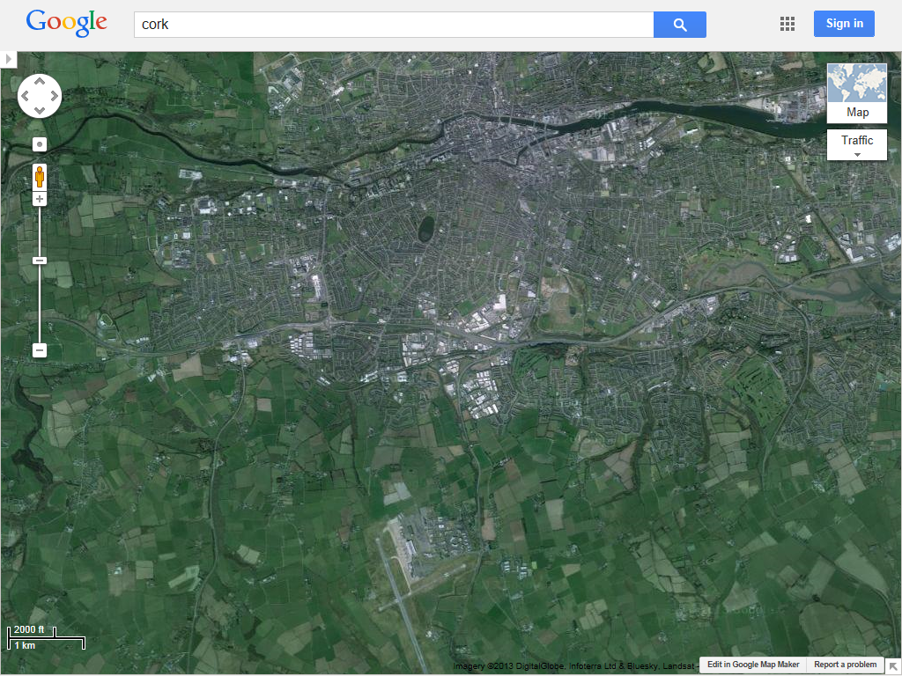

Slide 17
Industrial Estate
Cork Port
University of Cork
Cork IT
Why did apple pick this site on the edge of the city for their factory?
Airport

Slide 18
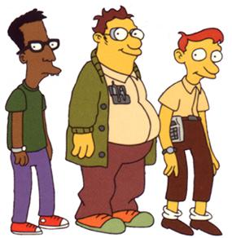
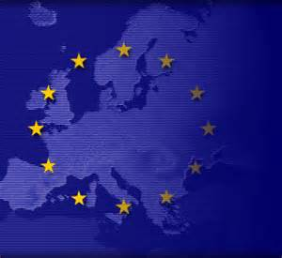
Reasons for apples location
Corporation tax- Ireland has a low corporation tax so they have greater profit.
Marktets- As Ireland is a member of the EU apple can avail of the free movements of goods.
Transport- Due to its close access to the port and airport goods can be shipped worldwide at a low cost.
Labour- Close to University College Cork, and Cork Institute of technology where there is a steady supply of skilled graduates.

Slide 19
Exam Questions

