Slide 1

Tourism: a Service Industry

Slide 2
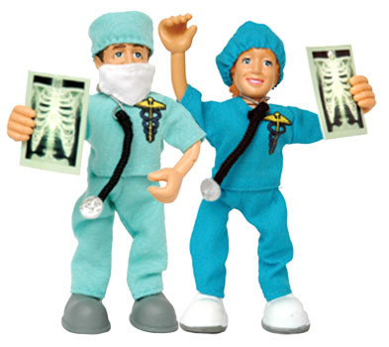


Tourism a service industry.
Tourism is a tertiary activity…..
What is a tertiary activity?????

Slide 3
Tourism a service industry.
Tourism is a tertiary activities…..
A tertiary activity involves the provision of services and facilities

Slide 4
Why is there a greater % of people working in primary jobs in a developing country??
Why is there a greater % of people working in tertiary jobs in a developed country??

Slide 5
Developed vs developing!!!
In poor countries (developing), very few people work in services. This is because people are too poor to be able to buy services that others provide. More people are needed to farm as there is no farm machinery.
As a country becomes wealthy, people demand personal services such as hairdressing, financial services such as banking and educational services for their children

Slide 6

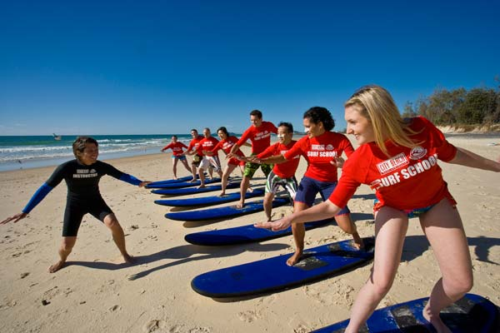
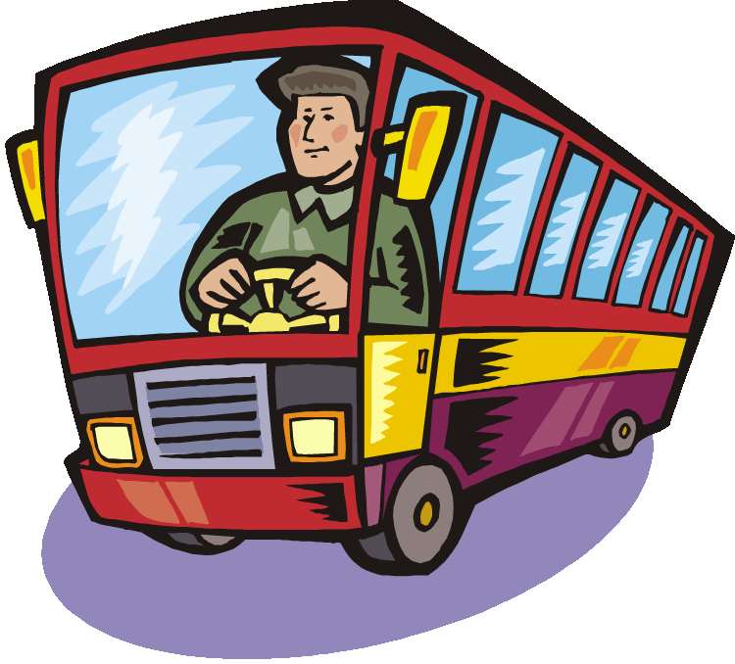
Tourism a service industry.
Can you come up with a list of jobs to do with tourism…

Slide 7
List of jobs

Slide 8
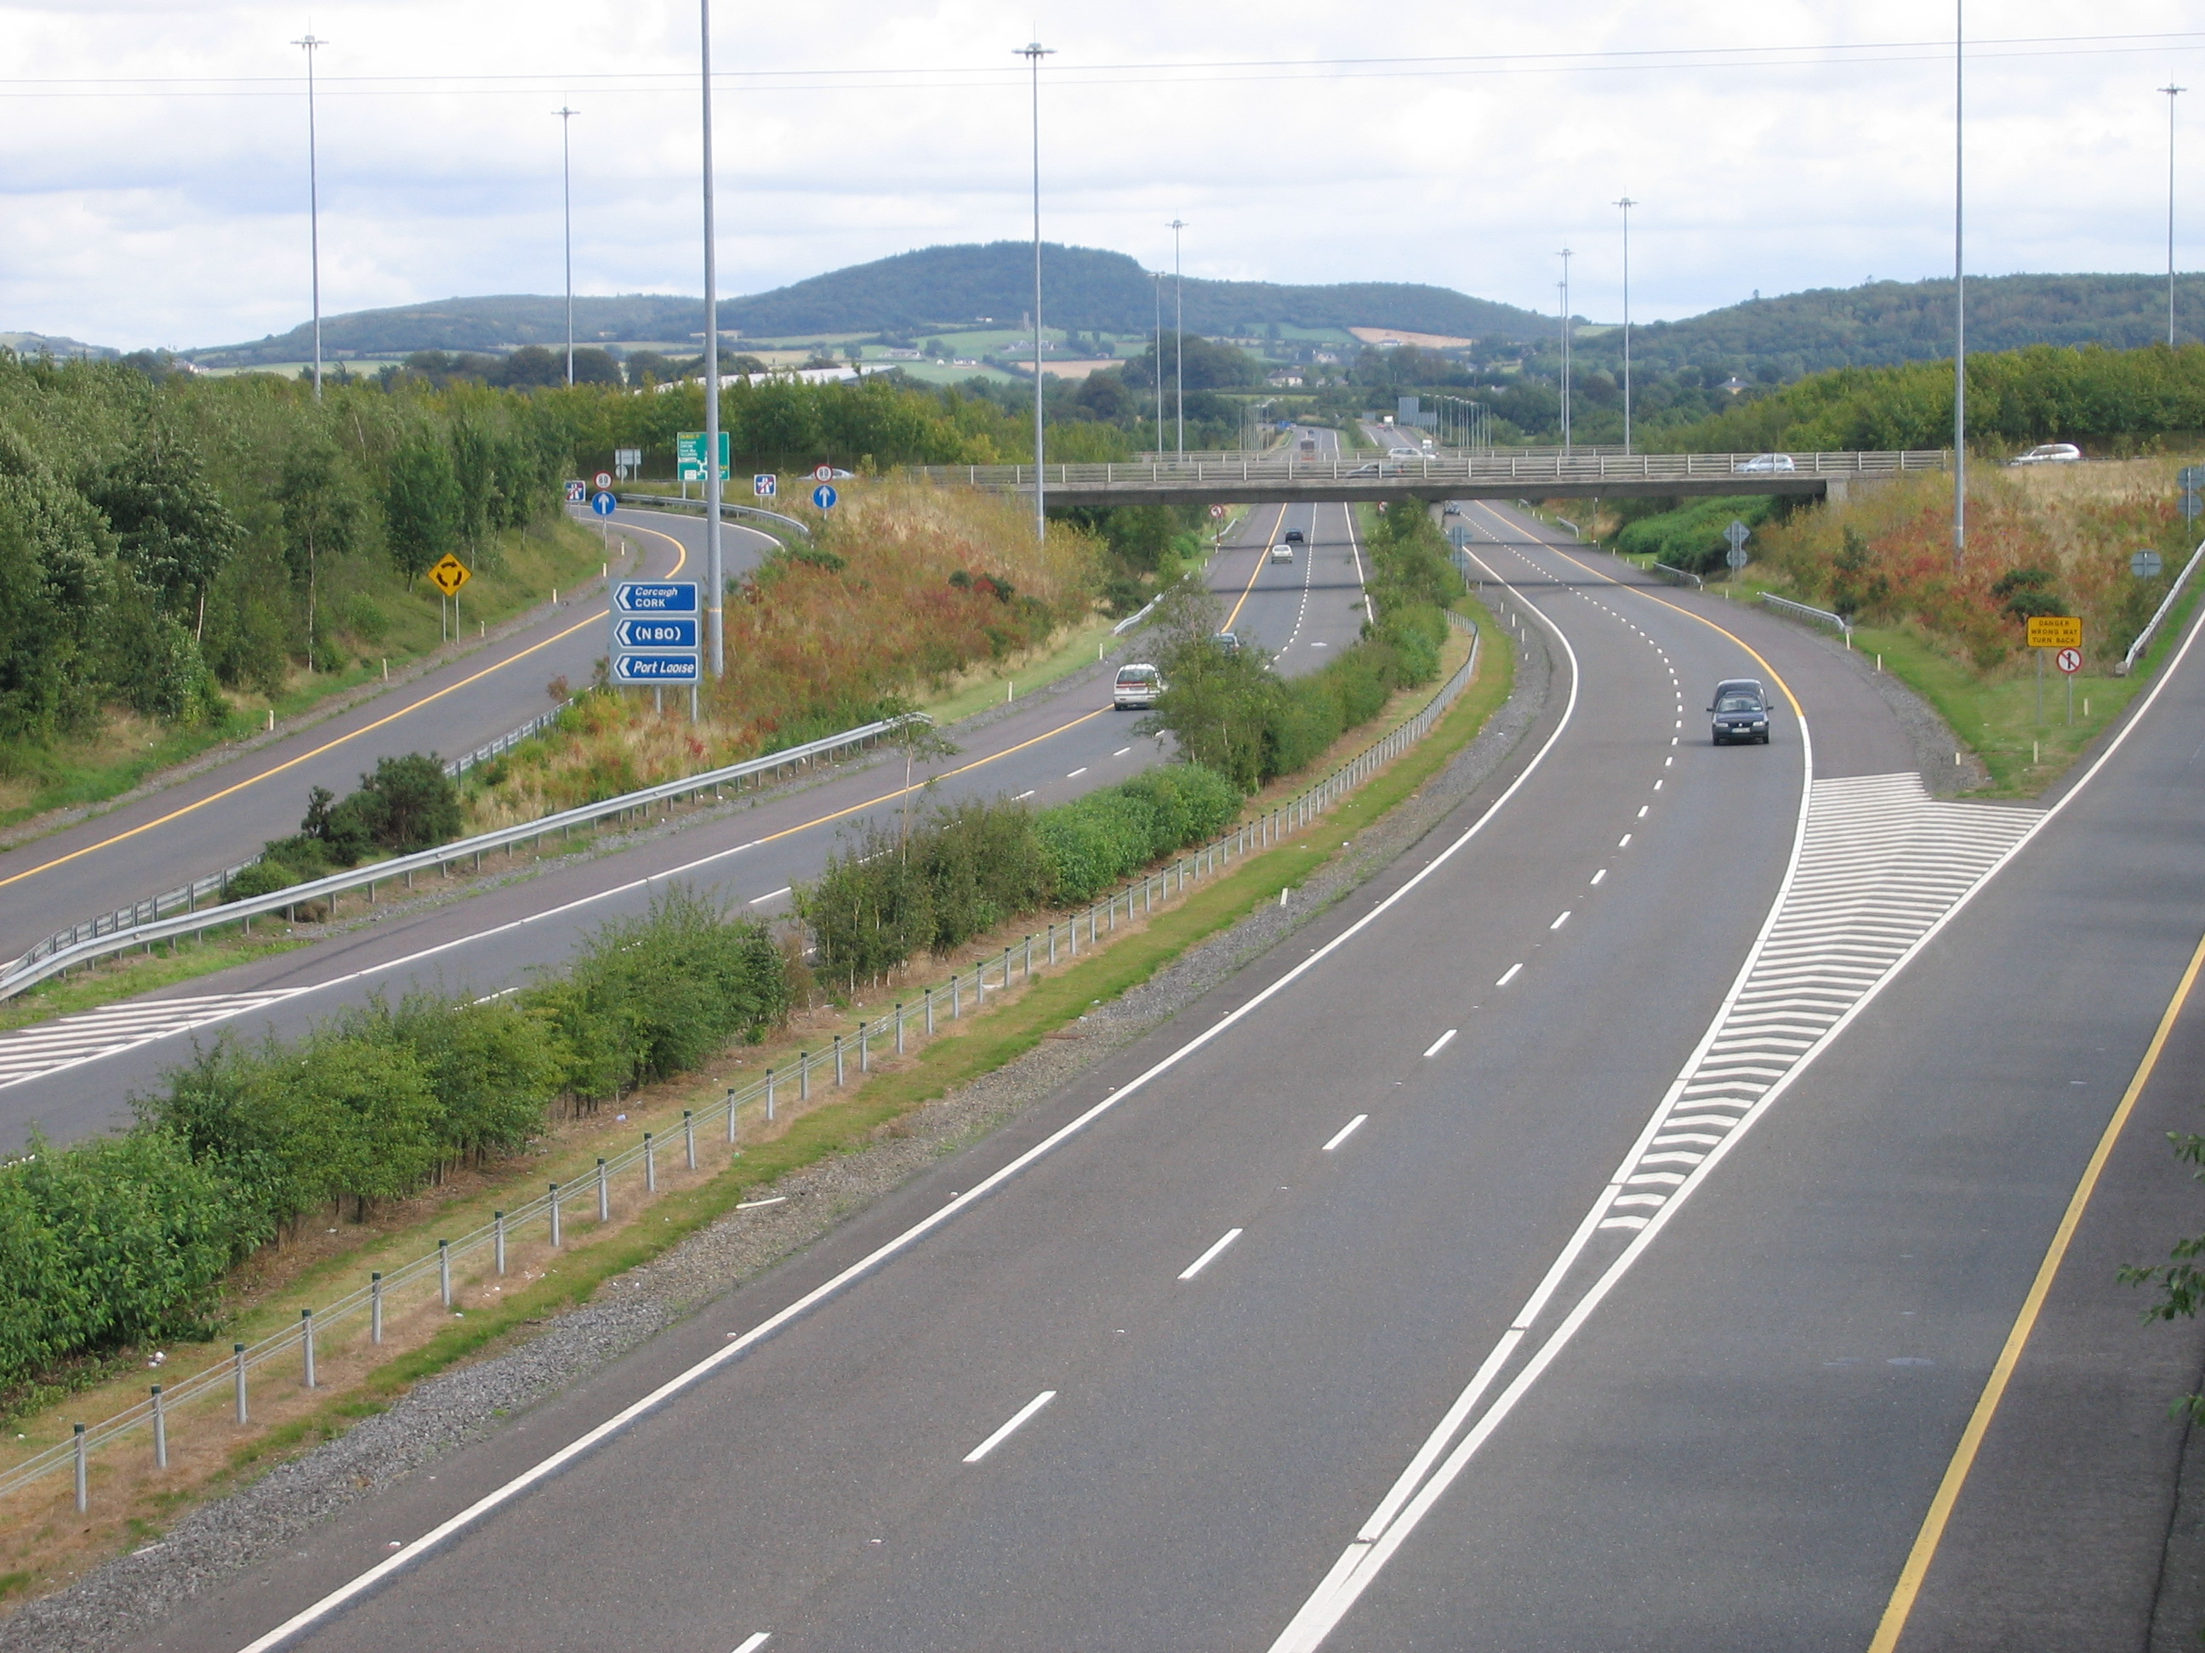


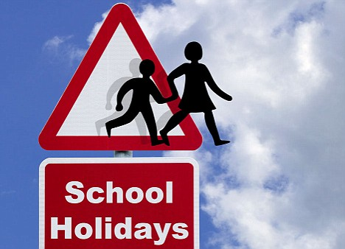
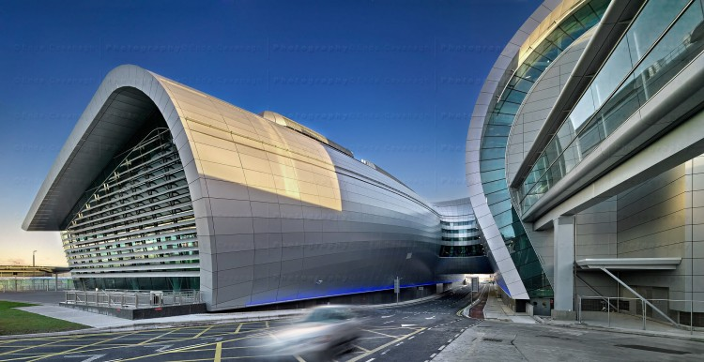
Tourism in Ireland has grown to over 6 million people a year giving the economy 3billion euro. WHY????
Holiday

Slide 9
Growth in tourism
People by law get paid holiday pay. This along with school holidays encourages people ta take holidays.
Transport in Ireland like roads and airports have greatly improved.
Low cost airline like Ryanair make it affordable for people to travel to Ireland.
“Package holidays” have made it very easy to organise a holiday.

Slide 10
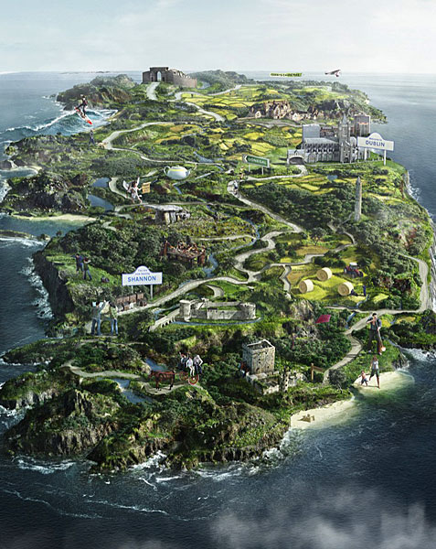
Why holiday in Ireland?

Slide 11
Tourism in Ireland
Tourism in Ireland tends to be located in particular regions which offer various attractions.
1. Areas of natural beauty.
2. Regions offering recreational and sporting facilities.
3. Beaches and coastlines.
4. Cities.

Slide 12
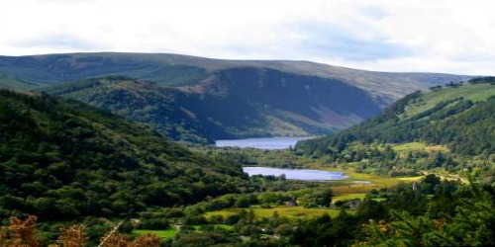
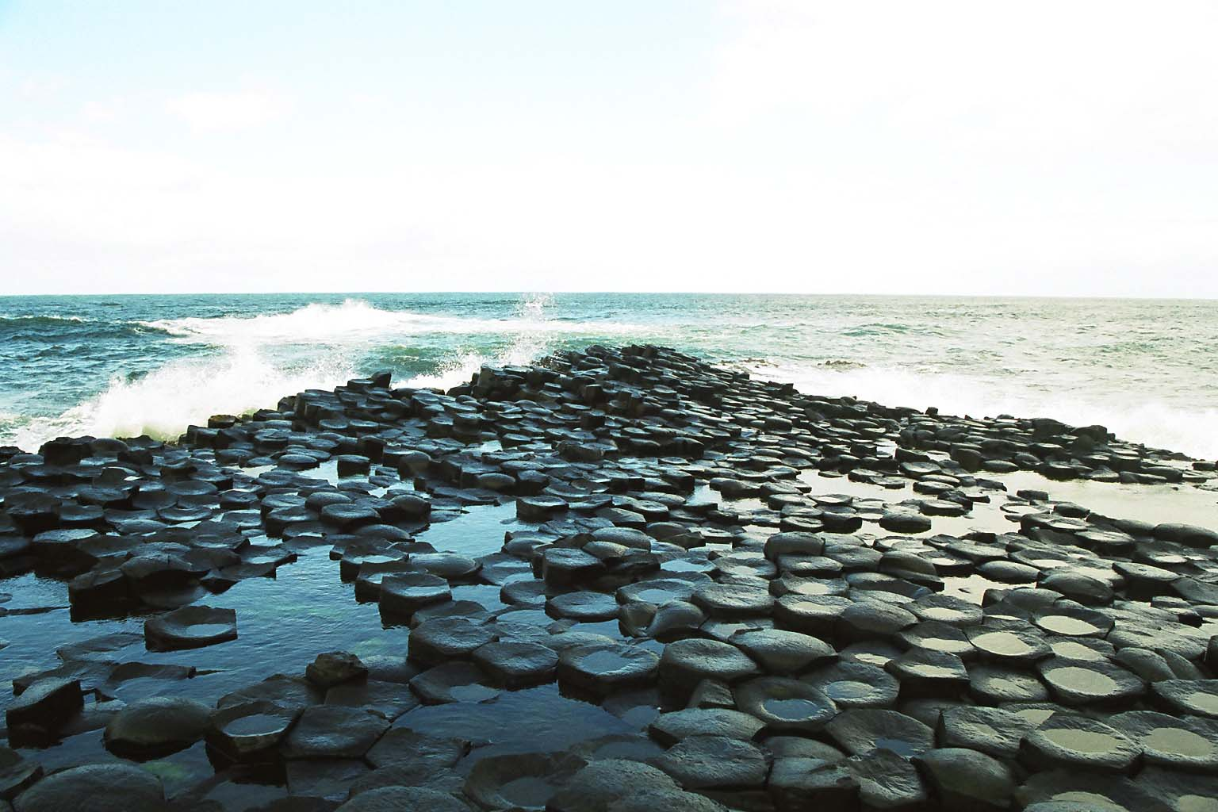
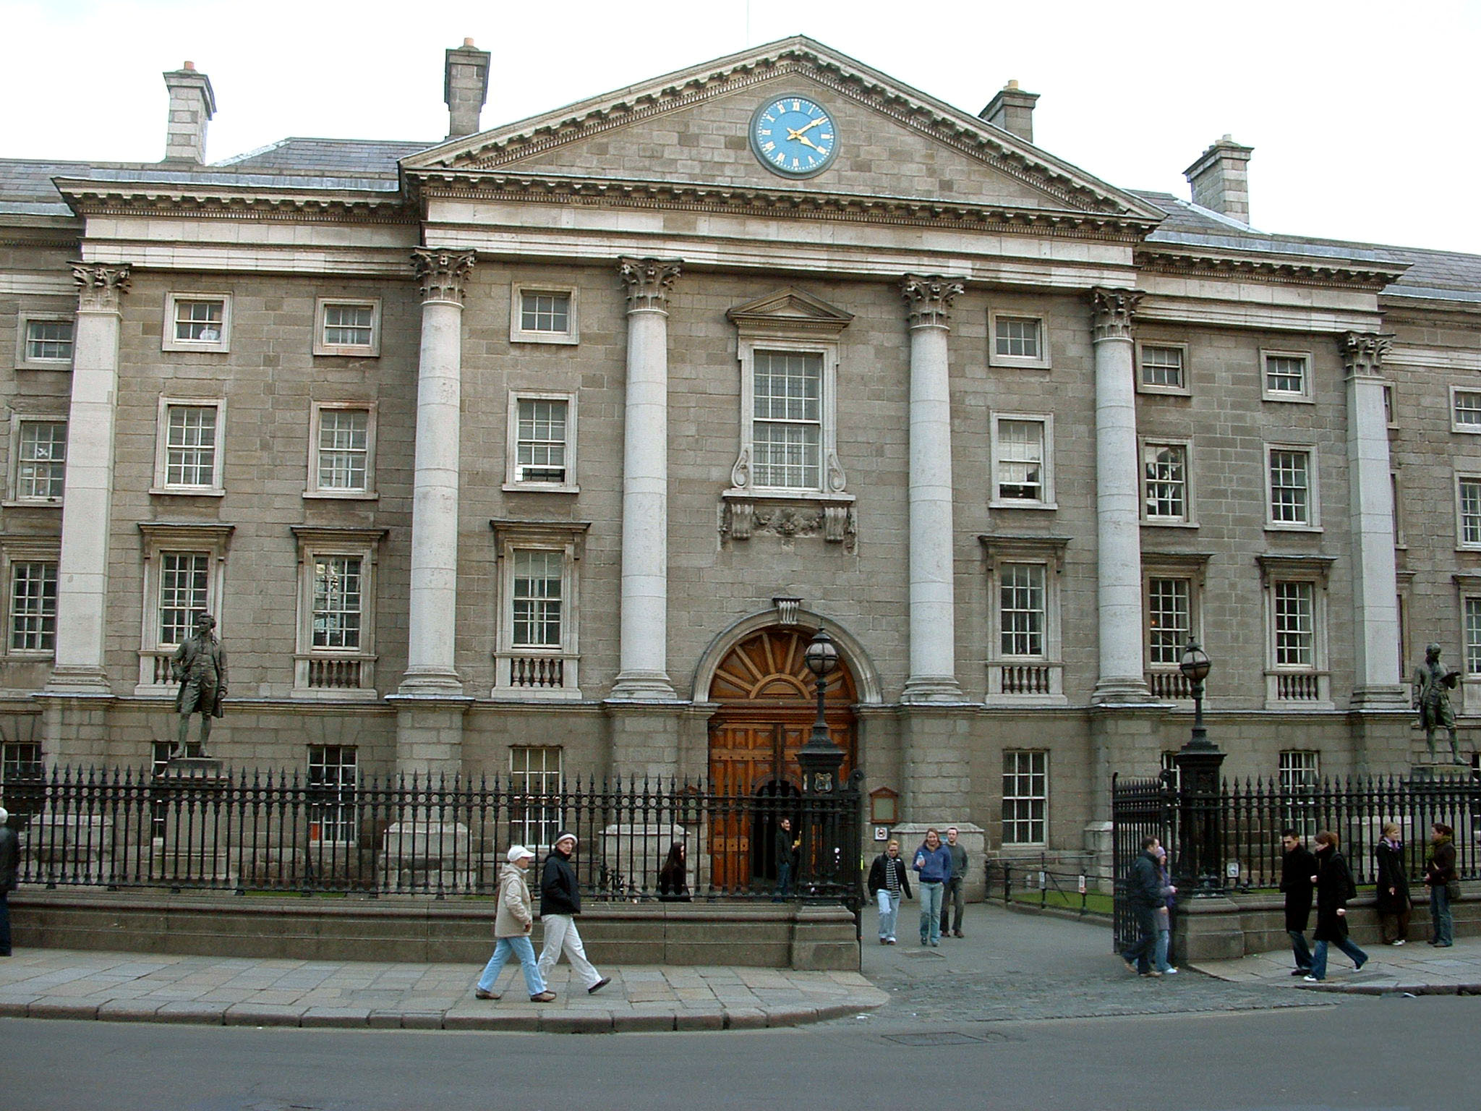
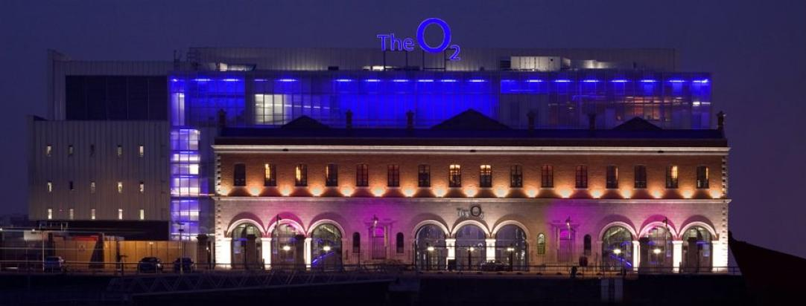
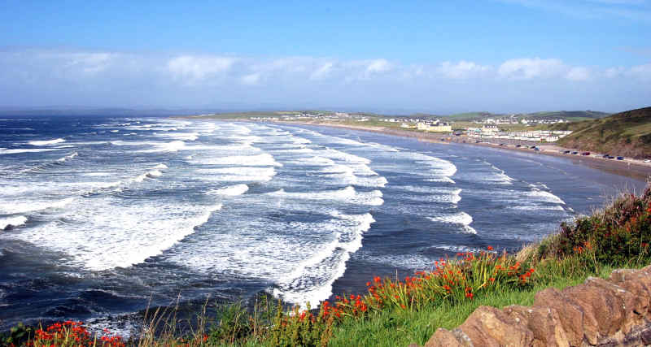
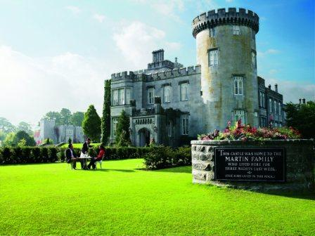
Tourism in Ireland.

Slide 13
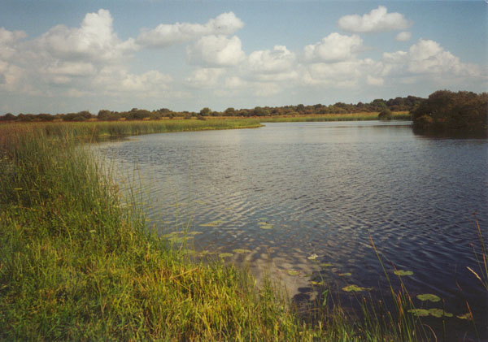
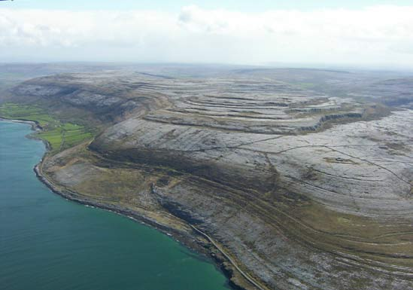
1. Area of Natural beauty
The ice age has carved out spectacular valleys like Glendalough in the Wicklow mountains which attract hill walkers.
The Burren in Clare is a beautiful landscape of exposed limestone.
The Shannon and other rivers and lakes are popular for cruising and water sports

Slide 14
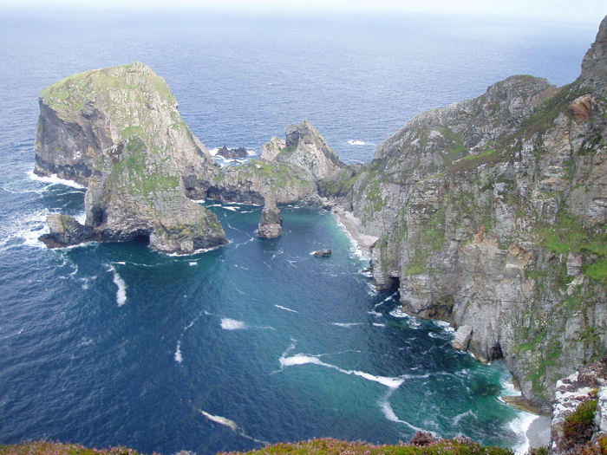
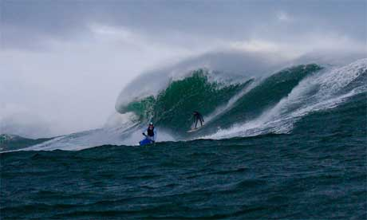
2. Beaches and coastlines
Coastal erosion has created a rugged coastline and beautiful beaches.
This cliffs of Moher are over 220 metres high and attract 750,000 visitors a year.
Ireland has spectacular long beaches that are know for their surfing.
Many visitors visit small isolated islands off the west coast like Achill and Skelling Michael.

Slide 15
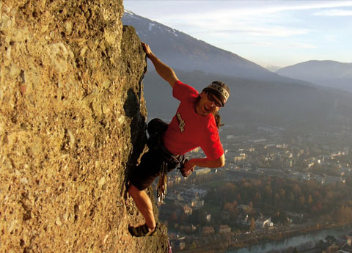
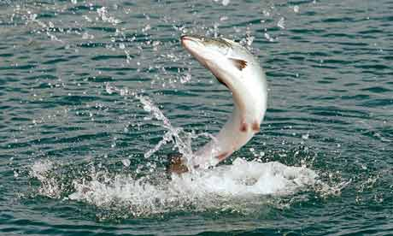
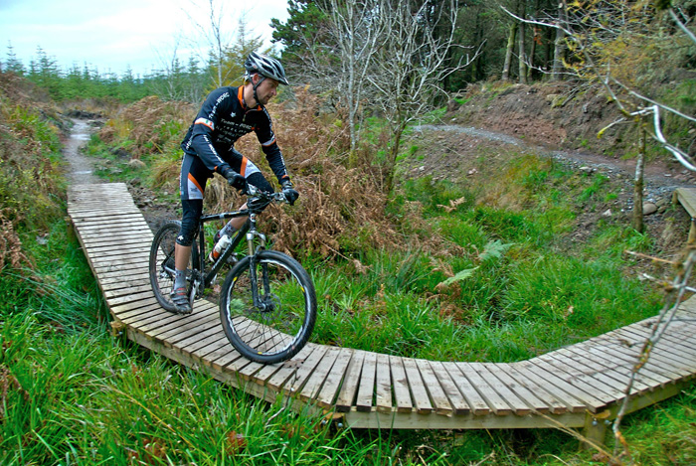
3. Recreation and sporting facilities
Irelands rivers are great for fishing with angling holidays organised.
Ireland has beautiful golf courses with spectacular views
International sporting fixtures like the six nations and concerts draw large crowds
Adventure holidays are becoming more popular such as Delphi in Galway where you can surf, abseil and canoe.
Irelands has numerous walking and cycling trails in its mountains

Slide 16
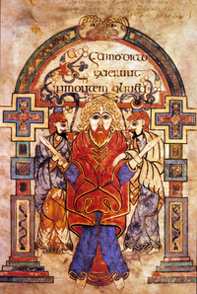
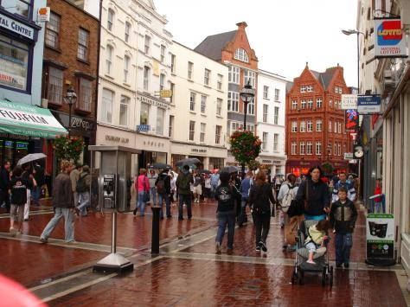

4. Cities
Dublin is Ireland’s most popular destination due to its history and airport but all other cities offer great city breaks.
In Dublin tourists often visit the book of Kells, the National Museum, Guinness Brewery and Grafton street.
All Irish cities offer excellent shopping opportunities in the heart of the city.
Cork is popular for its history, castle and Fota wildlife park.

