Slide 1
Them and Us: Problems with Industry
D. Boland
Geography

Slide 2
Often there are conflicts of interest and difference of opinions which arise between industrialists and others. Examples of these are;
Whether working hours should be reduced
To allow a Belgium company to build a incinerator in the Cork Harbour area

Slide 3
Should working hours be reduced Come up with 3 reasons for and against ???
WORKERS VIEWPOINT
EMPLOYERS VIEWOINT

Slide 4
Should working hours be reduced Come up with 3 reasons for and against.
WORKERS VIEWPOINT
Boredom and exhaustion causing productivity to decline.
39 hours a week is the basic working week but many companies push for overtime.
Long working weeks leading to unhealthy lifestyles.
EMPLOYERS VIEWOINT
Ireland has a shorter working week than other countries.
If hours reduce so do wages.
Shorter hours will reduce Irelands appeal to foreign multinational companies.

Slide 5
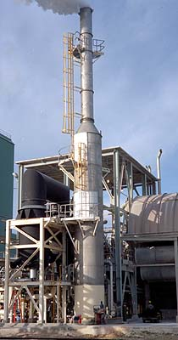
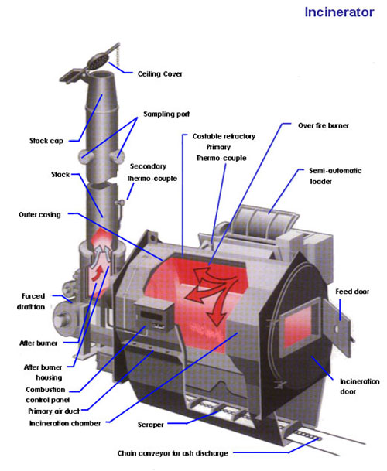

Slide 6
The Dublin Incinerator
2009 saw the planning permission for a large waste management plant at Dublin's Poolbeg. This includes a huge incinerator which would be used to burn waste from all over Dublin and the southeast of Ireland. This incinerated waste would be in the form of ash and air emmisions. This has led to a huge debate on how to manage our waste

Slide 9
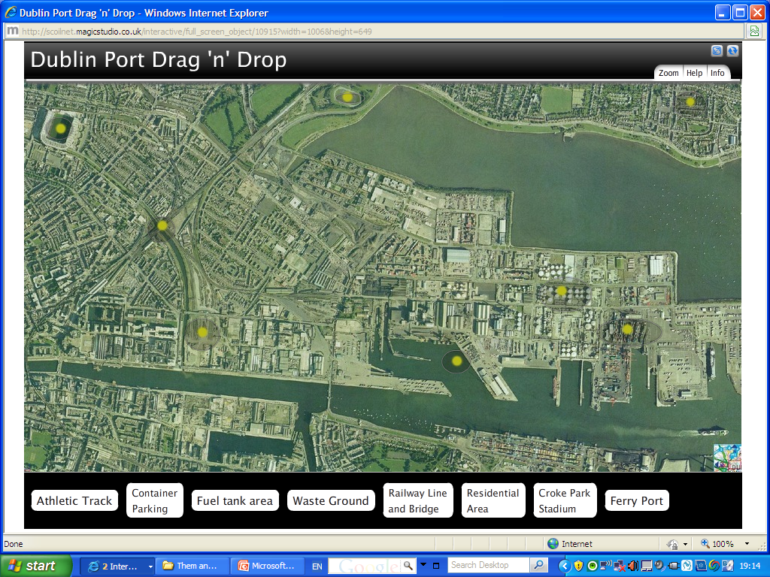

Slide 10
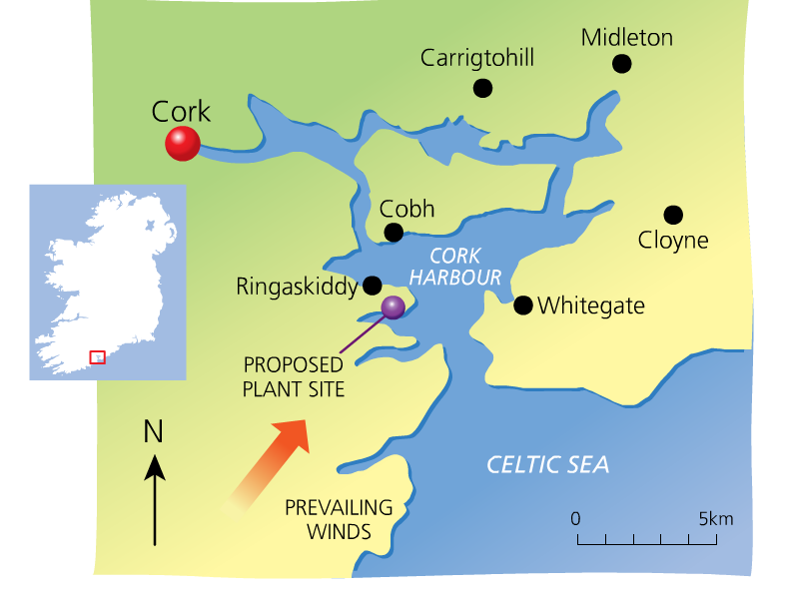

Slide 11
Advantages/disadvantages ?

Slide 12
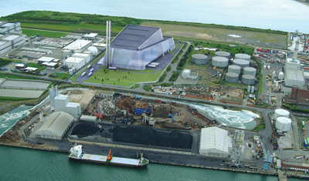
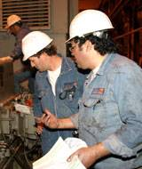
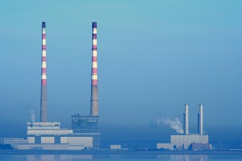
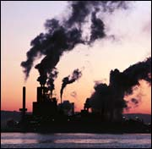

Slide 13
Advantages/disadvantages
Provide 200 construction jobs and 50 jobs when finished.
Should take responsibly for our own waste.
Heat from the incinerator could be used to generate electricity.
Damage the environment and blow fumes into the city centre.
Would put people with asthma in danger.
Trucks and lorries will greatly increase already heavy traffic in the area

