Slide 1
Patterns & Processes in the Physical Environment
Internal Forces

Slide 2
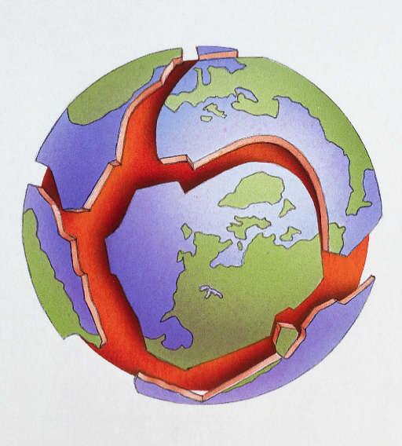
The Tectonic Cycle

Slide 3
The mobility of the Earth’s crust produces endogenic (internal) forces.
This gave rise to geological structures within the earth.
Crustal structures are created, changed and destroyed as part of this tectonic cycle.

Slide 4
The earth is made from a number of layers. The crust, the mantle and the core.
The core is the hottest part of the earth
The mantle is made of semi-molten rock which flows
The crust is the outside layers of the earth and is 60 km thick

Slide 5
The earth is made from a number of layers. The______, the ______ and the ________.
The _______ is the hottest part of the earth.
The _______ is made of semi-molten rock which is constantly flowing.
The ________is the outside layers of the earth and is ____km thick

Slide 6
The Earth’s Internal Structure
The crust is a layer of solid rock broken into plates. It is also known as the lithosphere.
Oceanic crusts are between 3-10 km thick, under the oceans. They consist mainly of heavy rocks such as basalt.
Continental crusts are up to 70km thick, under the continents. They consist mainly of lighter rocks such as granite.

Slide 7
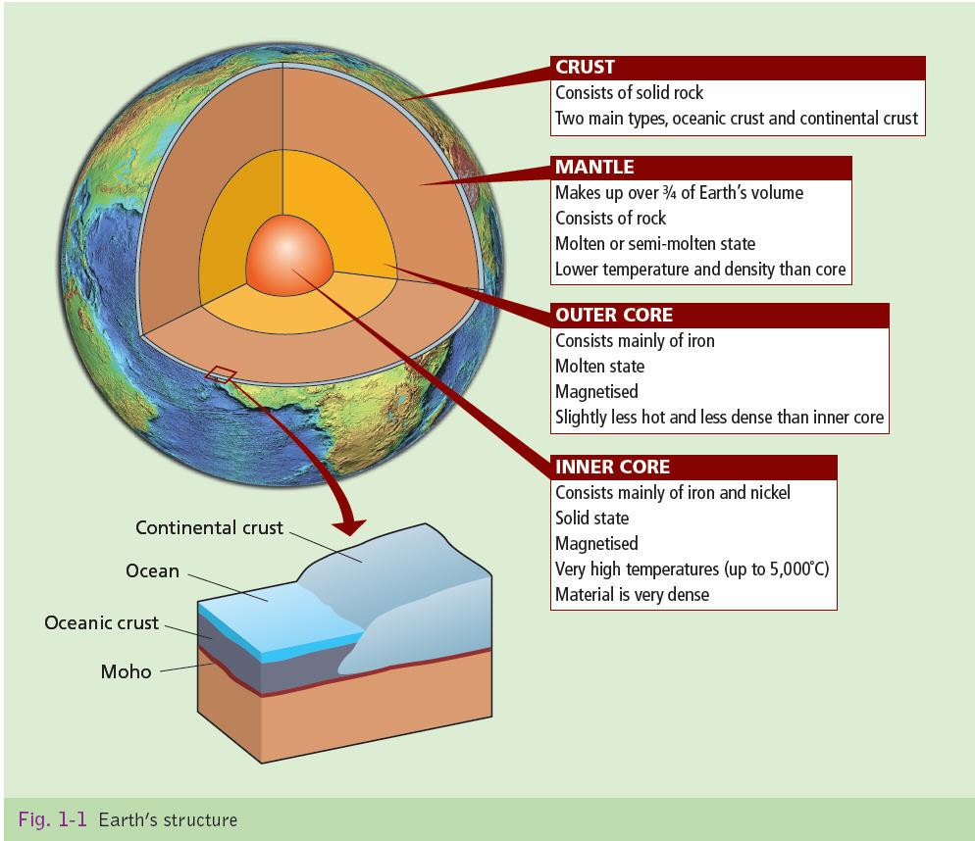

Slide 8
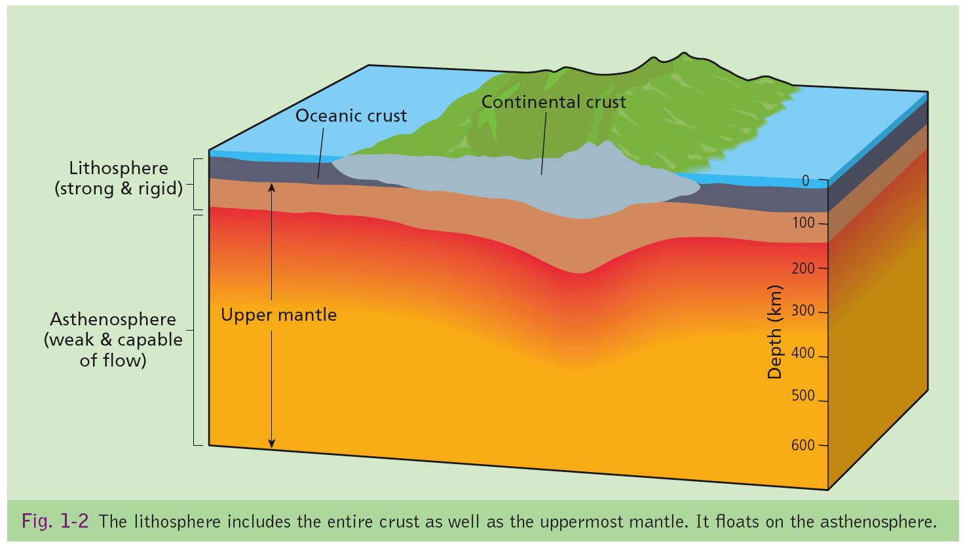

Slide 10
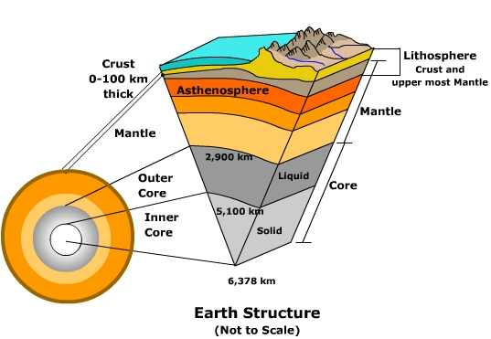

Slide 12
The Earth’s Internal Structure
The mantle is made up of semi-molten rock called magma. The mantle’s outer layer consists of hot, molten (melted) rocks and it is known as the asthenosphere.
Convection currents rise from the core through the mantle and cause crustal plates to move.

Slide 14
The Earth’s Internal Structure
The Outer core is a layer of molten rocks that consists mainly of iron.
The Inner core has a heat of up to 5,000c. It is solid consisting mainly of iron and nickel.

Slide 15
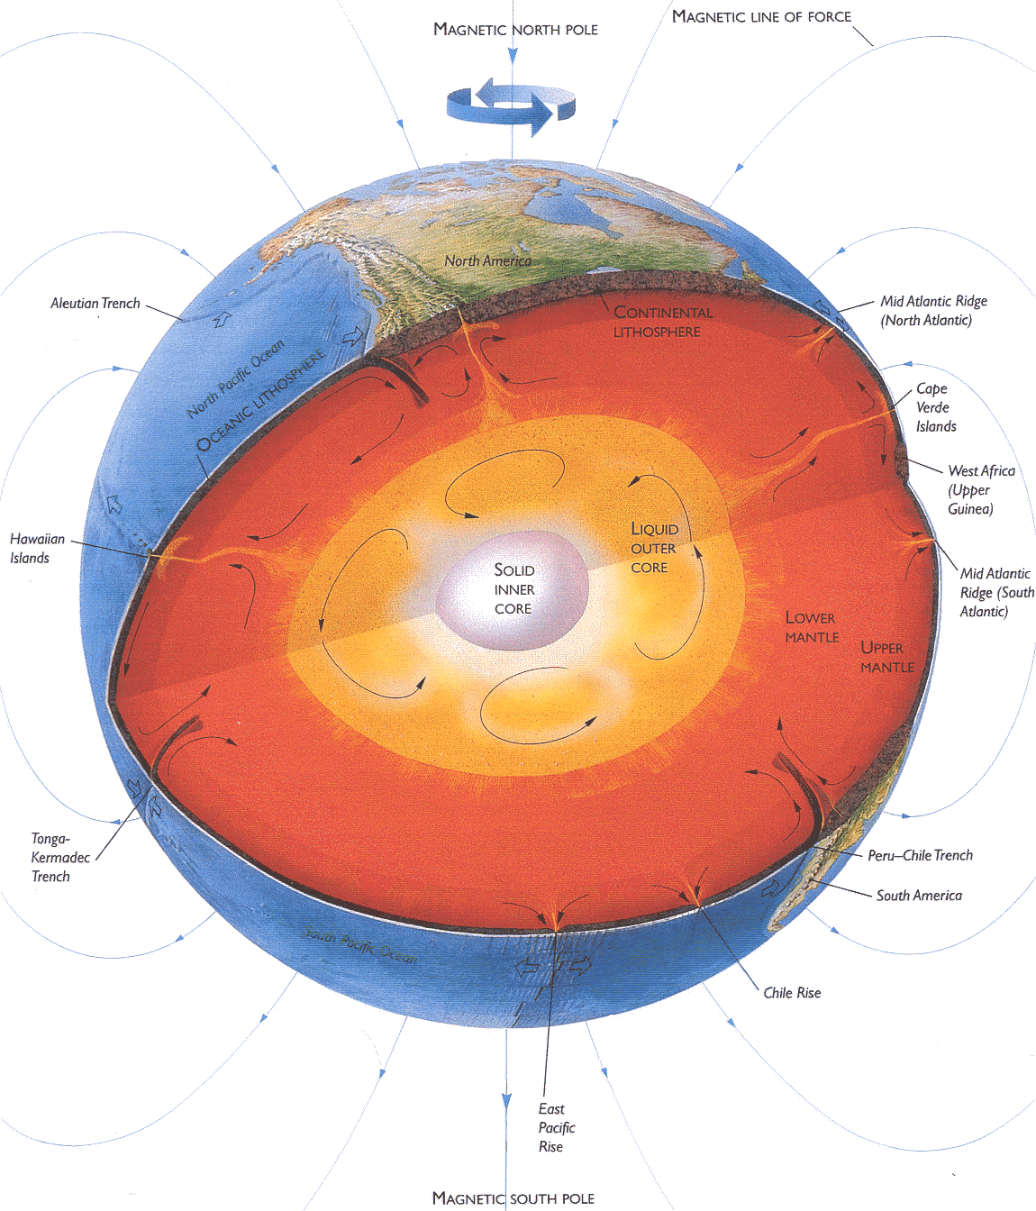

Slide 16
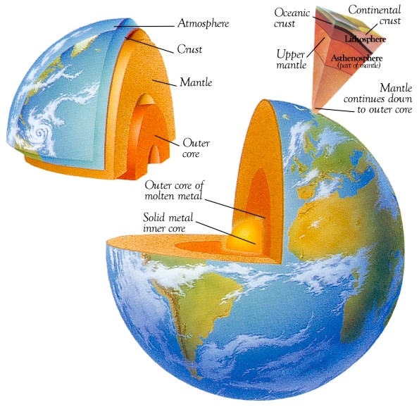

Slide 18
Convection Currents– How Plates Move
The convectional flow of magma (semi-molten rock) is the key to plate movement.
Magma rises from the earths core (5000)
Reaches the athensophere (1000) cools and sinks again in a circular motion.
As the magma moves it drags the plates along with it, as though they were giant conveyor belts.
Video Clip in folder.

Slide 19
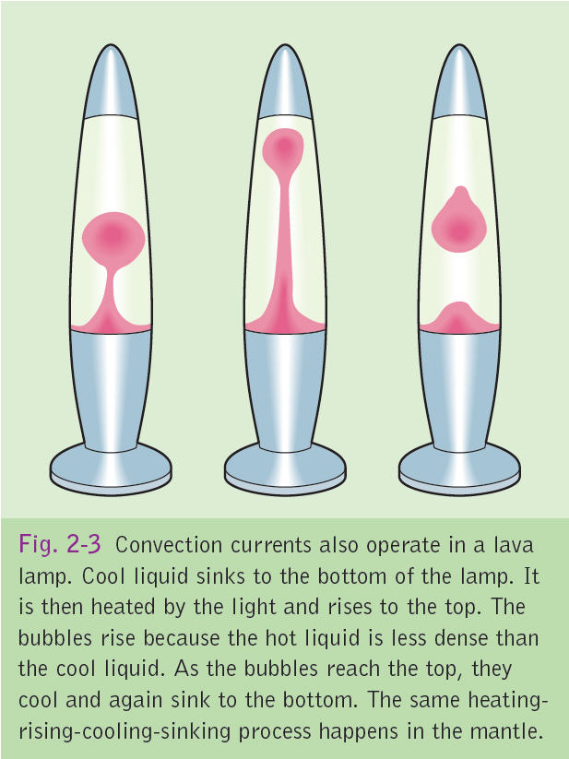

Slide 20
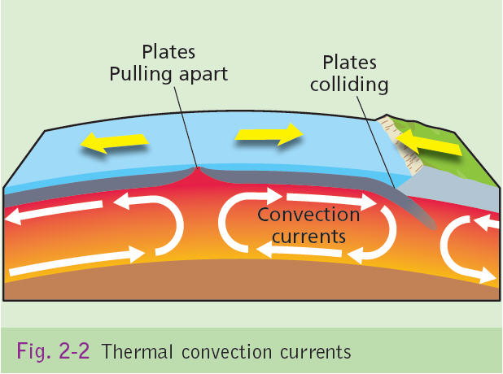

Slide 22
Theory of Tectonics

Slide 23
The Theory of Plate Tectonics
Plate Tectonic Theory is that the outer layer of the Earth (crust or lithosphere) is broken into slabs of solid rock called plates. 7 large plates and around 12 smaller plates cover the crust. These plates fit together like a jigsaw but are constantly moving either away from, towards or alongside each other.
Plate tectonics is a combination of 2 theories:
1. Continental Drift.
2. Sea-floor spreading.

Slide 25
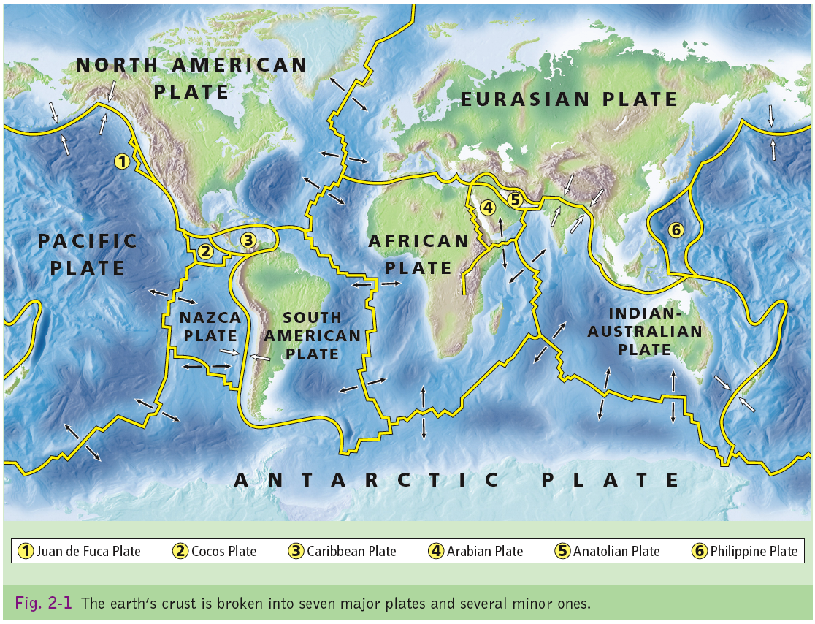

Slide 26
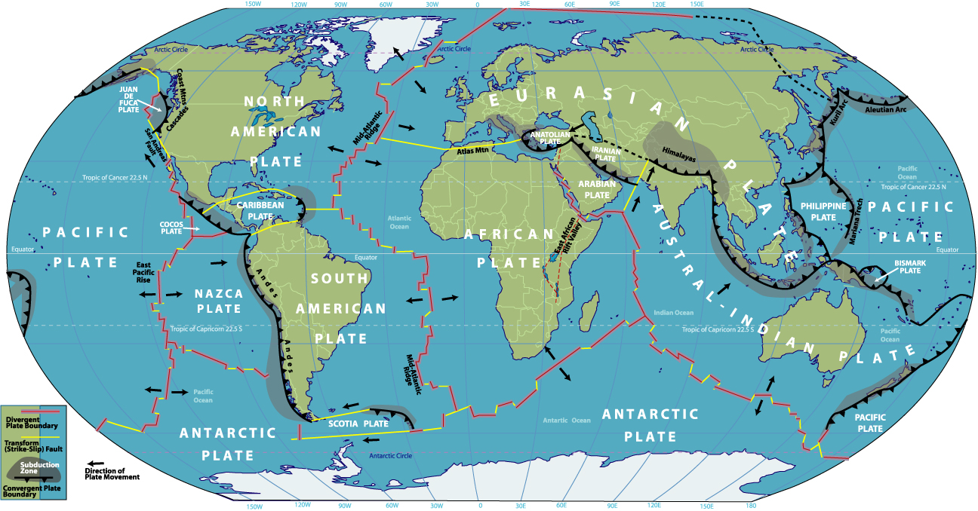

Slide 28
1. Continental Drift
In 1912 Alfred Wegener claimed that all continents once formed a single landmass named Pangaea (all land) but that these continents drifted apart in the lat 200 million years to form the 7 continents of present day.
Wegener backed this up by stating:
- The coastlines of Africa and South America match.
- Rocks in southeast Brazil and South Africa match in age, structure and type.
- Fossils of the reptile Mesosaurus were found in South Africa & Brazil.

Slide 31
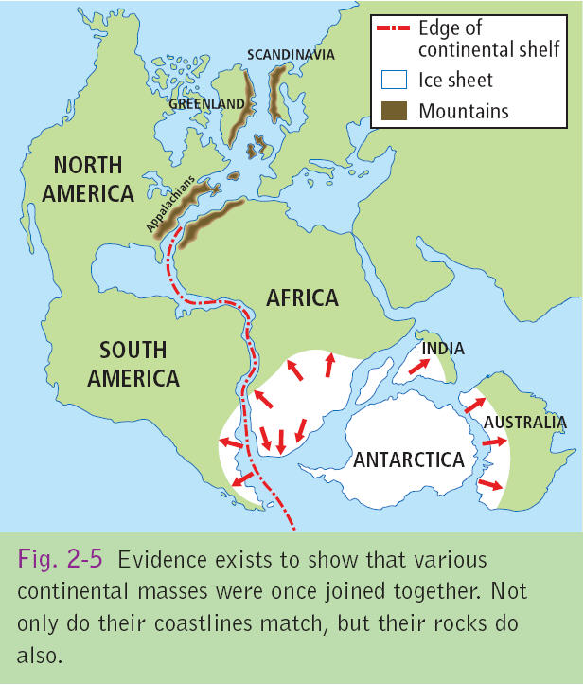

Slide 32
PROOF OF THEORY OF PLATE TECTONICS

Slide 33
WAGNER’S THEORY OF CONTINENTAL DRIFT

Slide 34
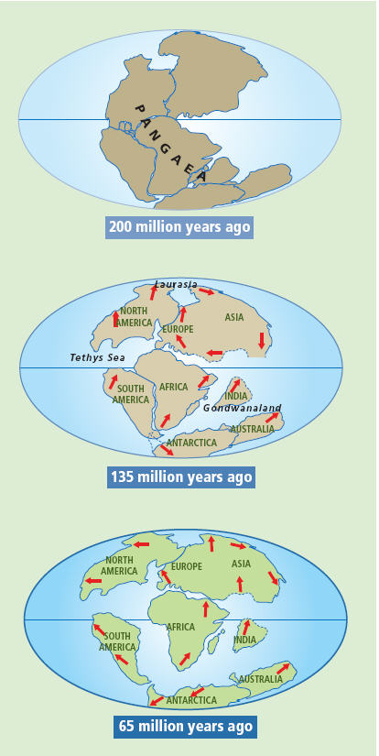
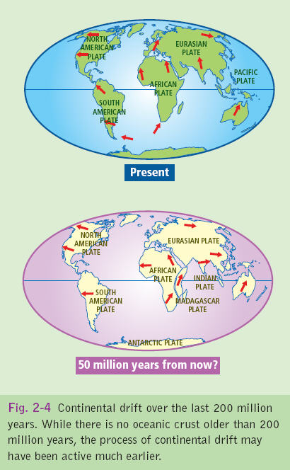

Slide 35
1. Continental Drift
Experts rejected the theory of continental drift, as Wegener could not explain how the continents moved.

Slide 36
2. Sea-Floor Spreading
In 1948, a mountain range that extends along the Atlantic Ocean from pole to pole was discovered, it was named the Mid-Atlantic Ridge. The ridge is about 1000km in width and 3km in height with a rift valley extending along its length.
Later similar ridges were discovered on other ocean floors. The rocks in the ridges are formed from magma.

Slide 37
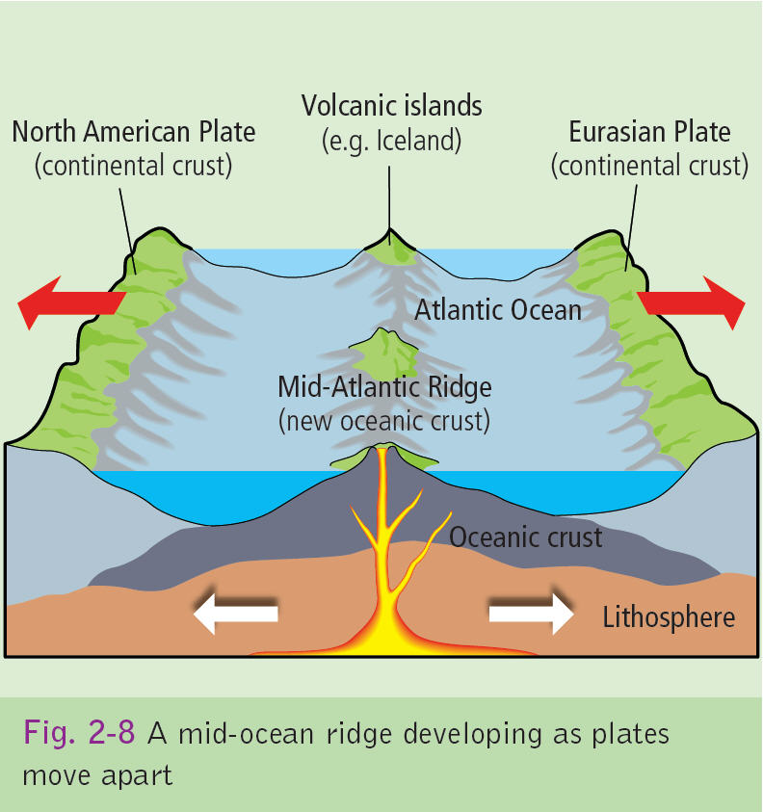

Slide 38
2. Sea-Floor Spreading
In the 1960’s Henry Hess, a US geologist, discovered that the rocks at the centre of the Atlantic ridge were the youngest with the rocks at the United States coastline being the oldest.
Hess stated that the Atlantic Ocean was widening by 5cm per year.
The theory of sea-floor spreading suggests that ocean floors are continually widened by plumes of magma forcing their way between plates.

Slide 39
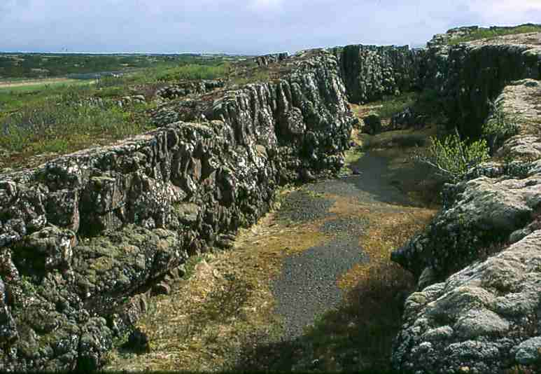

Slide 40
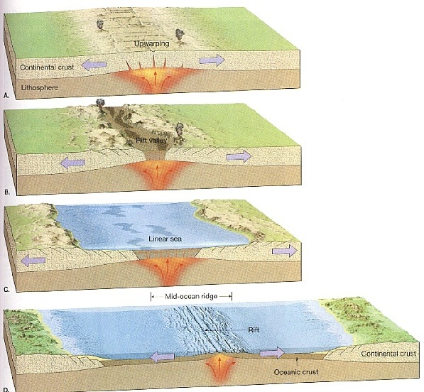

Slide 42
2. Sea-Floor Spreading
Even though new land is being created this doesn’t mean the earth’s getting bigger as old crust is being destroyed at the same rate as new crust is being formed.
Since sea-floor spreading shows how continents drift, Wegener’s theory is now generally accepted.

Slide 44
The Tectonic Cycle
The tectonic cycle is the way that plates move. As the plates seperate magma escapes creating new land. At the same rate crust is being destroyed where plates meet and land is destroyed (the plate goes back into the mantle and melts). In this way the earth does not get bigger or smaller but remains the same size.

Slide 45
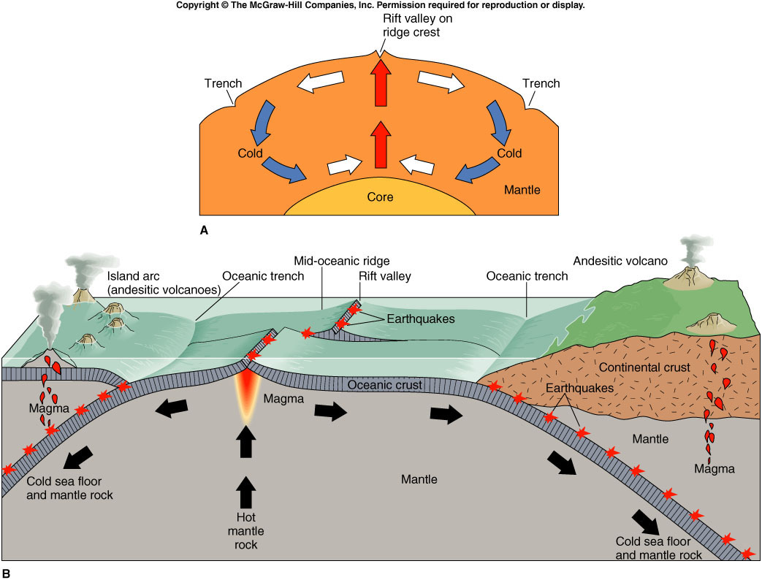

Slide 46
Plate movement involves:
When convection currents flow in opposite directions, magma forces its way between diverging (separating) plates. The magma cools and new crust is formed. The convection current then moves the plates away from each other allowing more crust to be formed. This is known as sea-floor spreading.
Example: The Mid-Atlantic Ridge at the divergence of the Eurasian and North American plates.

Slide 47
Plate movement involves:
As 2 plates collide, the edge of the heavier plate is pulled under the lighter plate.
The weight of the plate pulls the rest of it into the mantle in a process known as subduction.
Example: The oceanic Nazca Plate is pulled under the continental South American plate.

Slide 48
Plate Margins
There are three types of plate margins.
1. Divergent Margins (plates pull apart)
2. Convergent Margins (plates push together)
3. Transverse (where plates slide past each other

Slide 49
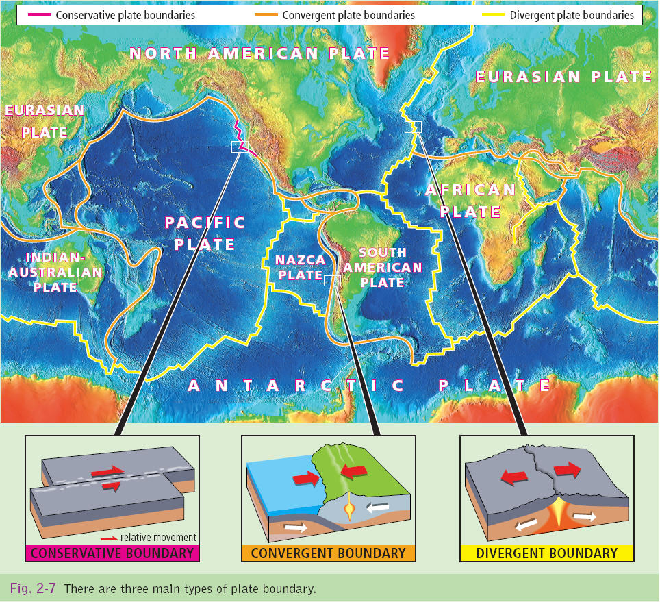

Slide 50
1-Divergent Margins
These plates are also called constructive plates as when they pull apart magma seeps out “constructing” new crust (land).
This new land is formed on ocean floors (Mid- Oceanic Ridges) and continental rift valleys.

Slide 51
1-Divergent Margins- 1.A Mid Oceanic Ridges
Mid Oceanic Ridges occur along the ocean floors where two plates are seperating. As the magma travels upwards from the core it gathers in a magma chamber under the surface. A lot of this magma cools and solidifies, but some of this magma escapes (erupts) through the fissures of the Oceanic Ridges cooling and forming new land in the form on a mountain range. Every eruption results in new land being formed on the ocean floor

Slide 52
CONSTRUCTIVE/DIVERGENT PLATE BOUNDARY/MARGIN

Slide 54
1-Divergent Margins- 1A. Mid Oceanic Ridges
An example of this is the where the American and Eurasian plate are diverging forming the Mid Atlantic Ridge.
As Harry Hess proved the newest land is created along the center on the mid-ocean ridge, while the oldest land is at the continent.

Slide 55
How the mid Atlantic ridge is formed

Slide 56
CONSTRUCTIVE/DIVERGENT PLATE BOUNDARY/MARGIN

Slide 57
The mid Atlantic ridge

Slide 58
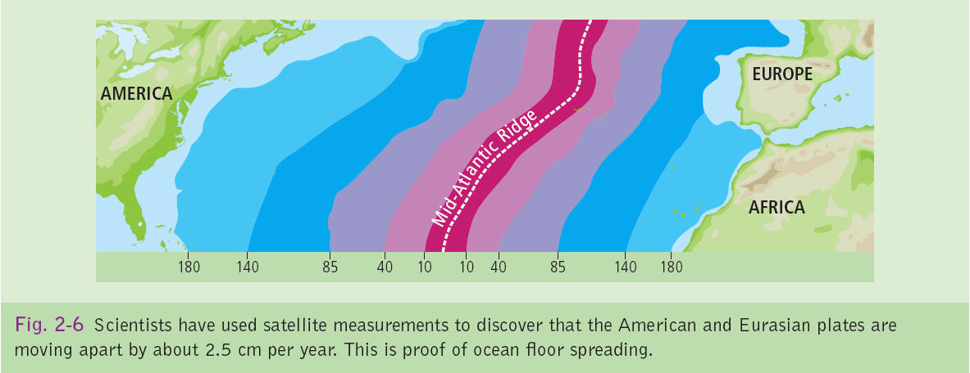

Slide 60
1-Divergent Margins 1.B Rift Valleys
When rising magma under continents force land apart it results in Rift Valleys. The East African Rift valley that extends for 4000km is an example of this. This continental divide will result in the african plate dividing.
This is another example of plates pulling apart. It is important to remember that even though land is being created where plates pull apart land is being destroyed at constructive margins (ie the tectonic CYCLE)

Slide 66
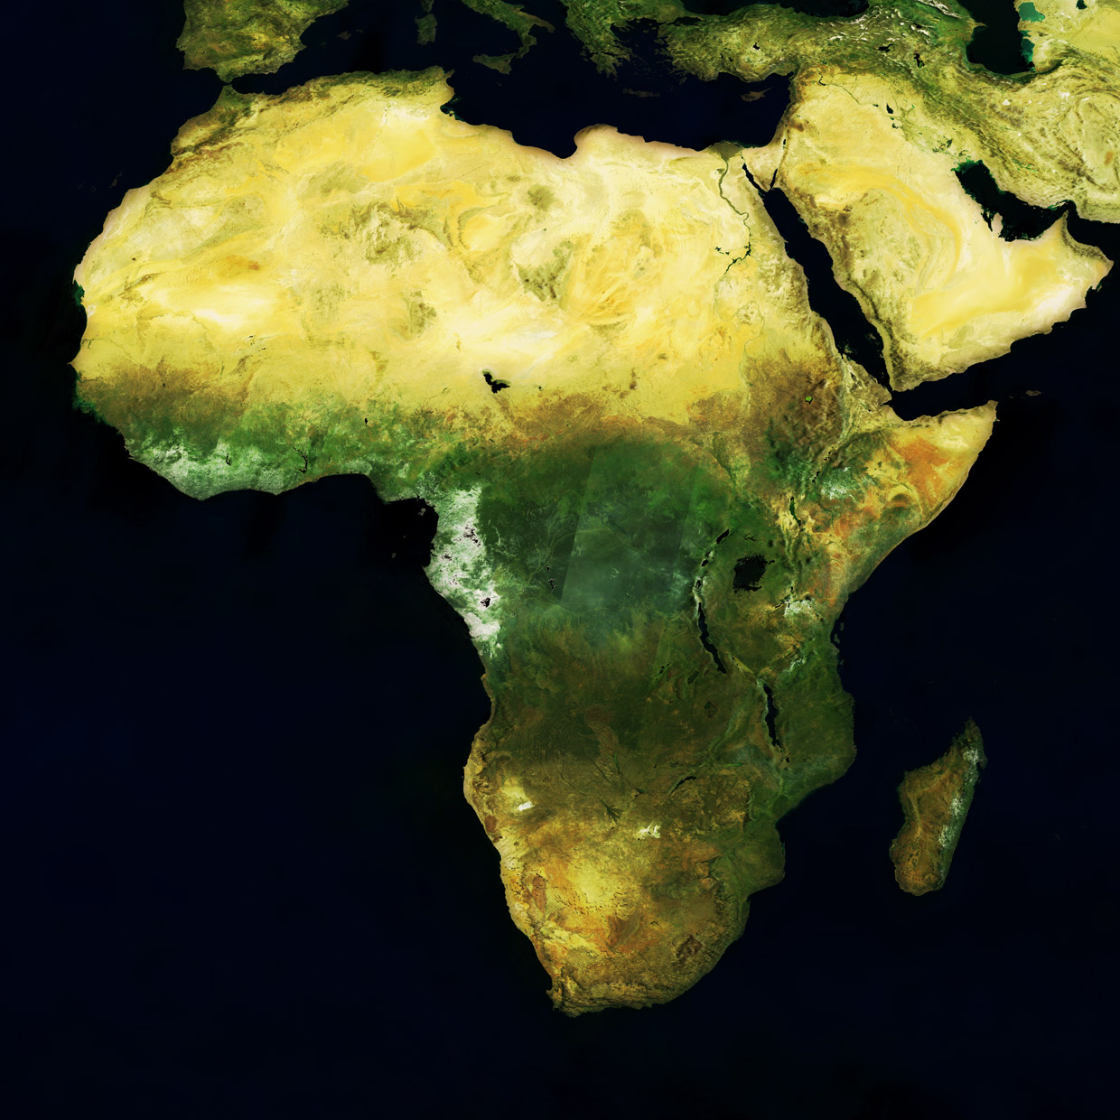

Slide 67
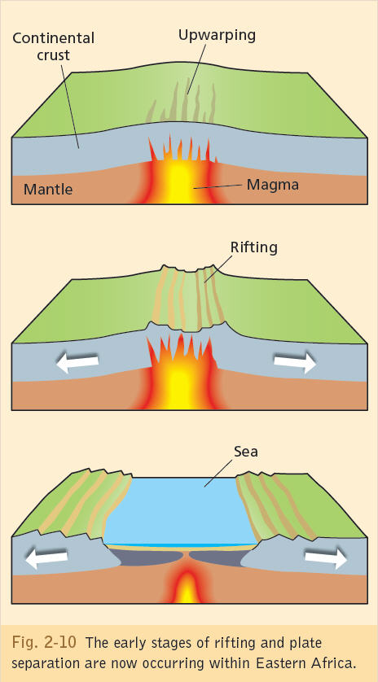

Slide 68
2-Convergent Margins
Convergent margins are where plates collide. These are also known as destructive as land is destroyed when plates meet. There are three types of convergent margins.
A. Where Oceanic- Continental plates meet.
B. Where Oceanic- Oceanic meet.
C. Where Continental- Continental meet.

Slide 69
2-Convergent Margins 2A. Oceanic-Continental
When these two plates meet, the heavier ocenic plate is pulled under the continental crust. This is known as subduction. This can results enormous pressure being put on the continental plate causing it to buckle and create fold mountains.
The oceanic plate that is subducted melts as it goes into the mantle causing a build-up of pressure, gas and magma which explodes through the crust forming volcanic islands and volcanoes.
The point at where the oceanic plate is subducted beneath the continenal plate is called the subduction zone and is maked by an ocean trench

Slide 71
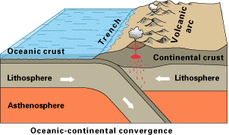
2-Convergent Margins Oceanic-Continental
An example good example of this is where the Nazca plate slides under the south american plate. This subduction zone is marked by the peru- chile ocean trench.
Also the island of Japan are formed under this process.

Slide 72
DESTRUCTIVE/CONVERGENT PLATE BOUNDARY/MARGIN TYPE 1:OCEAN-CONTINENT
Oceanic–continental plate collision

Slide 75
2-Convergent Margins 2. B. Oceanic- Oceanic
When these two plates meet (converge) the heavier plate is subducted forming a deep ocean trench. As it goes into the mantle it causes a build-up of pressure, gas and magma which explodes through the crust forming volcanic islands such as the islands of Guam

Slide 76
DESTRUCTIVE/CONVERGENT PLATE BOUNDARY/MARGIN TYPE 2:OCEAN-OCEAN

Slide 78
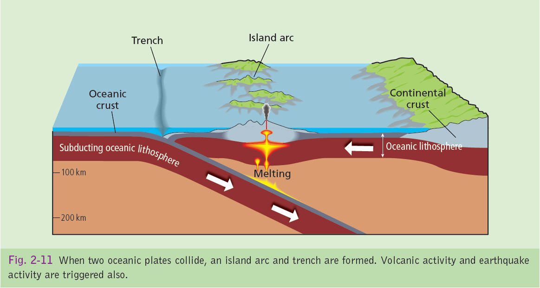

Slide 79
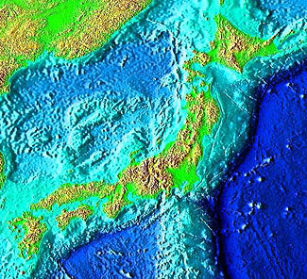
JAPAN TRENCH

Slide 80
2-Convergent Margins 2.C Continental- Continental
When two continental plates meet they form terranes which are the upper layers of plates peeled away. Ireland is made up of such terranes, where the american and eurasian plates converged
This also resulted in intense folding forming fold mountains such as the himalayas, als, and the andes
Example Eurasian and Indian plate.

Slide 81
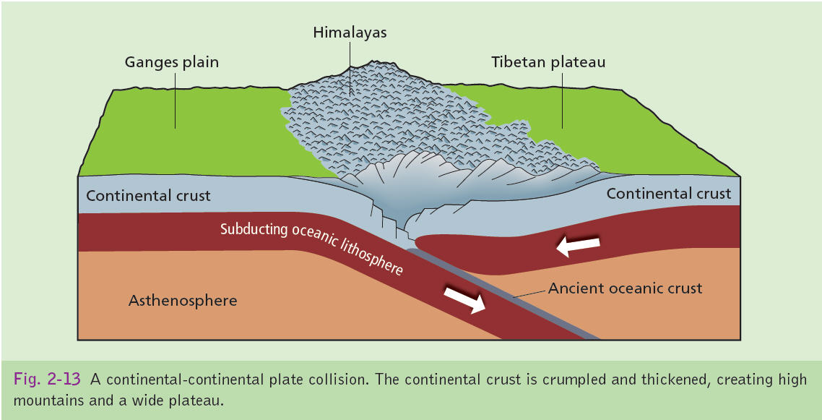

Slide 82
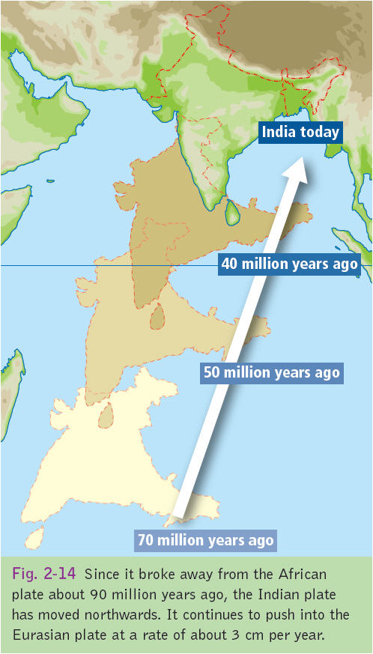

Slide 84
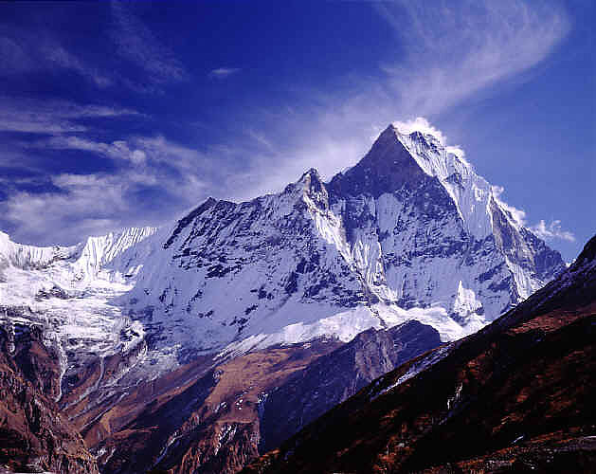

Slide 85
3 Transverse Margins
A transverse margin is where two plates slide past each other. An example of this is the North American Plate and the Pacific where both plates are moving in the same direction but at different speeds (pacific palte 6cm a year, north american plate 1cm a year)
These are called neutral boundaries as crust is neither created or destroyed here.
Earthquakes can occur when these plates lock resulting in a build up of pressure, which when released can cause an earthquake

Slide 86
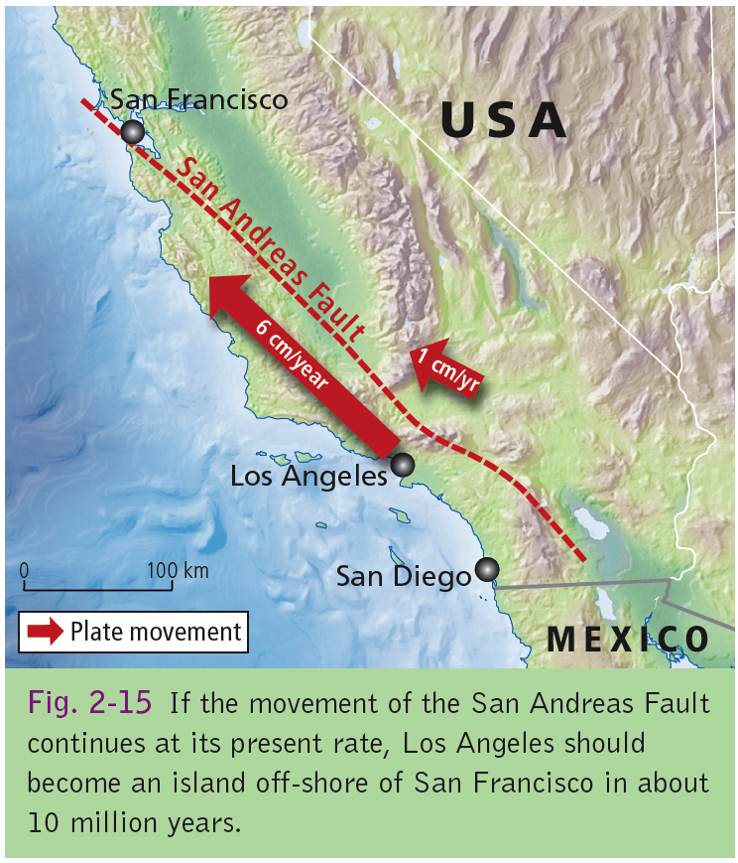

Slide 87
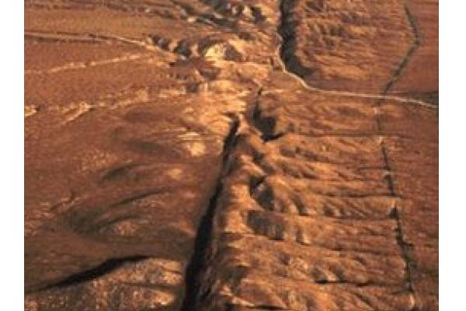

Slide 89
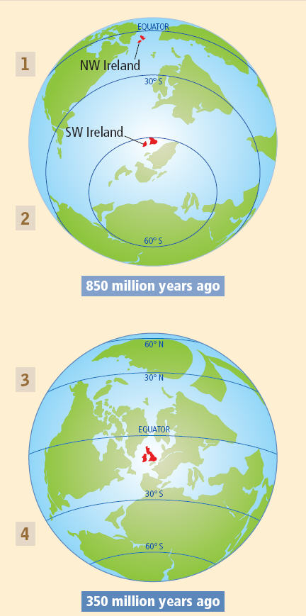
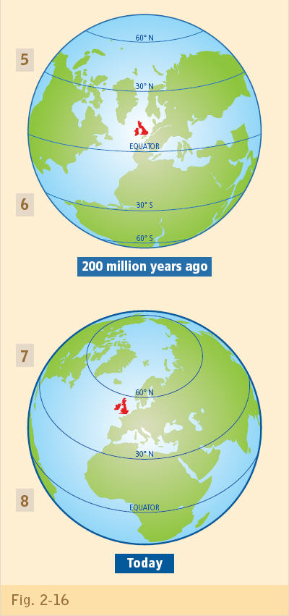

Slide 90
IRELAND’S JOURNEY

Slide 91
LCHL Q2.B,2008
B. VULCANICITY
Explain how the study of plate tectonics has helped us to understand the global distribution of volcanoes. [30m]

Slide 92
LCHL Q3.B,2006
B.
Explain how the study of plate tectonics has helped us to understand the occurrence of earthquakes . [30m]

Slide 93
LCHL 2009/2010
B.
Explain how the study of plate tectonics has helped us to understand the occurrence of fold mountains . [30m]

Slide 94
LCHL Q2 A,2008

Slide 103
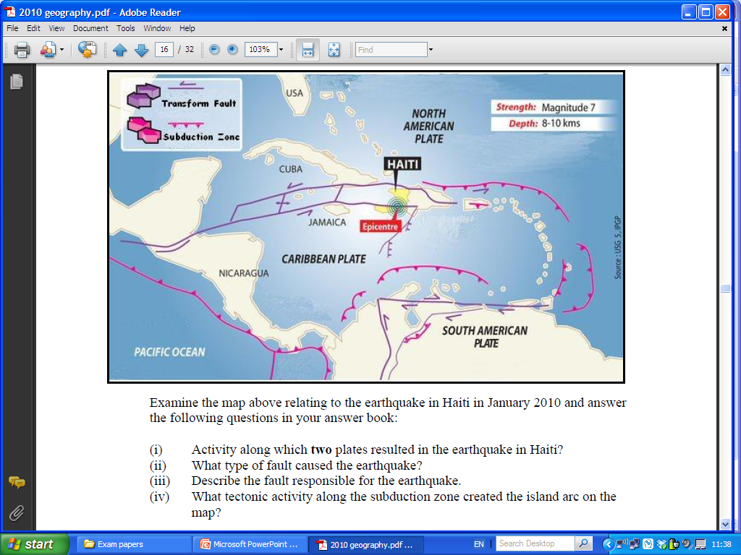

Slide 105
LC QUESTION
Plate boundaries are zones where crusts are created and destroyed. Examine this statement with reference to examples you have studied.(30 Marks)
Explain with the aid of a labelled diagram the process of global crustal plate movement as it is presently understood. (30 Marks)

Slide 108
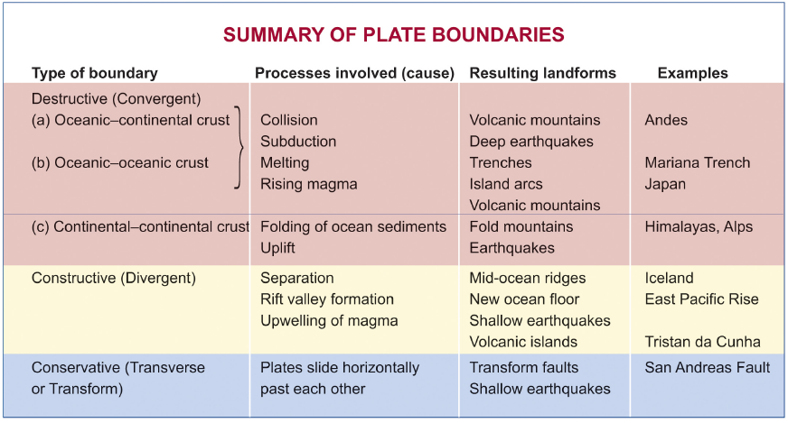

Slide 109
Type of Margin | Examples of Plates | Features Formed | Examples of Features | Processes Involved
Convergent Continental Continental
Convergent Oceanic- Oceanic
Convergent Oceanic- Continental
Divergent Continental- Continental
Divergent Oceanic- Oceanic
Transverse

Slide 110
Type of Margin | Examples of Plates | Features Formed | Examples of Features | Processes Involved
Convergent Continental Continental | Eurasian & Indian Plates | Fold Mountains | Himyalas Mts | Folding/ Earthquakes
Convergent Oceanic- Oceanic | African & Eurasian Plates | Island Arc | Lipari Islands | Earthquakes/ volcanic activity/ Subduction
Convergent Oceanic- Continental | Nazca & S.American Plates | Fold Mountains & Volcanoes | Andes & Nevado El Ruiz | Subduction/ Volcanic activity/ earthquakes
Divergent Continental- Continental | African & Indian Plates | Rift Valley | East African Rift Valley | Volcanic Activity Earthquakes
Divergent Oceanic- Oceanic | N. American & Eurasian Plates | Mid Ocean Ridge | Mid Atlantic Ridge | Volcanic Activity Earthquakes
Transverse | N. American & Pacific Plate | Fault Line | San Andreas Fault Line | Earthquakes

