Slide 1
European Region
Southern Italy

Slide 2
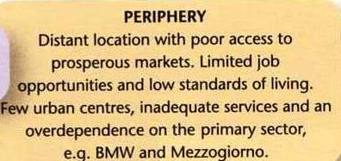

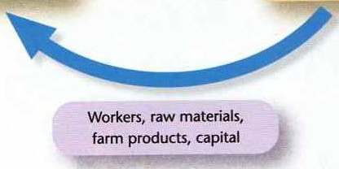



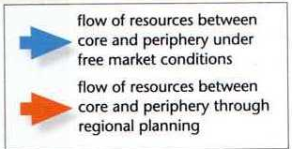
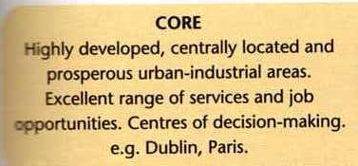
THE CORE-PERIPHERY MODEL

Slide 3
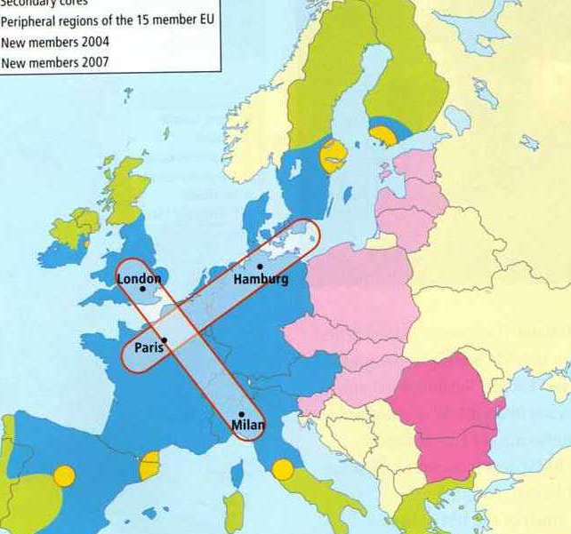
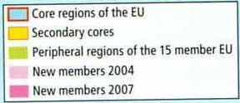

Slide 4
Socio-economic regions in Europe

Slide 5
Core regions of Europe

Slide 6
Peripheral regions of Europe

Slide 7
Former Objective One regions in Europe

Slide 8
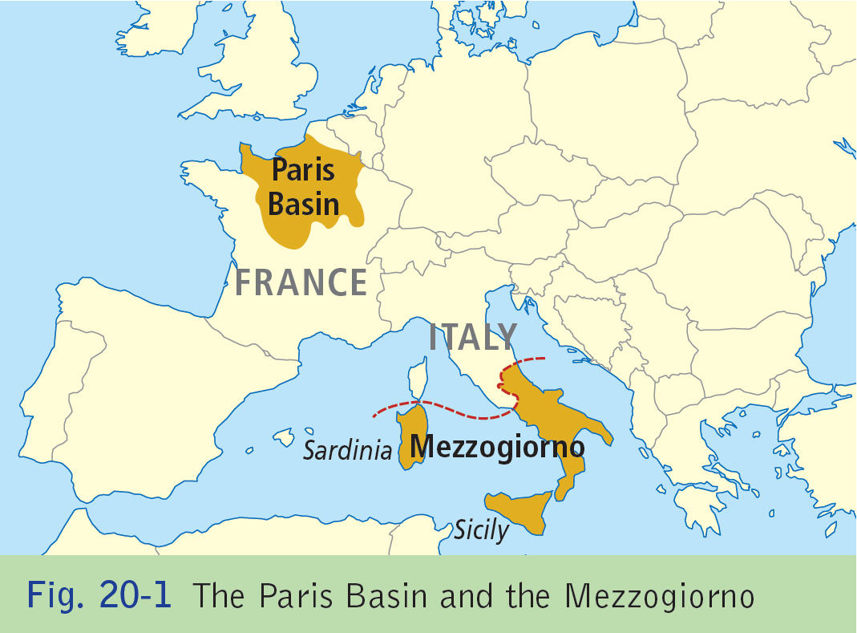
Core VS Peripheral Region

Slide 9
The Mezzogiorno
A Peripheral Region
“LAND OF THE MIDDAY SUN”

Slide 10
Mezzogiorno- “Land of the Midday sun”
40% of the land area in Italy includes the islands of Sicily and Sardinia, generates 25% of GDP.
Incomes are only 70% of those in North Italy.

Slide 11
By the end of the section you will know
Map of Italy.
Physical aspects of Italy.
Primary Activities.
Secondary Activities.
Tertiary Activates.
Human processes.

Slide 12
1 Map of Italy

Slide 13
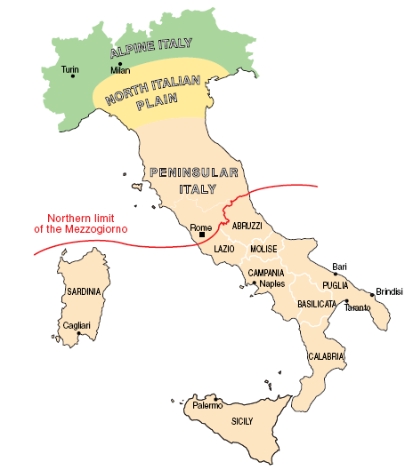
The regional divisions of the Mezzogiorno

Slide 14
Regions of the Mezzogiorno

Slide 15
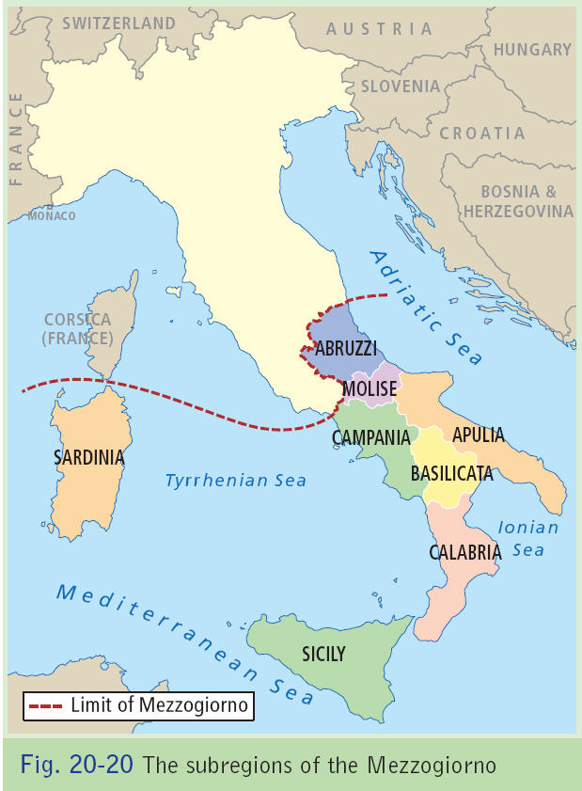

Slide 16
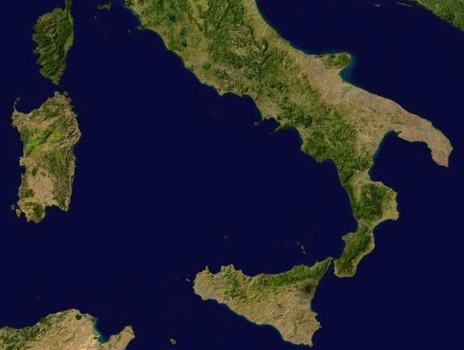

Slide 17
Satellite map of Mezzogiorno

Slide 18
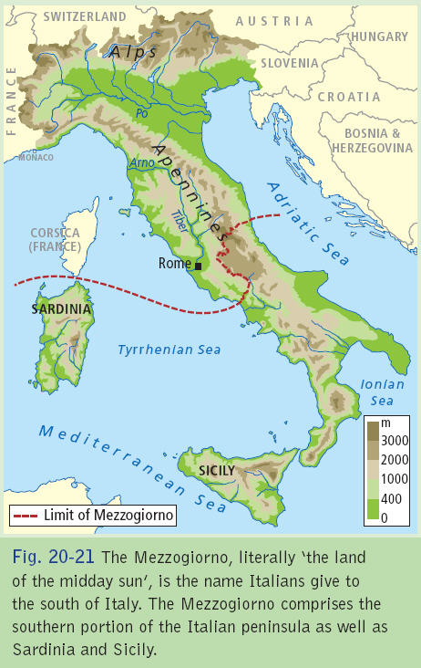

Slide 19
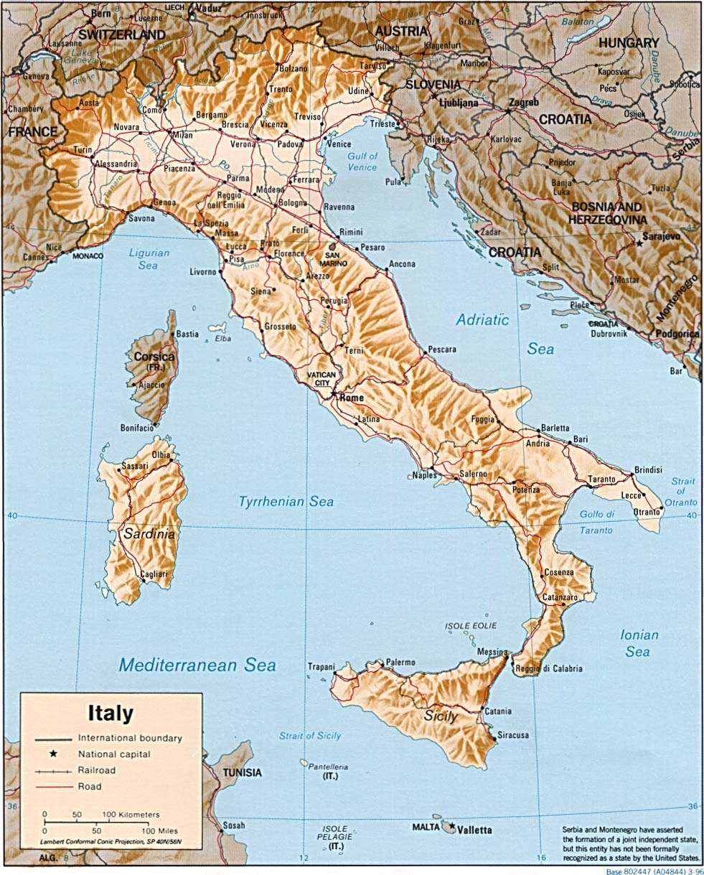

Slide 20
Relief and drainage of the Mezzogiorno

Slide 21
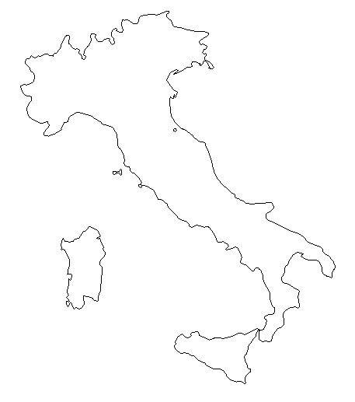

Slide 22
Physical Processes

Slide 23
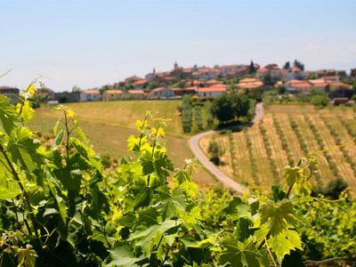

Slide 24
Mezzogiorno-Physical
85% is classified as upland (200m+). 45% classified as mountains (400+). 15% being lowland or coastal
Apennines- 1050km- is backbone of Italy caused by Alpine folding.
Gran Sasso d’Italia is the highest peak at 2914m.
Coastal lowland areas are small- Campania fertile plain is fronted by long sandy beaches and seperated by rocky headlands.
Sicily’s plain of Catania produces citrus fruit.

Slide 25
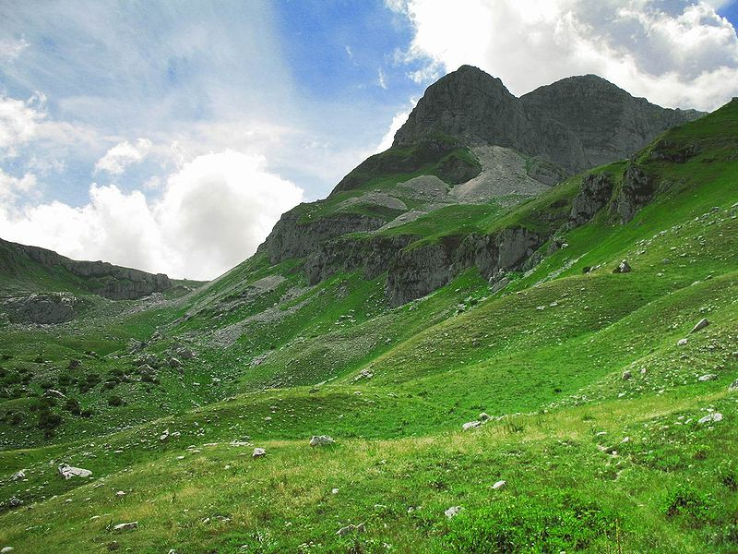

Slide 26
Relief and drainage of the Mezzogiorno

Slide 27
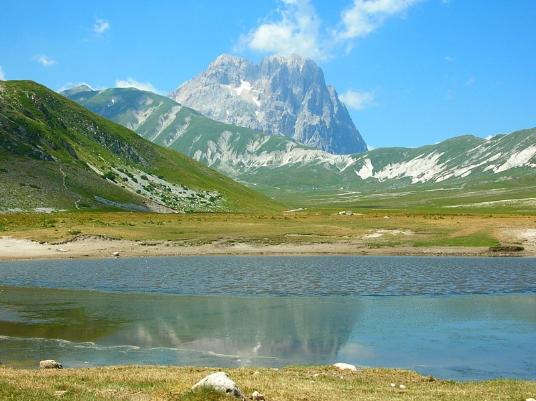
Gran Sasso d’Italia

Slide 28
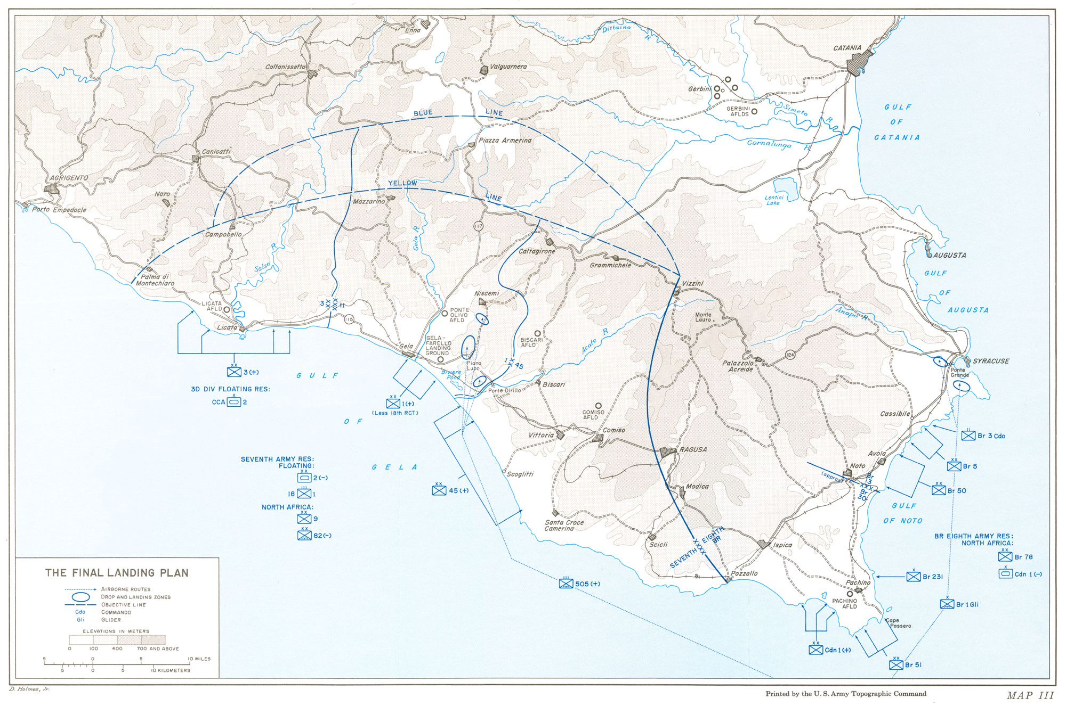
Sicily’s plain of Catania

Slide 29
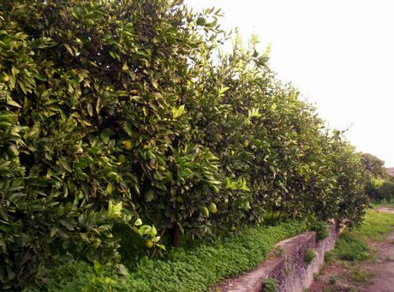
Catania’s Citrus Fruits

Slide 30
Mezzogiorno-Geology
Apennines have a permeable limestone centre and sandstone in the south. Means that there are few large surface rivers besides for the Agri and Volturno
Subject to natural disasters (tectonically active)
Earthquakes common-5.4 at St Giuliano di Puglia
Volcanoes at Vesuvius- eastern Apennines, Stromboli-Lipari Island- Mount Etna- Sicily

Slide 31
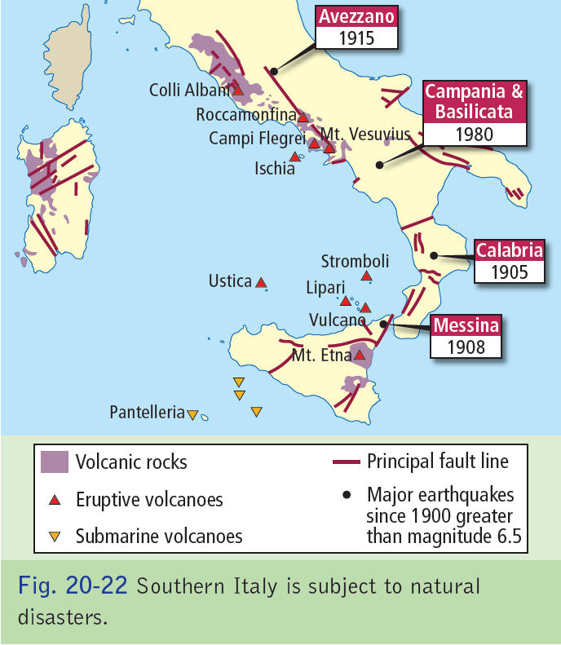

Slide 32
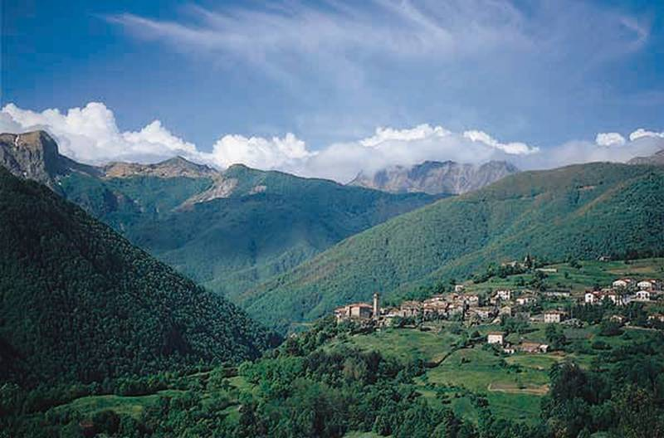
Apennines

Slide 33
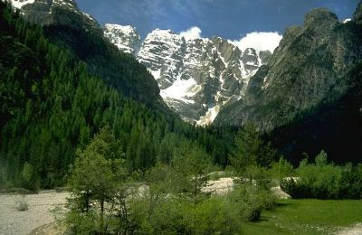
Apennines

Slide 34
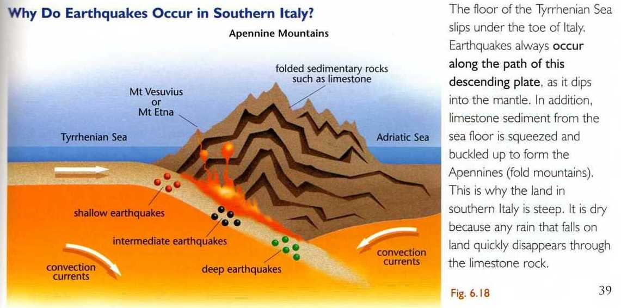
PHYSICAL PROCESSES-GEOLOGY

Slide 35
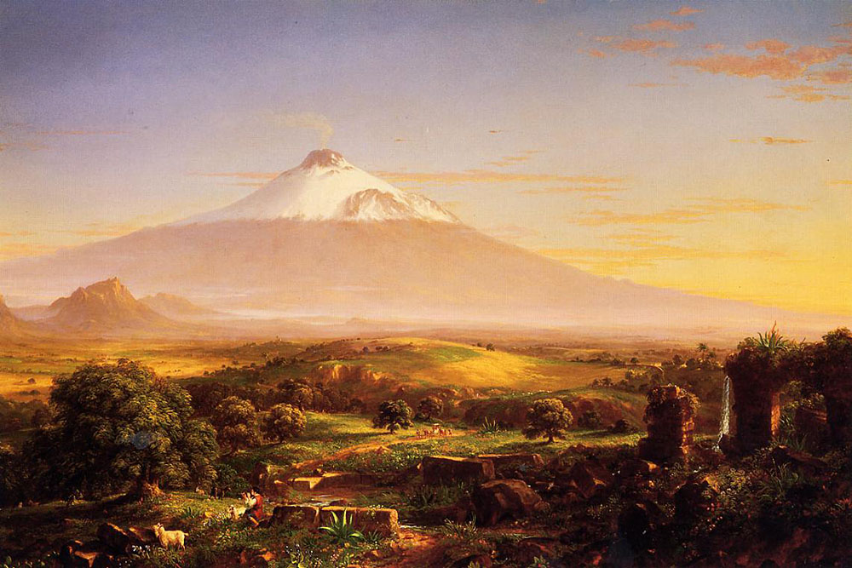
Mt Etna

Slide 36
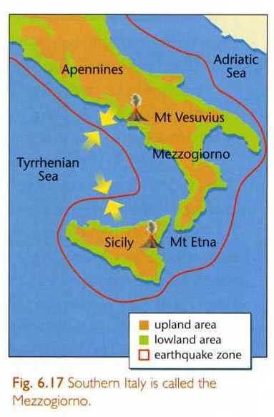
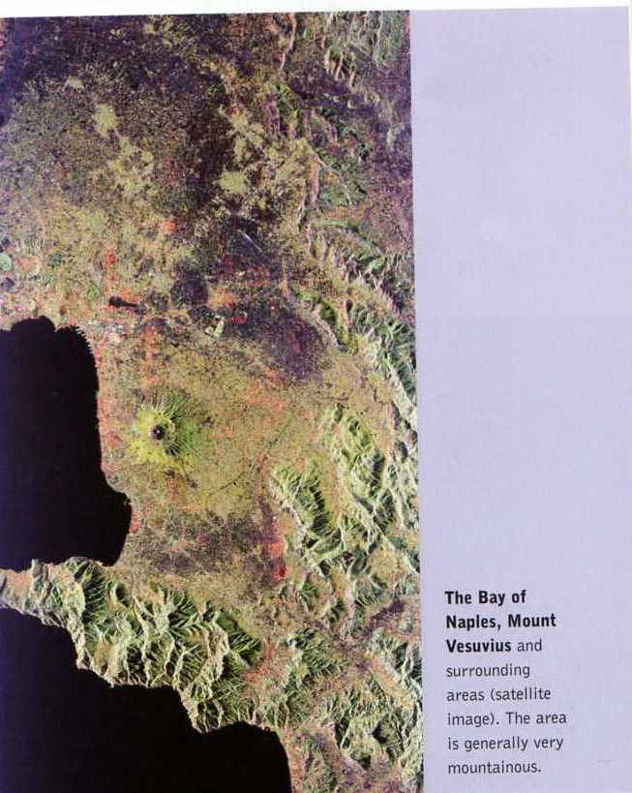
PHYSICAL PROCESSES-GEOLOGY

Slide 37
Mezzogiorno- Drainage
Valleys flood in the winter but experience drought in the summer. In limestone regions water drains underground throught sinkholes such as Castellana in Puglia
Volturno- flows into the Tyrrhenian
Agri- large river flows into Gulf of Taranto

Slide 38
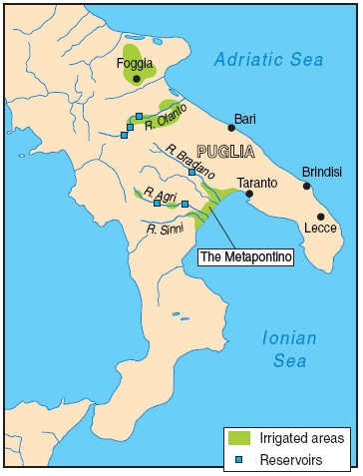
Map of the Metapontino region

Slide 39
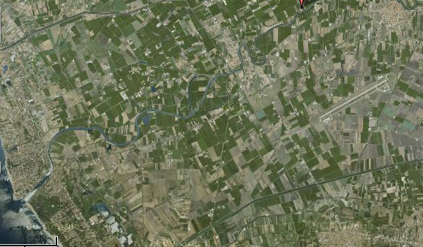
Volturno

Slide 40
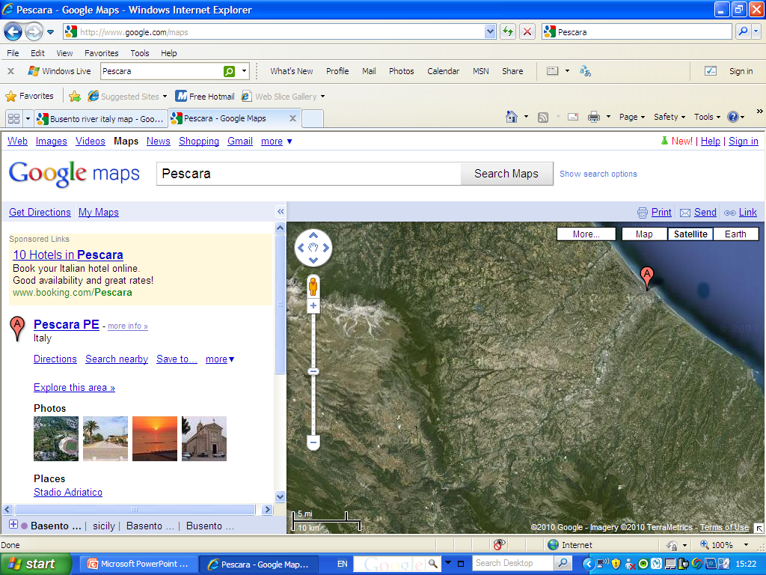
Pescara

Slide 41
Mezzogiorno-Soil
Campania have fertile soils with rich alluvial floodplains.
Terra rossa soils (red soils) made from weathered limestone are found in south of the region-vineyards, olive groves.
High Apennines are thin and denuded due to weathering erosion and earthquakes.
Rich soils found in densely populated plains EX Vesuvius (Rich volcanic soil)

Slide 42
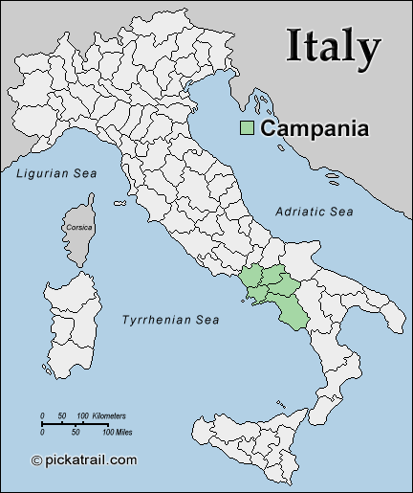

Slide 43
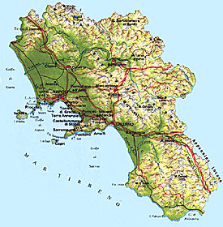

Slide 44
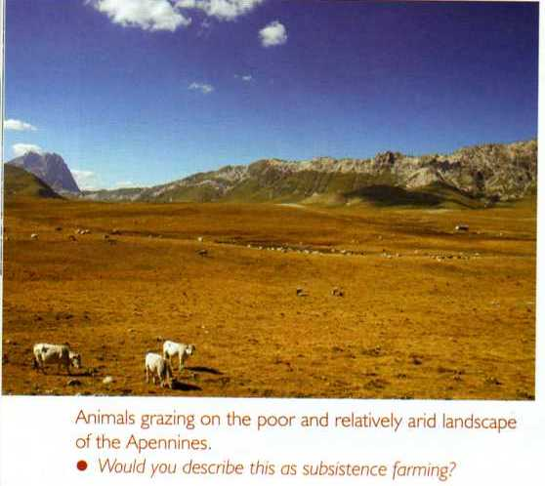
PHYSICAL PROCESSES-SOILS
GRANITE-
CALABRIA-
POOR&
THIN

Slide 45
Mezzogiorno-Climate
Warm temperate oceanic- hot, dry summers (high pressure) Average temp 29 C. Azores bring dry stable weather and can cause drought. Convectional Rainfall creates thunderstorms.
Mild wet winters (low pressure) Average temp =11 C. Winter vary in the Apennines with altitude

Slide 46
Annual precipitation and seasonal winds in Naples and Sicily

Slide 47
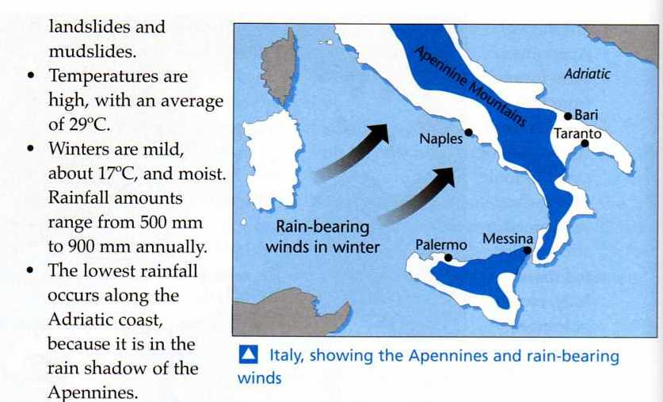
PHYSICAL PROCESSES-CLIMATE

Slide 48
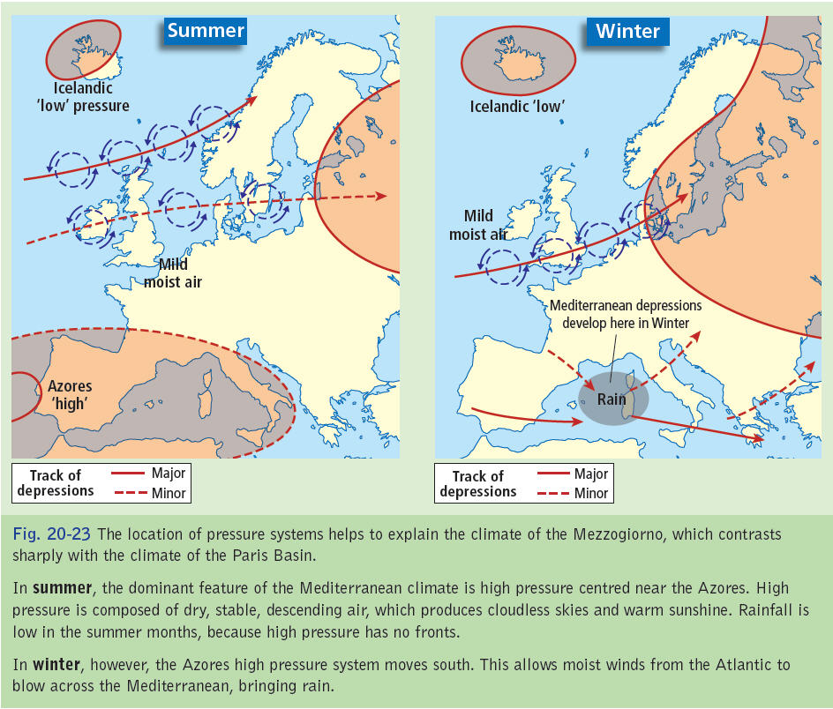

Slide 49
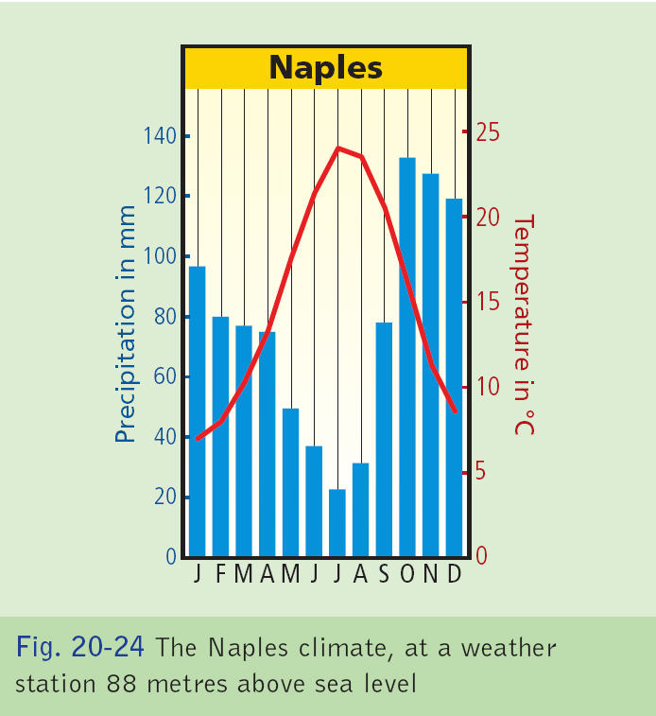

Slide 50
Mezzogiorno-Climate
Rainfall ranging from 400mm in Bari to 700mm in Naples. East of region is drier due to rain shadow effect of Apennine Mountains
Hot sirocco winds influence south of Mezzogiorno.
Sardinia subject to the cold mistral winds that bring a cold eastern winds from Europe

Slide 51
Climate charts and rainfall measures for Naples and Sicily

Slide 52
Primary Activities

Slide 53
Primary Activities
Primary Activities are the removal of natural resources from the earth.
Regions that are mainly involved in primary economic activities tend to be poorer.
10% of people are employed in primary activities in this region.

Slide 54
Primary Activities- Agriculture
Agriculture in the Mezzogiorna has traditionally been unproductive and subsistent, particularly until the 1970’s.
High dependency on EU grants.
Farm incomes are 50% lower than EU average.
There are many physical factors that led to agriculture being so unproductive including the mountaineos relief, infertile soils and the Mediterranean climate which frequently causes drought.

Slide 55
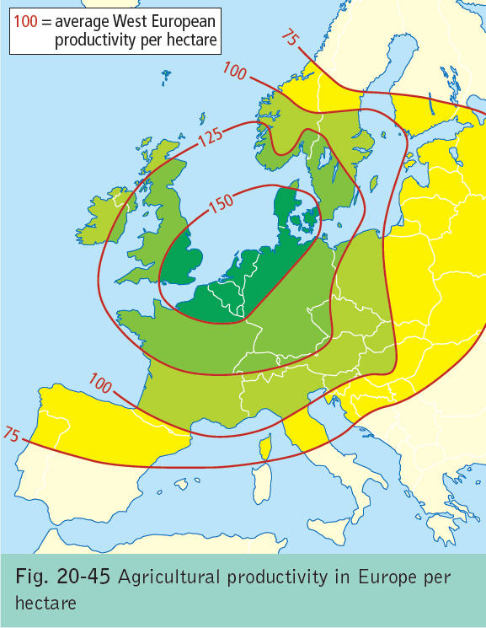

Slide 56
Primary Activities- Agriculture
The only productive region have been the alluvial soil near Cerignola and Naples.
Also, up until the 1950’s most land was owned by absentee landlords who rented the land to tenant farmers.
This was called the “latifundia” system of agriculture and made agriculture extremely unproductive. Only 25% of people owned their land.
70% of farms were less than 3 hectares.
Often overgrazing and overcultivation occuring

Slide 57
Agricultural production in the Mezzogiorno

Slide 58
Primary Activities
isolated from the lucrative north Italian/ EU market due to the poor transport links and the mountaineous relief between the two regions.
This migration of young people meant that there was no young workforce to take over from ageing farmers which meant many farms were abandoned.

Slide 59
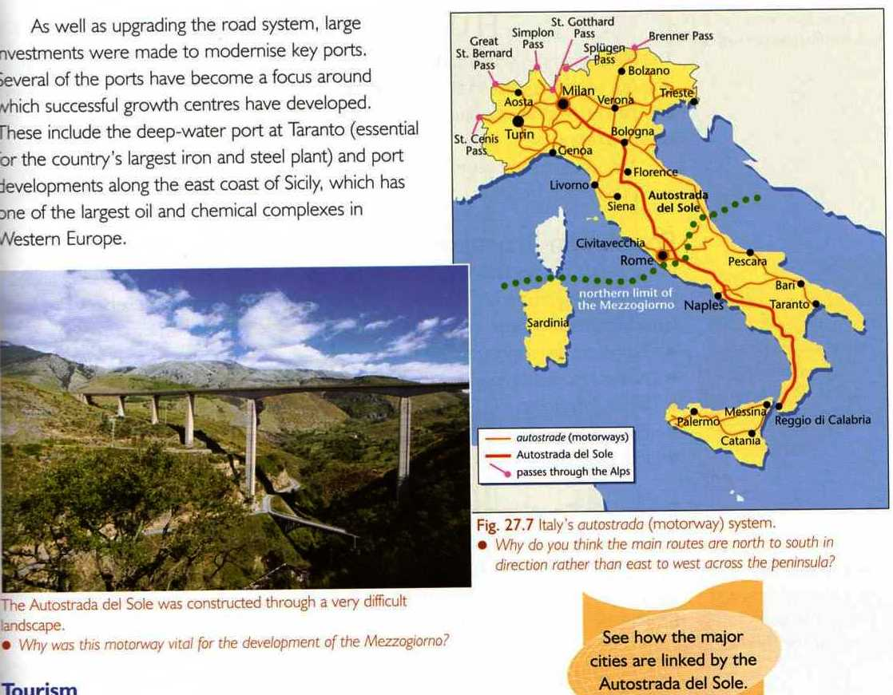
PRIMARY ACTIVITIES-AGRICULTURE REFORM

Slide 60
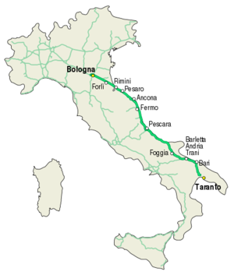

Slide 61
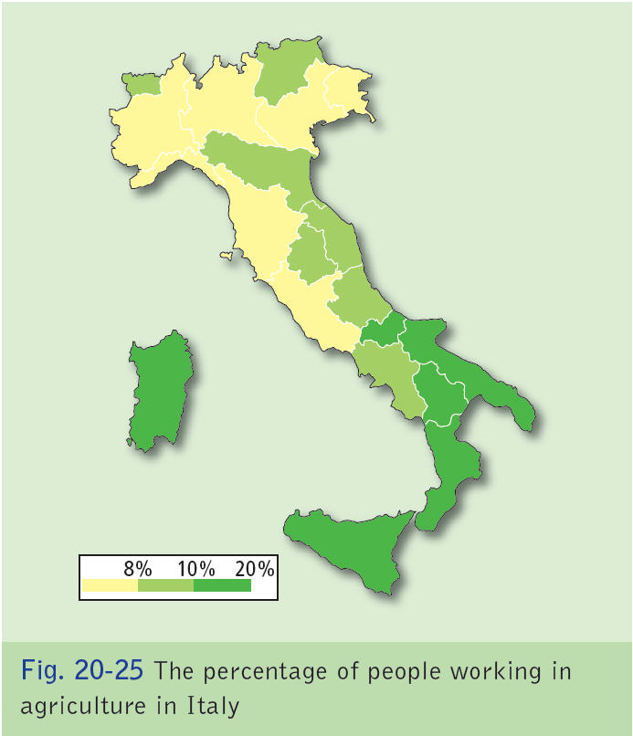

Slide 62
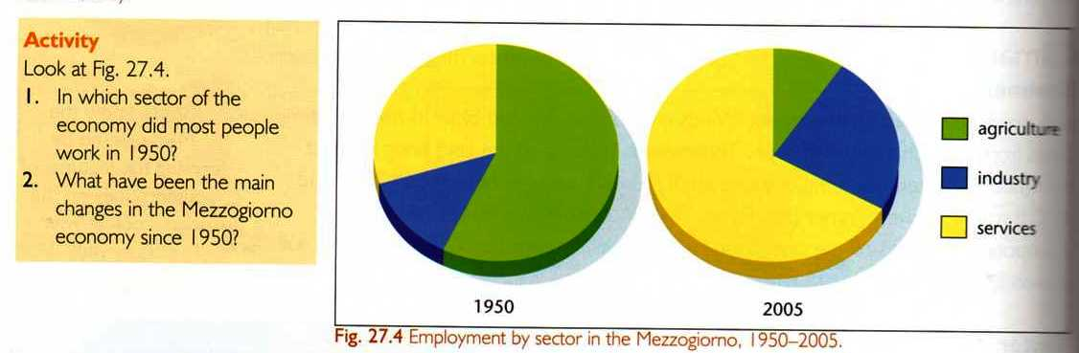
PRIMARY ACTIVITIES-AGRICULTURE

Slide 63
Primary Activities
In order to reform the agriculture sector in the Mezzogiorna, the Cassa per il Mezzogiorna was set up in the 1950’s.
Land reform was introduced; The large landlord estates were broken up and the land was distributed amongst the farmers, allowing them to adopt more modern methods of agriculture.
The Cassa encouraged a change from traditional agriculture to the production of cash crops such as citrus fruits and tobacco.

Slide 64
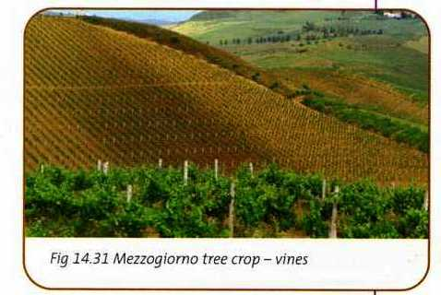
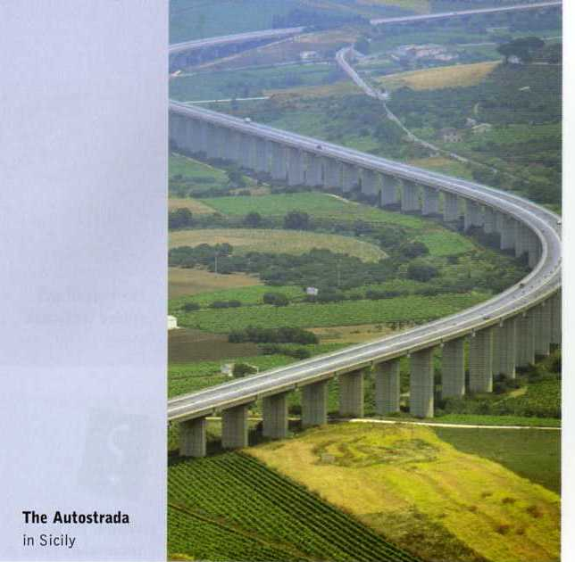
PRIMARY ACTIVITIES-AGRICULTURE REFORM

Slide 65
Primary Activities
Large amounts of money were invested in farmer education, mechanisation, irrigation and developing wells and reservoirs to make previously unproductive land productive.
Transport links were improved between north and south with the construction of the italian Autostrade which allows agriculture goods to reach the market quickly.
Malarial swamps were drained and reclaimed.

Slide 66
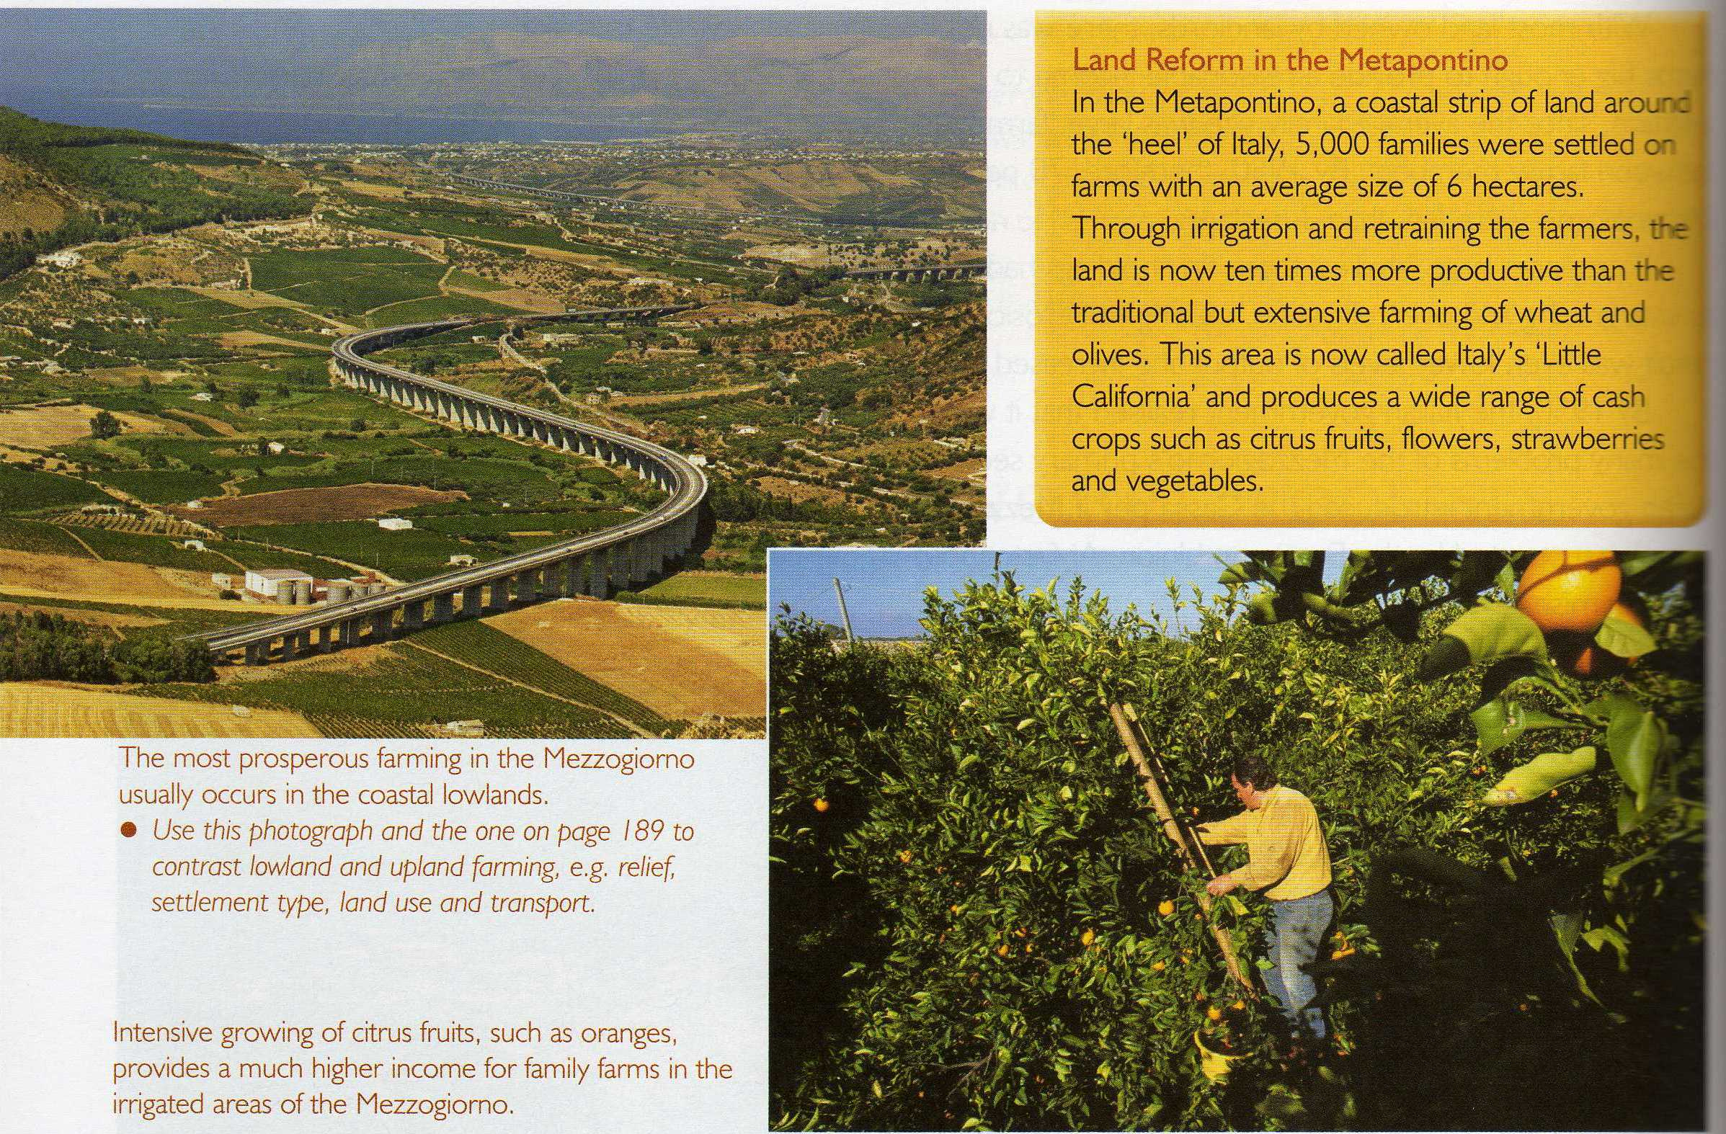
PRIMARY ACTIVITIES-AGRICULTURE REFORM

Slide 67
Typical land use in the Mezzogiorno

Slide 68
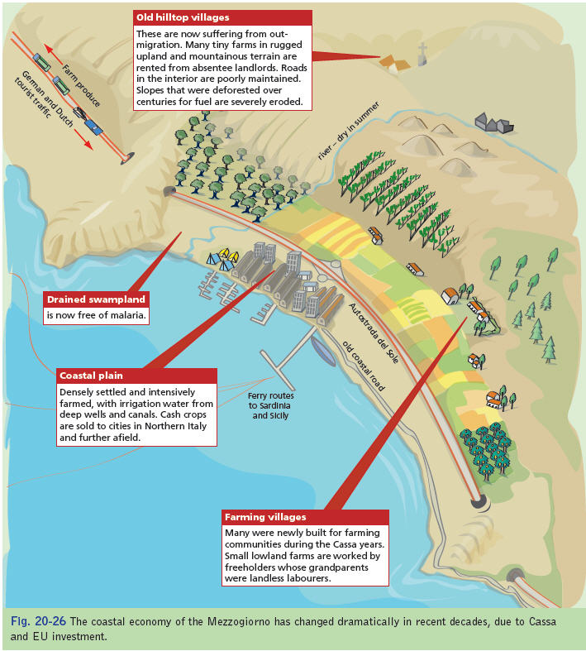

Slide 69
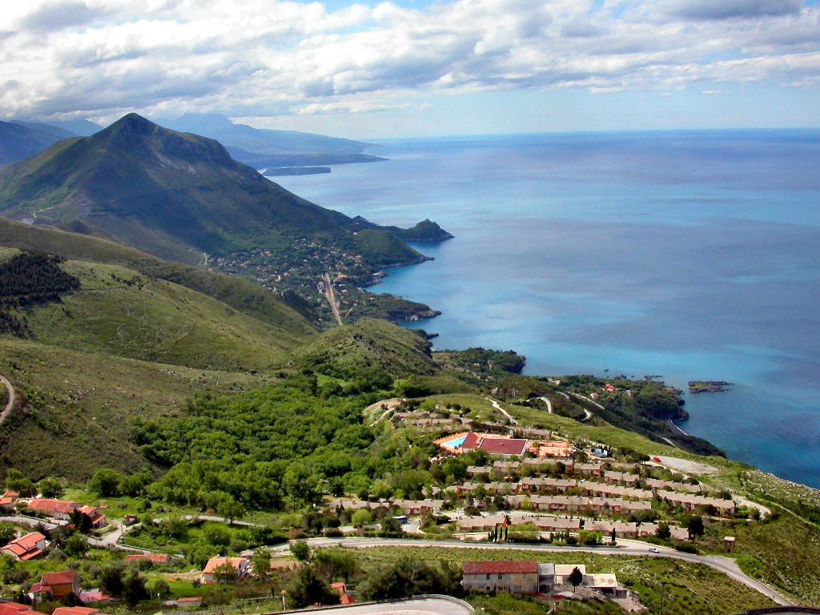
Southern Italy

Slide 70
Agriculture- Arable (Crops) farming
Used to grow hard wheat used for making pasta, bread, pizza.
Campanie specialise in production of tomatoes
Mezzogiorno main producer of citrus fruit, grapes (wines) & olives in EU.
60% of citrus fruits produced in Sicily

Slide 71
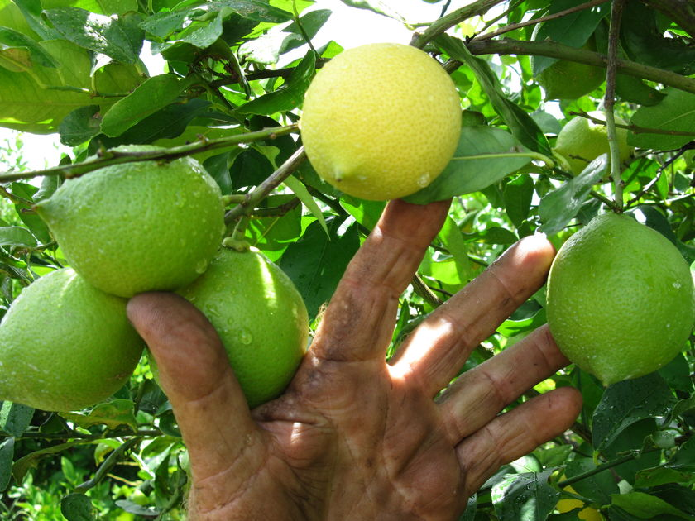
Citrus Fruits- Lemon and Lime

Slide 72
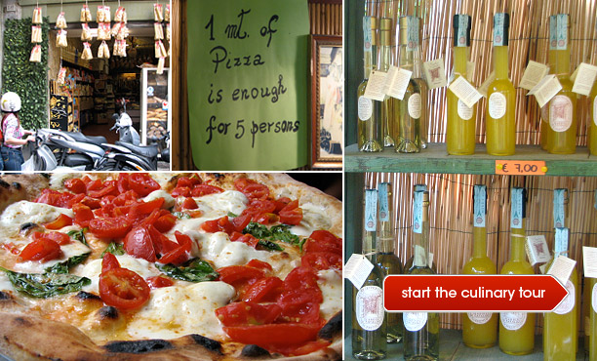
Campanie

Slide 73
Agriculture- Pastoral (Livestock) farming
High costs of irrigation make pastoral farming unprofitable though Buffalo are raised in Campania as their milk is used to make cheese.
Goats and sheep used in highland areas

Slide 74
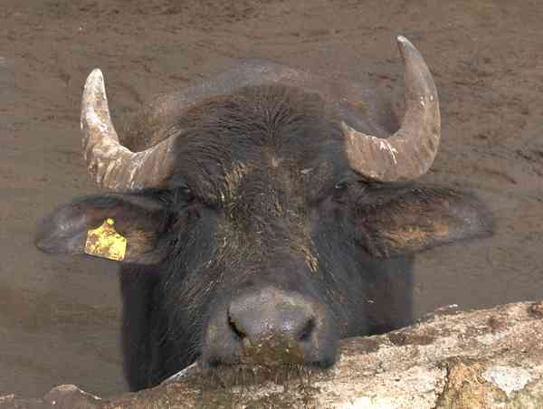
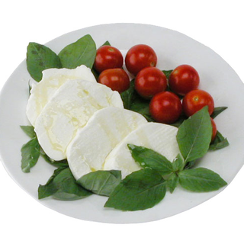
Campania Buffalo and cheese.

Slide 75
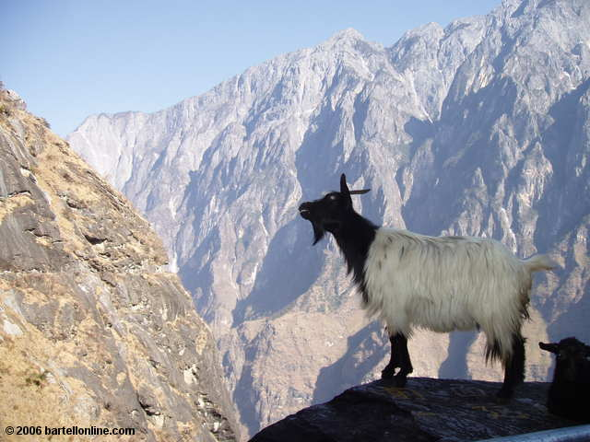
are

Slide 76
Negative effects of the Cassa
Only benefited the coastal plains and widened income gap between the plains and upland areas.
Seasonal overproduction has led to a dramatic fall in prices.
Mechanisation of farming led to loss of jobs
Irrigation system are expensive to maintain.

Slide 77
30 Mark Question
Describe how physical factors have affected agriculture in a European Region (NOT IRELAND) that you have studied.

Slide 78
Agriculture Questions
What is the % of people employed in agriculture?
Give a list of what people farm in the Mezzogiorno.
List the negative factors that hindered Agriculture in the Mezzogiorno.
What was the name of the plan the Italian government put in place.
Discuss the aims and implementation of this plan.

Slide 79
Forestry
The mixed woodland (cork & evergreen oak) that covered most of the Mezzogiorno have been cleared for agriculture and settlement.
Upland Calabria and Abruzzi have Beech and silver fir spaced widely apart.
Majority of upland areas have scrub vegetation

Slide 80
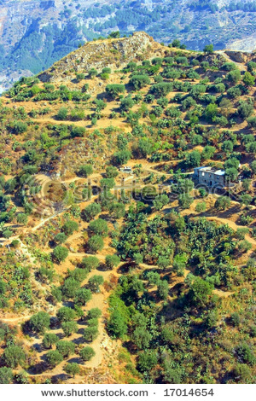

Slide 81
Mining and energy
HEP is limited due to climate and geological reasons.
Various pockets of gas exploited at Calabria and Sicily.
1980- natural gas pipe was built to Algeria
New wave of renewable energy being invested in the area

Slide 82

Gas Pipe line

Slide 83


Slide 84

Deepwater-Floating-Wind Turbine

Slide 85
Primary Activities Fishing
Fishing in not a major activity.
Though fishing is an important industry for many regions in Western Europe, the enclosed Mediterranean Sea contans relatively high levels of pollution and salinity which limit the variety of fish species.
The sea also contains low levels of oxygen, and plankton growth is slower than in the open waters of the Atlantic Ocean.
The dominant fishing ports in the region are areas such as Salernoo and Nicastro. There are some factors that have assisted the development of fishing here.

Slide 86


Slide 87


Slide 88


Slide 89
Primary Activities- Fishing
The peninsula contains a fairly large continental shelf and possesses a large amount of anchovies, tuna and sardines. The weather in the Mezzogiorna is seldom severe, which possesses many natural harbours.
The majority of the fish caught are sold for human consumption and as such there are no significant spin-off industries in the form of fish processing.

Slide 90
Examine the development of primary activities in a European region that you have studied.
The reason I have studied is the Mezzogiorna. Primary activities in the region includes agriculture and fishing.
Agriculture in the Mezzogiorna has traditionally been unproductive and subsistent, particularly until the 1970’s. There are many physical factors that led to agriculture being so unproductive including the mountaineos relief, infertile soils and the Mediterranean climate which frequently causes drought. The only productive region have been the alluvial soil near Cerignola and Naples. Also, up until the 1950’s most land was owned by absentee landlords who rented the land to tenant farmers. This was called the “latifundia” system of sgriculture and made agriculture extremely unproductive.
The mezzogiorna has traditionally been isolated from the lucrative north Italian market due to the poor transport links and the mountaineous relief between the two regions. The distance from the markets is a major problem for perishable goods. Throughout the past century there has been a trend of out migration from the Mezzogiorna to cities such as Milan and Turin in the north. This mmigration of young people meant that there was no young workforce to take over from ageing farmers which meant many farms were abandoned.
In order to reform the agriculture sector in the Mezzogiorna, the Cassa per il Mezzogiorna was set up in the 1950’s. The cassa invested hugely in agriculture in the region. The large landlord estates were broken up and the land was distributed amongst the farmers, allowing them to adopt more modern methods of agriculture. The Cassa encouraged a change from traditional agriculture to the production of cash crops such as citrus fruits and tobacco. Large amounts of money were invested in irrigation and developing wells and reservoirs to make previously unproductive land productive. Transport links were improved between north and south with the construction of the italian Autostrade which allows agriculture goods to reach the market quickly.
A secondary primary activity is fishing. Although fishing is an important industry for many regions in Western Europe, the enclosed Mediterranean Sea contans relatively high levels of pollution and salinity which limit the variety of fish species. The ses also contains low levels of oxygen, and plankton growth is slower than in the open waters of the Atlantic Ocean, The dominant fishing ports in the region are areas such as Salernoo and Nicastro. There are some factors that have assisted the development of fishing here. The peninsula contains a fairly large continental shelf and possesses a large amount of anchovies, tuna and sardines. The weather in the Mezzogiorna is seldom severe, which possesses many natural harbours.
The majority of the fish caught are sold for human consumption and as such there are no significant spin-off industries in the form of fish processing. Numerous difficulties face the fishing industries in the Mezzogiorno such as the decline in stocks and the introduction of quotas by the EU.

Slide 91
Secondary Economic Activities
Economic Challenge; Manufacturing

Slide 92
Secondary Economic Activities
Raw materials processed or semi- processed materials are further developed.
Maroity of 2nd activities are state owned.
24% of people employed in 2nd activities. This has tripled since 1960’s.
It is poorly developed.

Slide 93


Slide 94
Secondary Economic Activities
Disadvantages
Did not experience Industrial/ Agricultural revolution.
Impoverished agricultural sector and lack natural resources.
An unskilled, uneducated labour force.
Poor infrastructure.
Remoteness from major EU markets and poor local markets.
A limited supply of energy
High rates of emigration (Braindrain).

Slide 95


Slide 96


Slide 97
Secondary Economic Activities
Solutions-Cassa per il Mezzogiorno
Established in the 50’s to develop the area with a number of initiatives. 2.3 billion invested planning to create 300,000 new jobs. Fund also available for training.
Improve infrastructure-motorways (Autostrada del Sole), sea/air ports.

Slide 98
Map of growth centres

Slide 99
Secondary Economic Activities
Solutions-Cassa per il Mezzogiorno
Choosing growth centres to focus development-Naples-Bari-Brindisi-Taranto.
State owned companies place 40% of new investment here.
Setting up heavy industries (60% of new industries) in the hope of attracting light industries.

Slide 100
Map of industrial centers

Slide 101
Industry
Steel, ship building, car manufacturing, oil refining, chemicals and petro chemical.
Oil refining, chemicals and petro chemical established in Sicily because of oil and gas deposits.
Finsider a state owned steel company was most successful-the first of its kind in 1964 did not attract enough steel using industries so exports its steel
State owned Alfa Romeo (1968) established a plant in Naples but sold to Fiat in 1980 after failing to make a profit

Slide 102
Growth Centre- Taranto
Advantages- maritime tradition- location on Mediterranean trade routes-deep water port-improved transport links to the north.
An important strategic naval base
Port handled over 36 million tonnes.
Largest steel produced-10 million tonnes a year.
Chemical and petro chemical plants cluster around oil refinery
Food processing important industry

Slide 103


Slide 104


Slide 105



Slide 106


Slide 107
PRIMARY ACTIVITIES-AGRICULTURE

Slide 108
Evaluation of Cassa
“Cathedrals in the desert”
Very expensive- failed to attract smaller industries. (foreign companies scared by Mafia.
High absenteeism as workers not use to discipline and took time off to work on farms.
Limited growth of 2nd industry of 4.2%
300,000 jobs created in industry- 2million lost in agriculture due to mechanisation.

Slide 109
 | GDP per capita | Unemployment | Hospital beds per 1000 of population
North Italy | 25,527 | 4.2% | 4.4
Mezzogiorno | 13,028 | 20% | 3.9

Slide 110
Evaluation of Cassa
“Cathedrals in the desert”
Construction industry prospered with building of new infrastructures , tourism etc.
Funds spent helped people in north/centre
Over reliance of state investment and lack of local initiative and self reliance.
Huge contrasts in average income.
Unemployment rates are 20%. 23% of families live in poverty and infant mortality rates are four times of N. Italy.

Slide 111


Slide 112
Tertiary Activities

Slide 113
Tertiary Activities
Tertiary Activities involve the provision of services.
Regions that are involved in tertiary activities are generally richer.
67% of pop is involved in tertiary activities.
However most of these jobs are in tourism and are seasonal.

Slide 114



Slide 115
Tertiary Economic Activities
Transport
Transport links were poorly developed affected by mountainous terrain- roads found on coastal lowlands.
Train journeys often disrupted by snow in winter
12 billion invested on regional development- 2.5 billion spent of development transport infrastructure and making the area more accessible to tourists. Roads widened/ straightened, bridges tunnels built in mountaineous regions
Two main motorways created which connect the South to Europe. (Autostrada del Sole 754km)
Large % of money used to upgrade ports to attract heavy industry.
Very poor public transport networks.

Slide 116


Slide 117
Tourist Attractions
The climate guarantees dry summers and mean temperatures of 29 degrees.
Beaches vast empty and unpolluted.
Scenic beauty (Sorrento coastline appenines mts
Cultural and historic attractions such as ancient Greek/ Roman ruins EX Pompeii.
Active volcanoes (Etna and Stromboli)(Disaster tourism)
Cheap food and wine and area is less crowded
Winter attracts an increasing number of skiers.

Slide 118


Slide 119





Slide 120
Development Strategies
Tourism helped by infrastructures such as motorways, rail, ferrylinks and airports (Cassa- 15% of budget spent of attracting tourism). Though growth of tourism limited to coastal regions
Services such as water, electricity were modernised
Historic buildings preserved.
Grants provided to build/ improve hotels.
Advertisement campaigns both international and national
2001-10 million tourists from Italy and 6 from overseas.

Slide 121
Effects of tourism
Advantages
Disadvantages
Direct employment in hotels, restaurants etc.
Indirect jobs in agriculture banking
Tourism revenues pay for improved communications.
Demand for local farm produce.
High rise hotels and apartments spoil natural beauty.
Local people unable to buy inflated land prices
Water supply strained
Pressure on the environment.
Failed to attract foreign markets.

Slide 122

Advantages and disadvantages of tourism to Kenya
Notes:
You could also discuss how ‘local produce’ could be a disadvantage as well as an advantage of tourism (ie do the hotels buy locally or import food, drink, etc from abroad)

Slide 123
Case Study- Siracusa
SE Sicily with Mediterranean climate.
Ancient city.
Sandy beaches.
Religious Architeture.
Famous limestone caves, catacombs and amphitheatre
Old fortress building dating back to 1500BC
Areas noted for its fresh food cuisine and pasta dishes.
One hour drive from Mt Etna.

Slide 124


Slide 125




Slide 126




Slide 127
Radio Advert

Slide 128
Human Processes

Slide 129
Population
Mezzogiorno makes up 40% of land but 35% of pop.
Life expectancy is high 76 for men/ 82 for women.
Roman Catholicism is dominant religion.
Birth rate higher than EU average 9.4 per 1000 but decreasing due to urbanisation/ education/ female rights.
21 million people in area with varying pop densities. Highest in Campania.
There is a high dependency ratio due to high levels of migration.

Slide 130
Population
Mezzogiorno still face major problem in making improvement.
The Mafia, political corruption, slow economic growth, low literacy rates, poor health system.
Low broadband access with less computers per captia.

Slide 131


Slide 132


Slide 133


Slide 134


Slide 135
Migration
Many different ethnic groups due to centuries of trade with the Greeks/ Roman/ Arabs. Tend to be smaller, sallower with darker coloruing.
4 Million people left the south of Italy from 1951- 1981. This slowed down the Introduction of Cassa.
Large influx recently from Eastern Europe and Northern Africa due to weak economies. 560,000 migrants in 2004. They have capped the number of migrants allowed into Italy.
A lot of illegal migrants due to length of S. Italian coast line. Roughly 50,000 illegal migrants a year.

Slide 136
Internal Migration
Large % of people move to Northern Italy especially the industrial triangle.
The huge contrast between economic development resulted in an intense migration to Rome, Milan, Turin and Genoa.
Migration slowing as unemployment in northern cities is increasing

Slide 137
International migration
In the past century 10 million people migrated
50% went to USA, Argentina, Brazil, Canada and Australia.
France Germany and Switzerland after WW2 with USA migration laws and recession in other countries.
During 1980 a number of migrants returned due to economic recession and collapse of communist regimes.

Slide 138


Slide 139


Slide 140


Slide 143


Slide 144
Human Processes
Regional Development
Initiatives
Latifundia were subdivided between tenants
Marshes on poor land were drained (Metaponto)
Irrigation schemes made water available to over 8 million people.
Hillsides were reforested to reduce soil erosion.
Co-op set up to process and supply farm goods.
Industrial triangle of Bari, Brindisi and Taranto

Slide 145



Slide 147
Human Processes
Regional Development
Initiatives
Agricultural schools, hospitals social centres built.
Autostrada made
People re-housed from mountain villages to planned settlements

Slide 148



Slide 149
Metaponto-Irrigation
“Little California”
Used to be a poorly drained marshland infested with malarial bearing mosquitoes which produces low yields of wheat and olives.
Land drained and reclaimed for farming and settlement.
Dams built to store water.
5000 families settled here with 6hectares of farm each.
5 rivers which drain the land used now for the intense production of cash crops.

Slide 150
Map of the Metapontino region

Slide 151



Slide 152
Evaluation
Land reform only achieved on 10% of land
Farms less than 20 hectares to small to be viable
Farmers lacked skills and capital to develop land.
Since 1984 the Cassa was wound up and the EU took responsibility for regional development
1. Regional policy-75% of EU wages.
2. Common Agricultural Policy-irrigation, education and development of food processing

Slide 153
Rural Settlement patterns
Majority of people live in urban areas but the few living in rural areas live in houses that are mostly dispersed- with villages of an elevated sites to avoid the heat of the valleys.
Villages often found around churches/ castle and connected by minor road.
High levels of migration due to isolation, poverty and infertile soils.
Hillside villages depend on tourism and traditional craft industries

Slide 154


Slide 155


Slide 156


Slide 158
Rural Settlement patterns
Agricultural villages common on foothills and plains.
Live in large areas but commute to work on large commercial farms.
In Sardinia for historical reasons rural settlement located on elevated site to avoid sea pirates

Slide 159
Urban Settlement Patterns
Each district developed its own centre of commerce and industry with Naples (1.3m), Palmero (700,000) Catania (340,000) and Bari (332,000).
Naples is administrative capital of the south with 3rd largest city and 2nd largest port.
Many Urban areas over 100,000 serving its hinterlands.

Slide 160


Slide 162


Slide 164
Region | Birth rate/1000 | Death rate/1000 | Natural Change | Emigrants | Immigrants | Migration Balance
Mezzogiorno | 10.3 | 8.7 | +34,796 | 444,952 | 390,764 | -54,188
North Italy | 8.9 | 10.3 | -35,410 | 704,684 | 860,971 | +156,287

