Slide 1
The complexity of regions

Slide 2
1 Ireland- North and South.
2 Changing Boundaries of a language region.
3 Changing boundaries of an urban Region. (Dublin)
4 Changes in borders and their impact on Cultural Groups (Kashmir)
5 The European Union- Development and expansion

Slide 3
1. Ireland’s North South Divide
The British conquest and colonisation is the root cause of the conflict between Irish Catholics and Ulster Protestants.
Most Protestants were unionist and wanted to keep with Ulster while Catholics were nationalists and wanted an independent Ireland.
In the 1920’s the British conceded self government and two states were set up in Ireland.
The Irish free state was ruled from Dublin , being a rural society and Gaelic in culture and its economy was agricultural and underdeveloped.

Slide 4
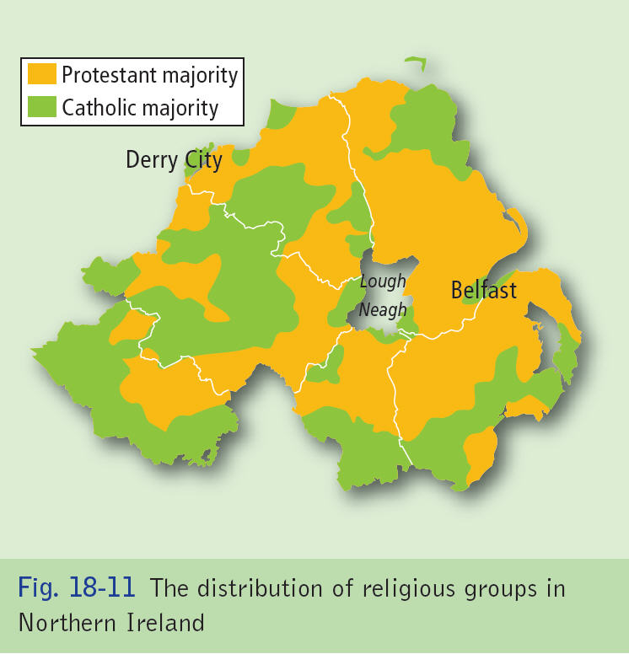

Slide 5
1. Ireland’s North South Divide
Northern Ireland was a developed, industrialised society predominately British in culture and 66% protestant, 34% catholic.
Civil strife continued with Unionists resenting Article 2 of the Irish Constitution, which claimed jurisdiction over Northern Ireland.
Nationalists aspired to cultural and economic freedom

Slide 6
1. Ireland’s North South Divide
During the 60’s and 70’s the republics economy began to develop, with thousands of jobs were created in new foreign industries as EU memberships opened up large new markets and employment soared.
At the same time the norths economy went into deep recession as shipbuilding closes.
In 1998 the good Friday agreement was negotited.

Slide 7
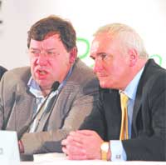

Slide 8
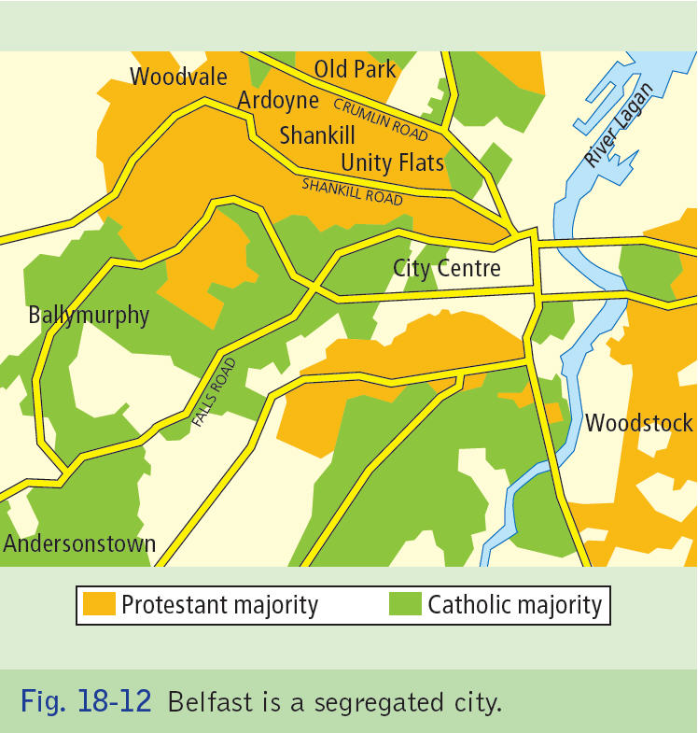

Slide 9
1. Ireland’s North South Divide
Article 2 was repealed by referendum.
Parties agreed to set up power sharing government. Cross border bodies were set up to promote North- South co operation.
a degree of civil harmony has been restored.
The economies of both countries have become interdependent, as well as a whole country representing some sports. However the GAA and Irish language is associated with Nationalism.

Slide 10
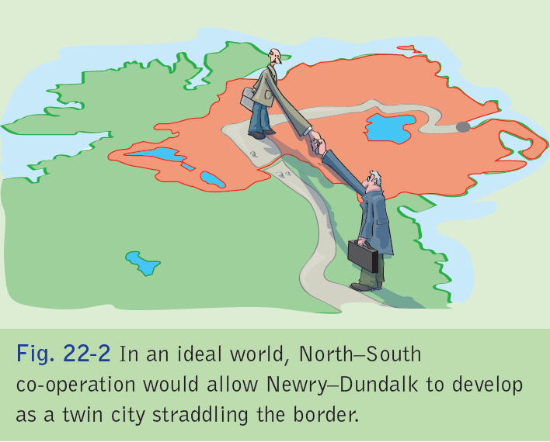

Slide 11
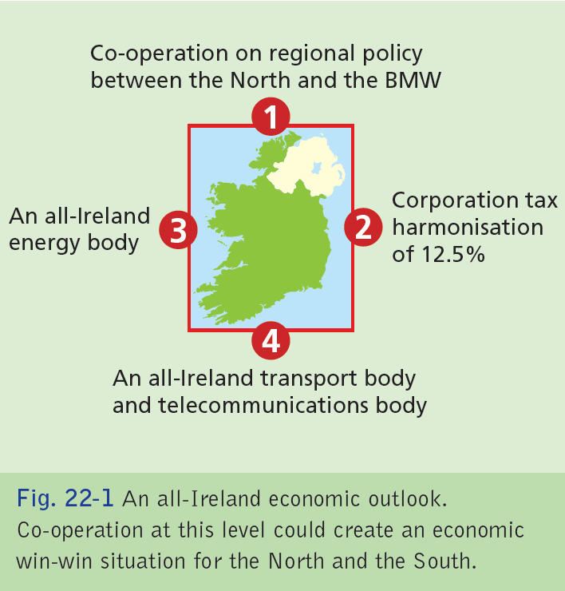

Slide 12
2 Changing Boundaries of a language region.
2‘THE BOUNDARIES OF REGIONS DEFINED BY CULTURE CHANGE OVER TIME’
DISCUSS THIS STATEMENT WITH REFERENCE TO A CULTURAL REGION YOU HAVE STUDIED. 30 MKS.

Slide 13
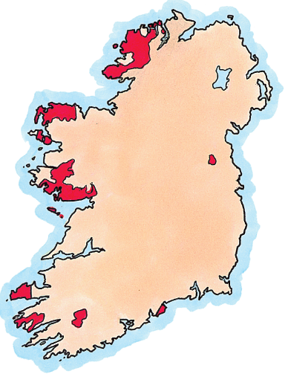
Fig. 1 Modern Gaeltacht areas in Ireland

Slide 14
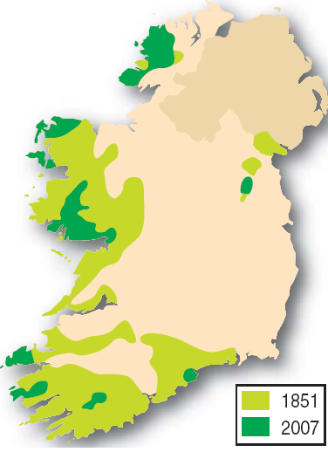
Fig. 2 Changes in Gaeltacht areas between 1851 (after the Great Famine) and 2007

Slide 15
Fig. 13 Gaeltacht areas of Ireland in the 21st century

Slide 16
Gaeltacht
Language is a powerful cultural force since people who speak the same language often have a strong sense of cultural affinity with each other.
The Gaeltacht areas where Irish is still widely spoken are mainly in the west of Ireland. They have been shrinking in size for over 200 years.
Gaeltacht regions are areas in Ireland where over 80% of the population speak Irish as their first language.
In 1841 almost 2m people spoke Irish as their 1st language, 250,000 in 1926
Today some 61,000 residents of the Gaeltacht areas are Irish speakers.

Slide 17
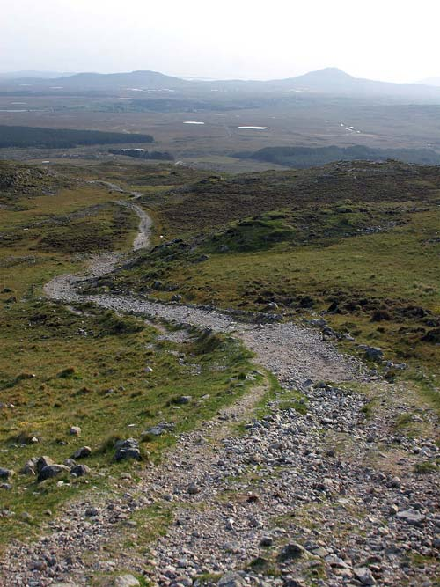
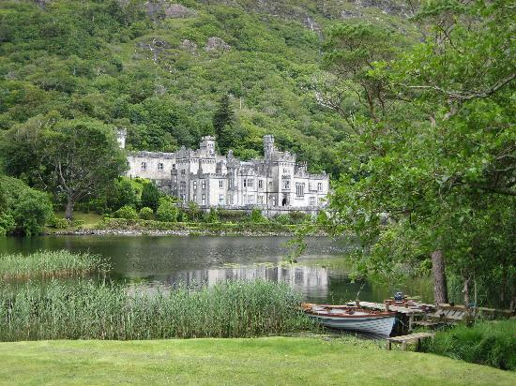

Slide 18
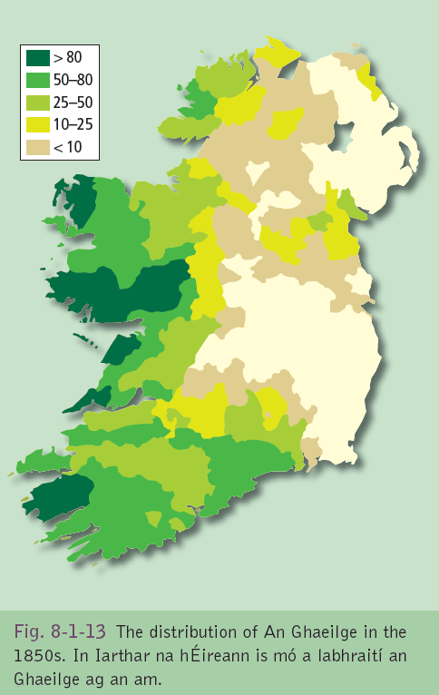

Slide 19
Gaeltacht
In 1851 counties/regions where more than 50% of people spoke Irish included Donegal, Mayo, Galway, Roscommon, Clare, Limerick, Kerry, Cork and Waterford.
Today these areas have shrunk backwards and occupy small diverse regions along the western seaboard.
Gaeltacht areas today are now separated from each other by great swathes of English-speaking communities.

Slide 20
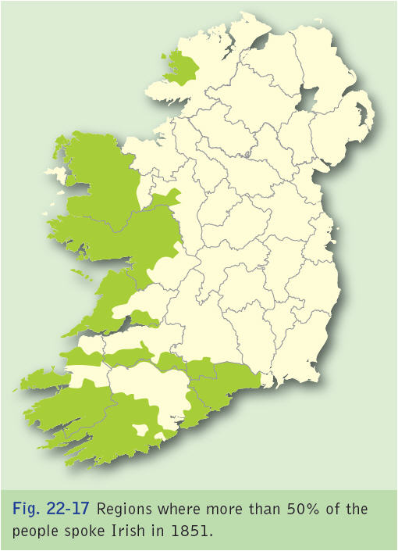

Slide 21
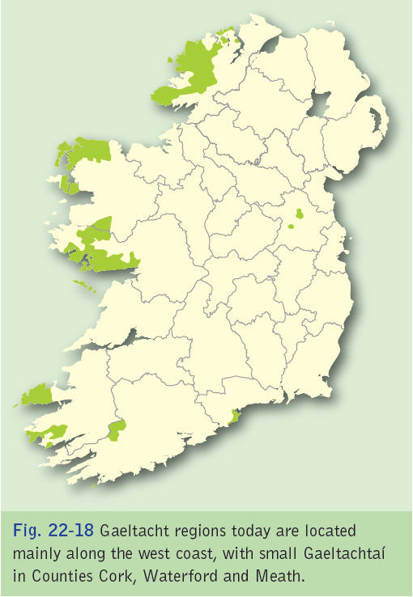

Slide 22
Gaeltacht- reasons for decline
Gaeltacht areas were badly hit by starvation and death during the Great Famine 1845-1847.
Thereafter, emigration was particularly high from these regions because they possessed few natural resources and the standard of living was very low.
Growing influence of Anglo-American culture
Right up to the present, poor infrastructure and low investment have encouraged people to continue to emigrate/migrate from these peripheral economic regions.

Slide 23
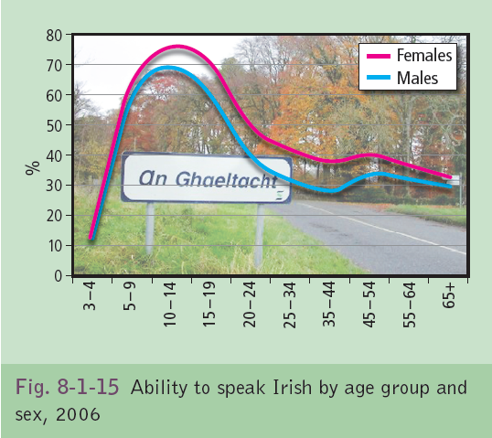

Slide 24
Gaeltacht
The influence of English-language TV,pop music and other media are also factors that chip away at the cultural base.
Today Irish speakers constitute 76% of the total population of G areas.
In the 1996 census, 19,000 G. residents said they were non-Irish speakers.
It also showed that only 51% of 3-4 year-olds living in the G. use Irish as their first language.
The Connemara G. is under increasing pressure due to the expansion of Galway City and the subsequent influx of non-Irish speakers into the Gaeltacht Area.
The Irish Govt. wants to conserve the G. and ensure that the boundary does not shrink further.
It gives financial support to Irish language radio &TV stations eg TG4.
Udaras na Gaeltachta helps develop the economy in these regions and the NDP (2007-2013) has allocated 457 m euro to G areas.

Slide 25
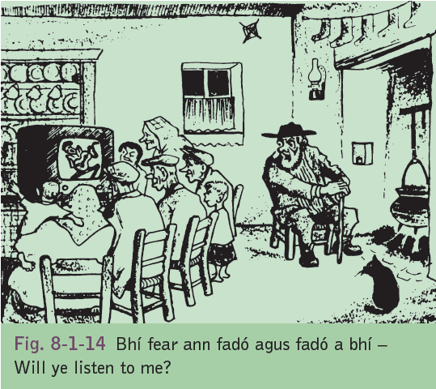

Slide 26
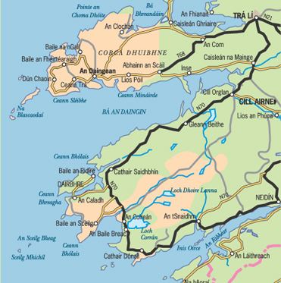
KERRY GAELTACHTS
County Kerry has a population of 139,835 people. Kerry saw a population growth of 5.5 per cent in the period 2002-2006.
The Kerry Gaeltacht consists of two distinct areas – Corca Dhuibhne and Uíbh Ráthach. The largest settlement in Corca Dhuibhne is An Daingean and Baile an Sceilg in Uíbh Ráthach
The Kerry Gaeltacht has a population of 8,695 and represents 9 per cent of total Gaeltacht population
The Kerry Gaeltacht encompasses a geographical area of 642km2. This represents 9% of total Gaeltacht area
In 2006 there were 864 people employed in a full time capacity in Údarás na Gaeltachta client companies in the Kerry Gaeltacht.

Slide 27
Changing Boundary of Urban Area- Dublin

Slide 28
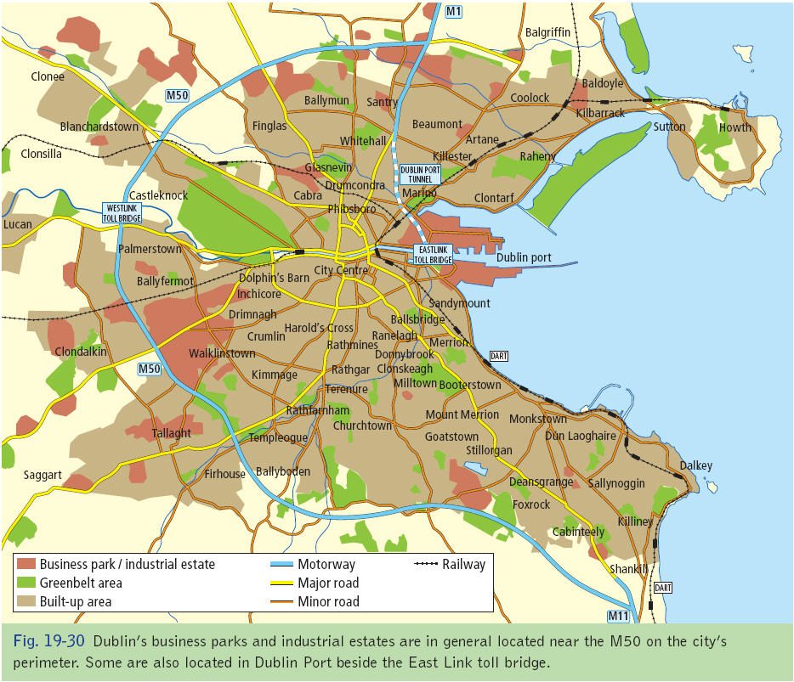

Slide 29
3. Changing Boundaries of an Urban Region
Medieval Dublin- Viking trading town on the liffey 12th C captured by Normans and walled.
Georgian Dublin-GPO, Custom House, Four courts, canals were build as Dublin expanded beyond its walls.
19th C- New suburbs built in rural areas outside the canals

Slide 30
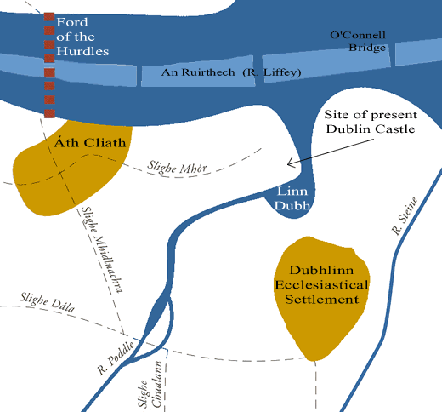
Vikings 1200AD
The Vikings settled in at Dublinn (the black pool).
As can be seen from the map this site was ideal for the Vikings as they were traders and travelled mostly by sea.
What has happened to the liffey since Viking times?
How come the R Poddle and R Steine dont appear on any of the dublin maps today?

Slide 31
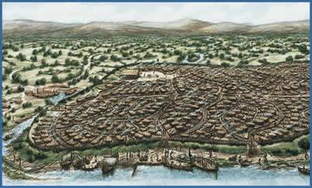
Dublin as it would have appeared in Viking times

Slide 32
3. Changing Boundaries of an Urban Region
The Boundaries of Dublin City have expanded since the 1950s up to today, this is due to rural- to- urban migration which has caused urban sprawl. The growth of the city is such that the zone if influence covers most of the eastern region.
Dublin is the capital and centre of government and offers thousands of civil service jobs, as well as offers educational and health care services, and attractive to workers.

Slide 33
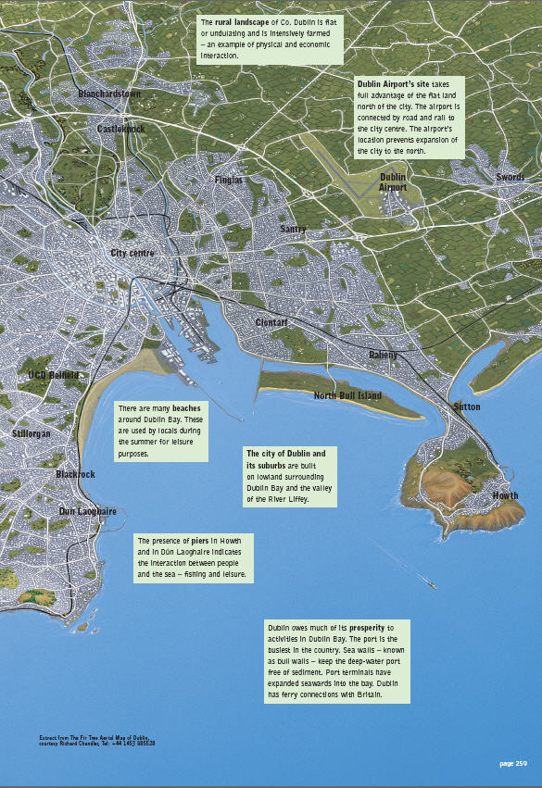

Slide 34
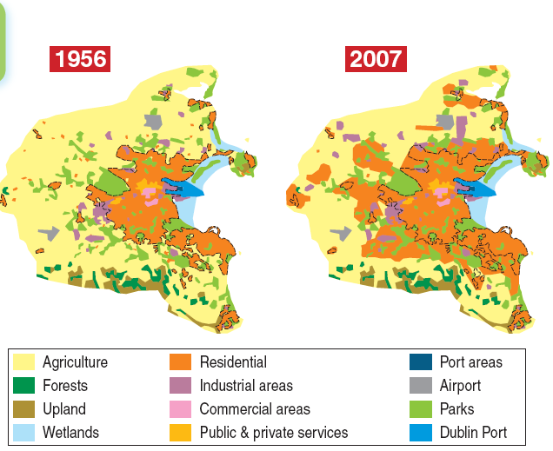
Fig. 8 The growth of Dublin city, 1956–2007

Slide 35
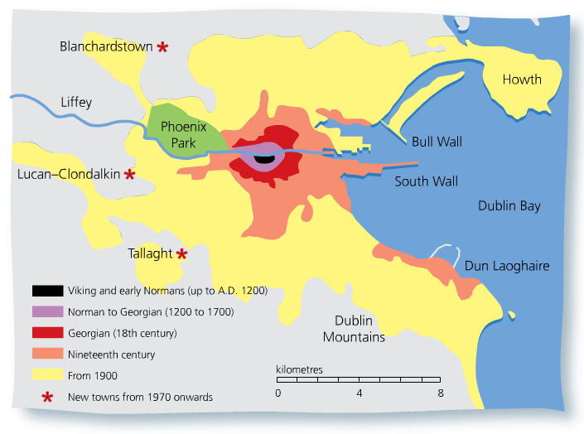

Slide 37
3. Changing Boundaries of an Urban Region
It is also attractive for industry. Its communications such as road, rail, port and air links are ideal for industries such as food processing and financial services.
In 1971 it had over 35% of the population, today with a population of over 1 million it now contains 46%.
This growth is due to migration from the west.

Slide 38
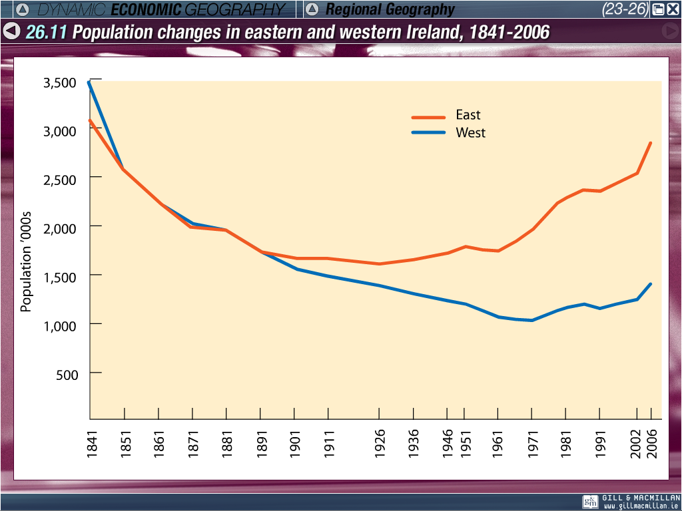

Slide 39
3. Changing Boundaries of an Urban Region
To accommodate this rising population, 3 new towns were built Tallaght, Blanchardstown and Lucan, which encouraged the spread of the city westward.
During the 90’s the demand for housing was so high that towns spread beyond Maynooth and Lexlip in Kildare.
Increased wealth and car ownership have led to traffic congestion, with people who cannot afford housing close to the city living in surrounding counties like Meath and Kildare

Slide 40
Fig. 12 Map of M50, national roads and rail lines leading into Dublin city

Slide 41
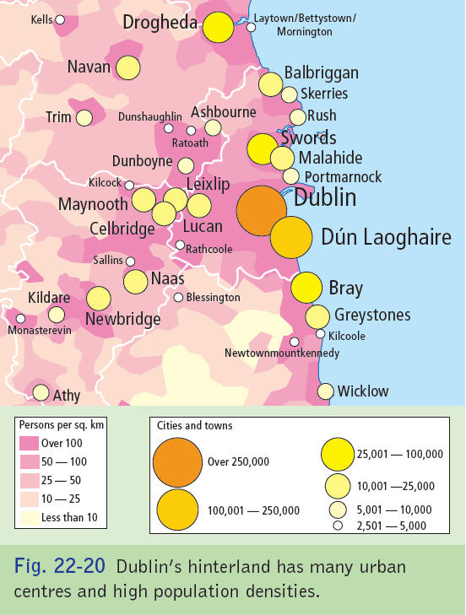

Slide 42
3. Changing Boundaries of an Urban Region
People live as far away as Mullingar and Carlow, 90 km from the city.
While in the past Dublin’s borders were close to Howth, the Phoenix Park and Dun Laoghaire it is now closer to swords, Celbridge and Bray.
With this expanse three new county councils were created to enable efficient provisions of waste, water, sewage and other services.

Slide 43
Fig. 10 The Dublin area commuter zone in the 1980s and 2000s

Slide 44
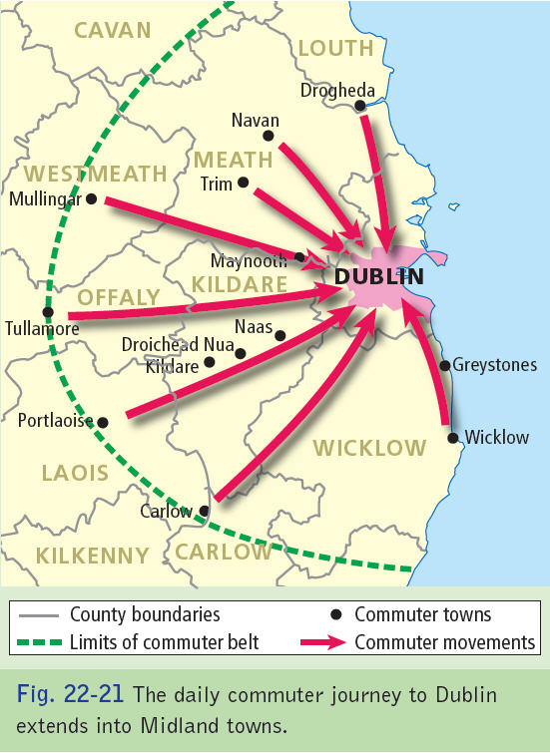

Slide 45
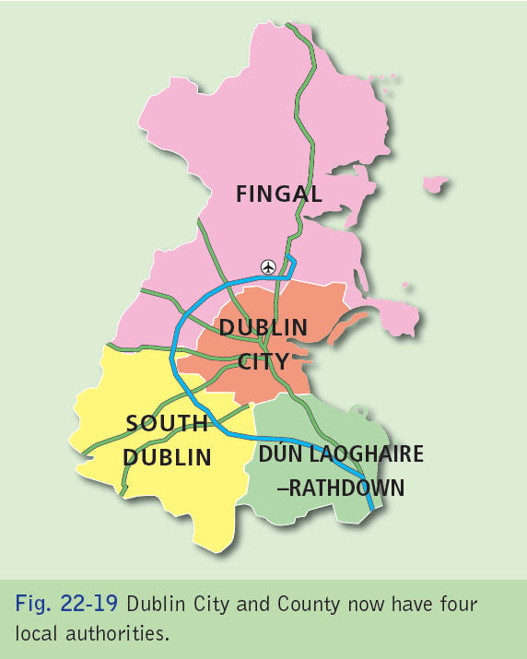

Slide 46
4. Changes in Borders and Their Impart on Cultural Groups
Kashmir- Look at India.

Slide 47
5. The European Union

Slide 48
The Foundations of the EU
The EU was the dream of two french men, Robert Schuman and Jean Monnet who wanted France and Germany to move beyond their past difficulties and work together.
They hoped to build a world region based on the three main pillars of society: Economic, Social and Politically.
It was hoped that European countries by joining together could rival the USSR and the USA which both dominated world trade at the time.

Slide 49
5. History of the EU
1951- Treaty of Paris- ECSC (European Coal and Steel Community) 1957-Belgium, France, West Germany, Italy, Luxenbourg and Holland were the original member states.
1957-Renamed EEC (European Economic Community) under the treaty of Rome. Common Agricultural Policy (CAP) was introduced as well as nuclear industry.
1965-EEC renamed European Community (EC)
1973- England, Ireland and Denmark.
1986-Spain and Portugal

Slide 50
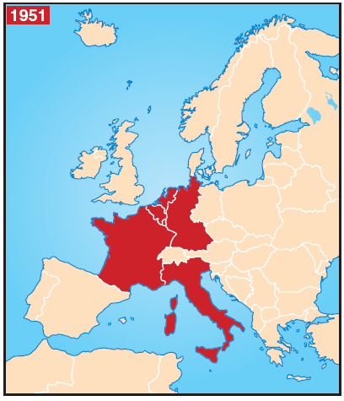
The six members of the European Coal and Steel Community, 1951

Slide 51
The 12 members of the
European Community in 1986

Slide 52
5. History of the EU
1995-Austria, Sweden, Finland
2002- European Common Currency came into operation.
2004- Malta, Cyprus, Slovenia, Estonia, Latvia, Lithuania, Poland, the Czech Republic, Slovak Republic, and Hungary.
2007- Romania and Bulgaria joined
2009- Lisbon treaty recognised a member states rights to withdraw from the EU.
2011- EU is largest, most properous trading bloc in the world?? Estonia joined.

Slide 53
The European Union- Development and Expansion. 6-27
Melting Pot or Salad Bowl???

Slide 54
The 15 members of the European Union in 1995

Slide 55
The 27 members of the European Union, including newest members Romania and Bulgaria

Slide 56
5. The European Union- Development and Expansion.
The states co-operate in three ways
Economy- A single Market- some with same currency.
Foreign Policy- members develop a shared opinion on global issues.
Social Policy- rights of environment, food safety and workers are protected.

Slide 57
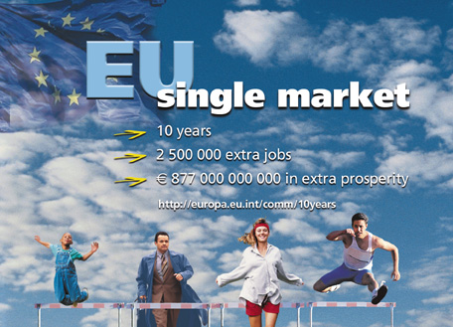

Slide 58
5. The European Union- Development and Expansion.
Decisions for the EU are made by:
1. The European council-make policies twice yearly
2. The European parliament- 732 members with limitied powers

Slide 59
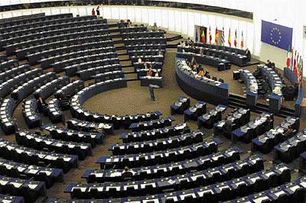
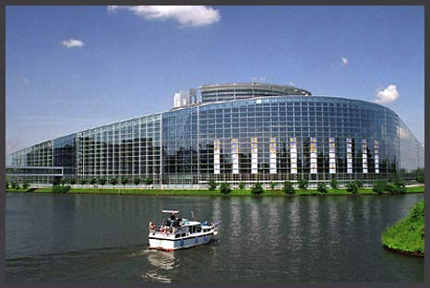

Slide 60
5. The European Union- Development and Expansion.
EU Policies 1. The common Agriculture Policy (CAP)
The EU bought all the farmers could see in the open market at guaranteed prices. “Food mountains” forced the EU to reform to “quotas” and paying farmers for land set aside.
The Rural Environment Protection Scheme (REPS) pays grants for tidy farmers and protected wildlife habitats.
Farmers get one payment each year in place of subsidies in the past. Protection against free trade is being reduced.

Slide 61
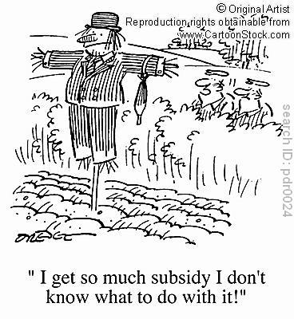

Slide 62
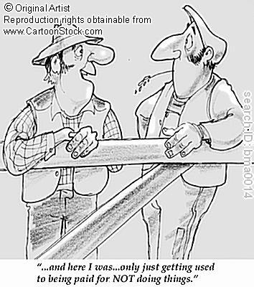

Slide 63
5. The European Union- Development and Expansion.
3.The Common Fisheries Policy (CFP)
Created a free market while preventing over-fishing and depletion of stocks.
1. Fishing is prohibited in some areas and each country has a quota.
2. Compensation is paid to skippers who agree to scrap their boats.
3. Restrictions are placed on fishing boats can only fish the Atlantic grounds nine days per month

Slide 64
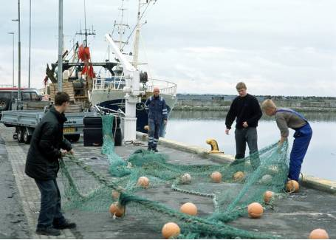

Slide 65
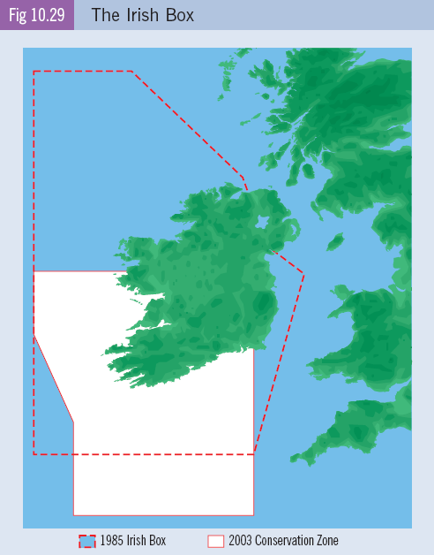

Slide 66
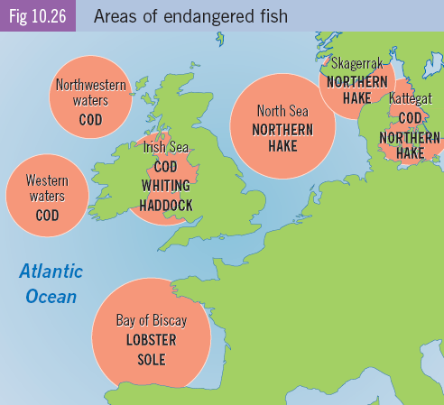

Slide 67
5. The European Union- Development and Expansion.
Regional Policy
The European union helps to pay for education and training to promote the development of problem regions. Regions are classified as either peripheral regions or regions of industrial decline.
Structural funds are given to pay for improvement in infrastructure.
(Discuss Irish Transport/ Energy infrastructure)

Slide 68
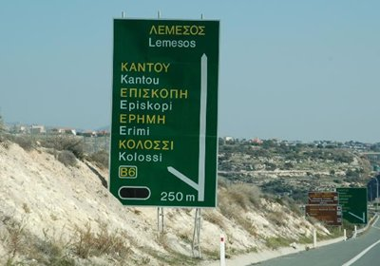

Slide 69


Slide 70
5. The European Union- Development and Expansion.
EU Enlargement
The enlargement of the EU increases the strain on the EU budget and on its governing institutions- the parliament, the council and the commission. France and the Netherlands have rejected the new EU Constitution. The implications for Ireland is reduced EU funding and competition for foreign investment.

Slide 71
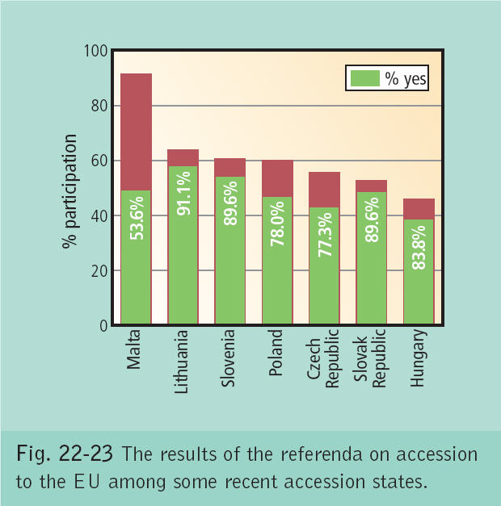

Slide 72
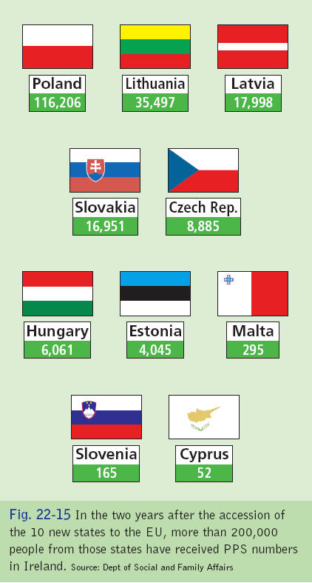

Slide 73
Effects of Expansion- Ireland
Provides a larger pool of labour for industry. Ireland needed 420,000 extra workers during the boom.
349,000 of these were foreign national workers
In 2005 Ireland had lowest unemployment rates 4.2%.
Unemployment in 2010 had increased to 14%.
Introduction of the Euro allows directs comparisons between European products/ Wages.
EU now has population over 500 million- exports have increased to this bigger duty free EU markets. (2010= 51.5 billion)

Slide 74
Effects of Expansion- Ireland
Multicultural Society-
Contributed taxes to state
Provided skills that were lacking in Ireland
Provided jobs in manual labour market.
Supported Irish economy & increased domestic demand.
New businesses created.
New cuisine introduced
Remittance money being sent home.
Migrants exploited in their work
Racism & bullying
Schools introduced policies to integrate different nationalities- (English/ Leaving Cert)

Slide 75
Effects of Expansion- Ireland
Irish workers taking advantage of EU policies by moving to European countries to find employment (Uk, Germany, Poland)
Negative impact on economy due to our connection with Greece and Portugal.
Manufacturing goods in new EU states are cheaper so competition is greater- Outsourcing of Dell in 2009 where it moved from its manufacturing site in Limerick to Lodz in Poland

Slide 76
5. The European Union- Development and Expansion.
1. EU Enlargement
CAP- The new member states depend more on agriculture. They need a greater share of the CAP. The EU has not increased its funding to meet this demand.
Structural, Regional and Social Funding: The new states need EU structural, Regional, and Social Funds. Ireland’s share feel from 978million in 03 to 44.5 million in 2007.
Competition for foreign investment: Ireland must compete with an economies where average are much lower.

Slide 77
5. The European Union- Development and Expansion.
1. EU Enlargement
EU Budget- Due to enlargement and economic growth, Ireland will receive less money under the CAP, Structural, Regional and Social Funds. In 2002, Ireland received about 1.5 billion more than it paid to the EU. After 2007, Ireland as one of the richer member states, will pay in more than it gets back.
Migration. Only Ireland sweden and the Uk allow free movement to workers and from the new EU member states. It was argued the immigration is necessary to meet the demand for labour so the Irish economy could continue to grow.

Slide 78
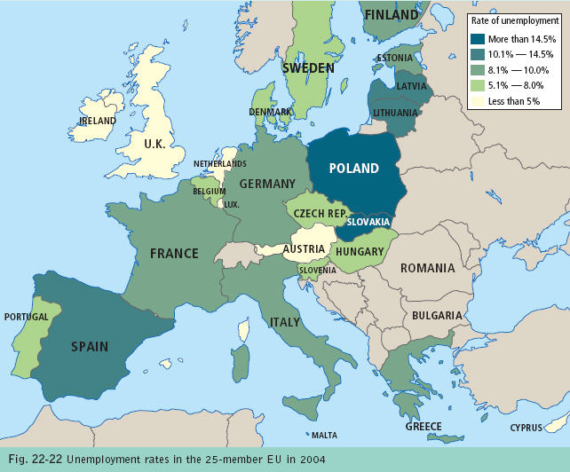

Slide 79
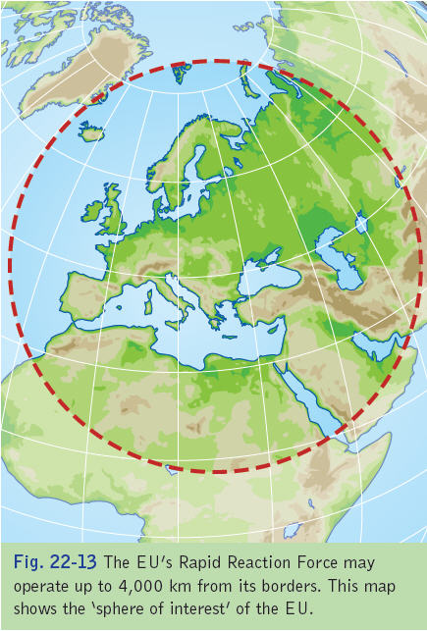

Slide 80
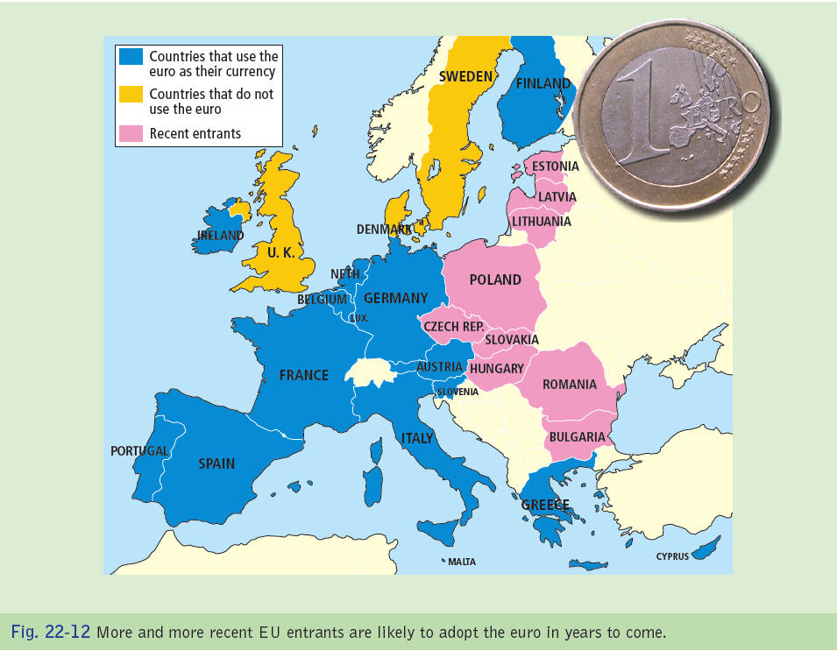

Slide 81
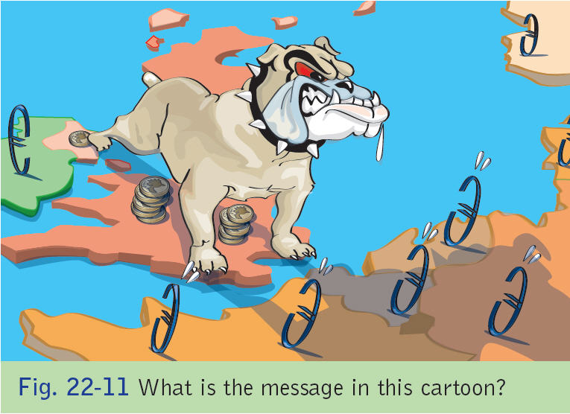

Slide 82
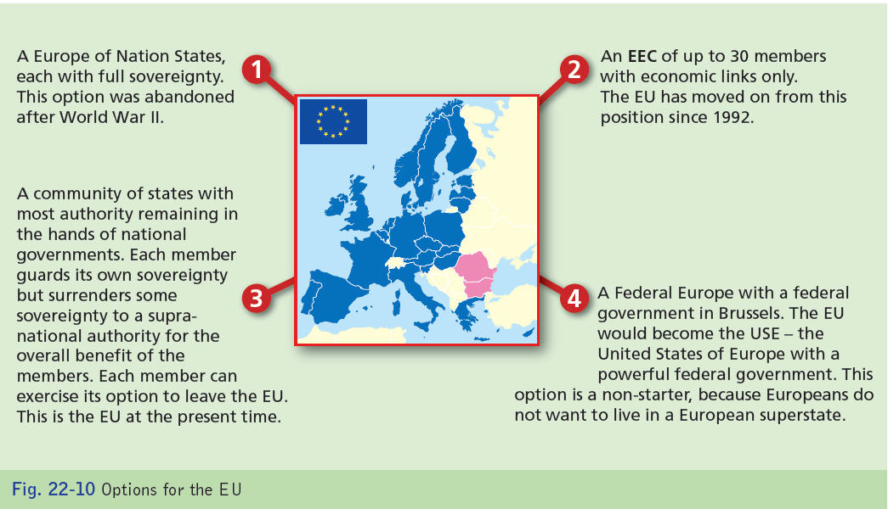

Slide 83
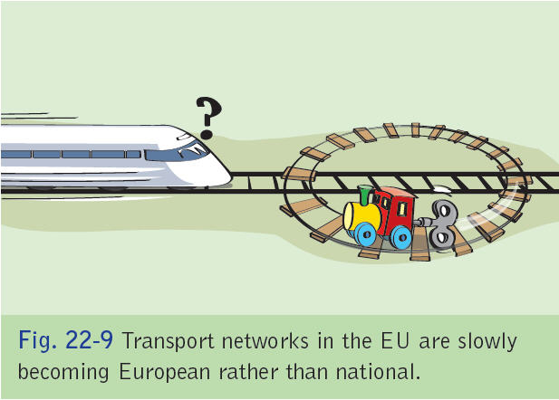

Slide 84
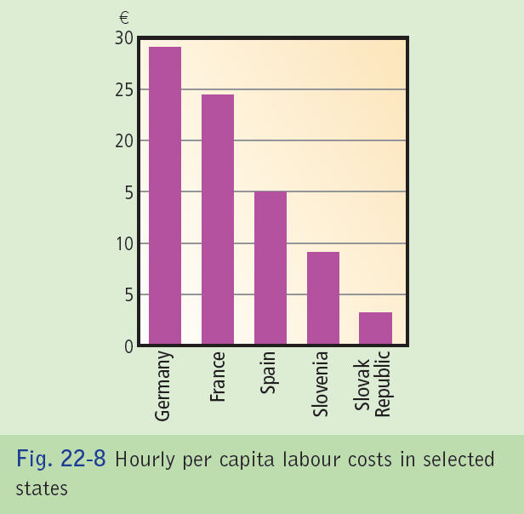

Slide 85
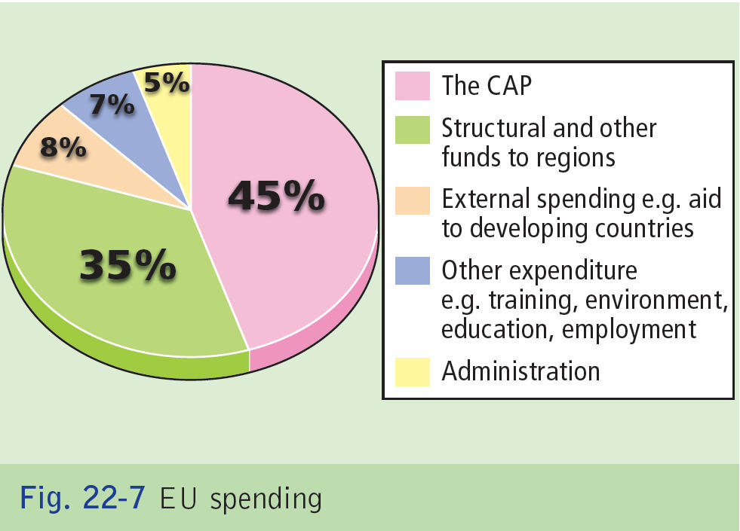

Slide 86
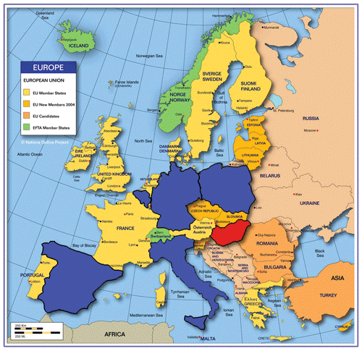

Slide 87
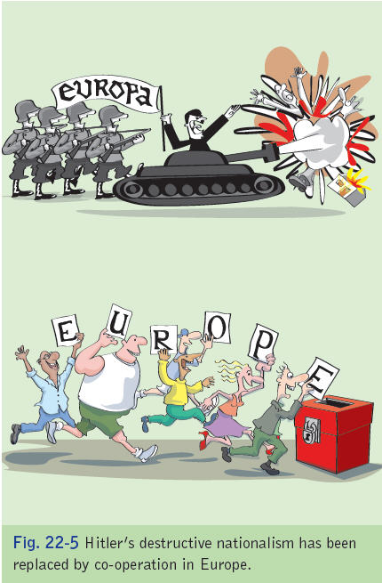

Slide 88
