Slide 1
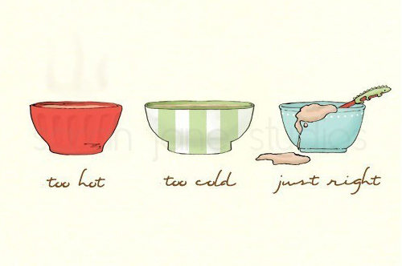
Temperate Climates
Mr Boland

Slide 2
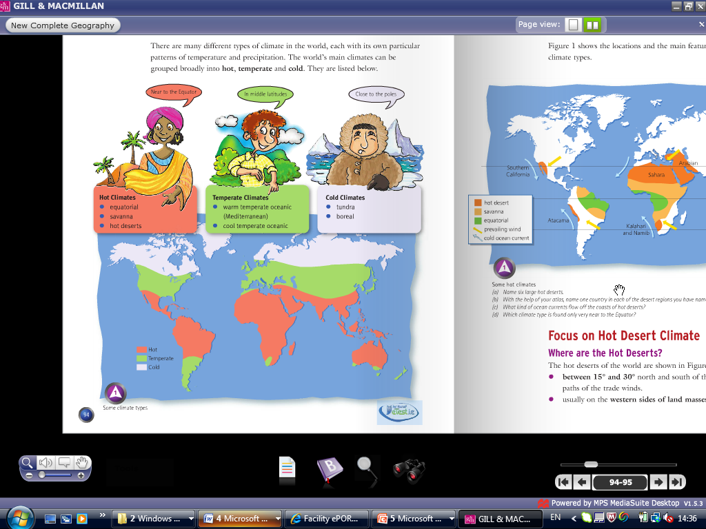

Slide 3
Temperate climates include cool temperate oceanic and warm temperate oceanic which is sometimes referred to as a Mediterranean Climate.
Which of these climates do you think Ireland is???

Slide 4
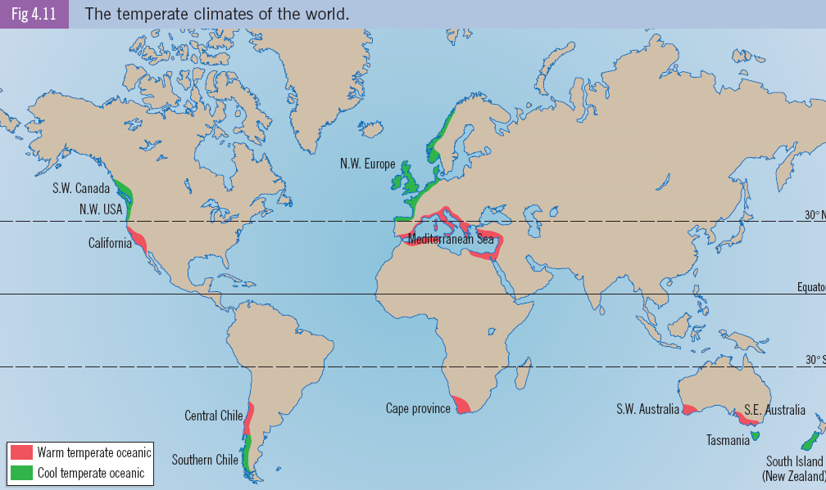

Slide 5
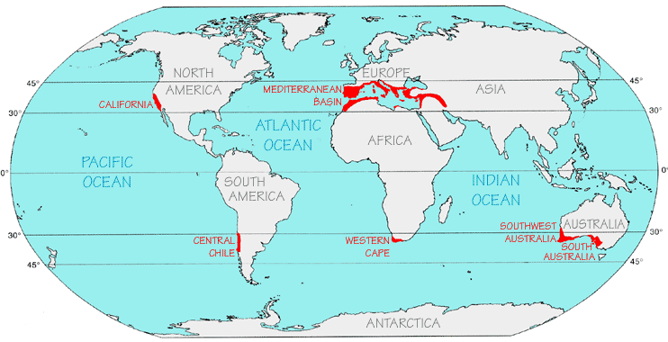
Where is the Mediterranean climates located??

Slide 6
Location
This climate is found between 30° and 40° north and south of the Equator.
It’s generally found on the western sides of landmasses (continents).

Slide 7
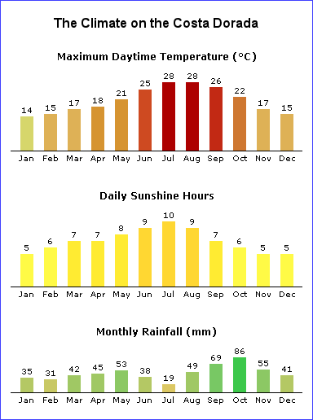
Describe the winter and summer weather (Temp/Rain/ Hours of sun) Look carefully at the temperature and rainfall. What is the mean temperature for the year. What is the temperature range

Slide 9
Which is the hottest month and what is it’s mean temp???
What month has the lowest precipitation???
How much rainfall has the three hottest months????

Slide 10
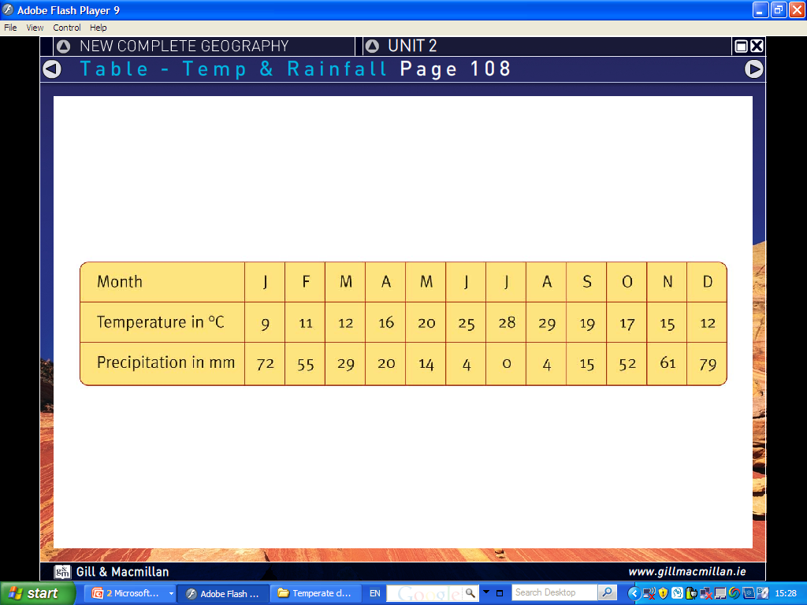
What is the annual temperature range?
What is the mean temperature for the year?
What is the average amount of precipitation that falls

Slide 11
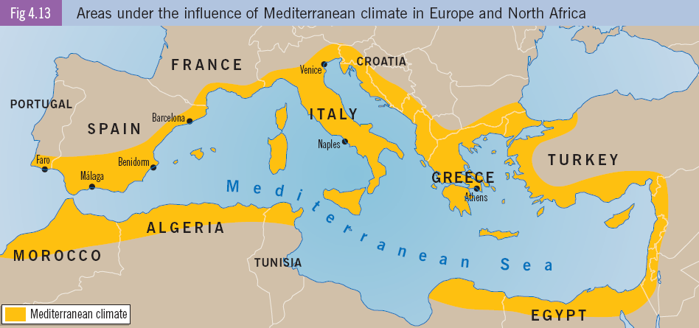
Can you name three countries and three cities that have a Mediterranean climate??????

Slide 12
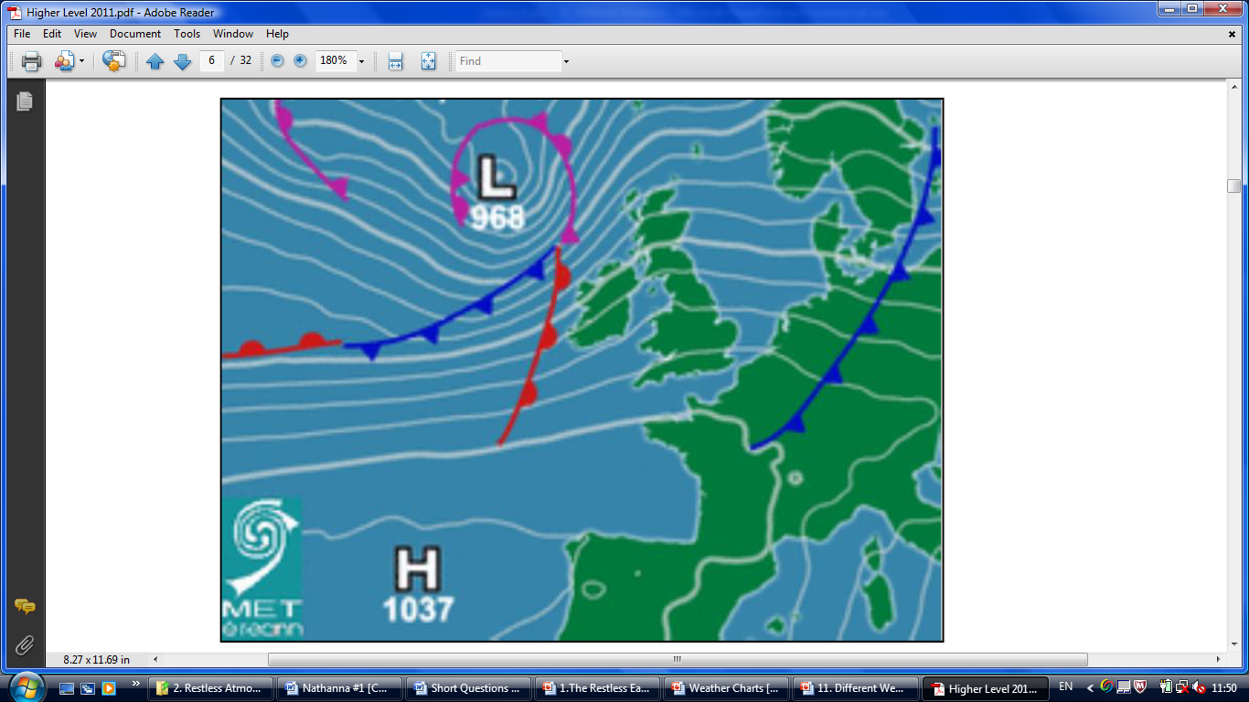
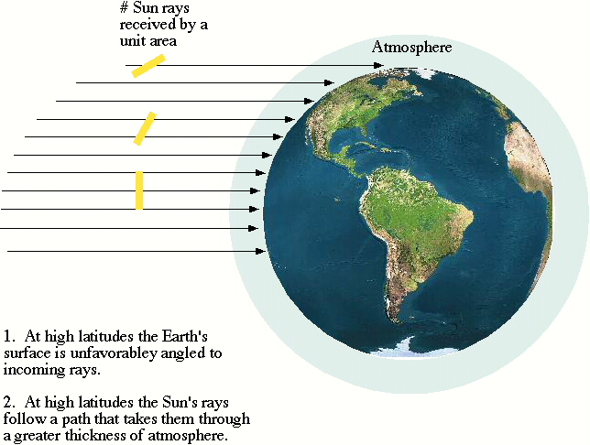
Why are summers hot and dry

Slide 13
Summer
Winter
Temperature are high 30 degrees+
Precipitation levels are very low
Temperatures are mild 10 degrees.
Winters are moist with between 400-700mm.

Slide 14
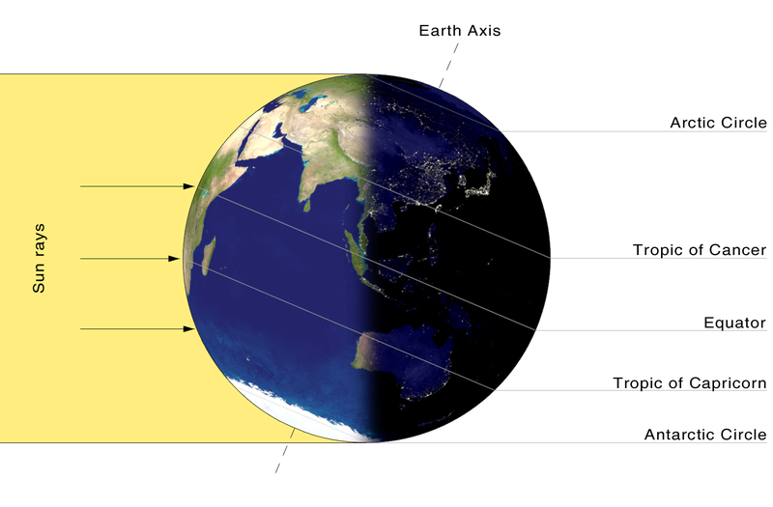
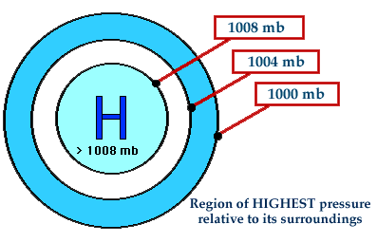
Why are summers are hot and dry

Slide 15
Hot and dry summers
Latitude between 20-40 degrees resulting in high levels of sunshine.
Northern Hemisphere is tilted towards the sun
High pressure creates cloudless sky which bring hot dry weather.
Trade winds blow over dry land.

Slide 16
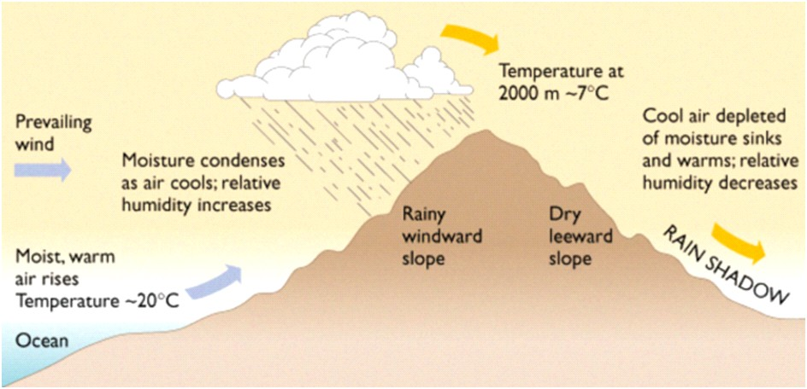
Mild and wet Winters
-sun is at a greater angle but there is enough energy to make winters warm.
-SW winds blow from the Atlantic over mountainous areas causing relief rain and bringing low pressure.

Slide 17
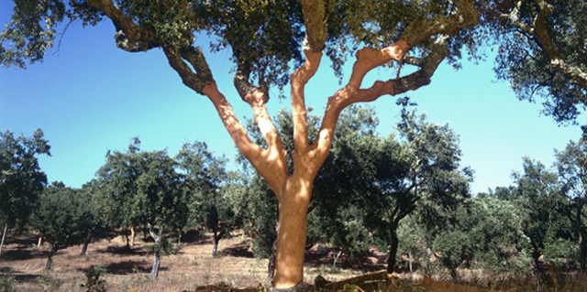
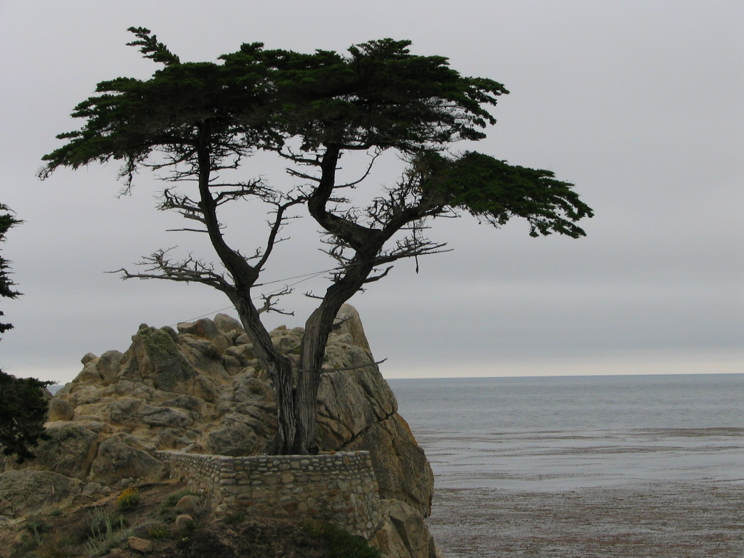
How do you think that plants (cork and olives) in this Mediterranean climate adapt to live in these conditions???????

Slide 18
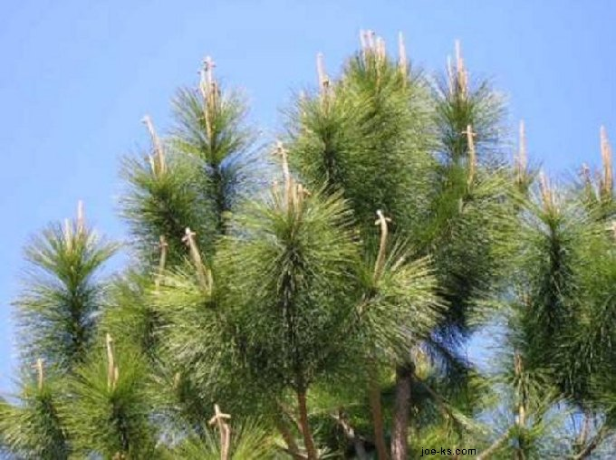
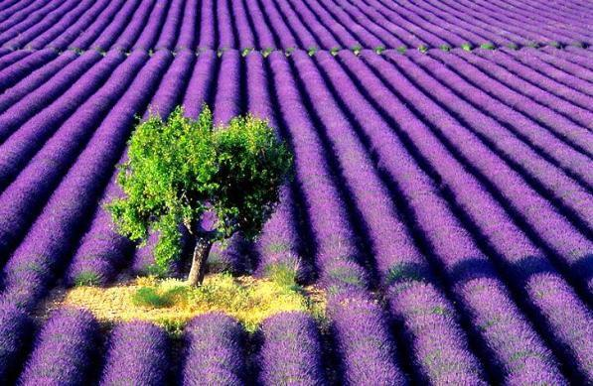
Mediterranean Vegetation
To stop the trees losing water:
Waxy leaves
Thick bark
Sharp thorns.
To avoid drought & get water trees have
tap roots
short life cycles
Plants are also spaced wide apart.

Slide 19
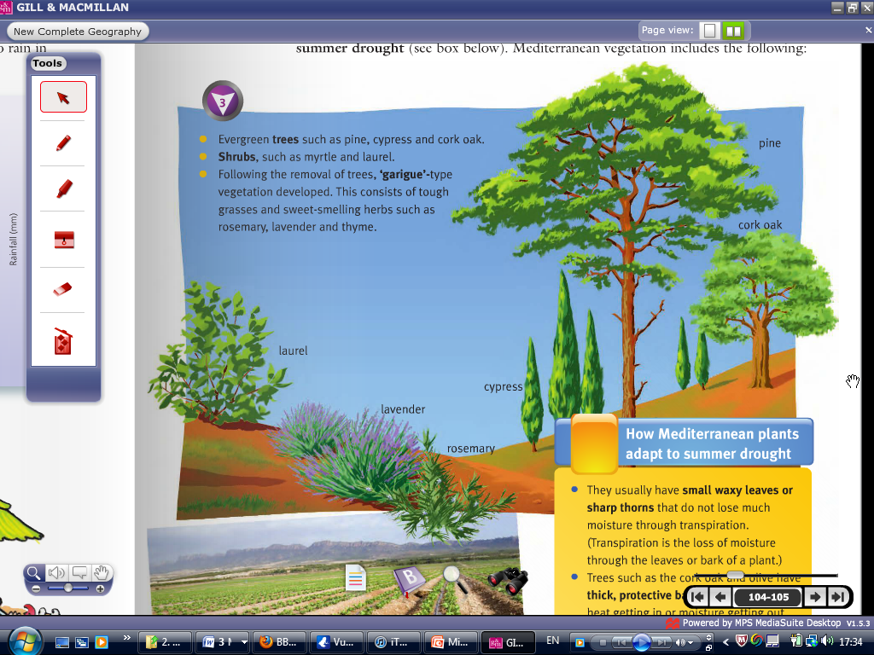

Slide 20
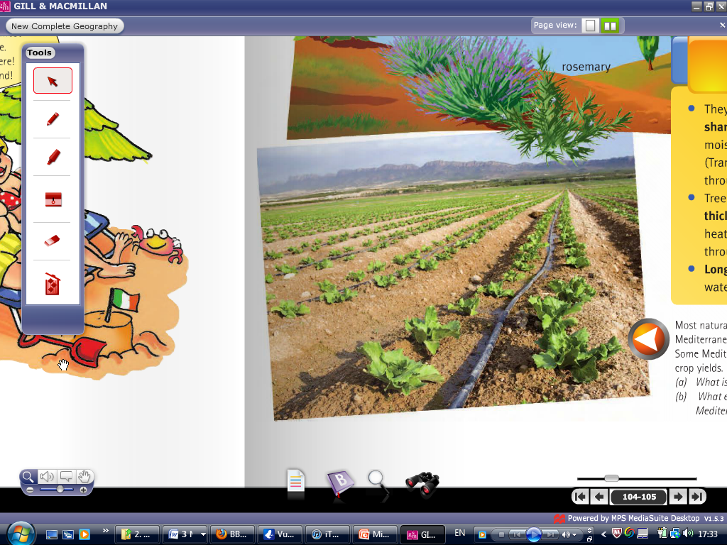
Irrigation Schemes used for farming

Slide 21
EXAM QUESTIONS

Slide 22
