Slide 1
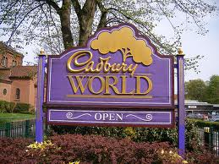
Secondary Activities as Systems
Mr Boland
Geography

Slide 2
System
Secondary activities refer to manufacturing industries (making things)
Here natural resources or raw materials are used and processed (changed).
Each manufacturing industry can be seen as a system
What is a system??

Slide 3
System
Secondary activities refer to manufacturing industries (making things)
Here natural resources or raw materials are used and processed (changed) into a product
Each manufacturing industry can be seen as a system
A system consists of inputs, processes and outputs

Slide 4
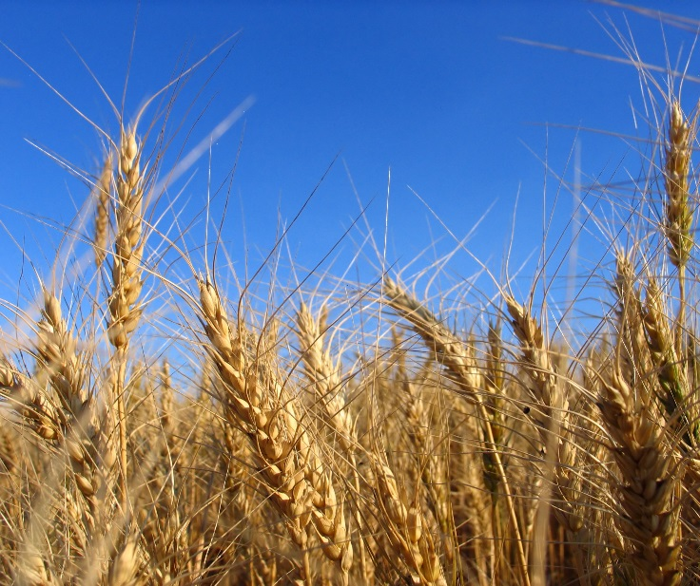
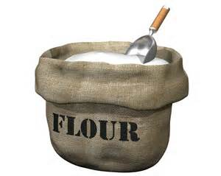
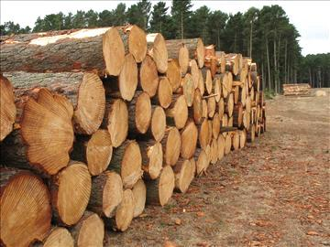
What is the missing link???
??????
??????

Slide 5
1. Pick an object in the class and describe the raw material that were needed to make this?????
2. Are there inputs other than the material used????
3. What happens in the manufacturing process? (how are they made in the factory)
4. Besides for the object are there any other outputs

Slide 6
Cadburys Chocolate; an example of a system.
All manufacturing industries can be considered as a system because they contain inputs, process and outputs. The case study that we are looking at is Cadburys chocolate.

Slide 7
Cadburys system.
Inputs- Cocoa beans, chocolate, milk, electricity, labour, machinery, paper.
Process- Sorting, Cleaning, Roasting, Kibbled (broken), winnowed( removed from shell) Mixing, Drying, Packing.
Outputs- Chocolate, waste, money

Slide 8
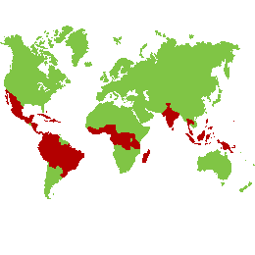
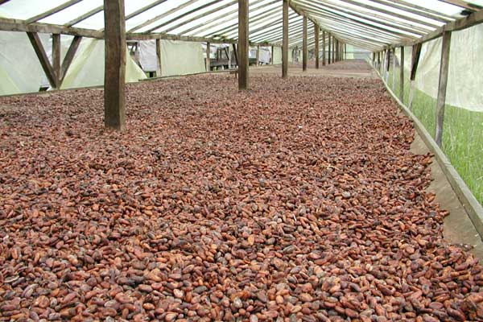
Step 1- cocoa beans are delivered to a factory in Coolock from Brazil, Ghana and Cameroon.

Slide 9
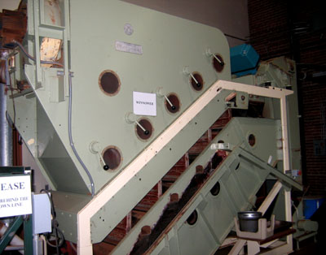
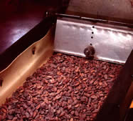
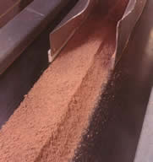
Step 2- Beans are cleaned, roasted, kibbled (broken up) and winnowed (removed from there shell. This makes cocoa mass.

Slide 10
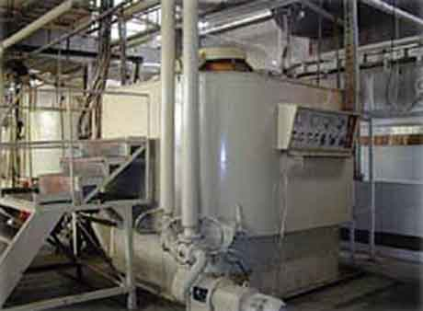
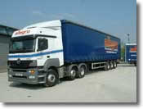
Step 3- This cocoa mass in transported to Rashmore, Kerry. Here it is mixed with fresh milk and cooked slowly. It is dried to form chocolate crumb and sent back to Dublin

Slide 11
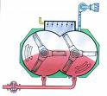
Step 4- This crumb is ground between enormous rollers and flavourings are added to the now chocolate paste.

Slide 12
Step 5- the paste is cooled, bars are shaped, wrapped and packed ready for the market.

Slide 13
Make a list of inputs, processes and outputs for the following

