Slide 1
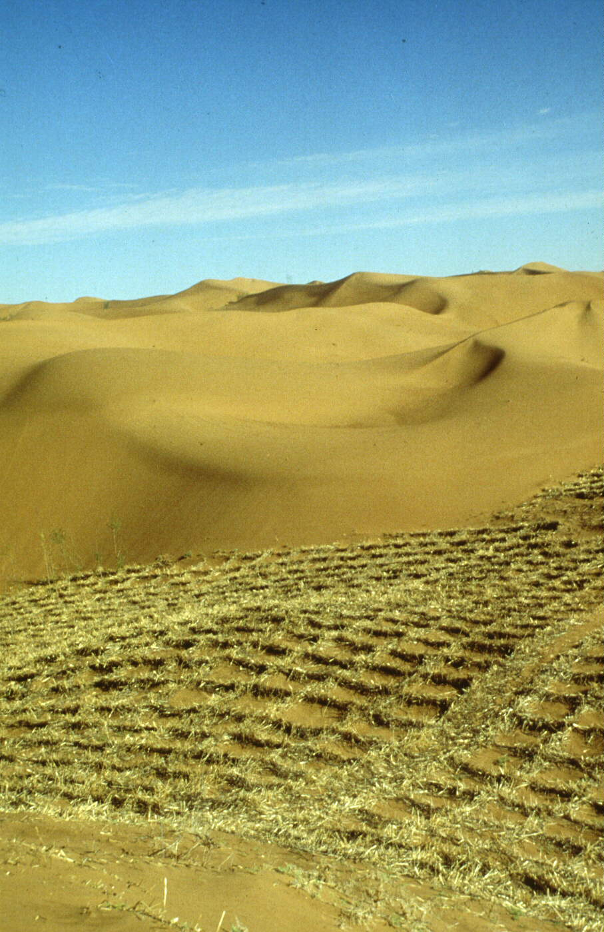
Desertification
Máistir Ó Míocháin
An Tíreolas

Slide 2
Desertification is the spreading of the desert around its edges.
The Sahel in Africa is a region that has been affected very badly.
http://www.youtube.com/watch?v=w9RxnuBiFbg

Slide 3
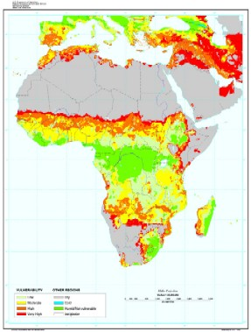
Sahel

Slide 5
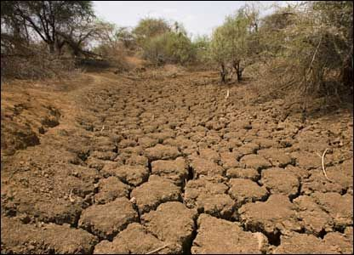
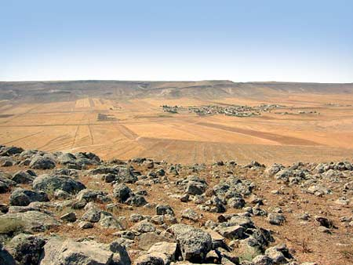
Desertification
The reasons for desertification are both natural and human.

Slide 6
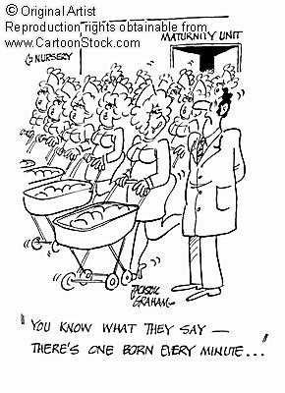
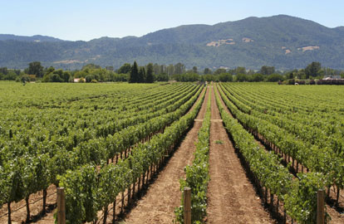
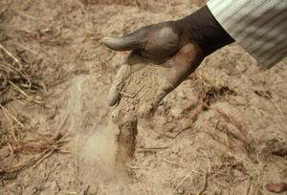
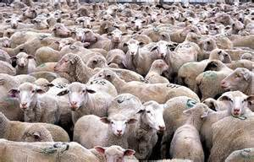
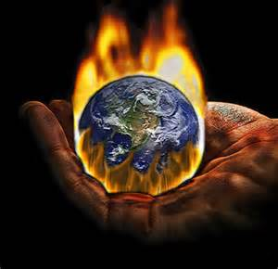
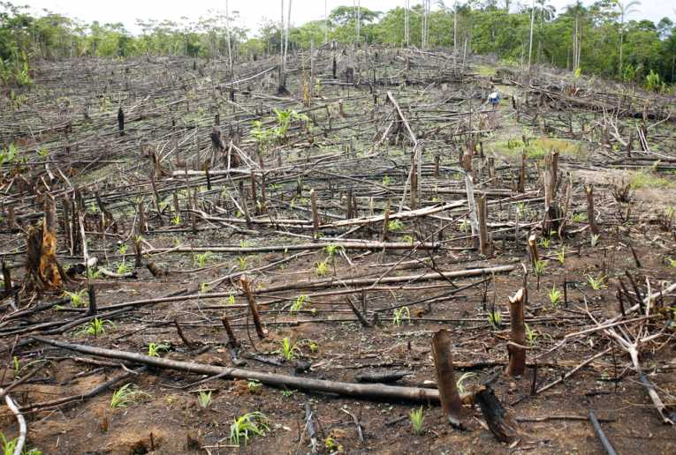

Slide 7
Causes of desertification
Rapid population growth means there are more people to feed and house.
More trees being cut for fuel, houses and farms so the roots do not hold the soil.
Land being over-cultivated (too much crops) makes the soil infertile.

Slide 8
Causes of desertification
Land is also being over-grazed ( animals stripping the land bare).
Global warming causing less rain and higher temperatures has also been blamed.
Land becomes dry and worn out and blows away the barren top soil.

Slide 9
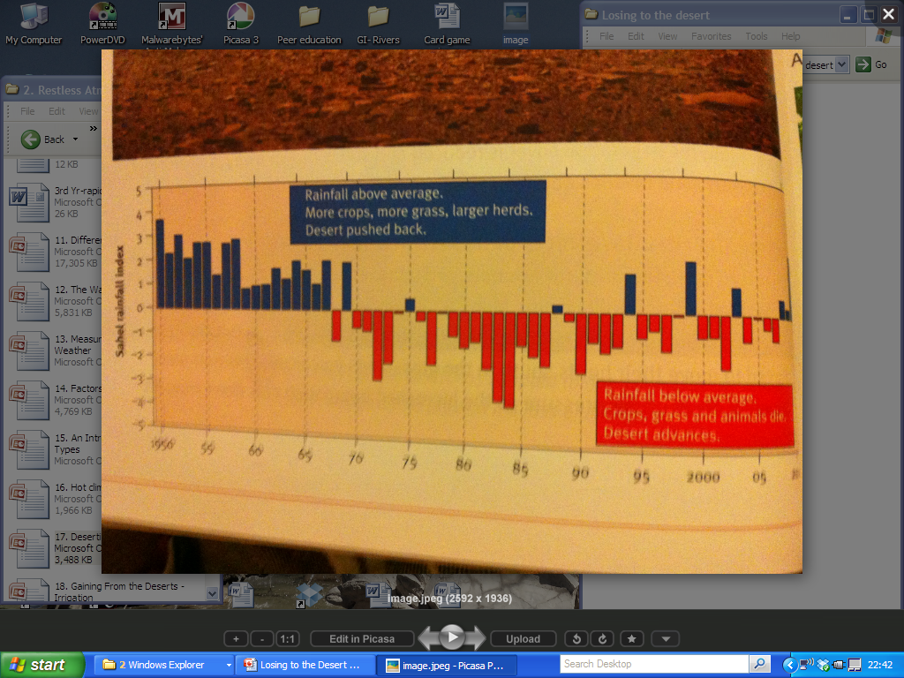

Slide 10
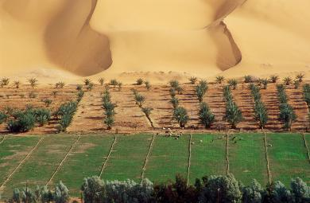
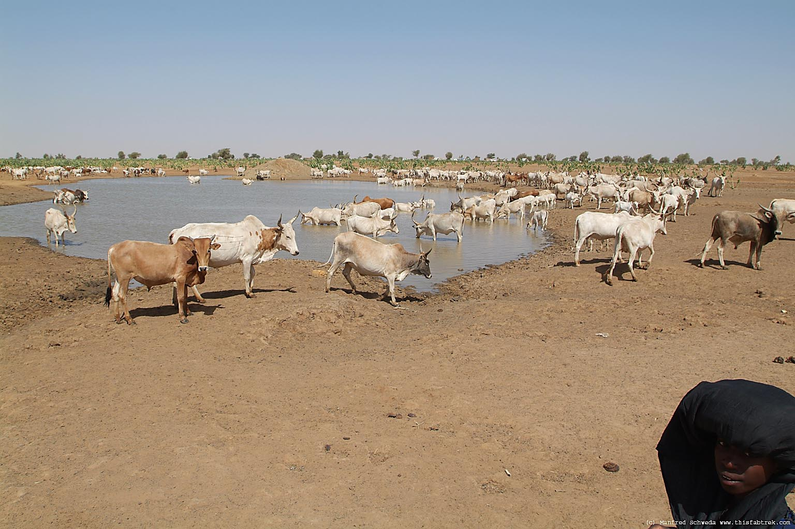
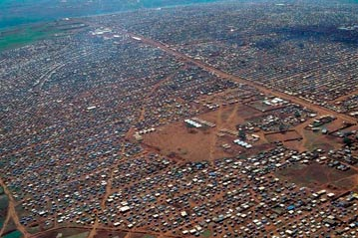
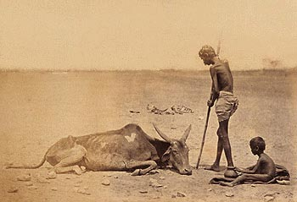
Results of Desertification????

Slide 11
Effects of Desertification
Severs droughts (long rainless periods) cause crops to fail and results in famines.
This has led to large numbers of people dying or living in refugee camps.
People have to migrate for food putting more pressure on the grasslands in the south causing more trees to be cut down.
People migrate to large cities creating slums

Slide 12
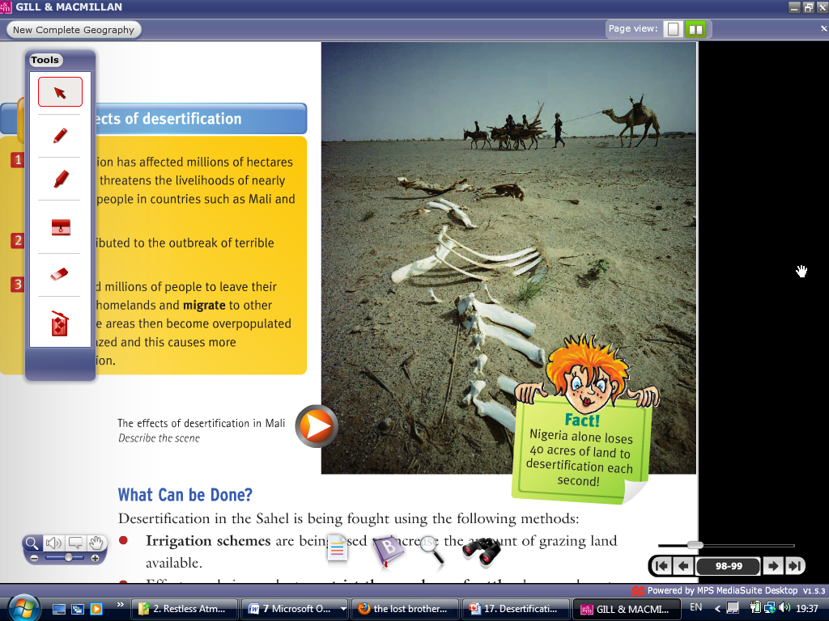
What does this movement result in?????

Slide 13
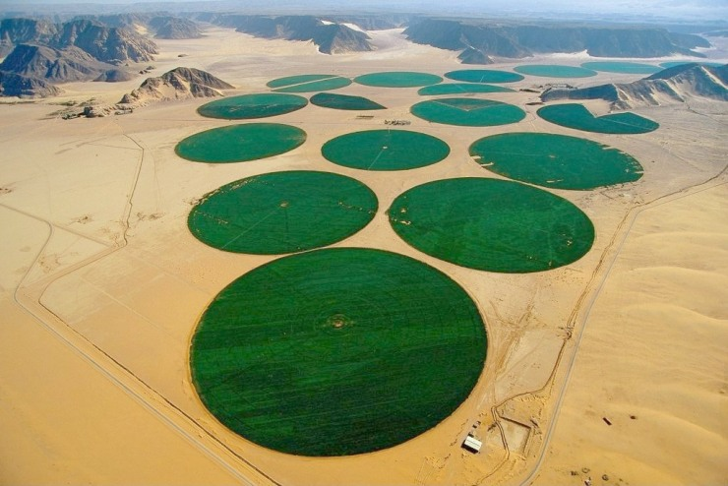
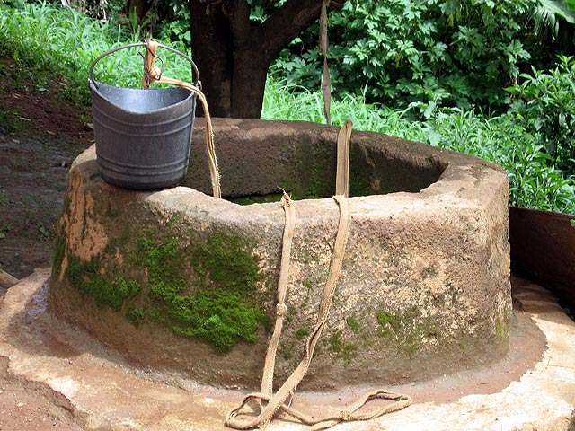
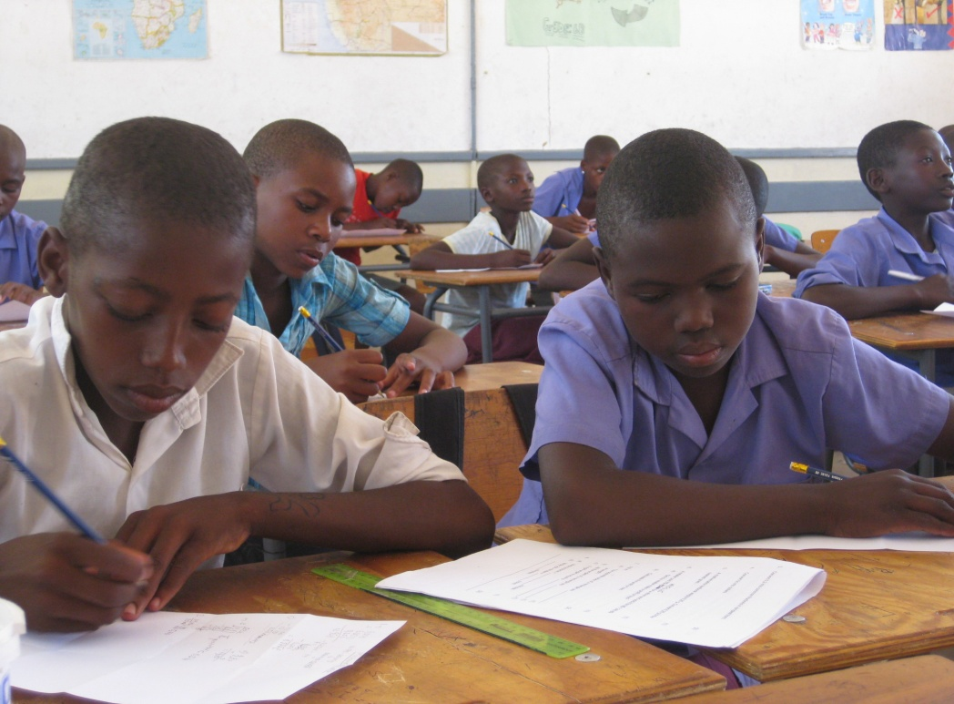
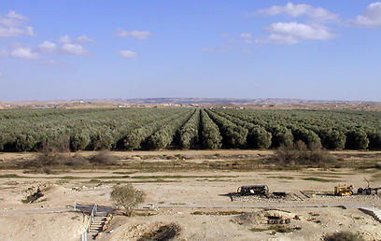
What are the solutions??

Slide 14
Solutions to Desertification
Plant grasses and trees to bind the sand together.
Restrict the number of livestock and introduce new breeds.
Create irrigation schemes to increase water supply and make more land for grazing. Dig Deeper wells.
Educate farmers and families in modern farming techniques

Slide 15
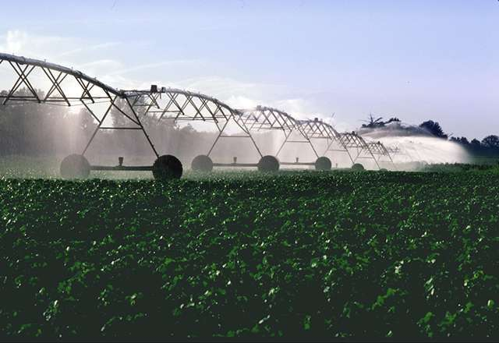
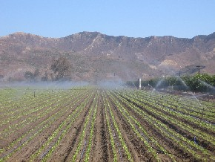

Slide 16
Exam Questions

Slide 17
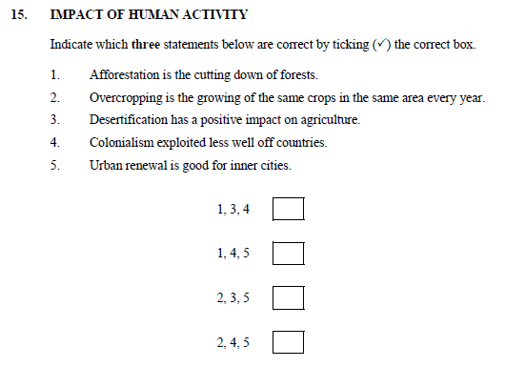

Slide 18
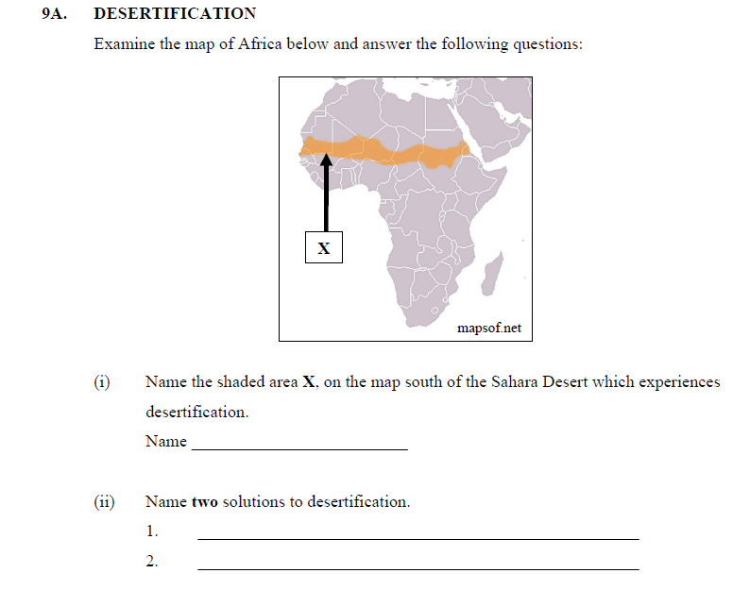

Slide 19
Using examples describe the causes and consequences of desertification. (10 Marks)

