Slide 1
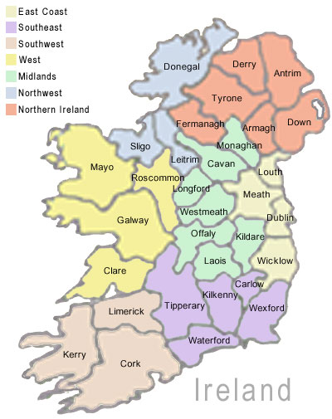
Regional Geography
Ireland
West v East
V

Slide 2
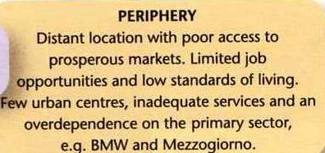

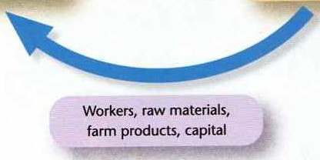



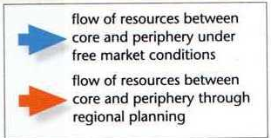
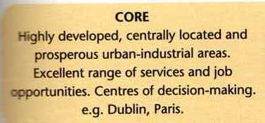
THE CORE-PERIPHERY MODEL

Slide 3
Core regions of Europe

Slide 4
Peripheral regions of Europe

Slide 5
Socio-Economic Regions
Peripheral v Core
The West (included in BMW – Border Midlands & West) is an example of a peripheral region due to Physical environment & distance from main Irish & European market centres.
Dublin is an example of a core region with favourable physical & human environments & a central location to markets.

Slide 6
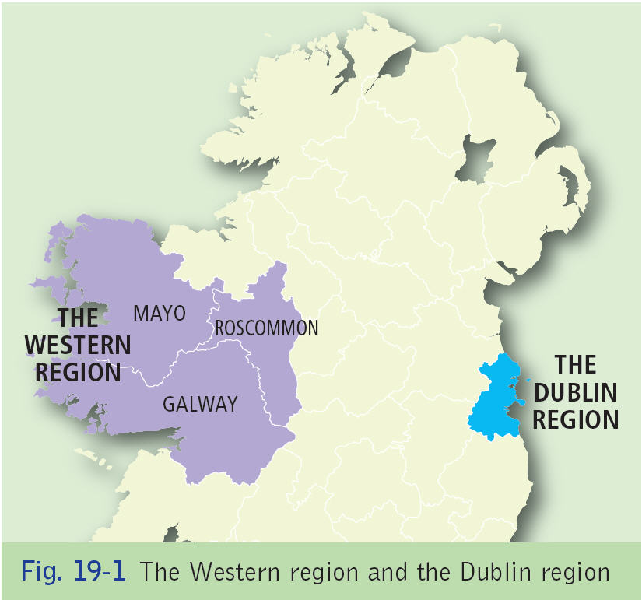

Slide 7
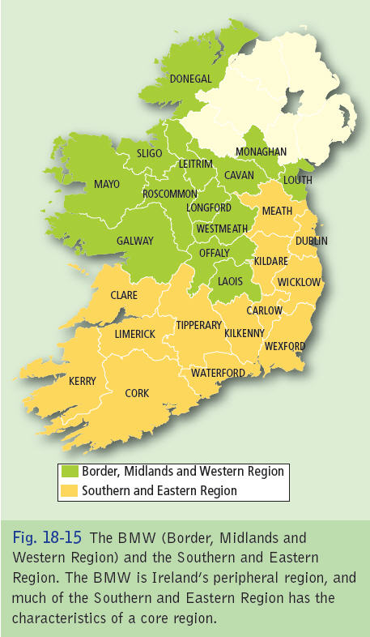

Slide 8
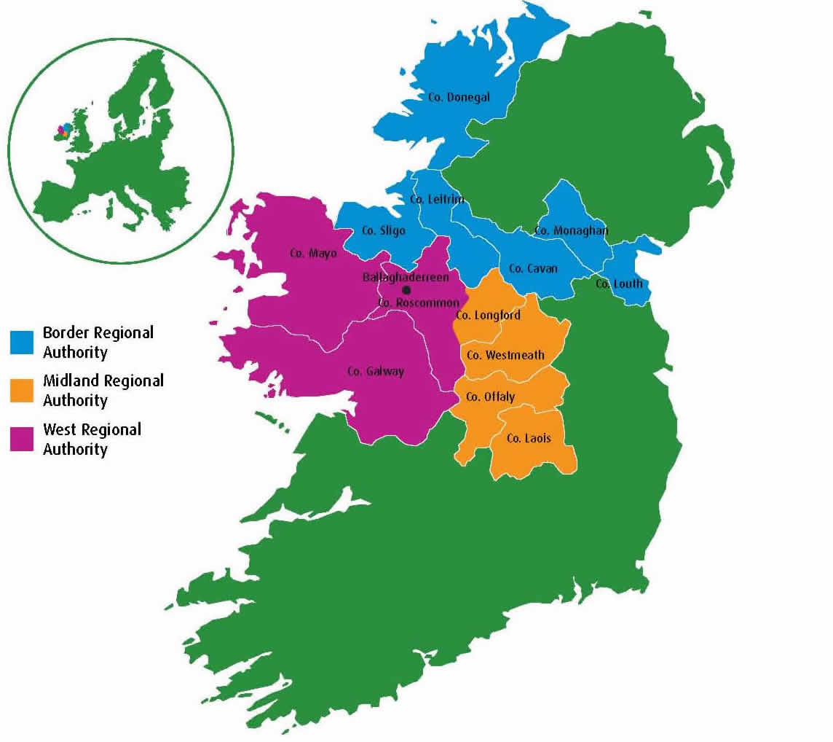

Slide 9
Core Regions | Movement of Resources | Peripheral Regions
Central Location | High-quality goods & services, government | Marginal Location
Favourable Natural Environment (relief, soil..) | decisions & incentives for regional growth. | Difficult Natural Environment (relief, soil, climate)
Good Communications |  | Undeveloped Communications
Intensive Farming |  | Extensive Farming (Pastoralism)
Urban, diversified, expanding economy |  | Rural society, over-dependent on primary industry
Plentiful supply of jobs |  | Higher Unemployment
Access to prosperous markets |  | Difficulty in accessing markets
High incomes & living standards | Raw materials, food, labour, Capital, semi-processed | Conservatism, low incomes & Standards of Living
Highly developed public services | goods, profits. | Inadequate services & Emigration

Slide 10
A strong economy is supported by a high amount of employment in Tertiary Activities (services).
Mayos’ peripherality can be highlighted by the fact that 18% of the pop is employed in Primary activities whilst this accounts for only 0.6% of Dublins’ employment.
Average Disposable income in Dublin = 129.6% & in West = 76.2% (based on national average of 100%).

Slide 11
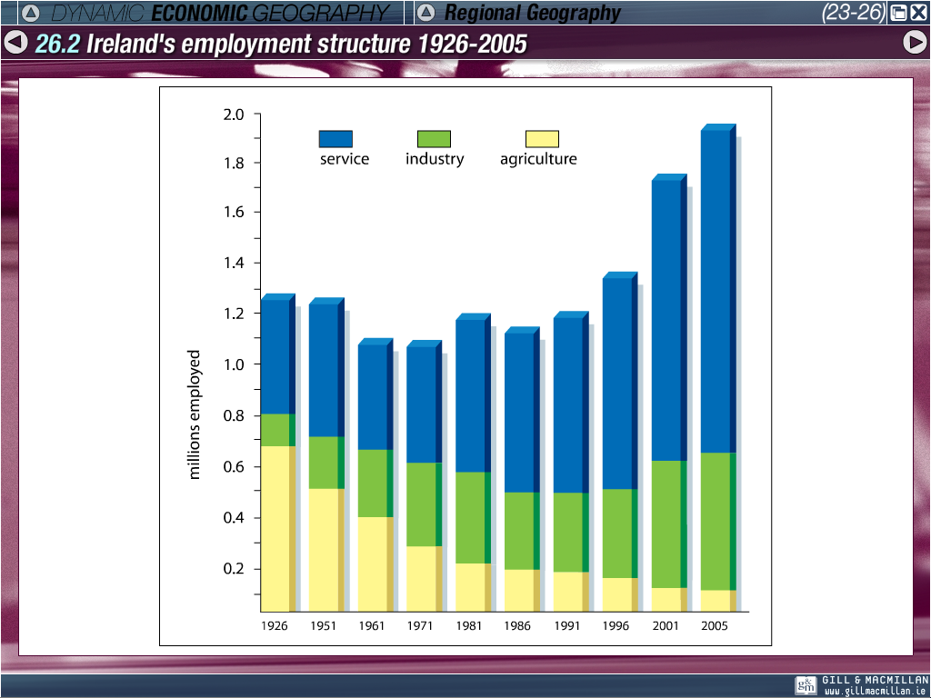

Slide 12
Although the West covers almost 20% of the area of Ireland, it holds only 9.8% of the population with a density of 29.95 per km².
In contrast, Dublin covers 1.1% of the total area, yet holds 28% of the population with 1,500.3 people per km².
(National average = 55.7 per km²)

Slide 13
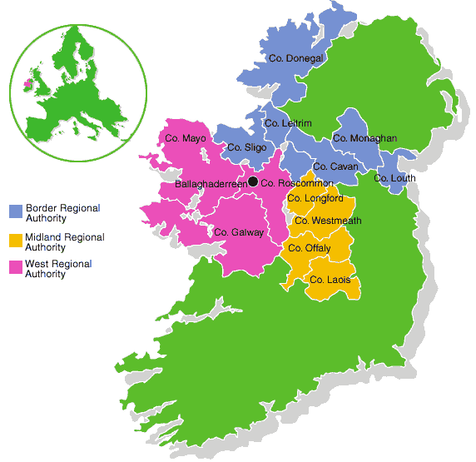
THE WEST

Slide 14
A Peripheral area- The West
What you need to know in this section;
Map of the West
Physicaly processes active in the West
Primary Activities
Secondary Activities
Tertiary Activities
Human Processes.

Slide 15
1. MAP OF west

Slide 16
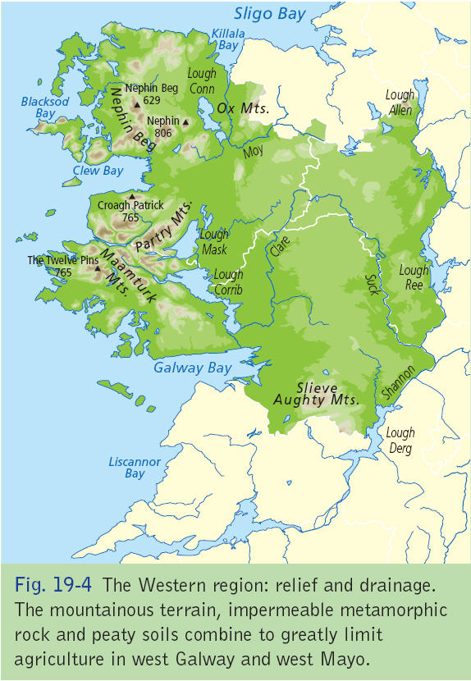

Slide 17
THE BMW
2. PHYSICAL PROCESSES

Slide 18
1.Physical Activities West Of Ireland
A. Climate
A. Climate
B. Relief
C. Drainage
D. Rocks and soils

Slide 19
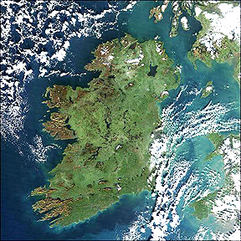

Slide 20
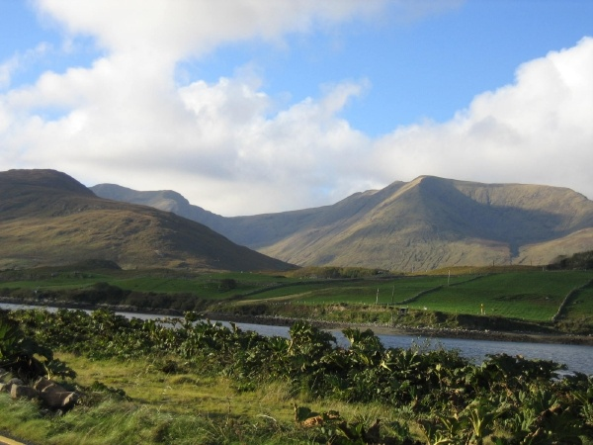

Slide 21
Physical Activities West Of Ireland
A. Cilmate
Cool temperate oceanic climate.
Temperatues range approximately 9 degrees.
3.5 hours of sunshine
Summer average of 15 degress.
Winter average of 6 degrees.
Average rainfall 1500mm in lowland- 2500 in highland areas- varies due to rain shadow.
Low pressure depression bring changeable weather to western Europe.
South Westerly winds.
North Atlantic Drift

Slide 22
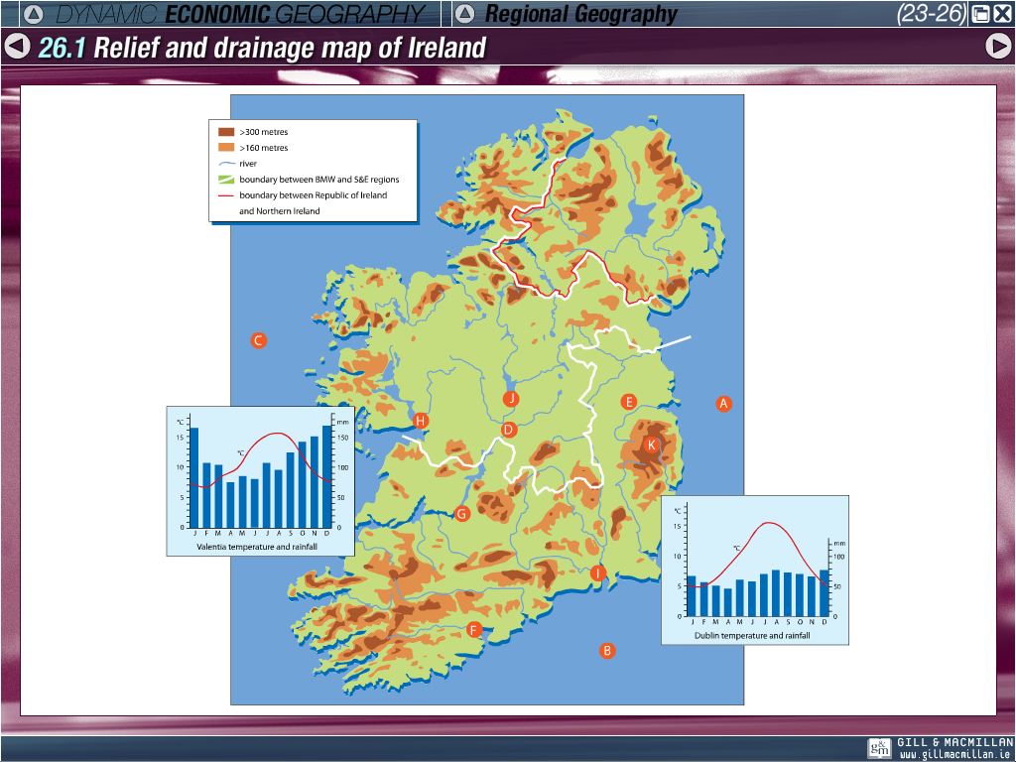

Slide 23
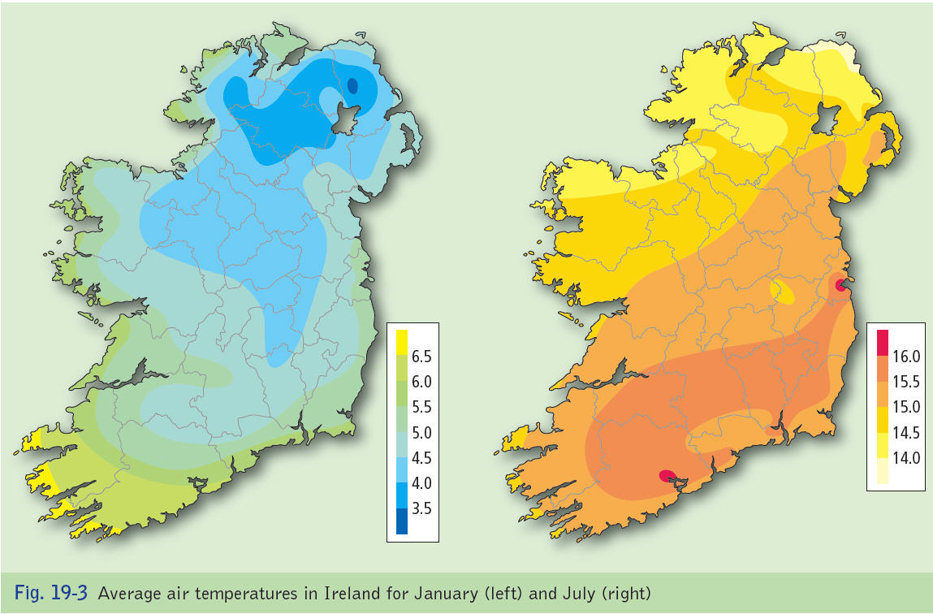

Slide 24
Relief rainfall-west coast

Slide 25
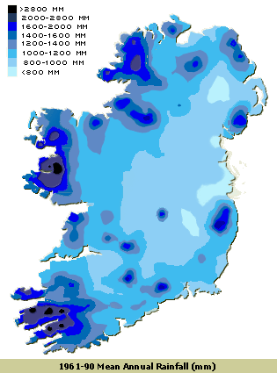
Rainfall in the West Region
While rainfall in the east measures between750 and 1000 millimeters (mm) of rainfall in the year. Rainfall in the west generally averages between 1000 and 1250 mm. In many mountainous districts rainfall exceeds 2000mm per year. The wettest months, almost everywhere are December and January. April is the driest month normally Hail and snow contribute relatively little to the precipitation measured.

Slide 26
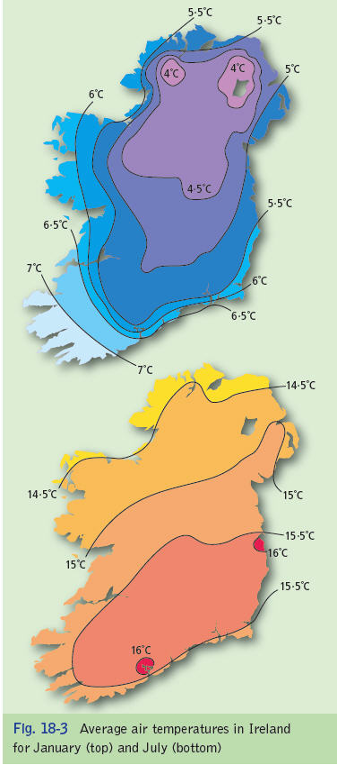
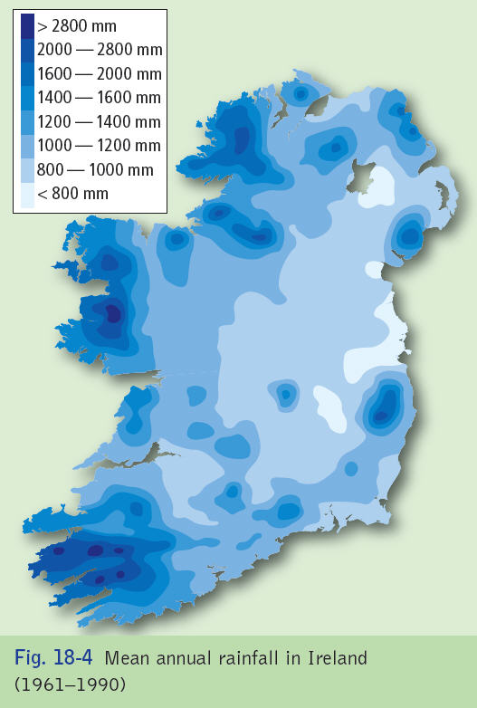

Slide 27
Physical Activities West Of Ireland
A. Cilmate
The factors that affect climate are... Latitude, prevailing winds, aspect, altitude, distance from the sea and the North Atlantic Drift

Slide 28
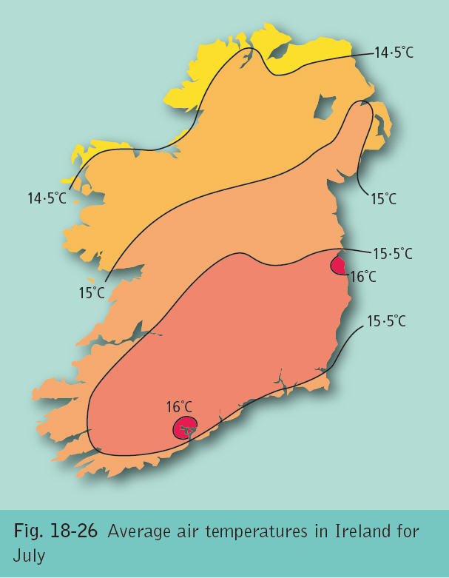

Slide 29
Physical Activities
B. Relief and drainage
The relief of the west of Ireland is rugged, very mountainous with mountain ranges such as the Maamturk mountains and Nephin Beg (Caledonian folding).
This results in a number of valley that have poor soil, which floods very easily which is poor for agriculture.
Drumlins belts like clew bay
River are Moy, Shannon, Clare,
Land is flooded, marshy and considered swamp land.

Slide 30
BMW – Rivers, mountains and lakes

Slide 32
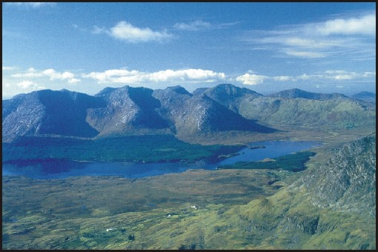
THE 12 PINS

Slide 34
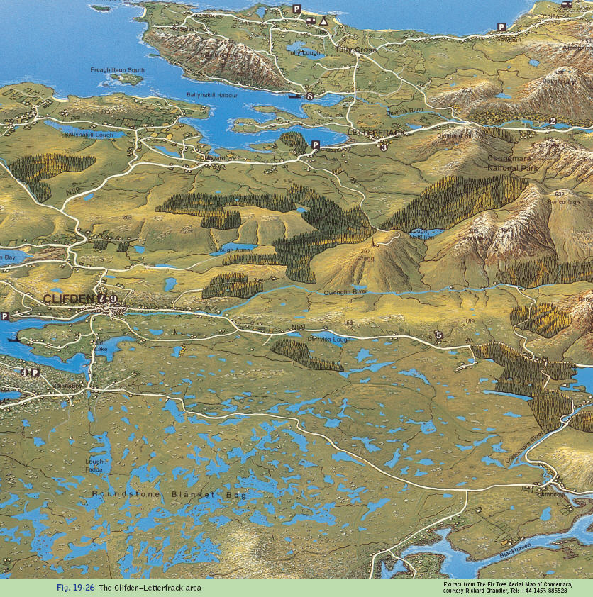

Slide 35
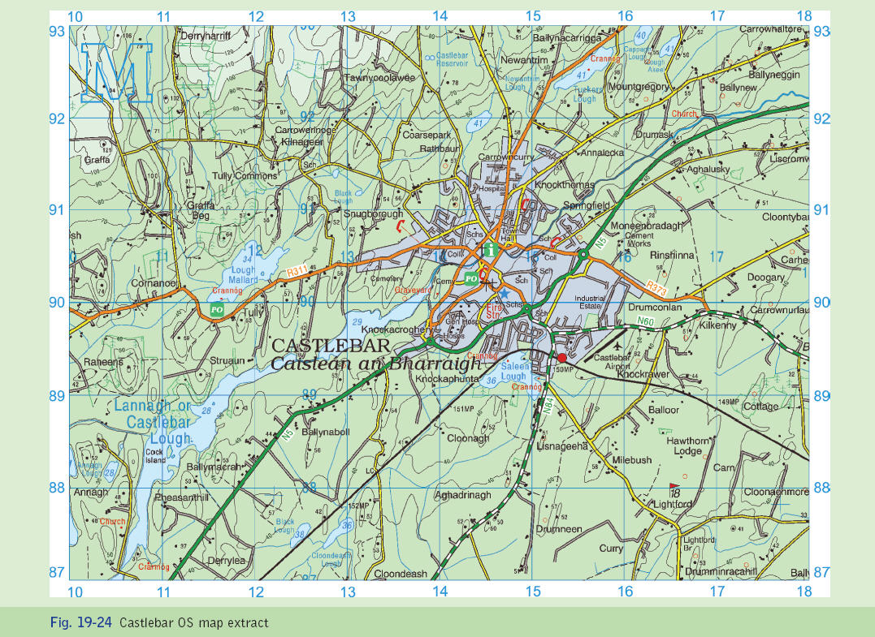

Slide 36
Physical Processes
C. Rock
Rocks found in the area help to establish the different types of soil found in the area.
Rocks like sandstone, shale and schist mean there are little minerals in the soil. (Note do not forget other factors that affect soil)
Upland have igneous & metamorphic rocks which are impermeable.
Glaciation has also affected soil production

Slide 37
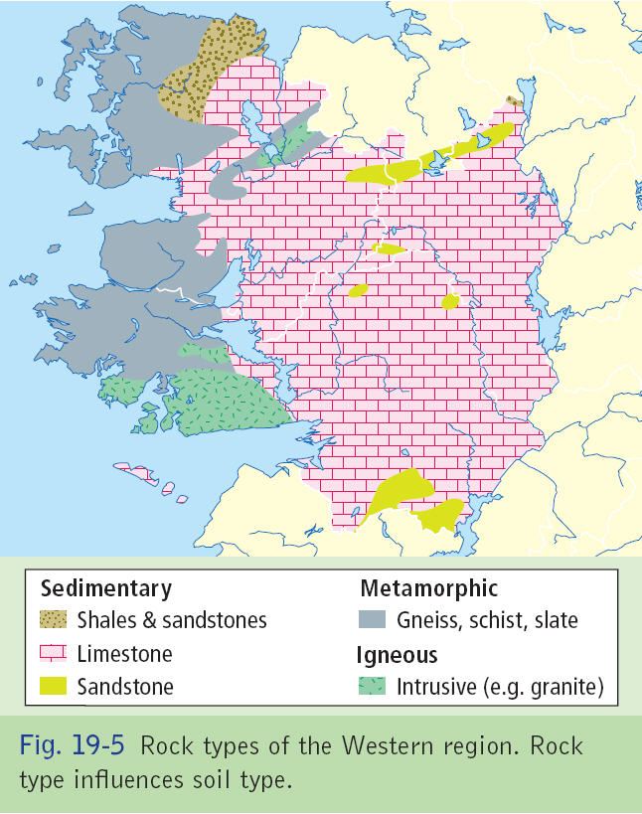

Slide 38
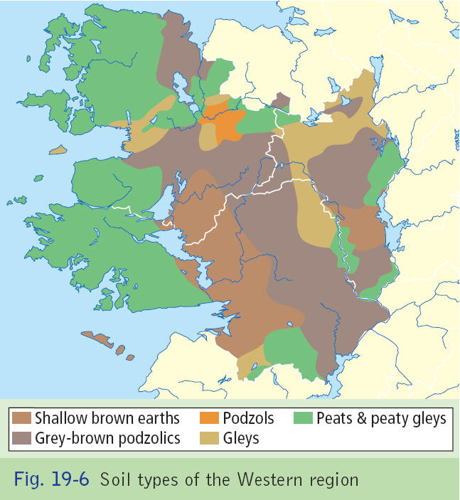

Slide 39
ROCKTYPE>>>SOIL TYPE

Slide 40
Physical Processes
D. Soil
Peaty soils are poor and shallow and are found in upland areas.
Gley soils are infertile and often waterlogged
Podzols.
Leaching caused by heavy rainfall= Hardpan= waterlogging
All three soil types are unsuitable for agriculuture lacking minerals and containing too much water. Most land is used for Forestry.

Slide 41
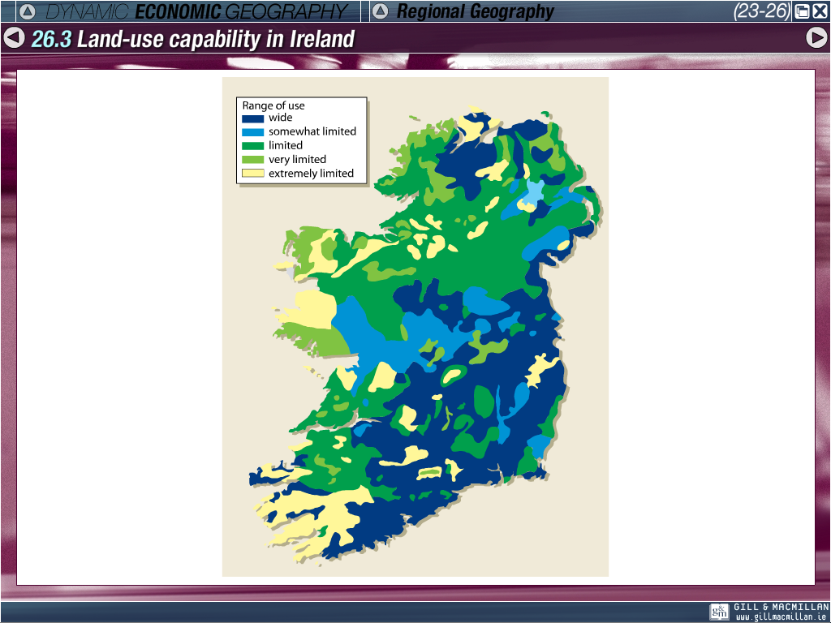

Slide 42
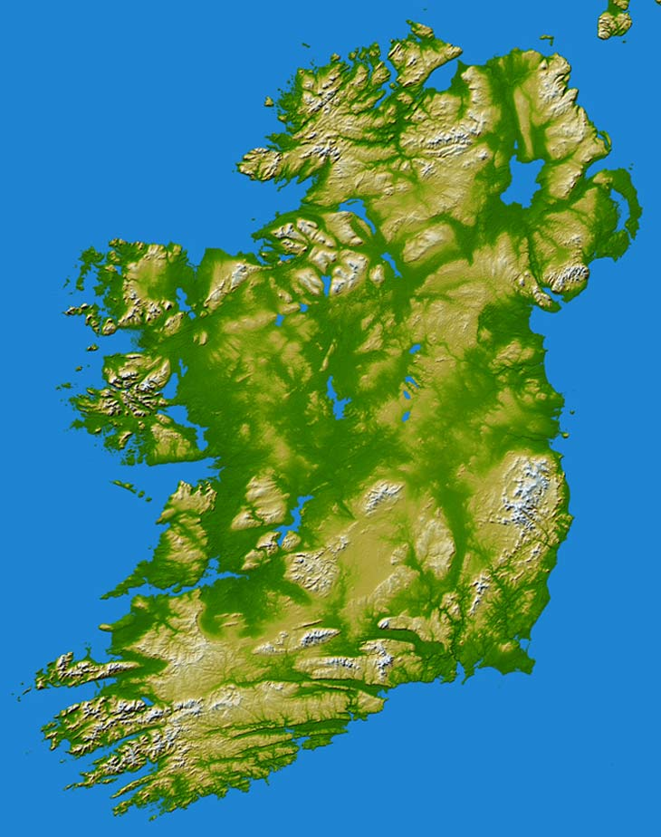

Slide 43
Fig. 5 Soils of the BMW region

Slide 44
D. Soils
Areas where they are brown soils are shallow and infertile

Slide 45
THE BMW
3. PRIMARY ACTIVITIES

Slide 46
Primary Activities
This involves removal of natural resources.
Areas involved in primary generally poorer.
Higher than average number of people working in this sector
EX- 24% of Roscommon’s Working population.

Slide 47
Primary Economic Activities
Agriculture
Hindered by physical, social & economic factors.
Physical Size: rugged relief, remoteness, wet, cool & windy. Peaty & gley soils with limited fertility.
Farm size: generally small & fragmented. Largely smaller than national average (10-25 acres).
Population structure: More than 50% of farmers aged 55 or over.
Peripheral Location: West is isolated from main domestic and overseas markets. Therefore, high transport costs in accessing markets.

Slide 48
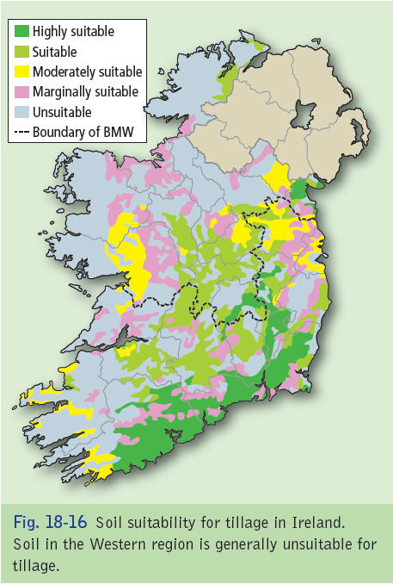

Slide 49
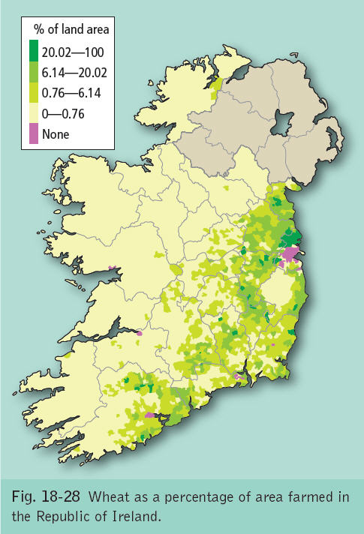

Slide 50
General agricultural regions of the BMW region.

Slide 51
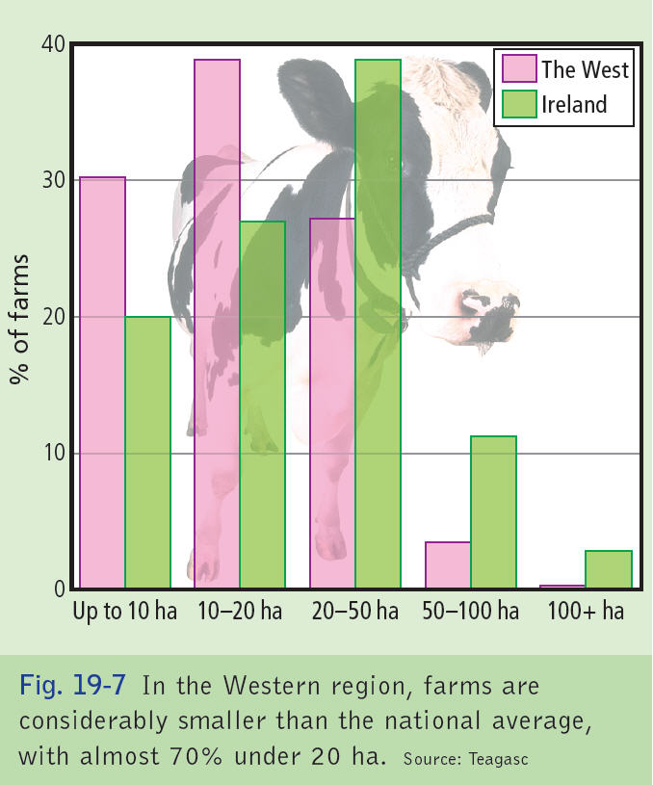

Slide 52
Agricultural Activities
Soils favour grass growth rather than cereals or root crops.
Grass is cultivated & harvested as a fodder (winter food) for livestock.
Livestock raising (pastoral farming) is the predominant type of farming, however, most cattle are sold at 2yrs of age to be fattened in eastern & midland farms.
Dairy farming is confined to larger farms.

Slide 53
Primary Activities
BMW
West is too wet with too little sunshine for wheat & barley growing. Only 2.4% of cereal crop is grown in the west.
Cereal production requires drier climate and fertile soil and limited to Louth in the BMW as a result.
BMW is classified as disadvantaged for farming resulting in subsidies from Brussels accounting for most farm incomes.

Slide 54
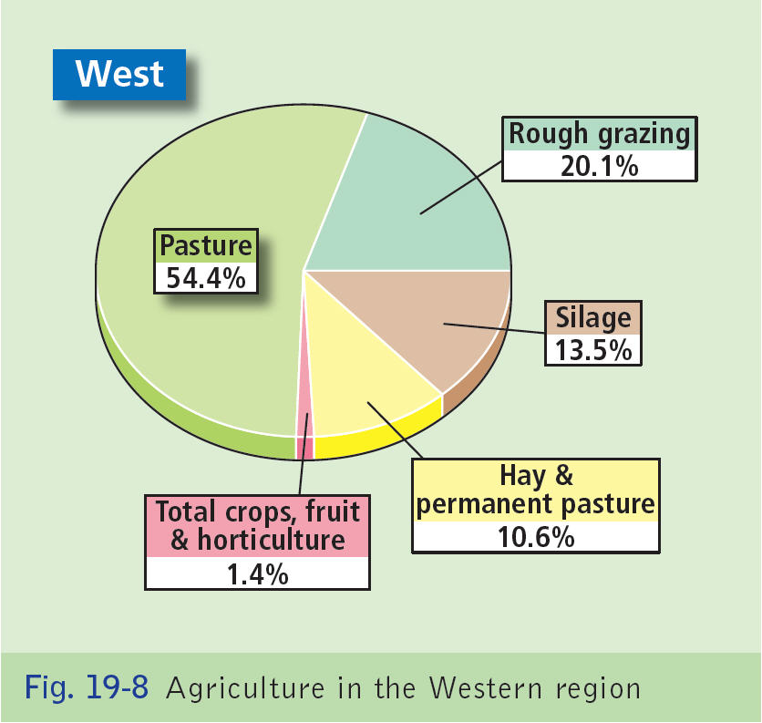

Slide 55
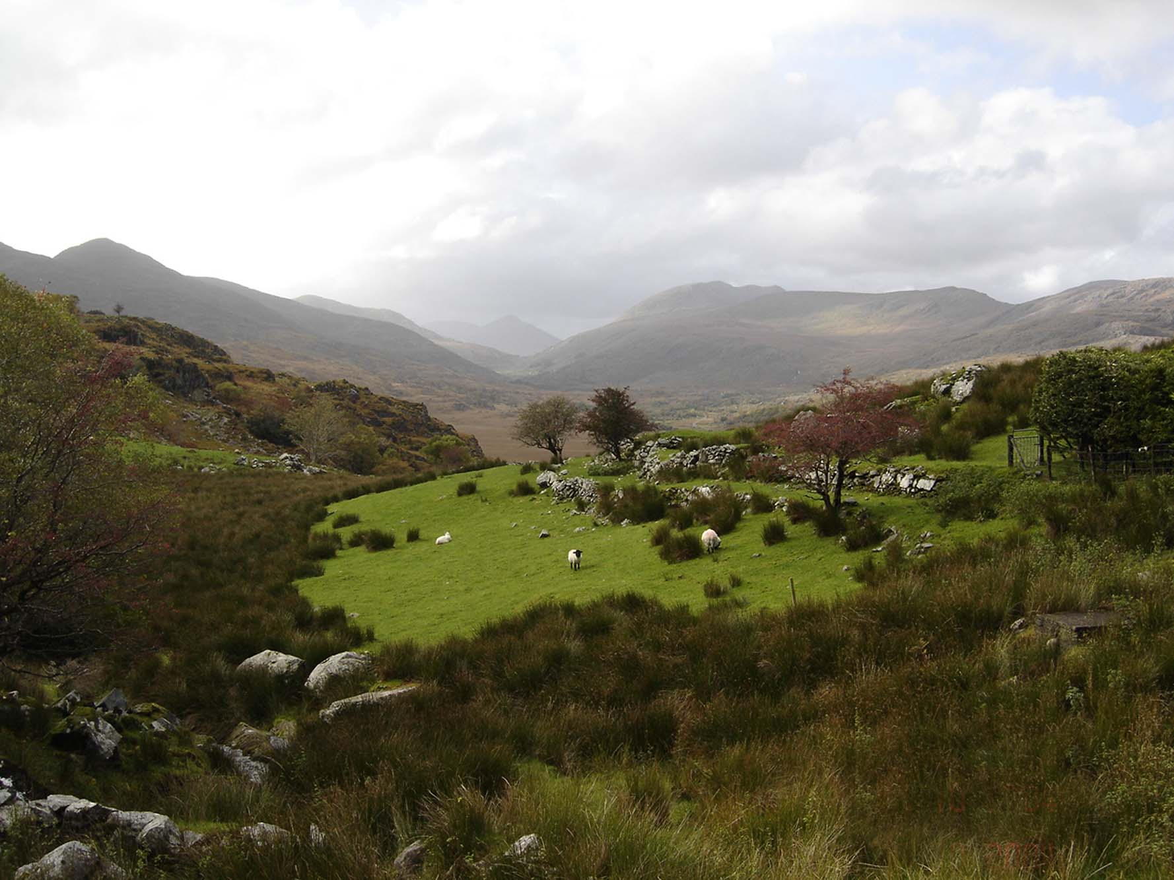
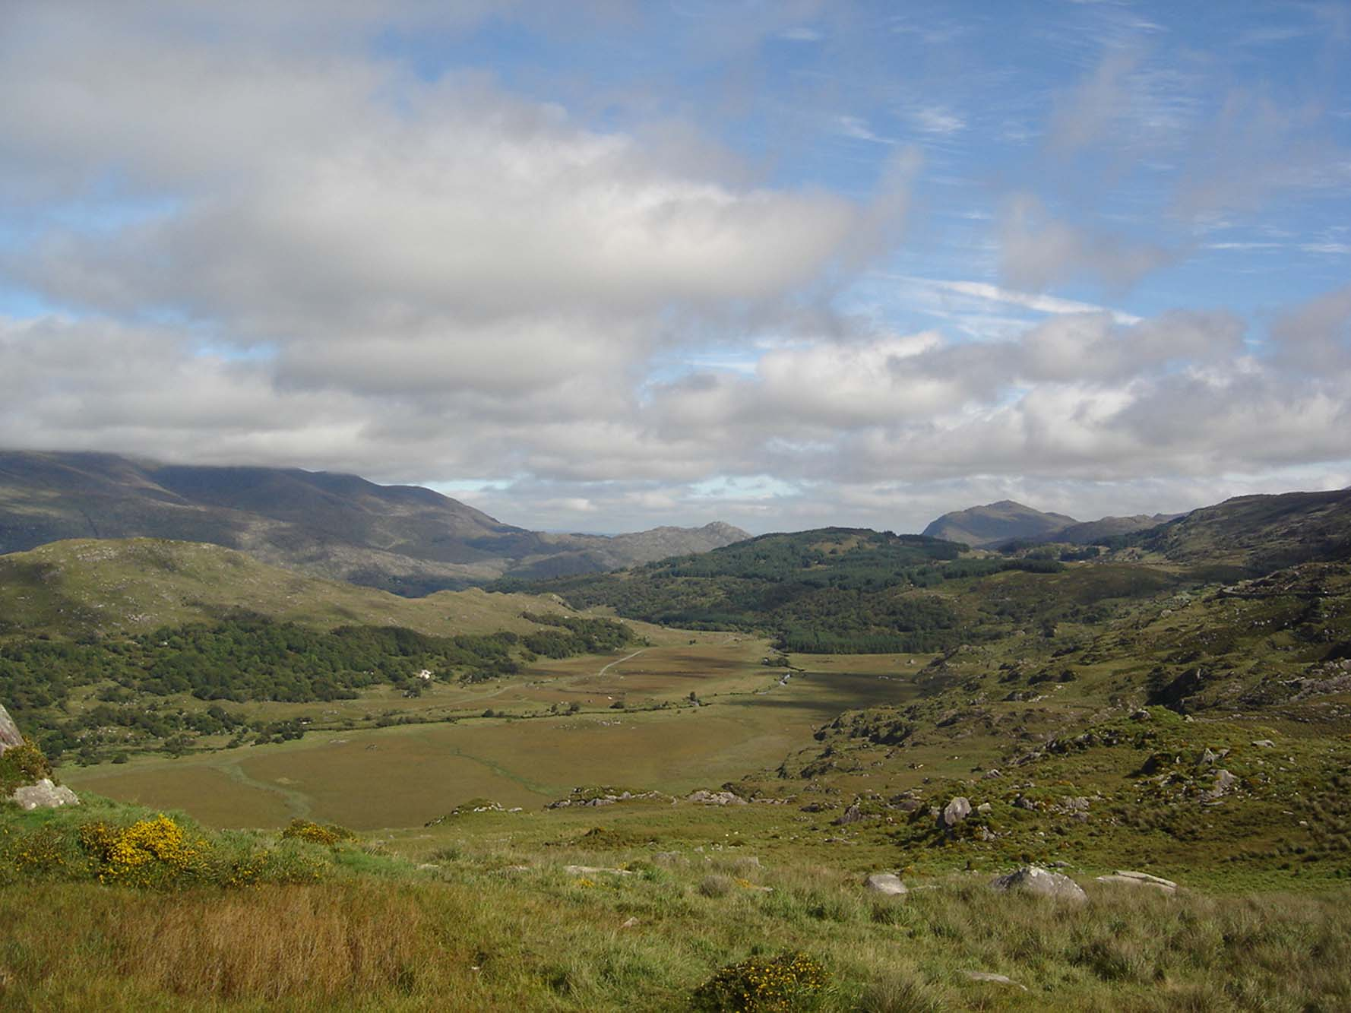

Slide 56
AGRICULTURE
Sheep farming is practised on well-drained mountain slopes & limestone lowlands of the region.
An estimated 27% of mountain areas have been degraded by overgrazing.
A combination of EU subsidies (headage – farmers paid based on number of animals kept on farm) and increased demand led to doubling of sheep population between 1980 & 1995, resulting in overgrazing.

Slide 57
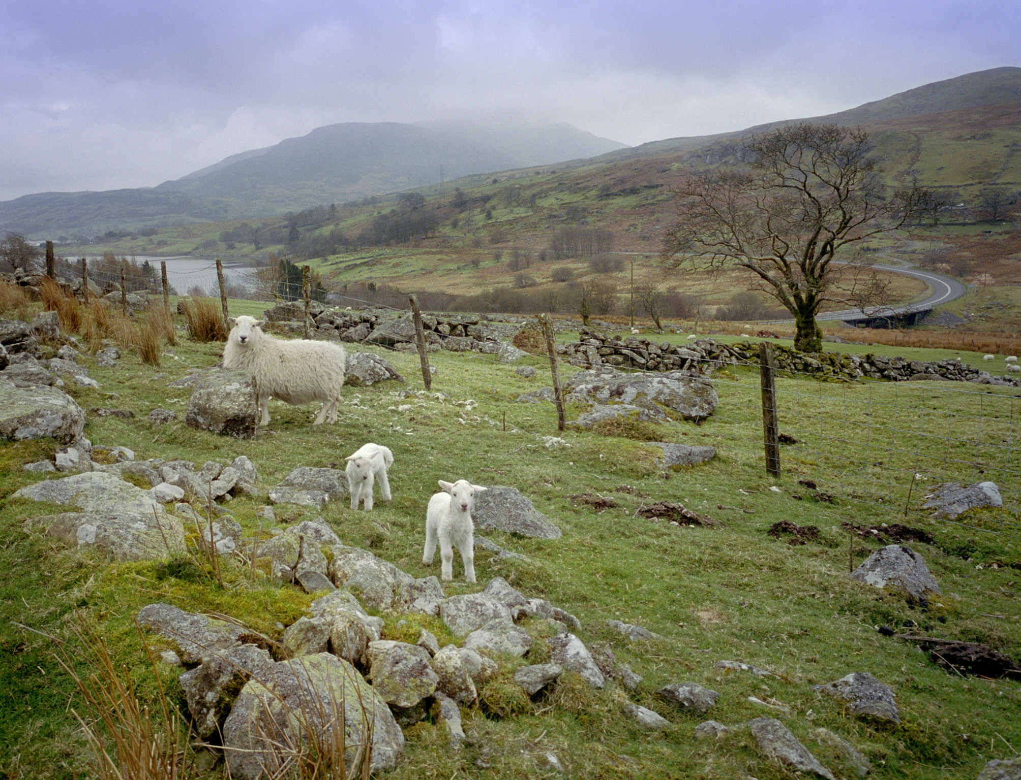

Slide 58
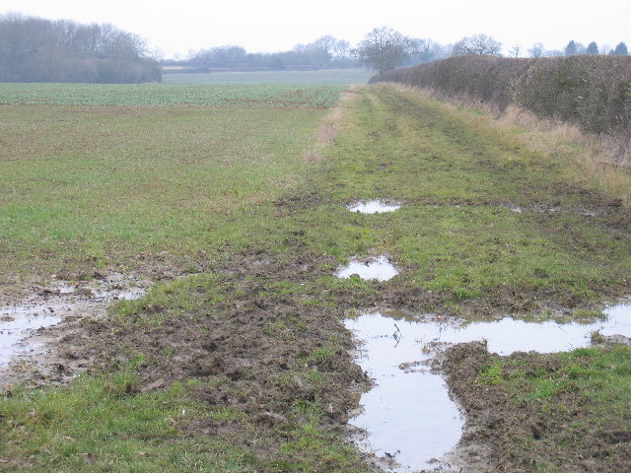
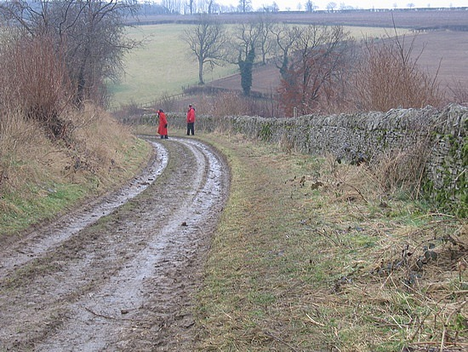

Slide 59
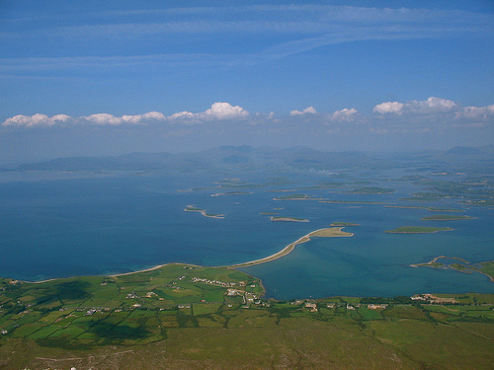
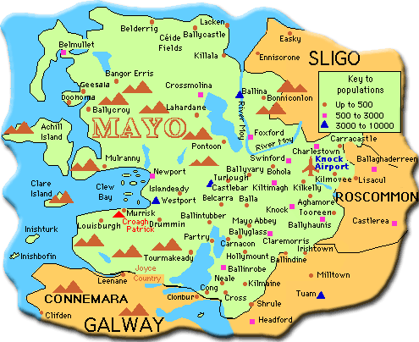

Slide 60
Primary Activities
Agriculture
Galway/Monaghan – Cattle.
Mushroom and poultry production are more common in the BMW region than anywhere else in Ireland as they dont depend on fertile land.
Farms are smaller than the national average - 30% under 10 hectares.

Slide 61
Impact of European union policies On Agriculture
Western farmers are heavily dependent on EU support.
The Common Agricultural Policy (CAP) is the main source.
Initially the E.U purchased all farm produce not sold on on open market. This benefited larger farmers. This has been re-drawn in last decade to benefit medium&small farmers more.

Slide 62
Impact of European union policies on agriculture
The Rural Environmental Protection Scheme (REPS) directly pays farmers for environmental conservation (tidy farms, preservation of wildlife habitats).
Farming has become a part-time job. A Teagasc survey has showed that almost 50% of farmers in the region have an off-farm job.

Slide 63
REPS annual payment of €200 per hectare for the first 20 hectares, €175 per hectare for the next 20 hectares, €70 per hectare for the next 15 hectares and €10 per hectare for the remaining hectares.

Slide 64
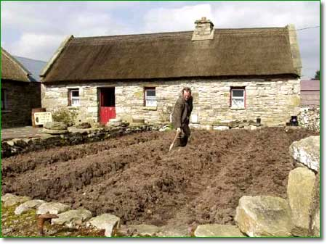

Slide 65
Primary Economic Activities
Fishing
Due to limited opportunities to farm on land, fishing has become an important industry.
The west has a variety of natural advantages for the fishing industry:
-Access to Atlantic fishing grounds.
-Favourable currents & water temperatures of NAD
-Shallow continental shelf (100m deep) producing a rich plankton supply for fish food and making trawling easier.

Slide 68
Fishing
Numerous sheltered inlets provide fishing harbours (Killybegs, Co. Donegal) & calm water for fish farms (Killary Harbour, Co. Galway).
Successful sea fishing and aquaculture has developed thanks to several physical characteristics. About 2,000 ppl are employed in fishing, processing and aquaculture in the western region.
The west coast of Ireland is effected by the warm North Atlantic Drift which keeps our shores free of ice and brings a variety of fish (Herring & Mackerel).

Slide 69
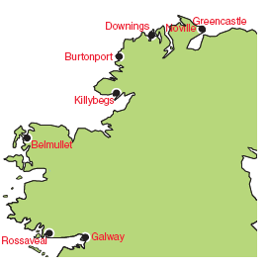
Fig. 7 Fishing ports in the BMW region

Slide 70
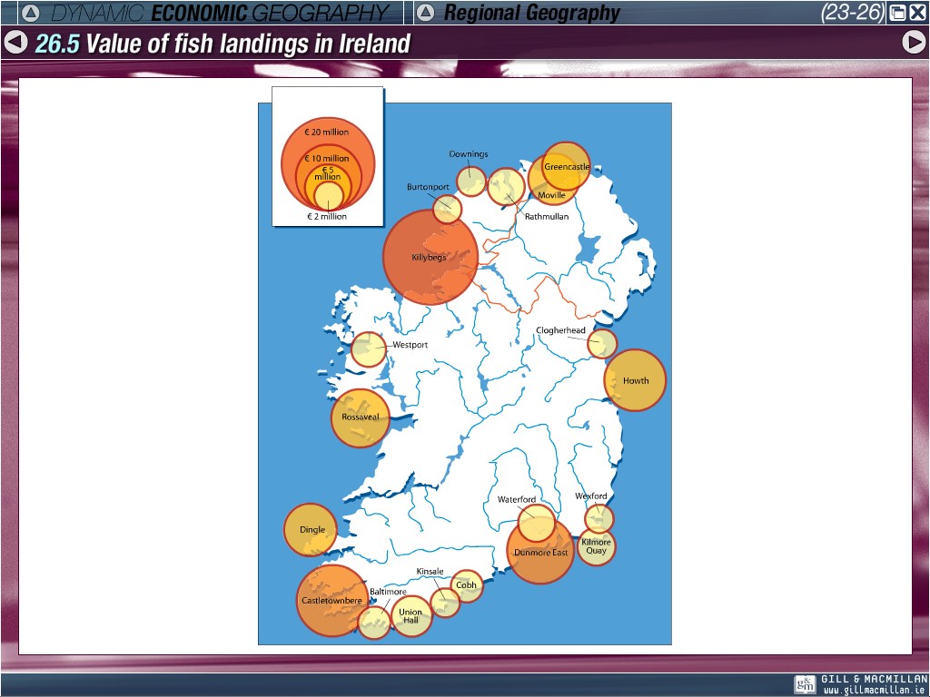

Slide 71
Impact oF EU
Developed a small, widely, old fishing culture and fleet into a modern financial viable industry.
More fish caught resulting in over-fishing and stopped the expansion on the industry.

Slide 72
Common Fisheries Policy-CFP
As studied before CFP resulted in-
1. Fishing banned in certain areas, use of quotas and regulation on fishing nets.
2. Compensation is provided to skippers who scrap their boats.
3. Boats limitied to 9 day a month on the Atlantic corridor

Slide 73
Changes in the West’s Fishing Industry
Greater concentration in the largest port, Rossaveal.
Fewer but larger fishing boats.
Reduced numbers of workers employed in sea fishing.
Increased onshore employment with 60% of fish landed being processed before leaving for market.
Growth in fish farming.

Slide 74
*Fish landing in tonnes (1995 – 2002)
Port | 1995 | 2002
Rossaveal | 7,376 | 11,760
Achill | 697 | 189
Carna | 204 | 128
Aran Islands | 92 | 55

Slide 75
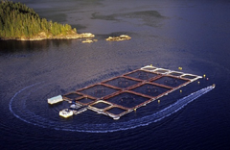
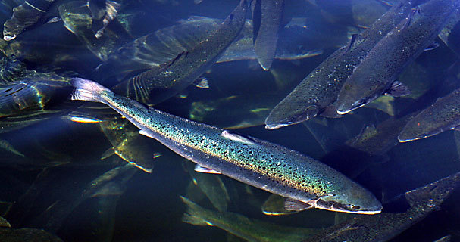
Fishing: Aquaculture
Sheltered & pollution frees waters are ideal for aquaculture.
Output from this has increased from 30,000 tonnes in 1993 to over 50,000 tonnes in 2000.
The increasing jobs at fish farming compensates for the jobs lost in sea fishing.

Slide 76
*Aquaculture licences (fish farming)
 | Salmon | Oysters | Mussels Shellfish | Other
Galway | 26 | 44 | 41 | 7
Mayo | 7 | 44 | 6 | 10
Rep. Of Ireland Total | 60 | 232 | 162 | 65

Slide 77
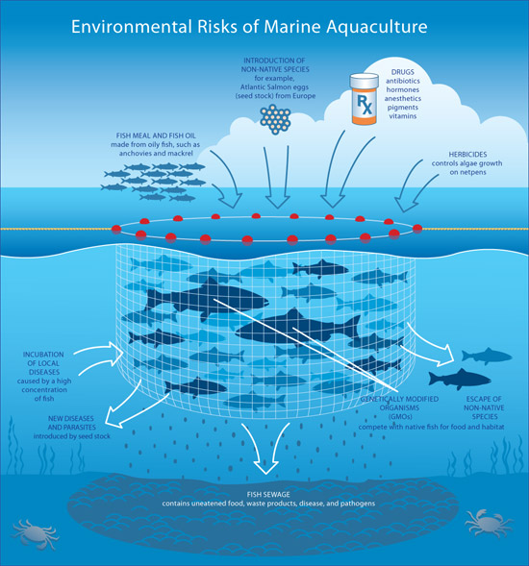

Slide 78
Fig. 8 Shellfish cultivation in the BMW region

Slide 79
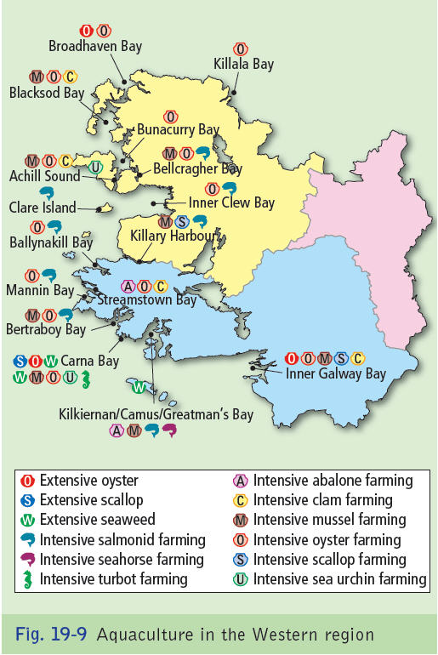

Slide 80
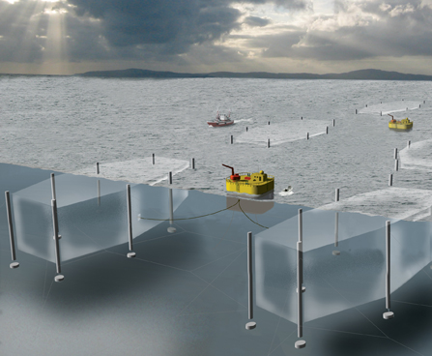

Slide 81
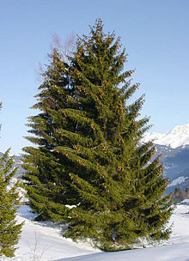
Forestry
Mild temperatures, well-distributed rainfall & long growing season of the west favour forestry.
Spruce & Pine common trees planted
Coillte, a semi-state company, planted most of Ireland’s coniferous forests, this exceeds 30,000 hectares in the West.
Government and EU grants encourage private investment in forestry as an alternative land use (idea is to reduce areas being farmed)

Slide 82
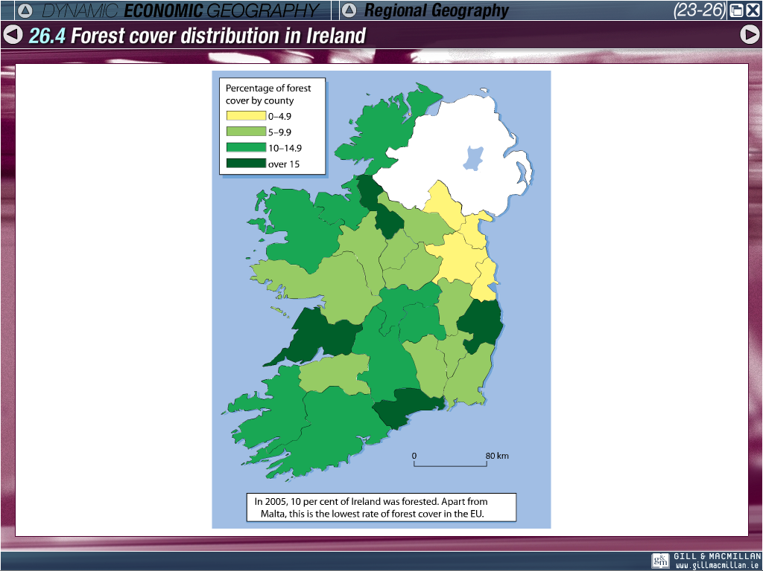

Slide 83
Forestry
Since the 1980’s, more than 60% of plantings have been on cheaper peat lands in the West.
50% higher yields of spruce trees than in the east
Afforestation (turning bare or cultivated land into forest) provides a profitable use for cut-away bogs in the coastal lowlands.

Slide 84
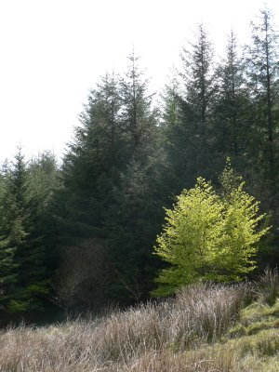
Coniferous forests can grow in areas with poor soils (podzols, gley soil)

Slide 85
Mining & Energy
Peat quickly forms in wet and humid areas where the rate of evaporation is low, as in the West of Ireland.
Renewable energy is generated by wind farming locations such as Bellacorick (6.5MW), saving the atmosphere from 160 tonnes of Sulphur Dioxide and 20,000 tonnes of Carbon Dioxide.

Slide 86
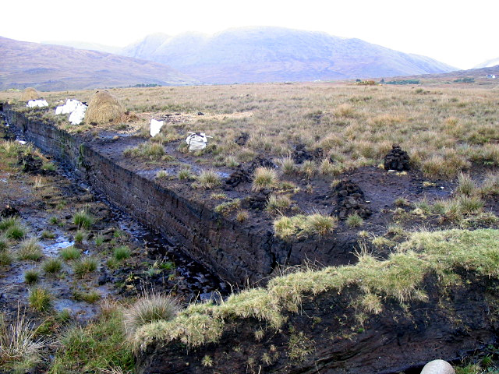
Peat Bog

Slide 87
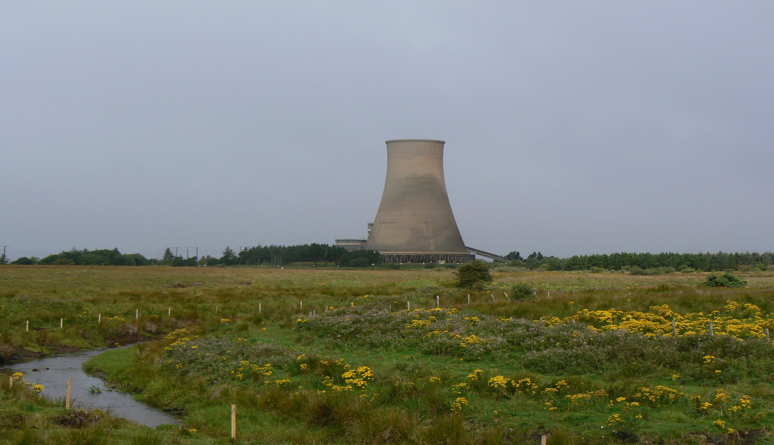

Bellacorick

Slide 88
Mining & Energy
A substantial natural gas deposit, the Corrib Field, has been discovered about 70km off the Mayo coastline, estimated to be capable of supplying Ireland’s energy needs for up to 15 years.
The gas will be piped ashore and processed at Bellanaboy Bridge, Co Mayo.
Work on the offshore section occurred in summer 2009 and involved over 7,000 lengths of pipe being welded together The onshore pipeline is still in the proposal phase but is expected to be some 9 kilometres (5.6 mi) in length.

Slide 89
Location map of Corrib gas field

Slide 90


Slide 91
West Clare Renewable Energy
20 August 2010
Up to 300 jobs will be created with the construction of a co-operative wind farm capable of powering every home and business in Co Clare that at a cost of €200m.
West Clare Renewable Energy (WCRE) Ltd has been granted planning permission to construct the largest community owned wind farm in Ireland.
It plans to construct 28 wind turbines on the western slopes of Mount Callan between Ennis and Miltown Malbay.
It is said that it has the potential to create 250-300 jobs during construction and sustain 30 farm families for the next 30 years in a rural part of West Clare.

Slide 92



Slide 93
3. SECONDARY ACTIVITIES

Slide 94
Secondary Actvities
Secondary Activities are raw material being processed or semi processed
Industries are either owned by Irish people are multinational companies (MNC’s)
In the Western region, a lower than average number of people are employed in the secondary sector as it is less well developed.

Slide 95
Secondary Activities
Manufacturing
The West is unattractive for inward investment due to physical & human factors, particularly in comparison to Dublin.
Poorly developed transport network, peripheral economic region, low pop. density, few urban centres and no major port facilities.

Slide 96


Slide 98
Secondary Activities
Roads/Railway lines are poorly developed as the region is generally mountainous with large lakes (e.g. Lough Ree). Roads narrow & winding..
It also adds to transport cost for industries that locate in the region (E.g. Donegal is 200km from Dublin) which discourages industrial development and inward investment.

Slide 99


Slide 100


Slide 101
Factors that affect secondary activities
The low pop density (25-30per km sq) with few large towns – Galway and Sligo largest centres. Irish average (60km per km)
Industry that requires large numbers will have difficulty finding workers made more difficult by lack of public transport (bus/train) and resulting in long commuting hours.
Lack on broadband access is limited

Slide 102


Slide 103
Factors that affect secondary activities
Electricity supply is also lower in the West
A lack of knowledge based workers students migrate to the east for jobs (Braindrain)
Annual job creation in West is lower than the national average.
Manufacturing wages also lower

Slide 104

Even with these college a lot of educated workers are going to the east of Ireland for Jobs (Braindraining)

Slide 105
Secondary Activities
Industries are small scale with labour intensive traditional jobs. This includes food processing, timber processing and textiles.
Many such traditional industries have closed since the opening of the Irish market to foreign competition in 1973
The region has a higher concentration of tradition and labour intensive industry, which are more prone to job losses.

Slide 106
Patterns in Manufacturing Industry
Between 1920’s & 50’s taxes were placed on imports to help native manufacturers compete:
Food Processing: Meat and milk in small scale factories. Ex. Milk in a co-op creamery owned by Connacht Gold.
Textile Industries: Based in local raw materials (wool) and traditional skills, particularly in clothing (Galway) and knitwear (Westport).

Slide 107


Slide 108




Slide 109
Industry in Galway city
Galway city is the exception in the west
It has only university in the region concentrating industry in Galway city due to size and quality of local labour force.
Has one of the world’s largest medical device company with Boston Scientific
Regions are not always uniform socially and economically. Galway's population has increased 53% in the last 30 years.

Slide 110


Slide 111
Industry in Galway city
Serves a extensive hinterland.
Broadband availability
Has excellent infrastructure, Route focus of road, rail, air and sea
3rd level educational colleges
Attractive physical and cultural environment.
Modern Industrial estates.
Hewlett Packard and Galway Crystal examples of large manufacturing industries

Slide 112


Slide 113

Secondary Activities
BMW
The Gov has started to develop the region via a NDP (National Development Plan) to develop road linkages and reduce transport costs and travel times (M6).
WDC (Western Development Commission) wants development evenly across the region and not concentrate in Galway.

Slide 114


Slide 115


Slide 116

Patterns in Manufacturing Industry
Both Udarás na Gaeltachta and the Industrial Development Agency (IDA) were agencies established towards developing the economy of the West.
Udarás na Gaeltachta: economic, social & cultural development in Gaeltacht regions.

Slide 117

The BMW region – future plans under the NSS

Slide 118

Patterns in Manufacturing Industry
IDA: Development in rest of region.
-These agencies have attracted a variety of new enterprises to the region in electronics, engineering, I.T, clothing, food processing, fish farming with companies from Belgium, Canada & France being attracted.

Slide 120





Patterns in Manufacturing Industry
Other enterprises include film-making, t.v ( Radio na Gaeltachta at Casla & TG4 at Ballynahowan, Co. Galway) employing about 200 full-time & 100 part-time workers.

Slide 121
Patterns in Manufacturing Industry- Influence of the EU
As the GDA is considered to be an underdeveloped region is receives help from the EU in forms such as the Regional Development Fund (Education and training) and the Structural Fund (transport and commuication).

Slide 122



Slide 123
Economic Challenge:
Attracting Replacement Industries
Industry in the west must compete with low-cost producers in Eastern Europe, North Africa & Asia.

Slide 124
Fig. 11 Communications in the BMW region

Slide 125
4.TERTIARY ACTIVITIES

Slide 126
Tertiary
Tertiary activities involve the provision of services.
Regions that are involved in tertiary activities tend to be richer.
In the west a lower than the average number of people are employed in the tertiary sector.
Because of the natural barriers roads are often narrow and winding while the steep ground has prevented the development of an efficient rail network.

Slide 127
Tertiary Activities - BMW
Transport
Transport infrastructure highlights the peripherality of the region.
Few national primary road
Road and rail are the fringes of a network focused on Dublin, although the M6 (Dublin-Galway) has somewhat improved this.
Main shipping ports are Galway & Sligo but they are limited
Low population & rural also makes public transport expensive to supply and therefore infrequent. 4% of the population use public transport compared to 11% nationally

Slide 128


Slide 129
Transport
natural barriers make roads often narrow and winding while steep ground has prevented an efficient rail network.
Money to be spent on Western rail Corridor called “West on Track”
500€ has been allocated under NDP but not spent.
Transport 21= Atlantic corridor.

Slide 132
Transport
Lack of a main international airport is also hindering secondary activities in the area and makes it difficult for overseas tourists to get here.
It is expensive to hire a car in Ireland and bus services are not attractive for tourists. As a result only 830,000 of 6million tourists to Ireland each year visit the BMW region.

Slide 133

Knock Airport

Slide 134
Tourism
Even though the sector is underdeveloped over two million tourists visit annually.
Tourism in the west is seasonal with highest numbers in July and August.
Physical aspects are an important physical factor in the development of tourism services.
Beautiful scenery the mountains, lakes and valleys are very scenic and attract thousands of tourists interested in walking and golf – Bangor trail, Co Mayo/ Craogh Patrick attracts 20,000 walkers every year.

Slide 135


Slide 136
Tourism
Bundoran, Co. Donegal is a popular surfing holiday and hosted the European Surf championships ’97.
Volvo ocean race
Niche holidays such as fishing, cultural event and team building exercises.
Airports are located in Galway, Knock and Sligo but services are limited due to low demand.
County Galway is by far the main tourist centre as it is the centre of all transport routes and the cultural capital of the west.

Slide 137


Slide 138


Tourism
Rugged mountains and coastline, quiet beaches, water sports, antiquities and culture attract 2 million tourists but also make it
Difficult to access.
EX Clifden, Spiddal & Westport.
Summer colleges in the Gaeltacht
cater for more than
20,000 students
which contributes to
local economy.

Slide 139



Slide 140
5.Human Processes

Slide 141
Population dynamics
Changed since great famine in 1841 going from 850,000 to present day 413,383.
During Celtic tiger people moved to urban centres in search of jobs.
Low marriage and birth rate.
Density is 25 people per km.

Slide 142


Slide 143
Population dynamics
Distribution is not even- affected by landscape. Coastal plains support fishing and tourism and can have a pop density of 160 sq km.
Ribbon developments (often holiday homes) increase pollution & traffic problems.
The population of Galway county increased 22% between 1996-2006.
The upland areas, are sparsely populated, like the 12 pins, Maumturk, Nephin & Party moutains

Slide 144


Slide 145


Slide 146
Language, Irish
Large Gaeltacht area in Ireland= Connemara.
Covers 800km
Gaeltacht population is falling
A group called Connemara West was set up to prevent further rural depopulation
Connemara Community Radio set up to promote Irish.
Teach Ceoil is a centre of Trad music

Slide 147
Regional (Rural) Development
People from rural areas are drawn to town in search of jobs.
Ireland has 7 universities= only one located in the west, with 13% of graduates finding jobs (Braindrain)
Lower pop density affecting local services and increasing the dependency ratio
EU funds have contributed to development in the West.

Slide 148
Regional (Rural) Development
Structural funds help pay to improve roads, railways and fishing harbours.
CAP, CFP, NDP, NSS, LEADER PROGRAMME all established to promote the West.
Funds also help to pay for building tourist accommodation, community centres & craft industries, water schemes and fish farms.

Slide 149
Urban Development
2006 census data shows an increase in population in larger urban centres in the west.
In contrast smaller urban centres (Roscommon town) were unchanged or even showed a slight decline (Boyle, Roscommon).
The major urban centres of the west are Galway (71,983) city and Castlebar (10,729).

Slide 150


Slide 151


Slide 152
Population Change
Urban Centres | 1996 | 2006
Galway | 57,241 | 71,983
Castlebar | 6,585 | 10,729
Ballina | 6,852 | 10,146
Ballinasloe | 5,654 | 6,051
Westport | 4,253 | 5,140
Clifden | 1,689 | 2,112

Slide 154
THE EAST OF IRELAND
A CORE AREA

Slide 155

East Ireland-GDA
Greater Dublin Area

Slide 156
GDA
What you need to know in this section;
Map of Area
Physical Characteristics of GDA.
Primary Activities in the GDA.
Secondary Activities in the GDA
Tertiary Activities in the GDA.
Human Processes of the GDA.

Slide 157
1. Map of the GDA

Slide 158
Fig. 14 Location of the GDA – Dublin and Mid East regions

Slide 159
The Dublin Region
The Dublin region comprises or Dublin city and county. The republic’s smallest but most populous region.
Physical and human factors interact in all economic activities in the region.
Dublin contains 30% of the population of the state.
The National Spatial Strategy of 2002 looks to develop urban centres known as gateways and hubs to counteract the growth of Dublin.
The population of GDA has grown by 5.6% (63,000)in the years 2002-2006.
Multi-ethnic city with 10% if the city foreign nationals and the presence felt in the food markets.
GDA experienced the problems associated with all urban centres including inner city decline, crime, substance abuse and unemployment.

Slide 160
Physical-Relief map of Greater Dublin Area

Slide 161



Slide 162


Slide 163
Physical-Relief map of Greater Dublin Area

Slide 164
Physical Characteristics of the GDA

Slide 165
Physical Processes
Relief and drainage in the East
Generally flat and undulating besides for the Dublin Mountains to the south of the city.
Dublin is located in a sheltered bay.
Land is well drained by rivers such as the Liffey and the Dodder providing fertile soil and good drainage.

Slide 166


Slide 167


Slide 168
Physical Processes
Climate in the East
Cool temperate oceanic
Mean winter temps are between 5°C & 6°C. The mean July temp is 16C.
800mm throughout the year-Due to shadow effect.
SW winds
4.5 Hours of sunshine
Growing season exceeds 280 days per annum+ ripen earlier

Slide 172
Physical Processes
Soil in the East
Rocks found in the GDA are generally Limestone.
High humus content
Soil in the DGA is mainly brown soil, which are deep, fertile, drained soils ideal for agriculture,
Many of the flood plains are covered in mineral rich alluvial soils such as the Tolka and Liffey.
Light sandy soil in Northeast are ideal for market gardening.

Slide 173
ROCKTYPE>>>SOIL TYPE

Slide 175
Primary Activities in the GDA

Slide 176

Primary Activities

Slide 177
Primary Activities
Regions involved in mainly primary activities tend to be poorer.
In the GDA primary activities account for a small percentage of jobs.

Slide 178
Agriculture
Highly productive and commercial.
1500 farms a little over 1% of national average
11% of national wheat crop
15% of potato crop
High yield of tillage crops- wheat and barley used for brewing and distilling and protein rich barley for animal feed. Wheat for bakeries.

Slide 179
Agriculture
Arable farming growing wheat are large and profitable due to the generally low lying relief of the area allowing for larger fields suitable for mechanised farming.
The climate is cool temperate but warmer and drier than the west of Ireland. Frost is rare due to the influence of the Irish Sea, this important for growing early potatoes and means a growing season of almost 280 days.

Slide 181
Agriculture
North Co. Dublin at Rush and Lusk have light sandy soil & is used for market gardening. These heat up quickly in summer and are easily worked.
Fruit & salad vegetables are grown in Green houses. More than ½ of Ireland’s greenhouses are located in north Co. Dublin.
Cabbage, potato and onions are grown in large fields.

Slide 182


Slide 183
Agriculture
Location close to a large market provides an outlet for the crops and dairy produce.
Age profile lower than west and does not suffer outward migration.
Farmers educated with market orientated and scientific approach.
Boulder Clay in Co. Kildare deposited in the last ice age are well drained and support good quality grassland. Cattle are fattened for the beef industry and Kildare is also the centre of the Bloodstock industry and produces racehorses for export.

Slide 184



Slide 185


Slide 186
Agriculture
Pastoral sheep farming is also carried out on upland farms.
Malting Barley is grown for the brewing and distilling industries. Protein-rich barley is grown to make animal feed.

Slide 187



Slide 188
Agriculture the human factors
Farmers also have access to many supermarkets who demand fresh produce.
Transport is well develop also allowing farmers to transport their product easily and at lower costs than farmers in the west.
Farmer incomes in the area are generally 40% higher than the national average.

Slide 189
Fishing
Fishing in the area is concentrated in Howth and Skerries but has been over fished in recent decades leaving it’s future uncertain.
Howth 3rd largest port in Ireland
Boats docking here in 2006 landed 3% of Irelands total fish landings.
Compare this to 35% in 1960 & we can understand a greater level of expansion in western ports such as Killybegs, Donegal.
40% of the total shellfish exported from Ireland comes from GDA.

Slide 190

Howth

Slide 191
Forestry
Forestry not dominant activity. Relief has influenced forestry in the area. The area lacks forestry except for the Wicklow Mts to the south. The Wicklow Mts rise over 800m and the steep slopes and high altitude are a disadvantage for arable farmers. The mild climate encourages tree growth.
Trees mature earlier and can be harvested sooner than in the West Of Ireland.
Thinnings from these forests are sold as Christmas trees or are sent to timber processing plants.

Slide 192


Slide 194



Slide 195
Secondary Activities in the GDA

Slide 196
Secondary Activities
Raw materials are processed or semi- processed materials are further developed.
A higher than average number of people is employed in the secondary sector in the Dublin region.
25% of Ireland’s manufacturing industries and 40% of people employed in the sector

Slide 197
Secondary Activities
Reasons for growth
Nodal points of transport, roads, rail, plane.
Access to European Markets
Direct government involvement
Corporate tax 12.5% lower than other countries.
Modern infrastructure and Communications.

Slide 198
Secondary Activities
Reasons for growth
Knowledge based MNC’S, well educated skilled workforce.
80 % of 3rd level colleges
Low age profile 45% of workforce under 25
Industrial output per worker is higher
Salaries in area is higher
Good social and cultural environment.

Slide 199
Secondary Activities- varieties of industries
Traditional industries such as brewing at Guinness, printing with the Irish Independent
Modern Industries such as Google and pharmaceutical giants such as Pfizer
Locate within city limits for close proximity to port
Good supply to local markets and labour pool

Slide 200
Secondary Activities
Dublin
The GDA includes large areas of farmland (North Co. Dublin), farmers in this area provide vegetables for the food processing industry (Tinned peas/beans).
Grain is produced North Kildare and East Meath used in food processing (Jacobs) and brewing (Guinness).

Slide 201



Slide 202
Secondary Activities
Dublin
Until the 1930’s, Ireland was completely dependent on imported coal as a source of power. Most was imported from Britain to the east coast of Ireland and a concentration of industry developed at Dublin.
In 1961 53% of Ireland’s manufacturing labour force was located in the Dublin region.
As a result of government policy to disperse manufacturing through the country, in 2003, just 23% of total employment in manufacturing was located in Dublin.

Slide 204
Secondary Activities
Dublin
The M50 has encouraged inner city manufacturers to relocate to suburban areas which has seen the development of Industrial estates. Workers are available from adjacent suburbs and sites are more spacious.
Construction of roads, office blocks, apartments and houses also provides employment in the region.

Slide 205
Fig. 9 The location of Blanchardstown, City West Business Park, Dublin Airport, Dundrum and Tallaght

Slide 206
Secondary Activities
Dublin
The industries are located on Industrial Estates & Business Parks, situated in suburban areas such as Finglas, Tallaght & Sandyford.
The sector employs more than 71,000 people in Dublin.

Slide 207
Fig. 9 The location of Blanchardstown, City West Business Park, Dublin Airport, Dundrum and Tallaght

Slide 208
Secondary Activities
Dublin
Dublin is Europe’s largest I.T centre with IBM (Blanchardstown) & Microsoft (Sandyford).
Satellite towns tend to have more space that city locations and allow for future expansion of businesses.

Slide 209







Slide 210







Secondary Activities
Dublin
The high-value pharmaceutical, chemical & biotechnology sector rapidly expanded with companies such as Glaxo Smith Kline & Bristol, Myers & Squibb located in the Dublin Region.

Slide 211
Secondary Activities
Recession
Dependent on foreign investment, cause for concern as many are outsourcing.
Over 800 overseas companies with 350 being American.
Suffered more job losses than anywhere else, losing 30,000 jobs roughly 40% of the national total.

Slide 212
Tertiary activities in the GDA

Slide 213
Tertiary Activities
Tertiary economic activities involve the provision of services.
Dublin has a high number of workers with 80% of workers employed in this sector.
Government introduced decentralisation policy but is on hold due to recent cutbacks
IFSC- High quality telecommunications network and support services

Slide 214
Tertiary Activities
Dublin
Dublin is the Political & Administrative capital of the Republic or Ireland.
The public administrative sector employes 25,000 in the capital in 2006.
The development of a high quality tele-communications network has attracted a large number of international financial and teleservice enterprises to the region.

Slide 215
Tertiary Activities
Dublin
Education and IT companies
Dublin has many universities including UCD, TCD and DCU acting as educators and employers for a growing population.
As many as 87% leaving cert students from some Dublin suburbs enter 3rd level institutions.
The IFSC (International Financial Services Centre) is located in the Customs House docklands area of Dublin and began construction in 1986 and by 2006 it housed 450 financial service companies employing 4,000.

Slide 216


Slide 217



Slide 218
The Dublin Transportation Initiative

Slide 219
Transport factors
Most efficient transport system in the country.
Airport handled 21 million passengers in 2009.
Terminal 2 opened
Car culture of commuting to and from work due to a failure in public transport.
This dependence on cars and the fact that 90% of commercial transport is by road has led to high levels of traffic congestion. (14km per hr in city)
Two LUAS lines connect Tallaght and Sandyford to the city centre as well as Connolly and Heuston station. (Luas Line expanding)
Bus Corridors expansion have speeded up bus times & taxi’s are allowed to use these also.

Slide 220
The number of cars in Ireland has increased significantly since 1961 and is likely to continue to increase.

Slide 221
Fig. 10 The Dublin area commuter zone in the 1980s and 2000s

Slide 222
Transport factors
Transport 21 still plans to modernise Dublin’s transport system with Luas line extensions and two metro lines connecting the city centre to Dublin airport and Swords.
M50 upgraded.
If the GDA is to be sustainable in the future people must adopt the European model of high urban density along public transport routes rather than the American model.

Slide 223
GDA rail network under Transport 21

Slide 224






Slide 225
Transport
Dublin Port Tunnel has taken thousands of trucks a day from the city centre and the M1 along with the M50 have eased traffic through the city along with speeding up transport times.
Dublin port 50% of Irish trade.
In 2005 26.9 million tonnes of cargo was handled in the port, an increase of 550% since 1961.
The main imports are oil & petroleum products, vehicles, wheat, fertilisers, paper, fruit, tea & coffee, timber & electronics.
Chief exports are I.T, beverages, processed foods, confectionary, scrap iron, peat moss & wool.

Slide 226



Slide 227
National roads network in the GDA

Slide 228
Fig. 20 The construction of Dublin Port Tunnel

Slide 229


Slide 230
Tourism
Main point of entry for visitors.
90% of flights land at Dublin, this has risen due to Shannon’s loss as a stop over for aircraft.
Attracts 27% if visitors and earns roughly 1 billion
2009 over 5.5 million tourists.
It is a yearly business and not seasonal like the West with many 4 and 5 star hotels as well as budget holiday packages catering for business trips or holiday goers.

Slide 231



Slide 233
Tourism- Advancement
Government involvement in leisure and cultural attraction events- Trinity, St Patrick’s Day
Many modes of public transport
Well development accommodation and hospitality sector.
Fáilte Ireland promotes Dublin as a city break destination with attractions such as museums, art galleries, music venues and shops. (3rd most popular city in Europe)
The surrounding areas are very scenic and Glendalough and Powerscourt in Co. Wicklow are major attractions.
In Co. Kildare attractions include the K-club, horse racing in the Curragh and Punchestown in Co. Kildare.

Slide 234


Slide 235


Slide 236
Tourism
The attractions include a rich cultural heritage such as museums & historic buildings along with major sporting events such as The Leopardstown Races and the All-Ireland Championships.
In 2011 the Europa Cup Final will also come to Lansdowne Road.
The growth of tourism in and out of Ireland has led to the development of Dublin airport.
Numbers down due to recession

Slide 237





Slide 238
Human processes in the GDA

Slide 239
Human Processes
Urban & Rural Development
Dublin has a large urban centre and suburbs.
Pop has grown steadily during the past century.
Between 1926 & 2006 the region’s population increased by over 100%.
30% of pop.
Growth limited to airport in north and mountains in south, resulting in urban sprawl and dormitory towns-Discuss problems

Slide 240


Slide 241
Human Processes
Urban & Rural Development
The sprawling & expansion of the built-up area has caused many old villages such as Sandyford, Santry & Tallaght to become suburbs.
The building of one-off homes along routeways has led to ribbon development whilst towns such as Malahide & Swords have become dormer (commuter) towns.

Slide 242



Slide 243
Human Processes
Population
Pop is 1.3 million
Pop grew 6% from 2002-2006
Celtic tiger attracted workers to city both Irish and foreign workers.
Migrants tend to be young skilled workers.
Increase in younger women seeking jobs
Number of young people aged 0-14 expected to rise 26% by 2021

Slide 245
Human Processes
Population
Educational attainments not evenly spread. Average is 51%- national average is 55%, this is increasing.
Dublin is a multicultural city- different religions represented (Jews, Muslims, Islamic(Mosqes). 8% of pop is foregin national introducing culture, languages, relgions and food.

Slide 246


Slide 247


Slide 248


Slide 249
Population of newer & older suburbs
Location | 2006 (1996)
Lucan-Esker | 25,776 (7,364)
Skerries | 8,172 (7,339)
Sutton | 5,905 (6,203)
Portmarnock | 7,973 (9,149)

Slide 250


Slide 251
Human Processes
Population
Due to recent rapid growth the M50 has struggled to fulfil its purpose as an urban bypass and Dublin’s urban development is spilling into Kildare, Louth, Meath and Wicklow, effecting them socio-economically.

Slide 252


