Slide 1
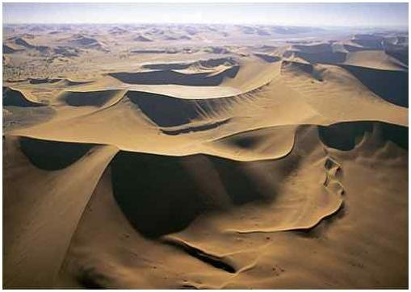
Hot climates: Deserts
Mr Boland
Geography

Slide 2
Where are deserts found???

Slide 3
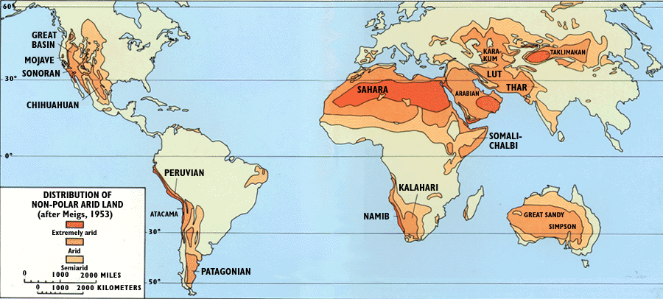
What have all deserts got in Common????

Slide 4
Where are deserts?
......in the path of the trade winds, 15 and 30 degrees north and south of the equator.
.......the western side of land masses near cold ocean. currents

Slide 7
Looking at the diagrams answer these questions.
How can cold currents contribute to making deserts dry??
How can trade winds contribute to making deserts dry??

Slide 8
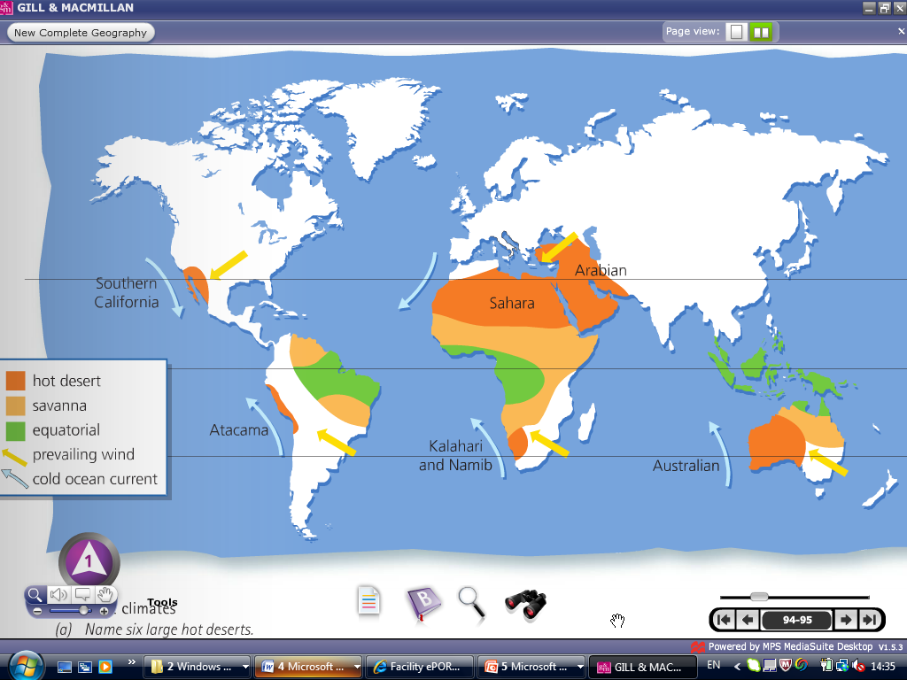

N.E. Trade Winds
Canaries Current

Slide 9
Deserts receive less than 100mm of rain each year
Trade winds are blowing towards the equator. These cold, dry winds become warmer and absorb moisture from the desert.
When winds blow from the west they have to pass over cold ocean currents. Hence they cool and lose their moisture before they can reach the land.

Slide 12
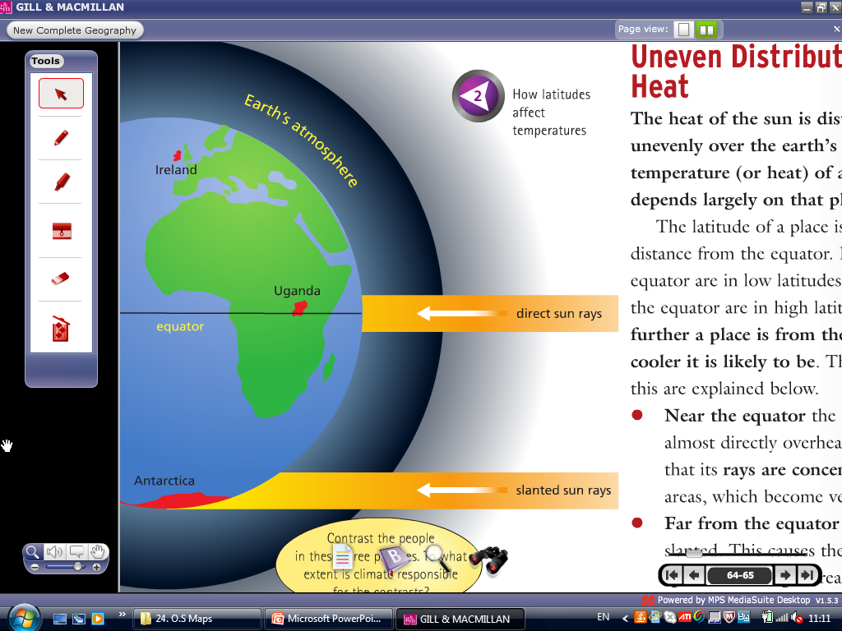
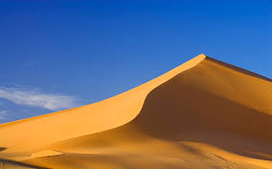
Why are Deserts hot

Slide 13
Deserts are hot usually over 30 to 50 degrees Celsius.
High pressure means that there is no clouds, no rain and light winds.
The latitude means the sun is high in the sky and is shining all day.

Slide 14
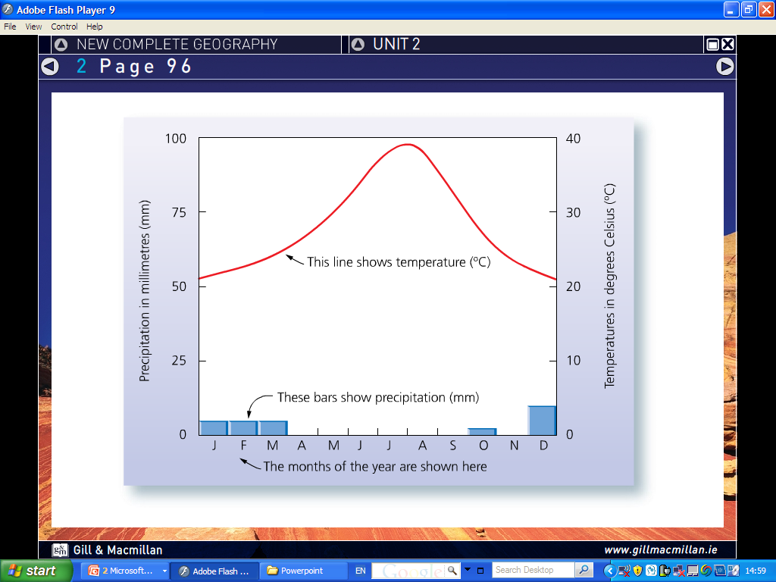

Slide 15
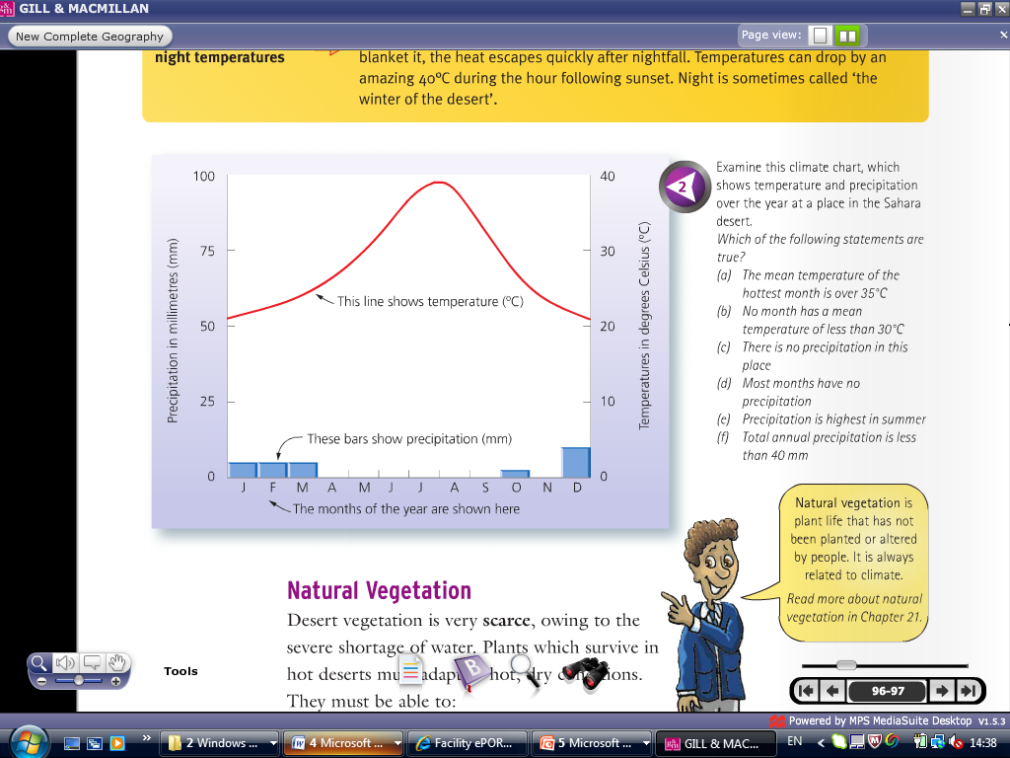

Slide 16
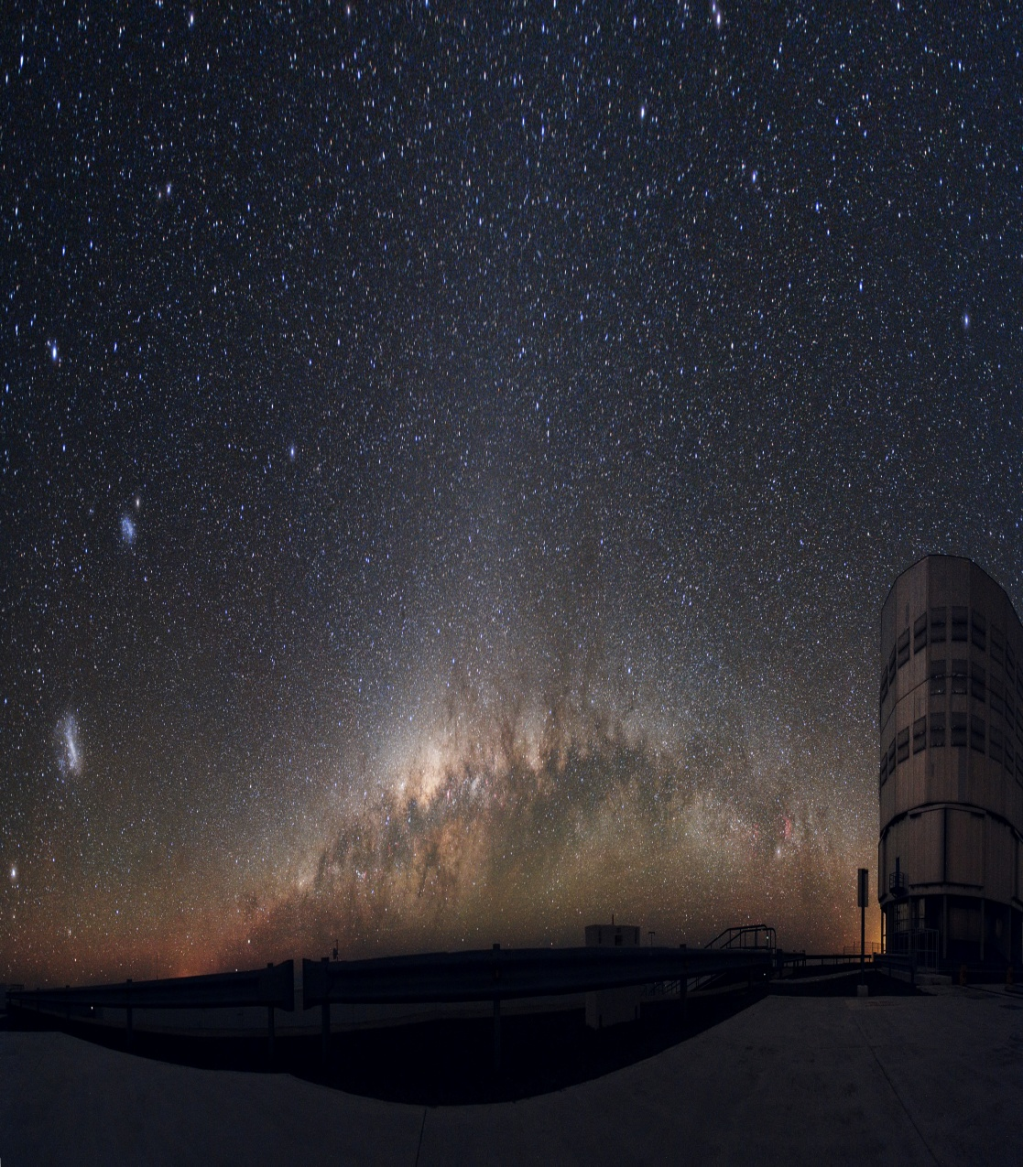
The temperature range can go from 30 degrees at day to 5 degrees at night.... WHY????

Slide 17
There is a large temperature range due to high pressure.
As there is no cloud cover at night there is rapid loss of heat from the sandy desert.
Remember land heats up quickly and losses heat quickly

Slide 18
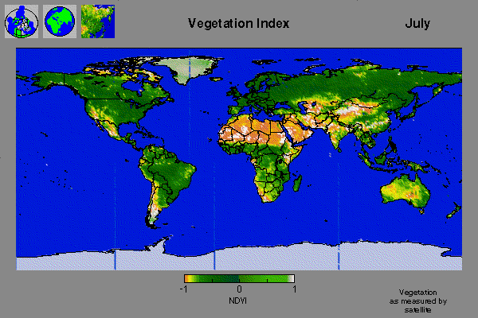
Natural Vegetation
As can be seen from the map vegetation in deserts are very sparse.
Plants have to adapt to the dry hot conditions
How does a cactus adapt to living in the desert?

Slide 19
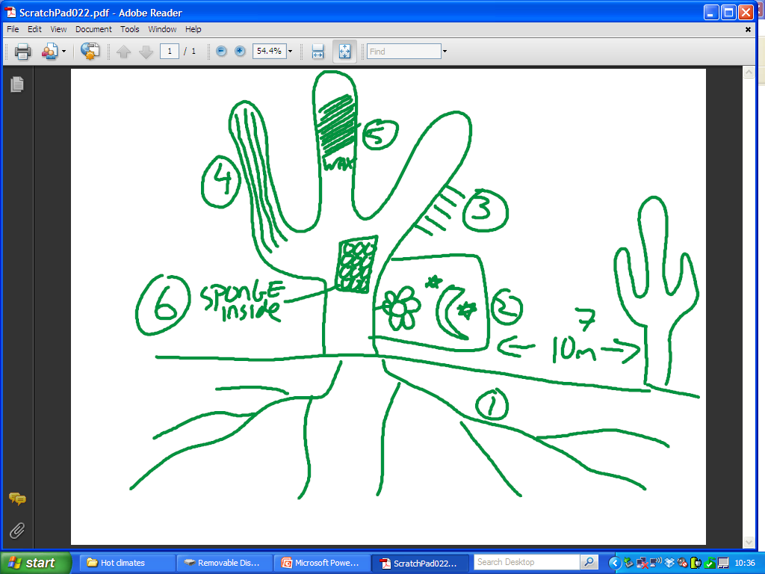

Slide 20
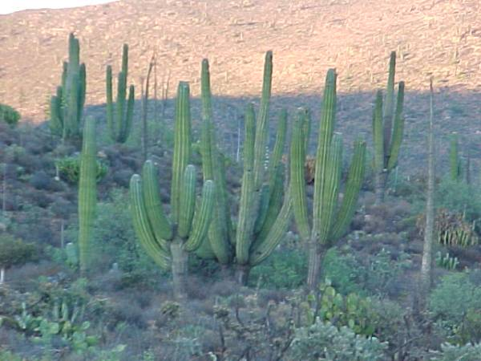
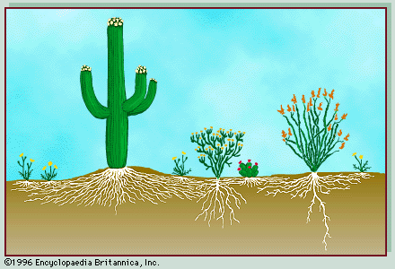
Vegetation- Cactus
Deep tap roots- to get water
Spaced far apart so there is no competition for water.
Skin is soft, spongy and has grooves to soak up water and expand.
Leaves are sharp spikes so there is no evaporation off them.

Slide 21
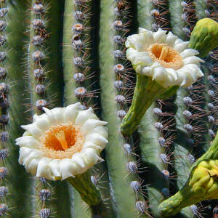
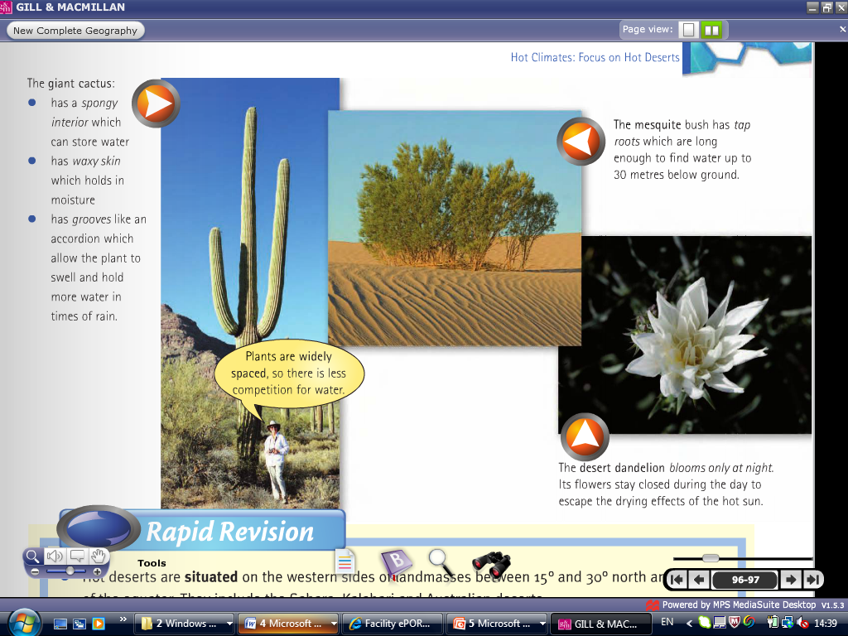
The flowers only open at night so they do not dry out.
Waxy skin prevents moisture escaping from within the plant.

Slide 22
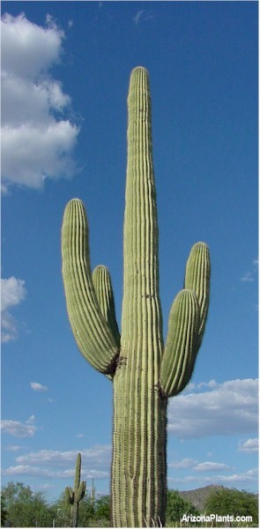
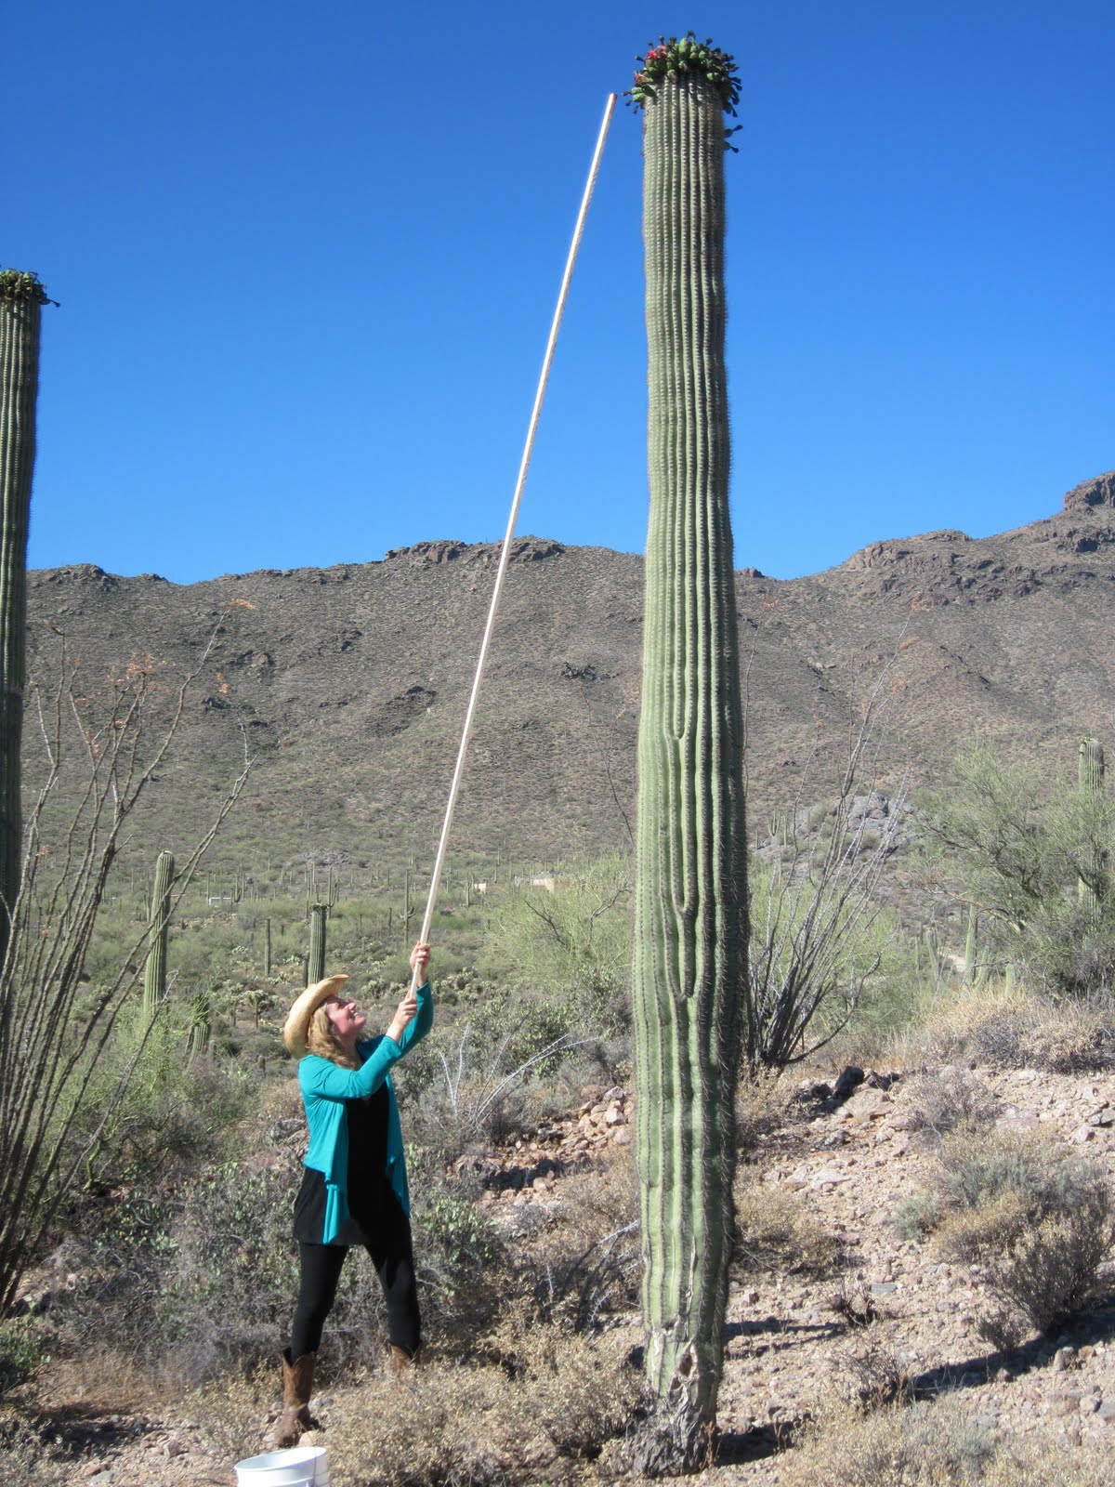
Saguaro is an example of a giant cactus.

Slide 24
Animals in the Desert

Slide 25
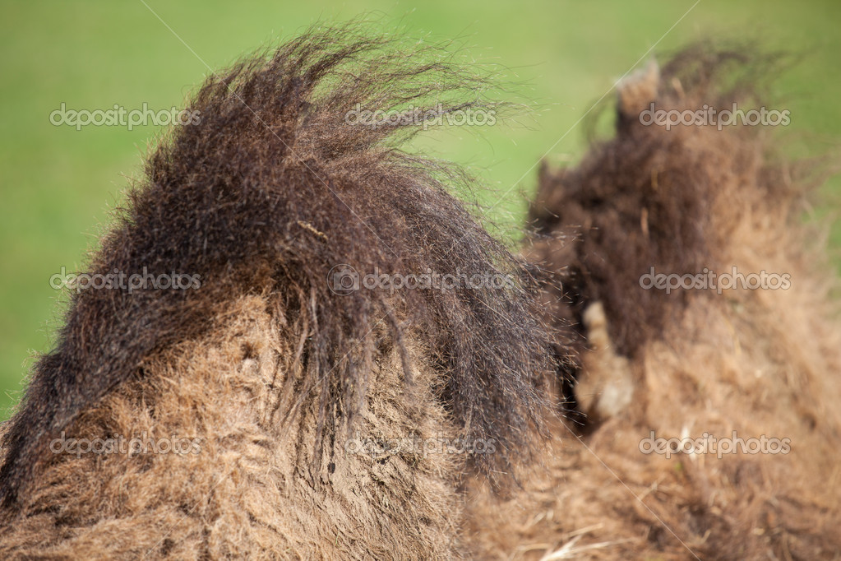
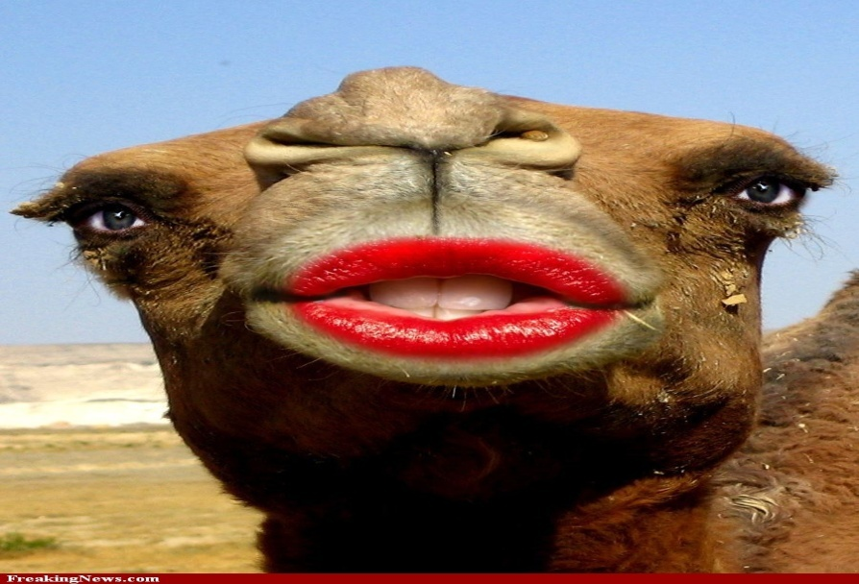
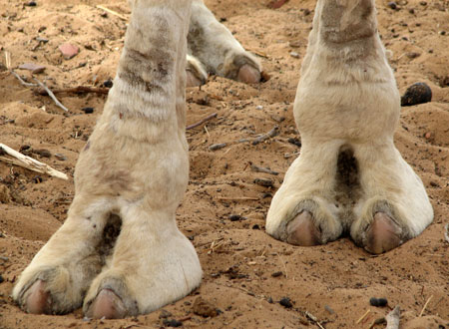
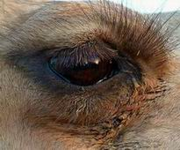
How has a camel adapted to live in the desert?

Slide 26
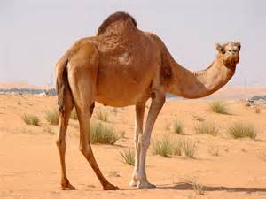
Humps to store fat and water.
Large eyelashes to keep sand out of their eyes.
Wide feet to walk in the sand
Thick lips to eat prickly plants

Slide 27
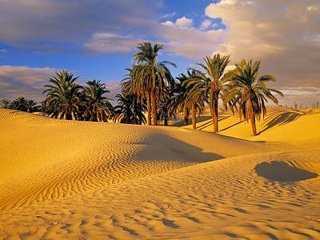

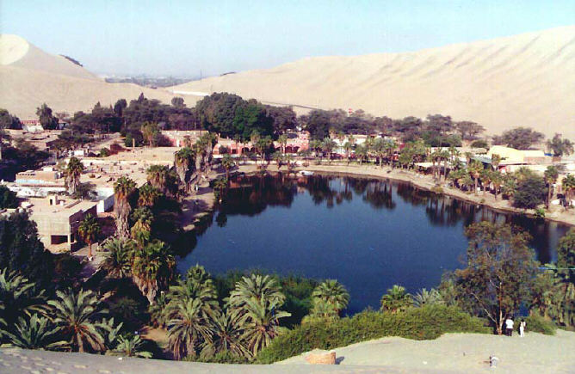
Oasis
-An oasis is an area in the desert where the presence of water has made the land fertile.
-These areas are covered by vegetation and can support crops.
-Many people use oases to grow crops.

Slide 28
Exam Questions

Slide 29
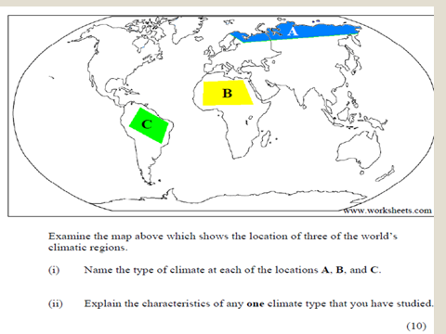

Slide 30
Describe how a climate you have studied affects vegetation/animals in that area. (10 Marks)

