Slide 1
Factors which affect climate
Mr Boland

Slide 2
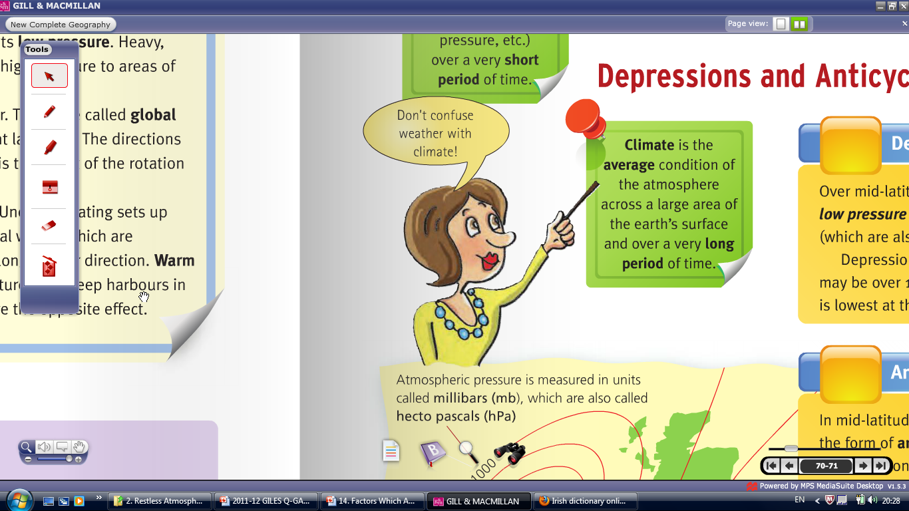
1) What is your understanding of weather?
2) What is your understanding of climate?

Slide 3
Weather is the day to day conditions of the atmosphere.
Climate is the average weather conditions across a large area over a long period of time (35years+).
Irish Climate is Cool Temperate
Today's weather is ___________ ???

Slide 4
The main Factors that affect world climates are
Latitude
Distance from sea or ocean
Prevailing wind

Slide 5
(1) Latitude
Latitude is the distance north or south of the equator.
The further north we go the colder it gets.
This is because the sun has to travel a further distance, through more atmosphere and is hitting the earth at a slant, producing less heat.

Slide 7
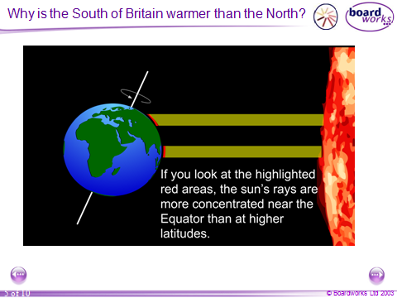

Slide 8
Why then is Warsaw hotter in the summer and colder in the winter than Limerick, even though they are at the same latitude.

Slide 9
What is the range

Slide 11
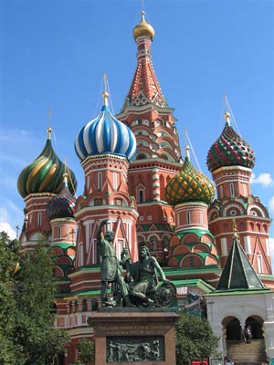
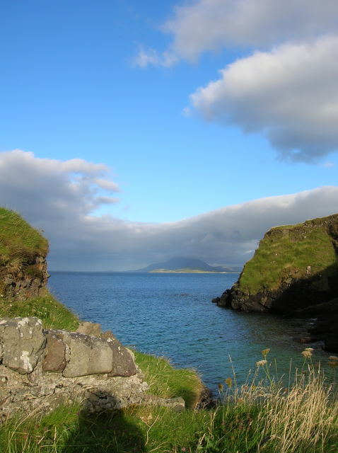



Slide 12
(2) Distance from the Sea
Reasons for difference in temperature are because the sea absorbs and loses heat much slower than land.
This means that coastal areas (Ireland) do not have very hot summers or very cold winters.
Temperature range is low and the climate is considered to be a temperate climate.

Slide 13
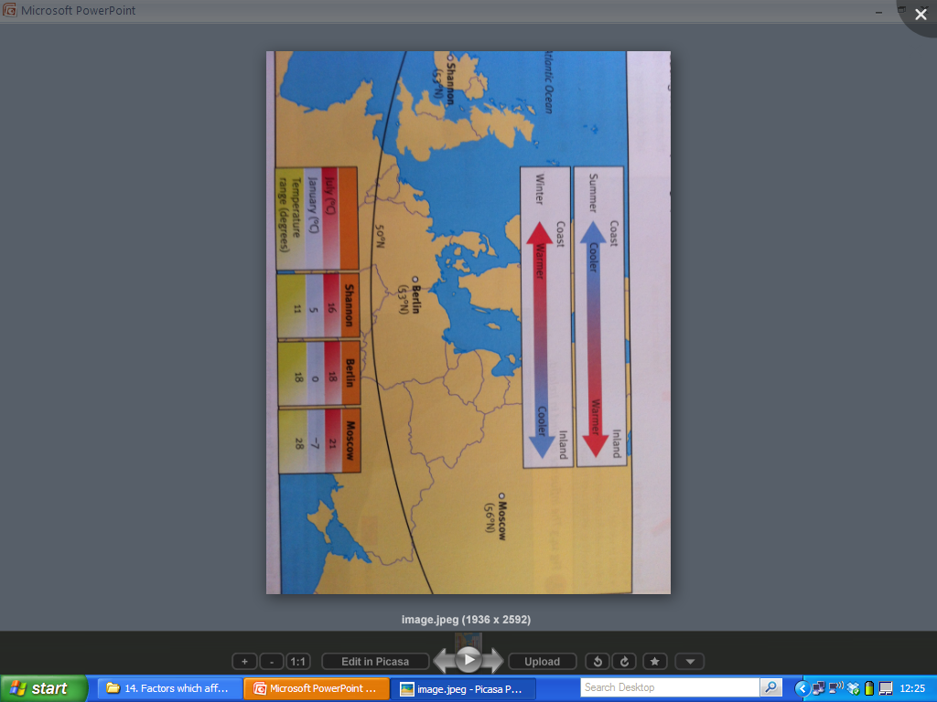

Slide 14
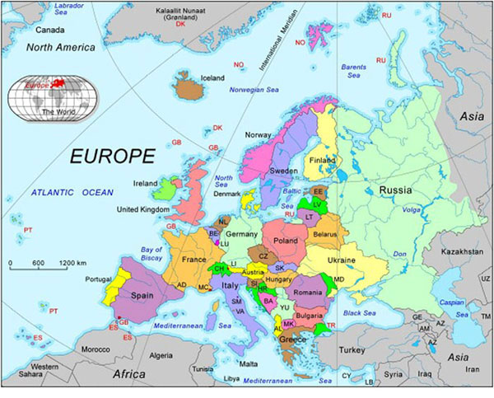

Slide 15
Distance from the Sea
Further inland,. land absorbs and loses heat much quicker that the sea
This means that areas far inland have hot summers and cold winters.
They have a high annual temperature range and the climate is described as a continental climate.

Slide 16
(3)Prevailing Winds and Air Masses
The wind that blows most frequently over an area is called the prevailing winds.
These winds are called after the direction that they come from.

Slide 17

Name each wind and say how each could affect the climate of Ireland and give reasons for your answers

Slide 19
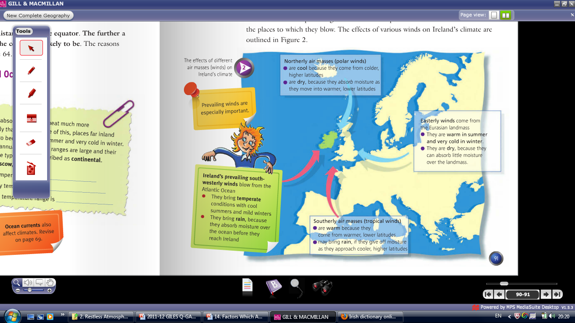

Slide 20
Local Climates
Within global climates there are small areas that may experience special climatic conditions. These are affected by.
Altitude
Relief

Slide 21
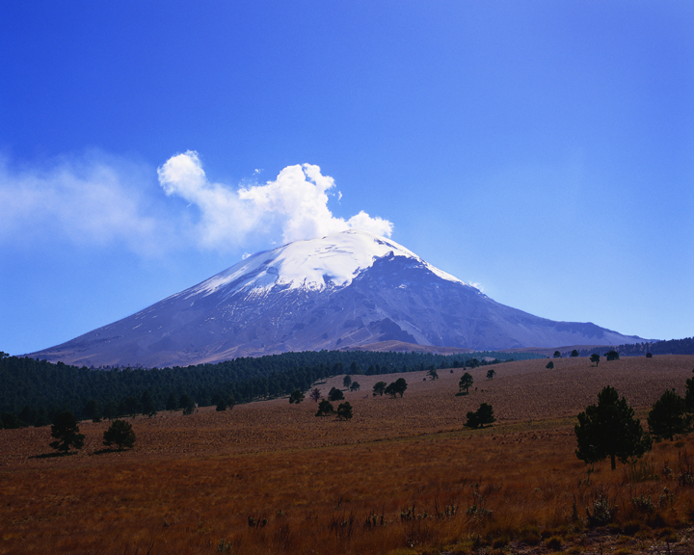
Why is there snow on top of this mountain.

Slide 22
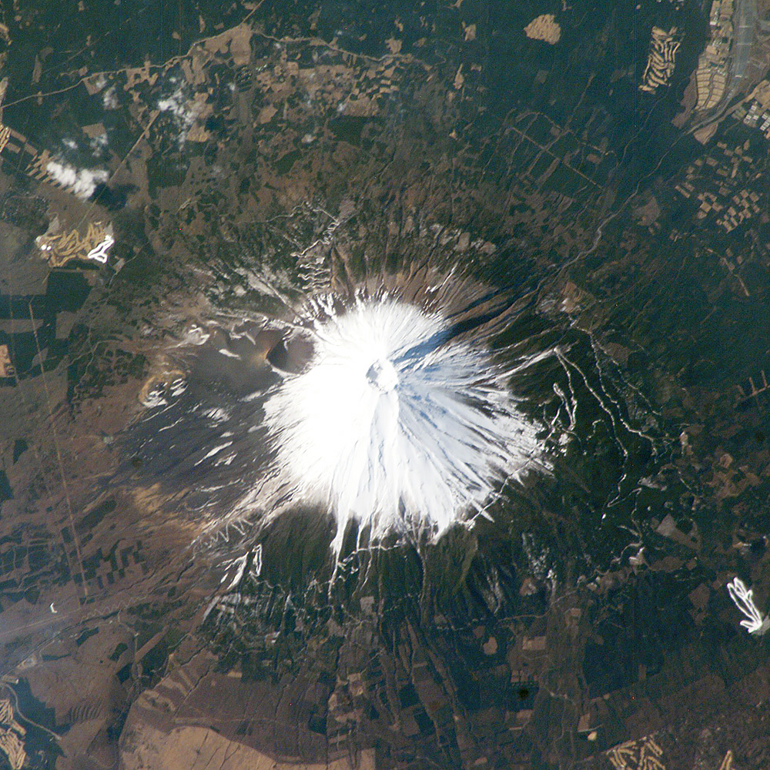
(4) Altitude
Altitude refers to the height above sea level.
For every 150 metre above sea level the temperature drops by one degree, this is the lapse rate.
The reason for this is because the atmosphere gets thinner the higher one goes.

Slide 23
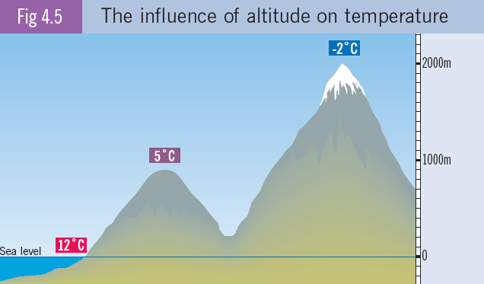

Slide 24
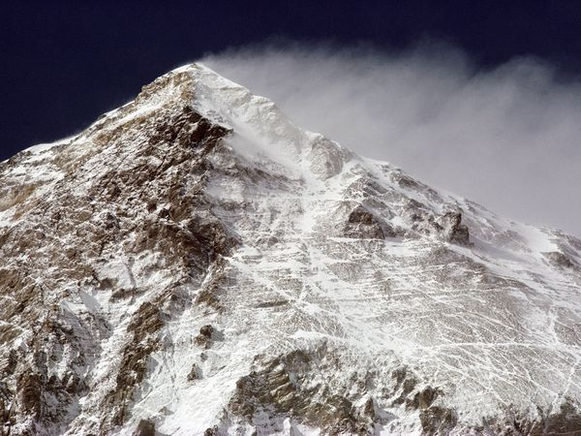
The chill factor
The top of high mountains are exposed to high winds.
These winds can further reduces temperatures

Slide 25
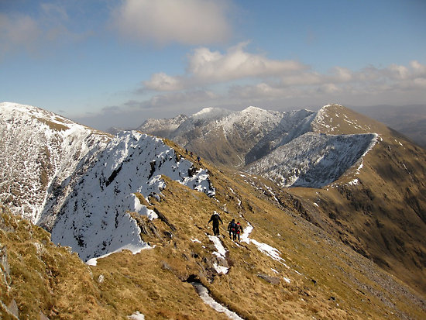
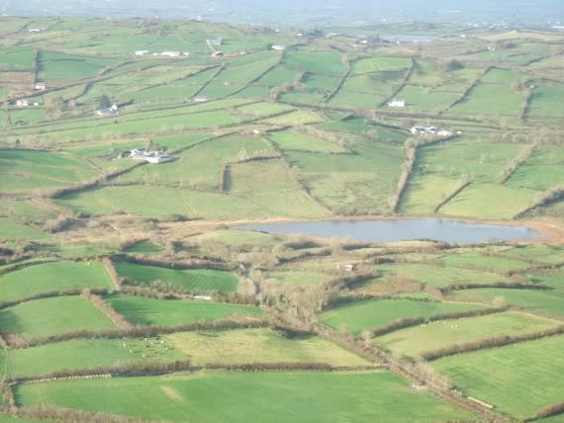
(5) Relief
Relief means the shape of the land.
Monaghan has a hilly topography, while Kerry has a Mountainous topography.

Slide 26
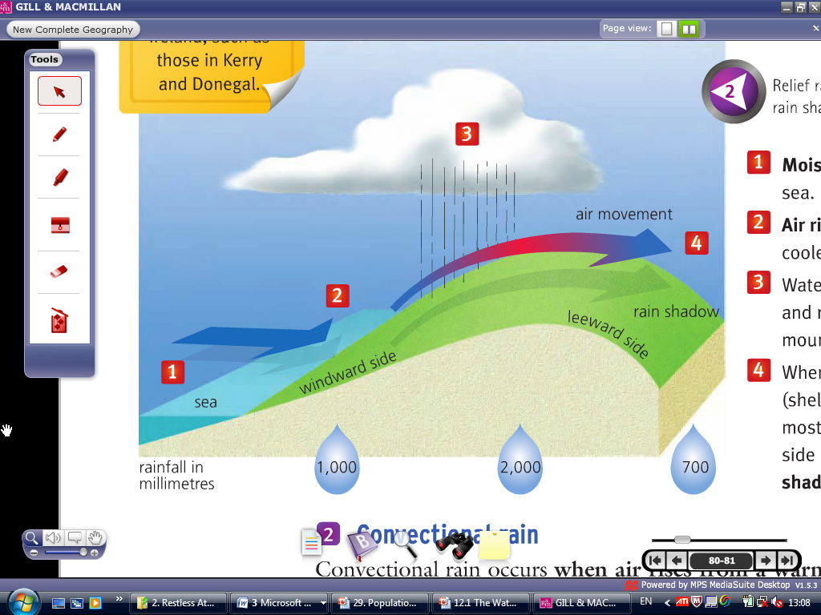
(5) Relief- Precipitation
When winds blow in from the sea, the seaward slopes of coastal mountains may receive high levels of relief rain.
The leeward slopes may be dry because of the rain shadow.

Slide 27
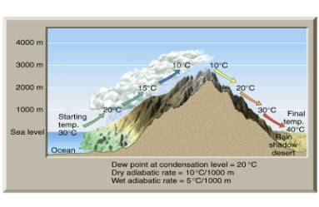

Slide 28
Why is there snow on one side of these mountains and not the other.
What direction is the snowy side facing

Slide 29
(6) Aspect
Aspect is the direction in which a slope faces.
If the slope is facing the south it will be warmer as it is facing the sun and warm winds
If the slope is facing the north it will be out of sunlight and will be facing cold northerly winds.

Slide 30
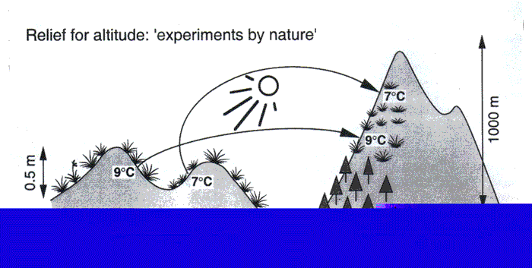
Which slopes are the warmest and why?

Slide 32
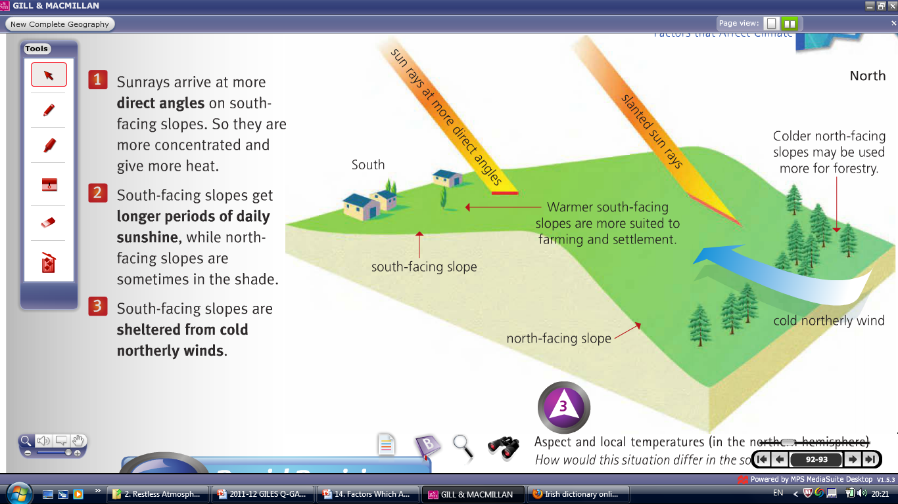
(6) Aspect and Temperature

Slide 33
Junior Cert Exam Questions

Slide 34
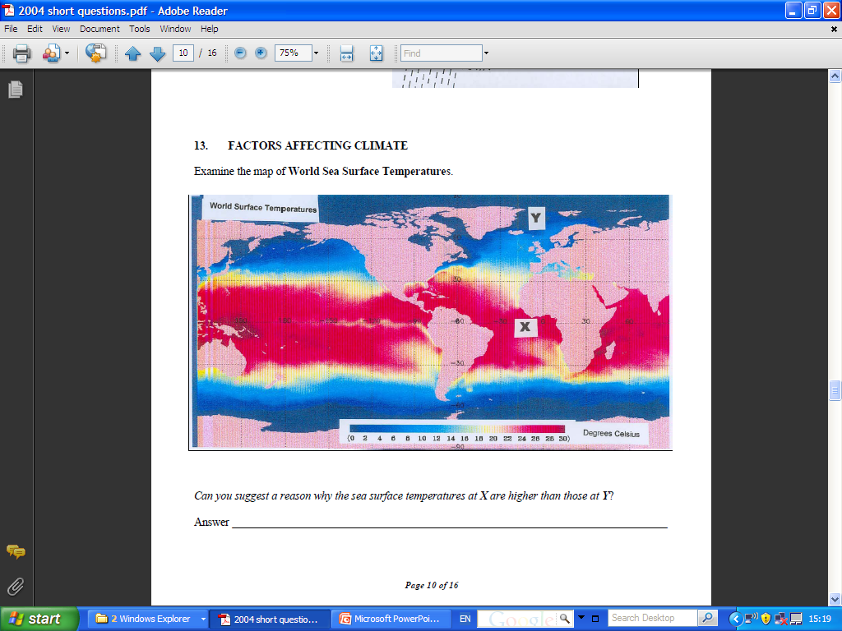

Slide 35
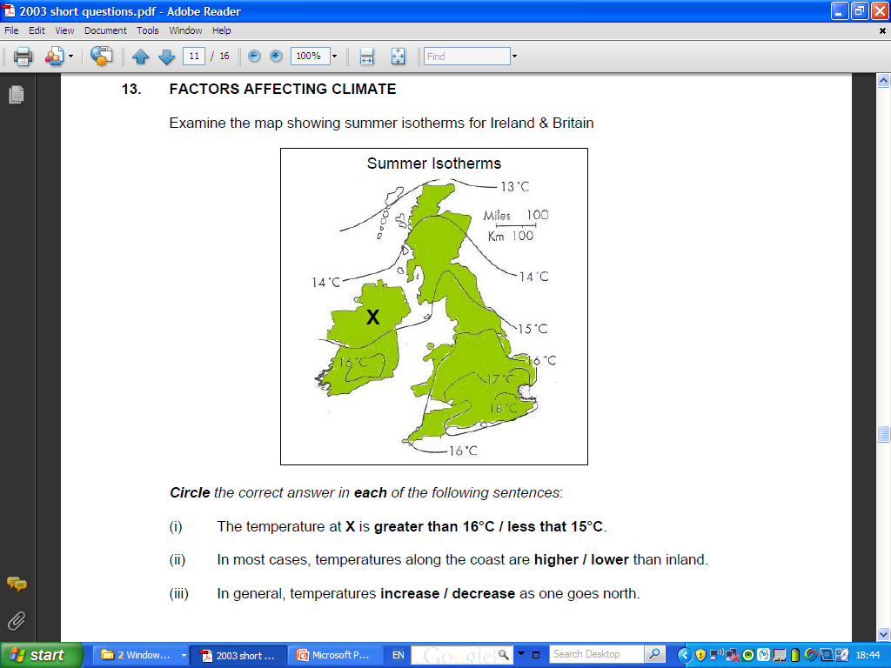

Slide 36
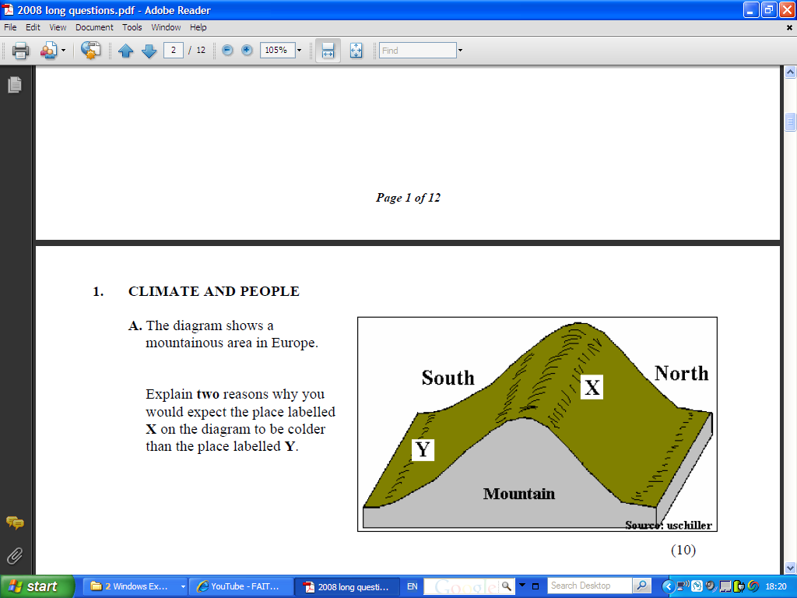

Slide 37
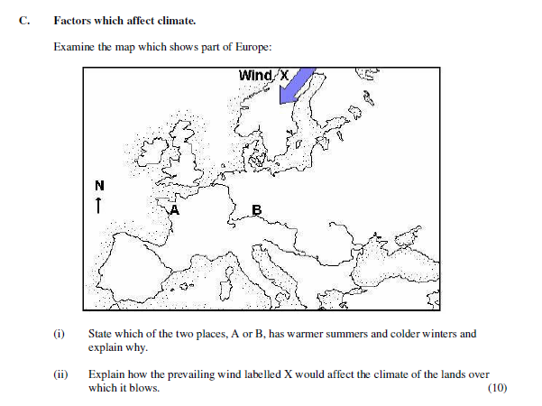

Slide 38
