Slide 1
Deformation
Mr Boland
Geography

Slide 2
The earths crust is divided into layers. But because the earths plates are convergent, neutral and divergent the layers of the earths crust have been changed and deformed.
The three types of deformation are
1. Folding
2. Faulting
3. Doming

Slide 3
1. Folding
Folding of rocks occurs when they are compressed or squeezed. Rock can be folded because at depth it is subjected to great heat and pressure which makes the rock flexible and so it cab bend without breaking
The parts of folds are
1. Anticlines- this is the upfold or the ridge.
2. Synclines- this is the downfold or the valley.
3. Limbs- these are the arms of the folds.

Slide 4
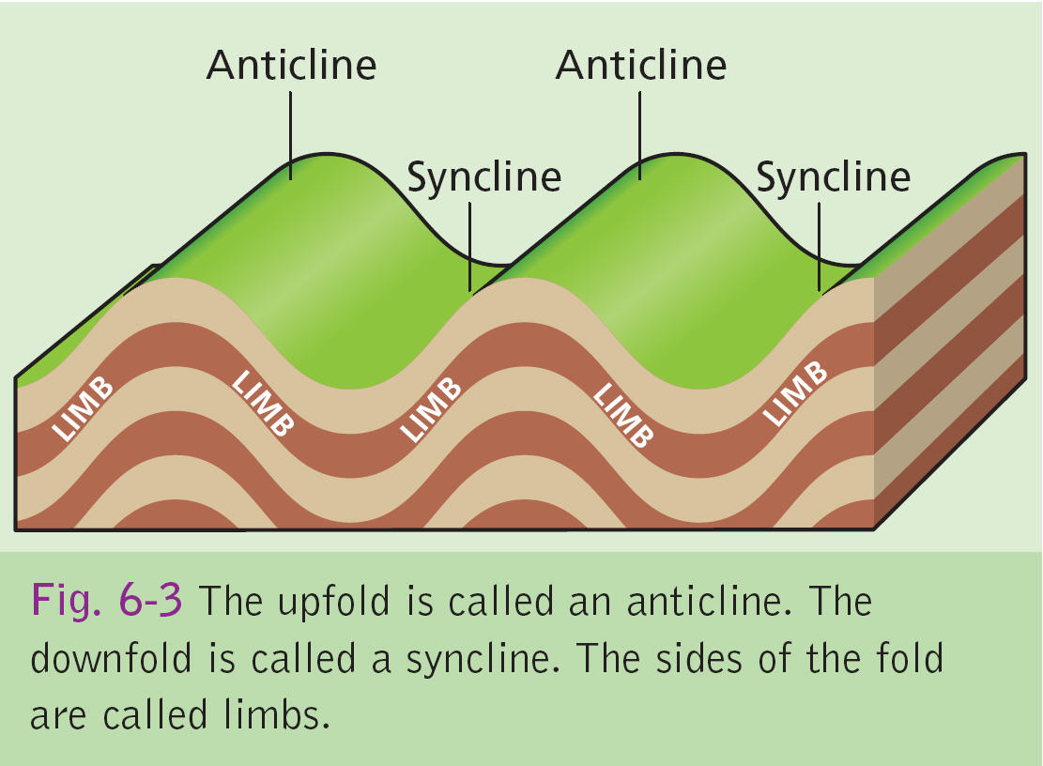

Slide 5
Types of folding
There are many different types of folds such as.
Monocline-horizontal layers tilt in one direction
Symmetrical (simple) folds- where both slopes of the anticline are equal.
Asymmetrical fold- where one slope of the anticline is greater than the other.
Overfold-Where one slope of the anticline has overturned.
Overthrust fold- the rock strata are no longer continous because the folding is so great it has called a fault/ crack and one limb is pushed over the other.

Slide 6
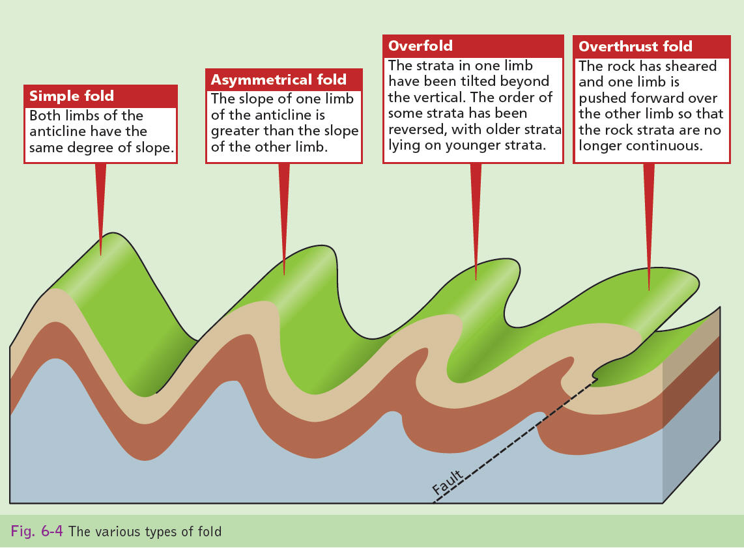

Slide 7
Fold Mountains
There are three types of fold mountains.
Caledonian fold mountains.
Armorican fold mountains.
Alpine fold mountains.
Irelands mountains are Caledonian and Armorican fold mountains.

Slide 8
Caledonian Fold Mountains
When the American and Eurasian plate collided it resulted in intense folding and compressing of sand and mud from the sea bed. Igneous rock then formed as magma forced its way under the folds and cooled. This also resulted in metamorphic rock being formed as the heat from the magma changed any rock in came in contact with.

Slide 9
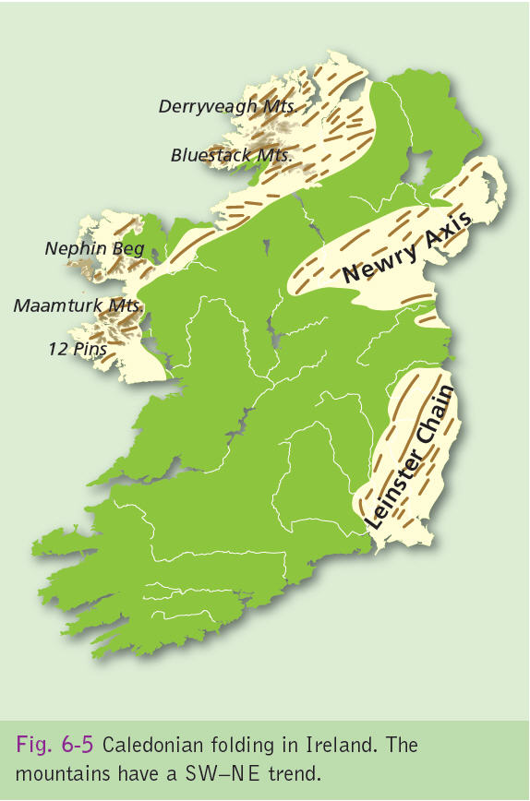

Slide 10
Caledonian Fold Mountains
Examples of Caledonian fold mountains are Wicklow- Dublin mountains, Donegal mountains and the Galway/ Mayo mountains.
These mountains all run from the northeast to southwest.

Slide 11
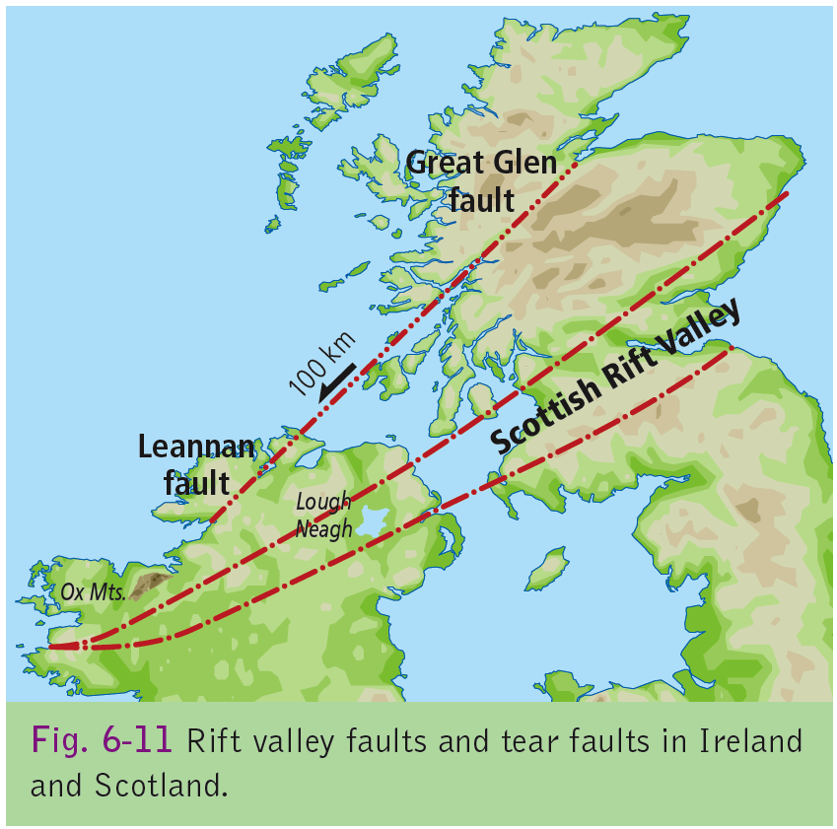

Slide 12
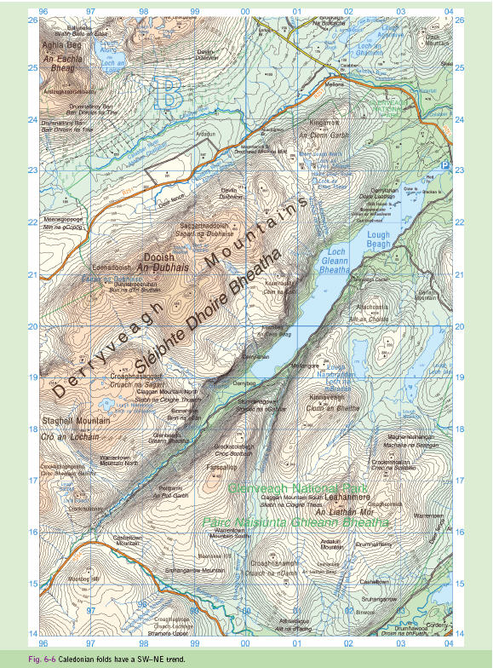

Slide 13
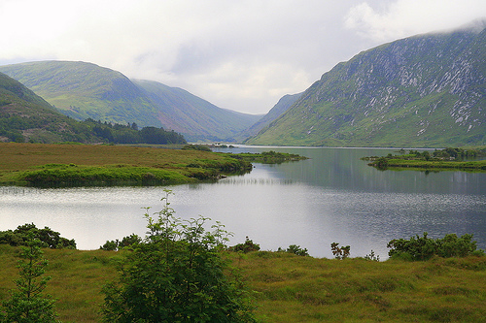

Slide 14
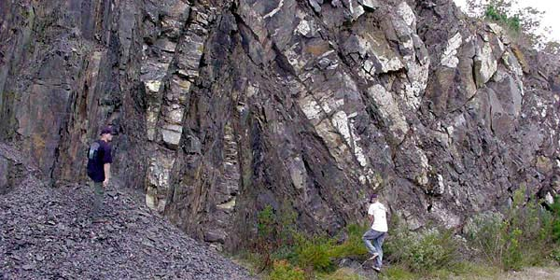

Slide 15
Armorican Folding
The Armorican fold mountains formed less than 300 million years ago and affects the south of Ireland. These mountains run east to west and give rise to a distinct “ridge and valley” landscape.
Anticlines (ridges) of red sandstone are separated by synclines (valleys) of limestone and shale.
It is this folding that lifted the karst landscape of the Burren from beneath the sea

Slide 16
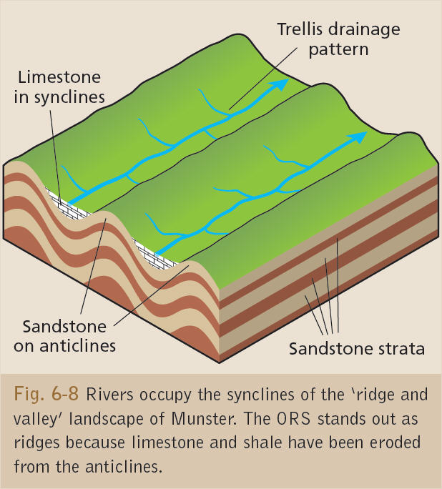

Slide 17
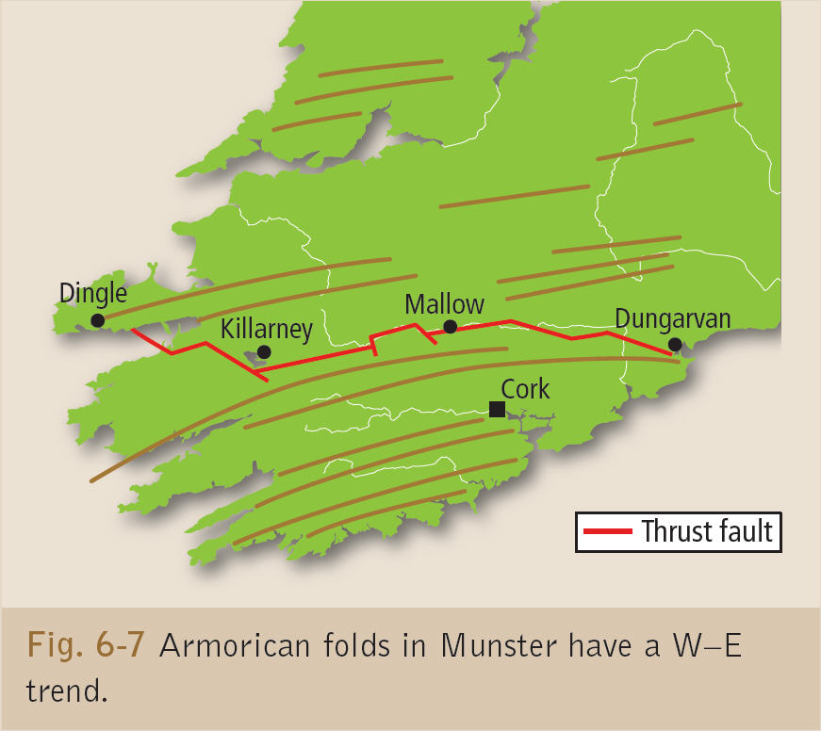

Slide 18
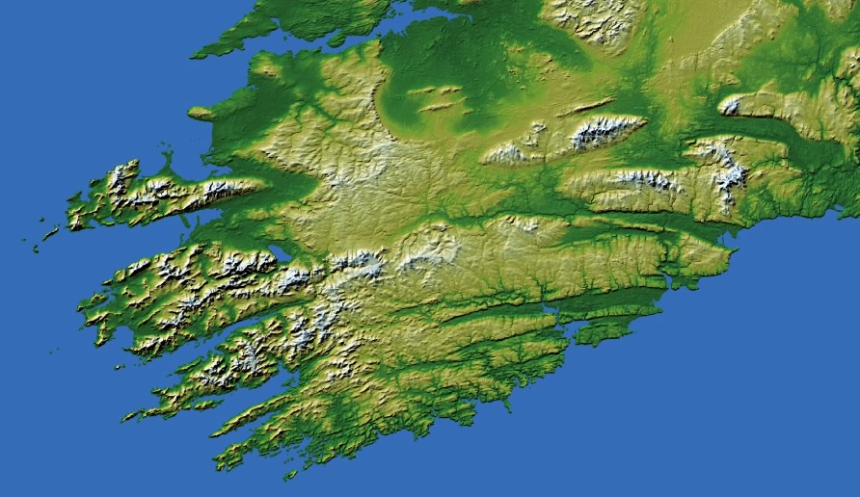

Slide 19
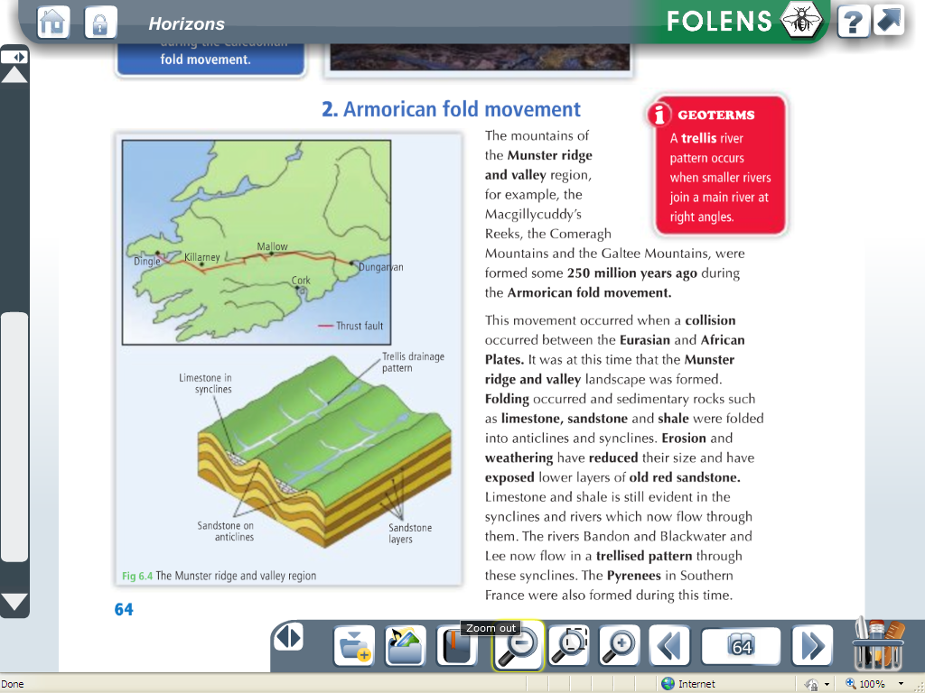

Slide 20
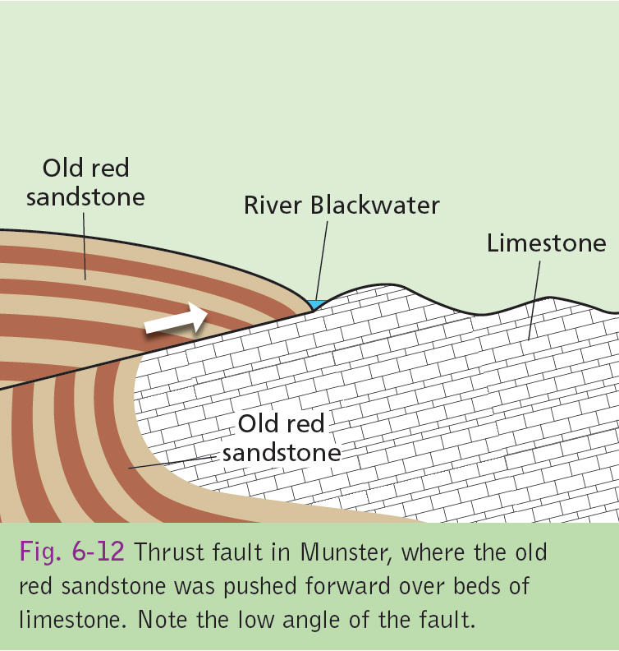
Reverse Fault
There is an example of a Reverse fault running from Dungarvan to Dingle Bay, where the African and Eurasian plate collided. The pressure pushed the sandstone on top of the limestone.

Slide 21
Alpine Mountains
When the African and Eurasian plate converged 30 million years ago it formed alpine fold mountains like the Alps. These are young fold mountains. Earthquake activity in the area show that the plates are still converging

Slide 22
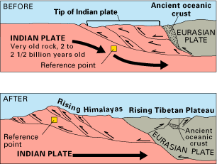

Slide 23
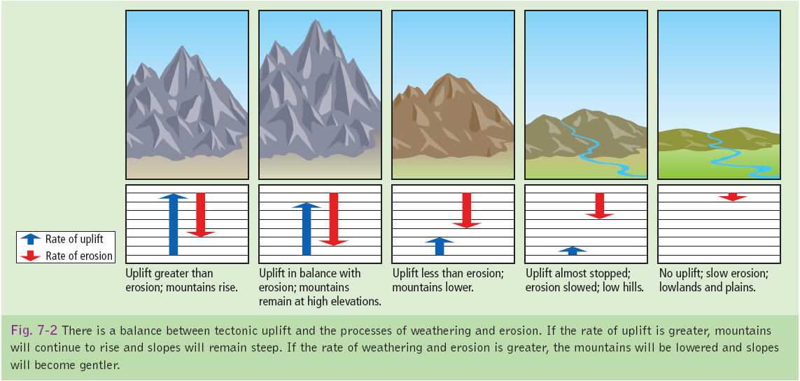

Slide 24
When plates are pushing together it causes uplift this means that the mountains are getting higher, if the rate of erosion is greater than the uplift the mountains gets eroded and get smaller. If the rate of uplift is greater than erosion the mountain continues to grow.

Slide 25
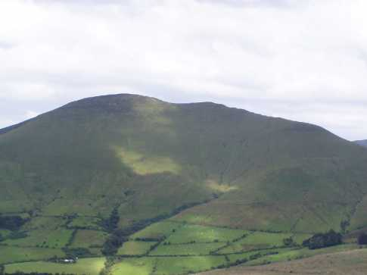
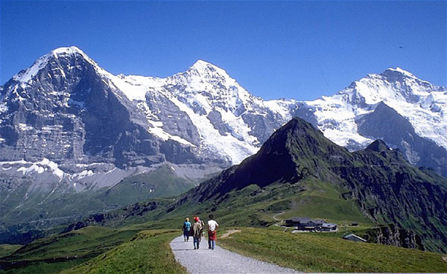

Slide 26
Global distribution of fold mountains

Slide 27
Fold mountains are found at only one plate margin- Convergent margins.
At convergent margins fold mountains only occur at
Oceanic- continental margin
Contenental- continental margins

Slide 28
Continental- Oceanic Margin
Ex;Nazca plate & South American Plate forming the Andes.
The heavier oceanic crust slides beneath the lighter contennetal crust. As the plates collide, the sea- floor sediments carried by plate collision slowly compresses the sediments and uplifts them.
At the same time the rocks of the continental crust are also folded and uplifted.
Fold mountains formed in this way may also have volcanic mountains within them. This is because as the oceanic crust is subducted below the continental crust, it melts and is recycled; Ex-Cotapaxi .

Slide 29
Continental- Continental Margin
When two continental plates collide such as the India and Eurasian plate neither plate sinks into the mantle. This is due to plates being rich in silicon and aluminium (sial) that are less dense than the material below so they float of the surface of the mantle. Rocks on both sides are folded and uplifted.
Example Himalayas

Slide 30
2.Faulting

Slide 31
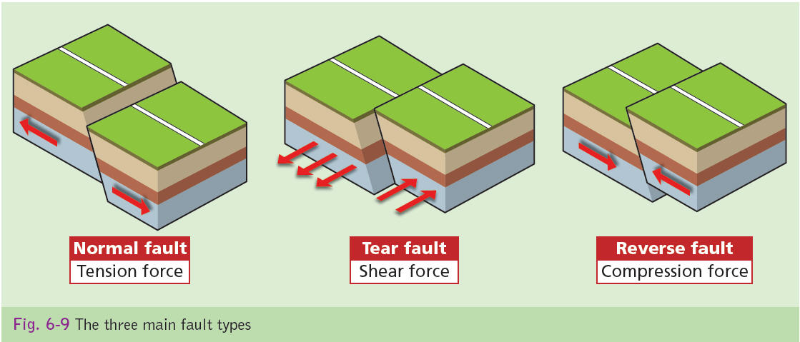
Faulting happens when pressure is so intense it open a fracture in the ground. This could result in the fracture running along a fault line. Movement here can be up/down/side to side.
Types of faults are, normal, reverse & tear faults.

Slide 32
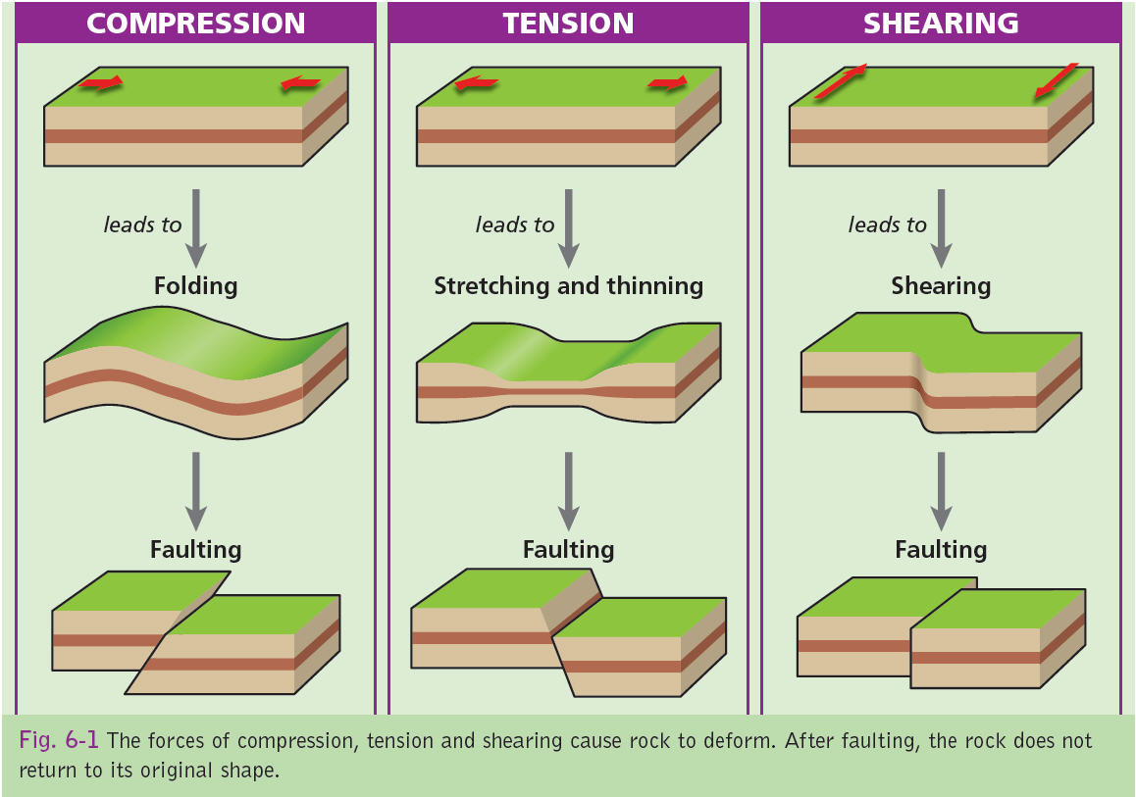

Slide 33
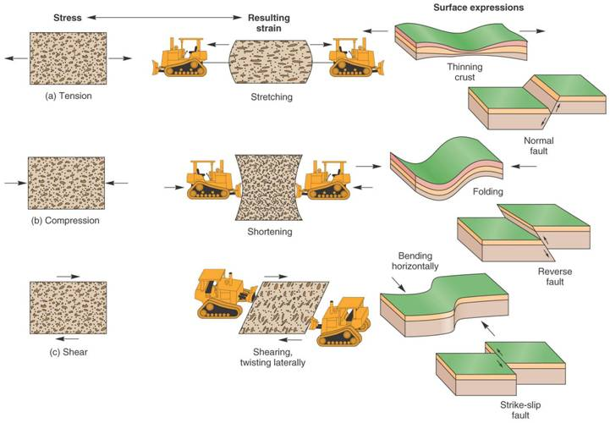

Slide 34
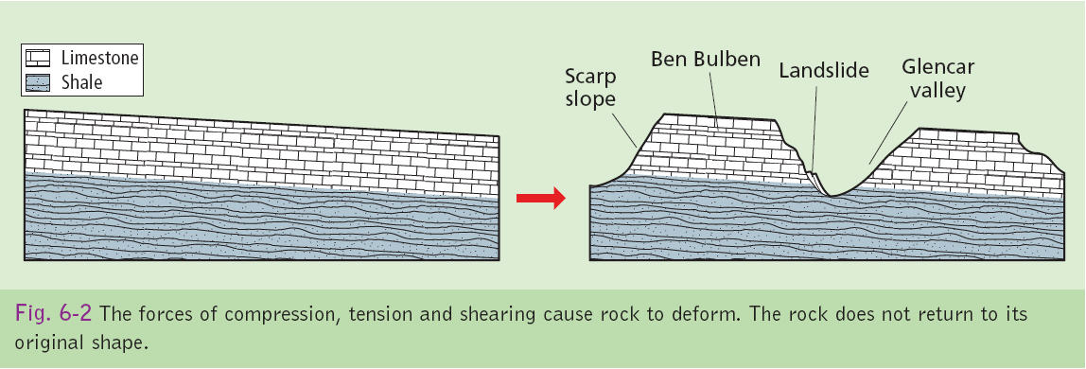

Slide 35
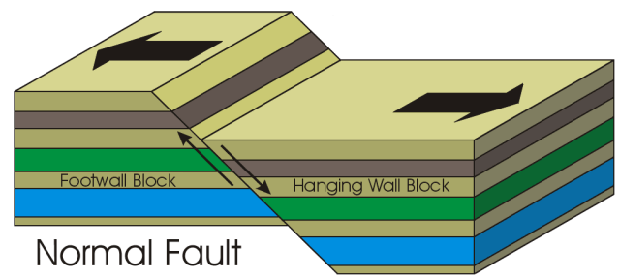
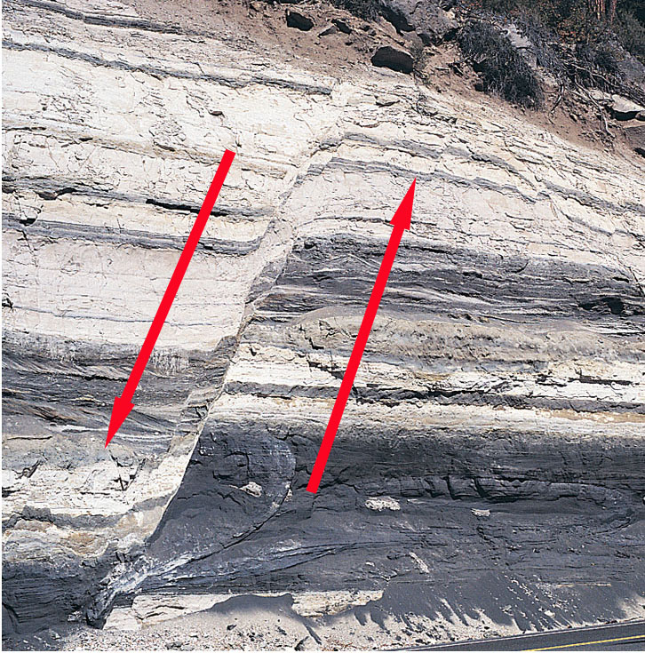
1. Normal fault
When two plates are separating a fracture occurs, one plate slips downwards due to gravity.
Normal faults result in rift valleys and block mountains.

Slide 36
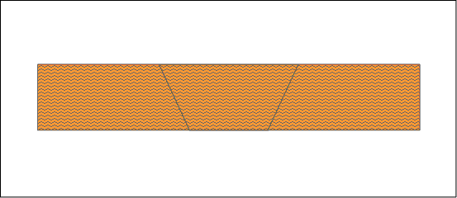
Rift Valleys
When two normal faults are parallel to each other, the inner slab slips down as the crust parts. This is what causes rift valleys or graben as they are sometimes know.
The east African rift valley is widening due to continental divide.

Slide 38
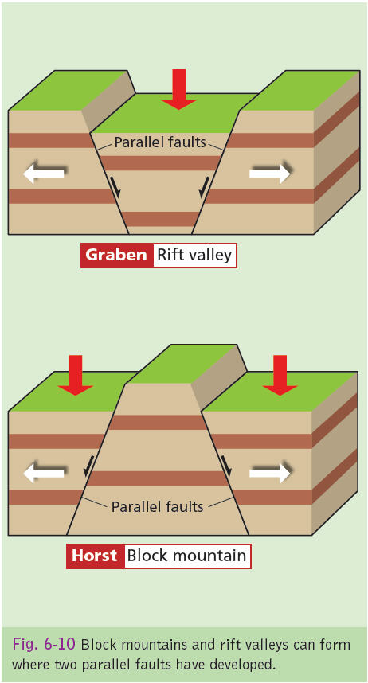
Block mountains
Block mountains form due to compression between diverging plates.
The Ox mountains are an example of a block mountain.
A block mountain is also know as a Horst.

Slide 39
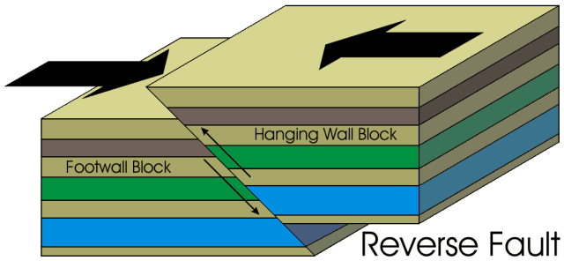
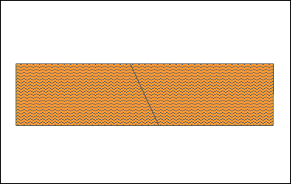
2.Reverse Fault
When plates converge a fracture may open in the earth. angel greater than 45 degress
This causes one plate to be forced up as the pressure increases, when the crust is shortened it is know as a reverse fault.

Slide 40
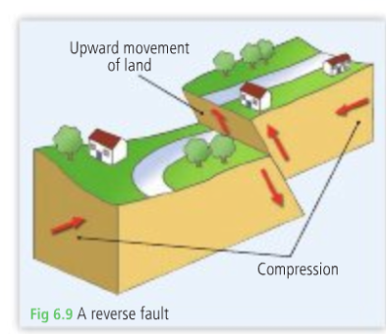

Slide 41
Reverse Fault
There is an example of a Reverse fault running from Dungarvan to Dingle Bay, where the African and Eurasian plate collided. The pressure pushed the sandstone on top of the limestone.

Slide 42
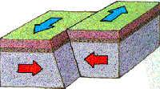
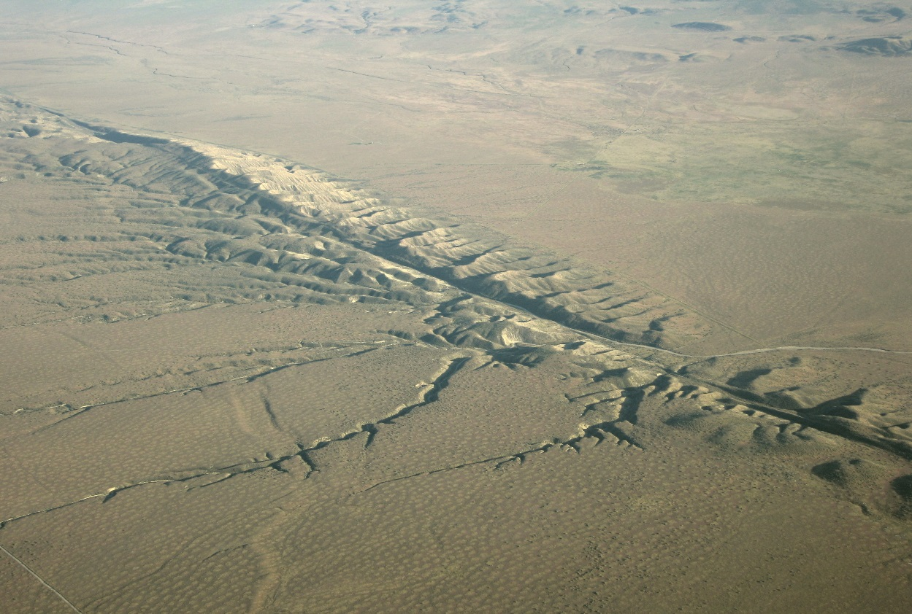
Tear Faults
This is a fault where one block moves sideways or horizontally past another instead of up and down.
EX; San Andreas Fault Line

Slide 43
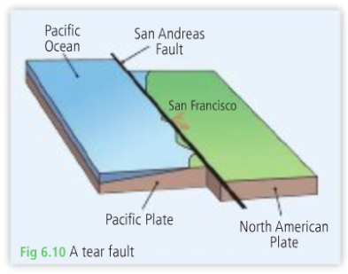

Slide 44
In Ireland the Lennon tear fault in Donegal is an extension of the Great Glen fault in Scotland. Here the North of the fault moved in a SW direction for 100 km.

Slide 46
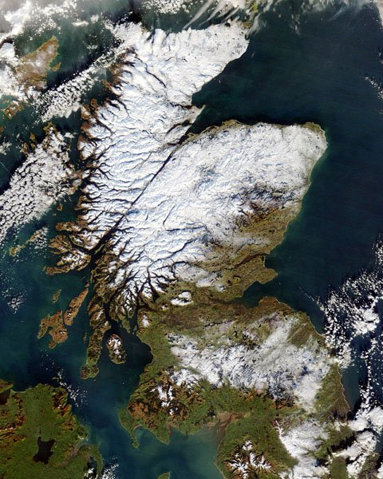
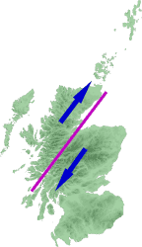

Slide 47
The rocks along this fault badly crushed so they are weathered and eroded very easily.
This means rivers can cut easily into the fault.

Slide 48
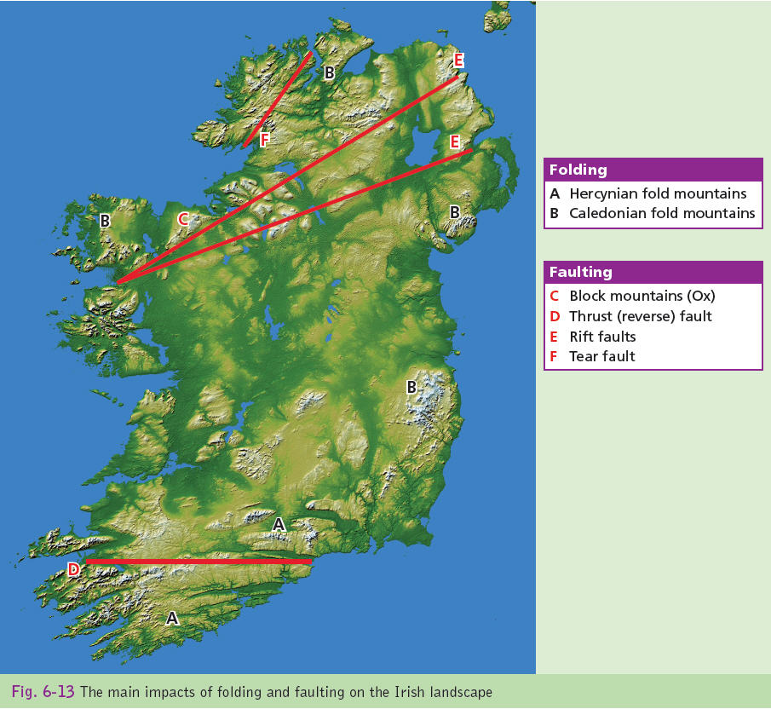
Folding????
Faulting

Slide 49
Armorican Fold Mountains

Slide 50
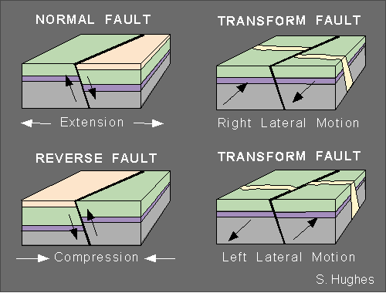

Slide 51
Doming

Slide 52
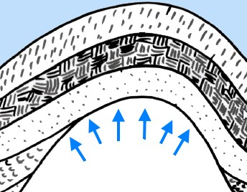
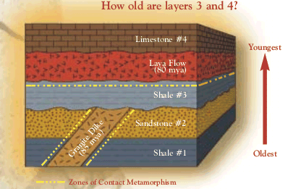
A sedimentary dome looks like an upturned bowl.
The original structure was a bed of flat lying sedimentary rock.
Great amounts of magma pushed up from under the asthenosphere forcing the layers up without breaking or faulting them.

Slide 53
3. Doming
Often the magma underneath cool to form igneous rock.
Over time the sedimentary rock is weathered and eroded to leave a granite dome.
ExampleSlieve Bloom in Laois were formed 60 million years ago as

Slide 54
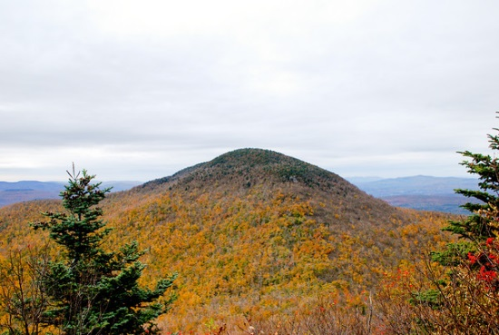
Granite dome surrounded by sedimentary rock

Slide 55
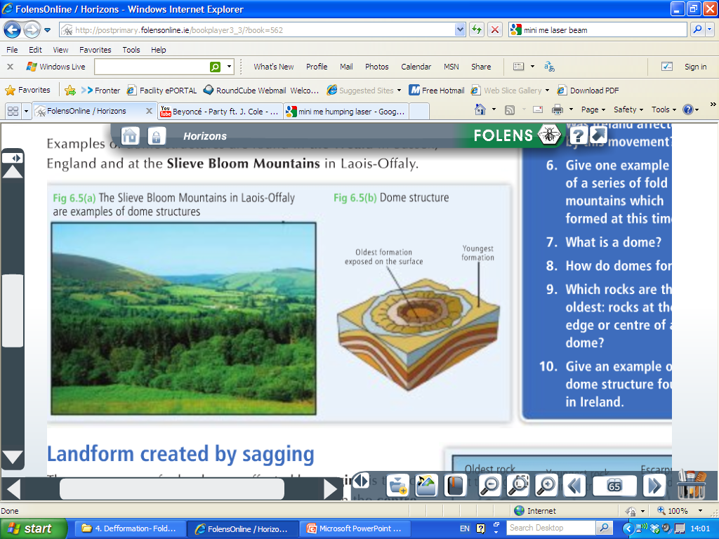

Slide 56
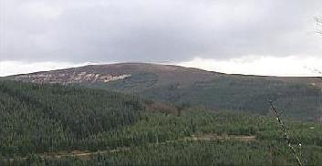

Slide 57
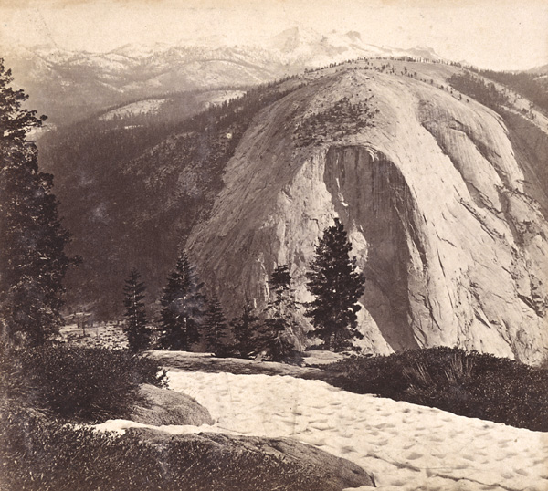

Slide 58
Questions

Slide 59
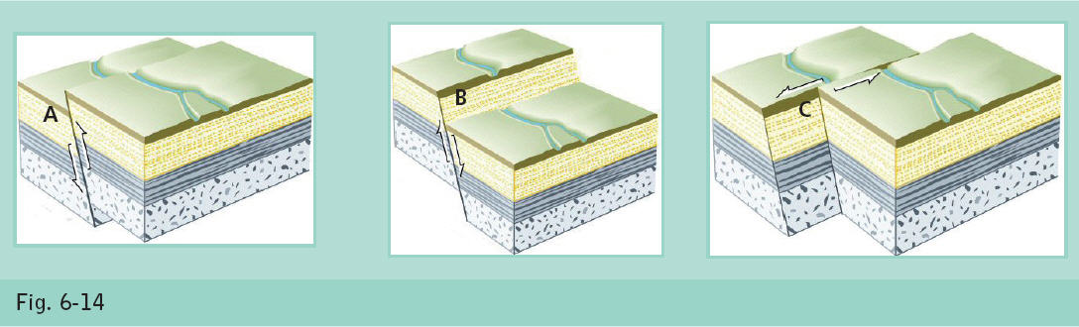

Slide 61
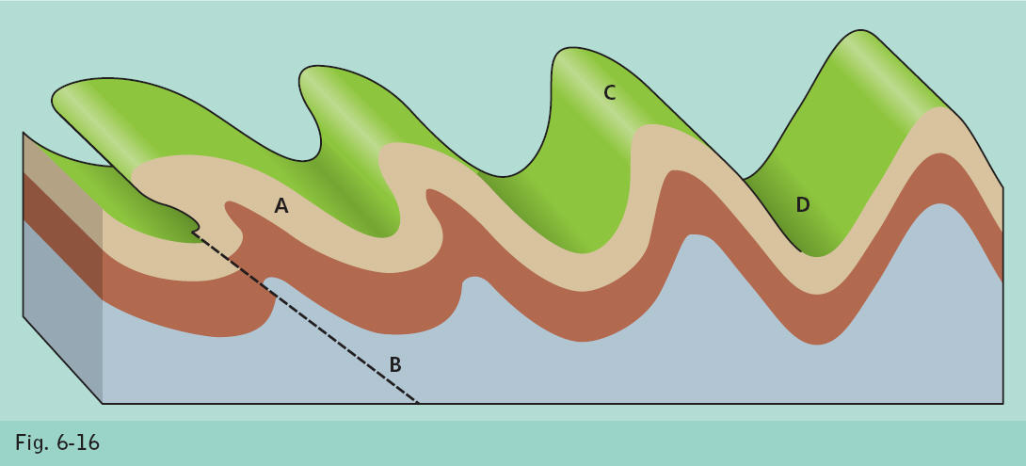

Slide 62
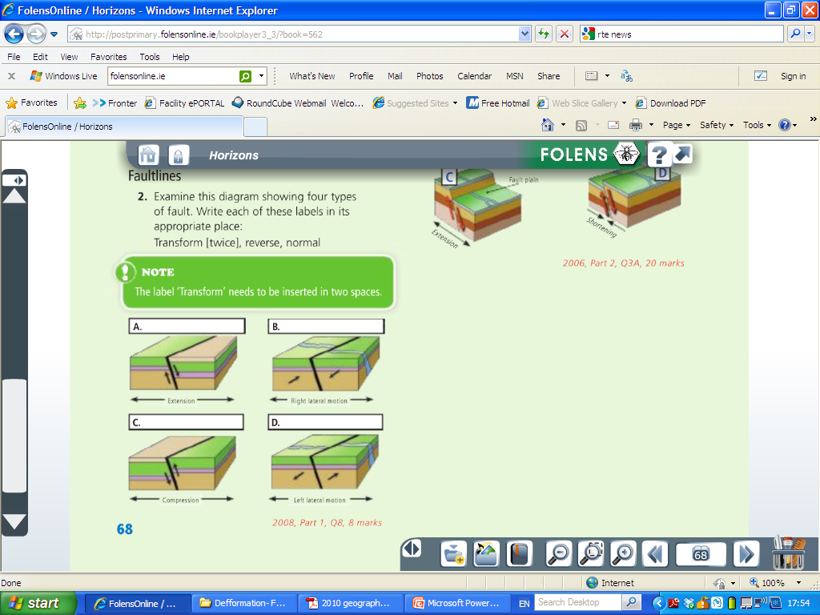

Slide 63
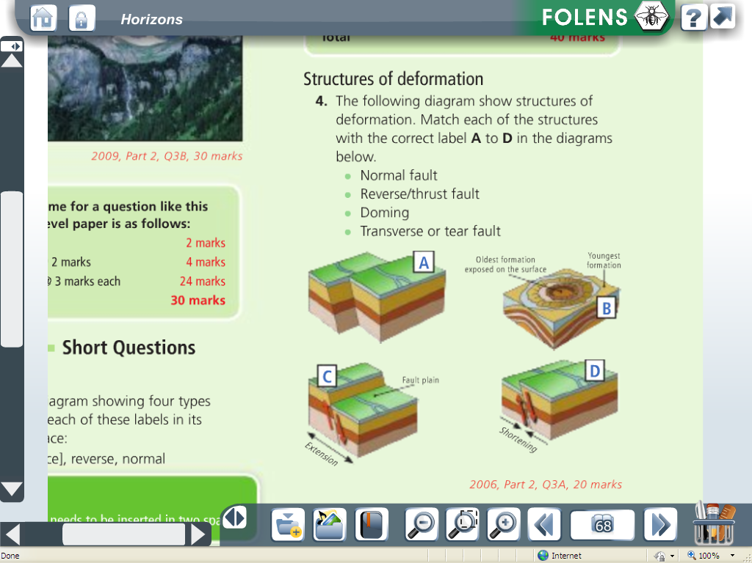

Slide 64
30 Mark Questions
Examine the impact of folding and faulting on the Irish landscape.
Describe how the study of plate tectonics help us understand the location of fold mountains.

Slide 65
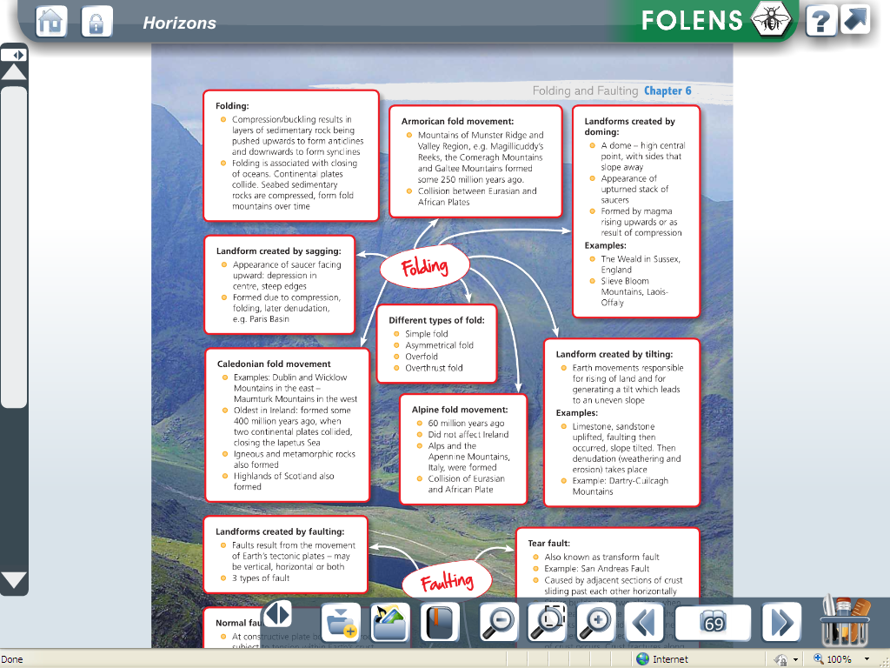

Slide 66
