Slide 1
Regional Geography
Definition of Regions
D Boland

Slide 2
What is a region
A region is an area of land with a unique character that makes it different from other areas. The criteria that distinguish regions are natural/ physical attributes and human environment.
Regions are complex and often blend into one another, with their borders sharing common characteristics and changing over time.

Slide 3
What you need to know in this Section
Physical region- The Burren.
Climatic regions-Cool Temperate Oceanic
Region of industrial decline- Europe.
Region of cultural divide.
Region defined by religious belief.

Slide 4
1. Physical Region

Slide 5
Geomorphologic (Physical)Region.
A region defined by its physical attributes. The Burren in County Clare

Slide 6
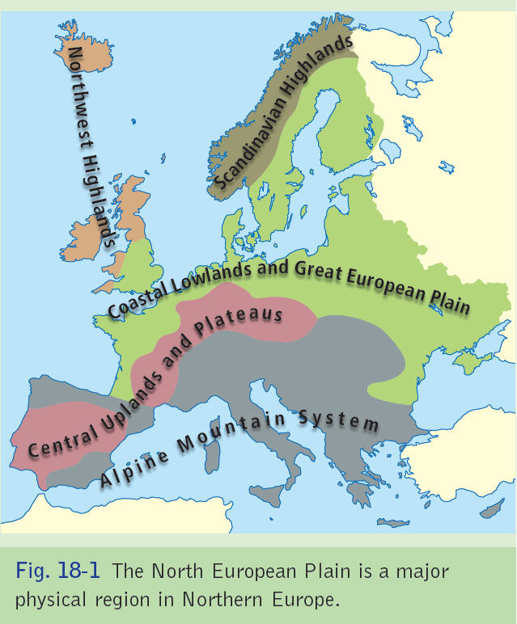

Slide 7
Geomorphologic (Physical)Region
“The Burren”
The word “Burren comes from the Gaelic name for “Stony place”. The Burren located in Clare is a karst region made of limestone that produces a desert like landscape. It cover an area of about 250 km2 and is distinct geomorphic region. The limestone of the Burren formed during the Carboniferous period 340 million years ago. Layers of coral and seashells on a tropical sea and bed were compressed by the weight of overhead deposits. Calcium carbonate in the bones of the dead sea creatures cemented the deposits to form limestone. The horizontal layers of the rock are separated by bedding planes.

Slide 8
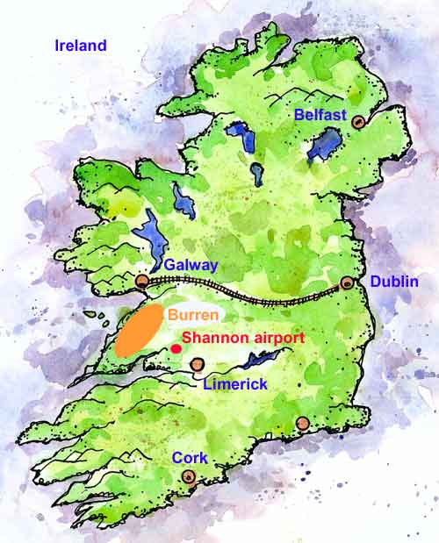

Slide 10
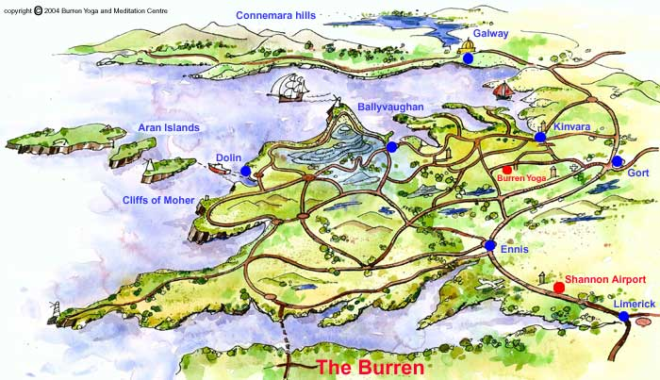
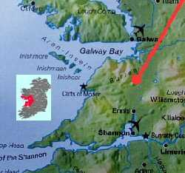

Slide 11
Geomorphologic (Physical)Region
“The Burren”
Over time, rivers carried mud and sand into the sea to be deposited on the limestone. The mud compressed to form shale and the sand to form sandstone. Amorican folding raised the land from beneath the sea. During the folding process, the rocks fractured so that vertical joints known as fissures.

Slide 12
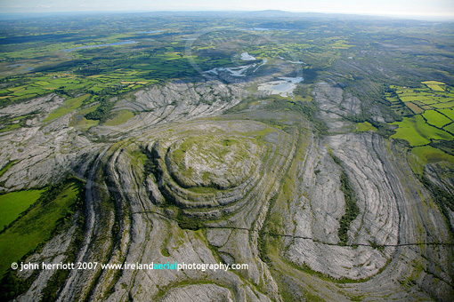

Slide 13
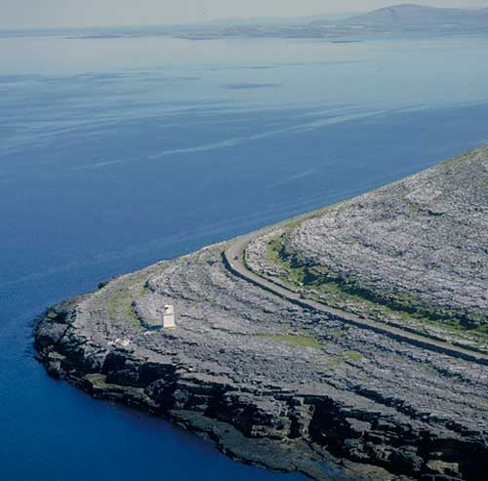
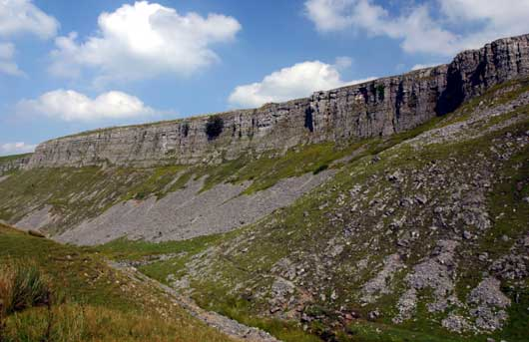

Slide 14
Geomorphologic (Physical)Region
“The Burren”
Over millions of years, the layers of shale and sandstone were removed by weathering, erosion and mass movement. During the ice age, glaciers stripped away the shale cover and formed deep U-shaped valleys. The shale cap only not survives at higher elevations such as Slieve Elva and Poulacapple and creates an unusual terraced landscape like at Black head

Slide 15
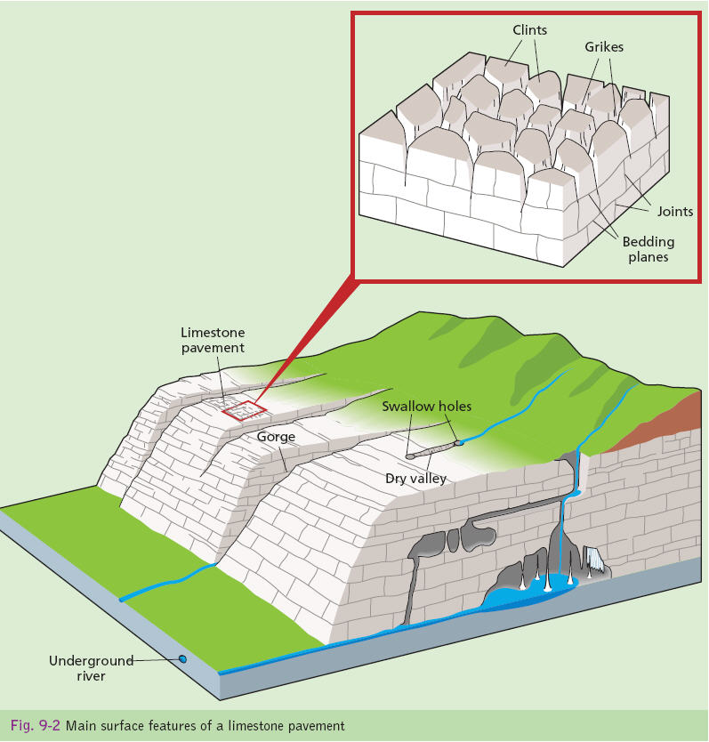

Slide 16
Geomorphologic (Physical)Region
“The Burren”
Rivers are only found on Shale an impermeable rock. In contrast, on limestone, the rivers disappear into swallow holes. The water flows downwards through permeable limestone to form underground streams and caverns.
As it flows on a bed of till deposited by glaciers, the Caher is the only surface river in the Burren. The interaction of surface processes and rock structures have made the Burren region a heavily dissected plateau separated by dry valleys

Slide 17
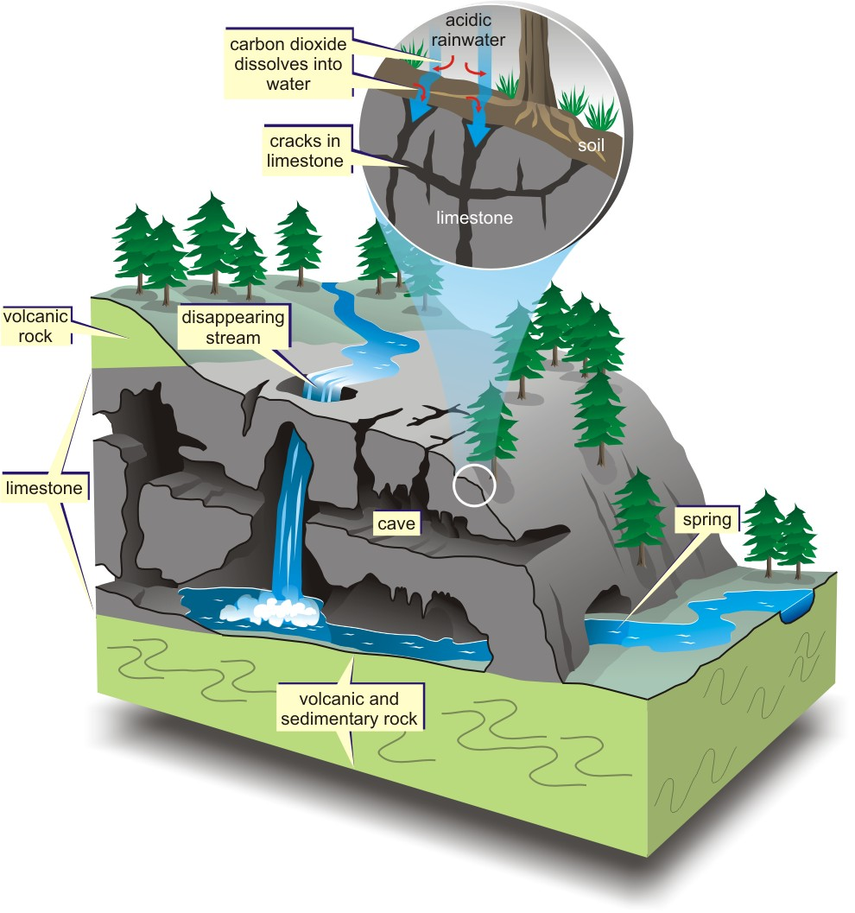

Slide 18
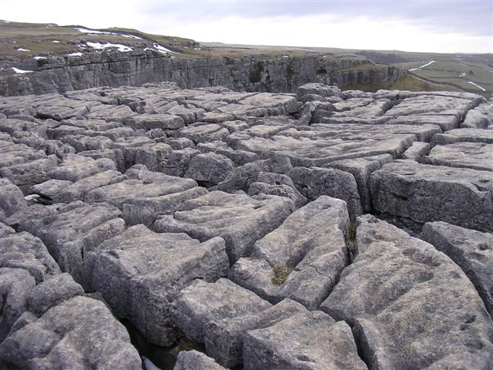
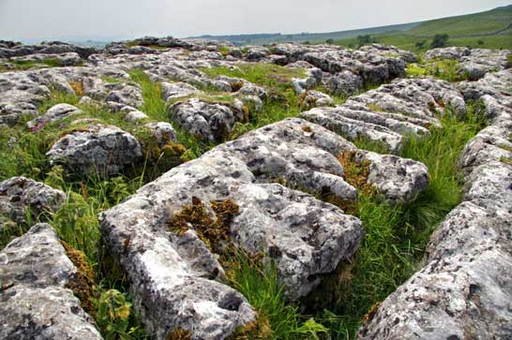

Slide 19
Geomorphologic (Physical)Region
“The Burren”
Unusual plants such as the spring gentian and animals like the burren blue butterfly are also characteristics of this region

Slide 20



Slide 21
The Burren
Discuss in detail the processes of Carbonation
Discuss in detail the formation of Limestone pavement or caves caverns.

Slide 22
2. Climatic Regions

Slide 23
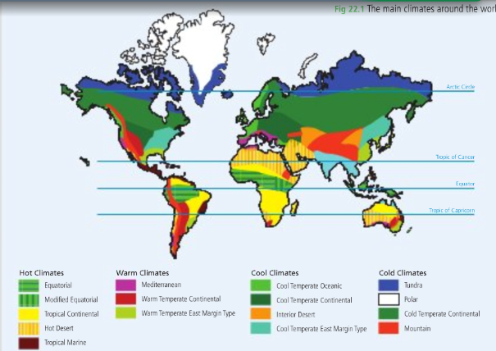

Slide 24
Climatic regions
Climatic regions are areas of the earth that share broadly similar temperatures and precipitation patterns Europe has five main types of climatic regions
1. Warm temperate oceanic.
2. Cool temperate oceanic.
3. Central European transitional.
4. Eastern European continental.
5. Arctic

Slide 25
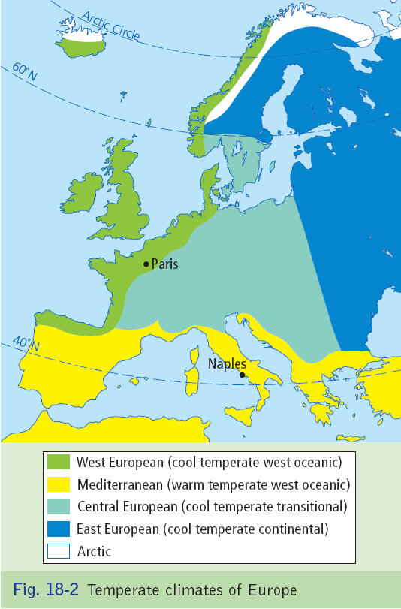

Slide 26
Cool temperate Oceanic Climate
The temperate oceanic climate is characteristic of the west coasts of continents between 40 and 60 degrees north and south of the equator such as western Europe northwest USA and New Zealand.
They generally have cool summers and mild winters

Slide 27
Cool temperate Oceanic Climate
Figures
Temperatues range approximately 9 degrees.
Summer average of 15 degress.
Winter average of 6 degrees.
Average rainfall 1500mm- varied due to rain shadow.
Low pressure depression bring changeable weather to western europe

Slide 28
Cool temperate Oceanic Climate
Latitude
The Atlantic coast of Europe experiences conditions dues to its mid latitudes location between 40 and 60 degrees. Temperatures decrease pole wards as the sun shines at a lower angle. More heat is lost as solar radiation travels through more atmosphere and is dispersed over larger areas.

Slide 30
Cool temperate Oceanic Climate
Prevailing Winds
The prevailing winds are winds most common to an areas- the south-westerly winds are mild and moist and are associated with depression (low pressure” which brings rainfall throughout the year.

Slide 32
Cool temperate Oceanic Climate
North Atlantic Drift
This raises temperatures along the coast of western Europe above the level experienced at similar latitudes elsewhere. In winter, the port of Narvik remains icefree from Stockholm on the Baltic sea is ice bound

Slide 34
Cool temperate Oceanic Climate
Altitude
Mean temperature decreases with altitude. Therefore average temperatures at Valentia, Kerry are 6 degrees warmer than on Carraunthoohil even though both are at similar latitudes.

Slide 35
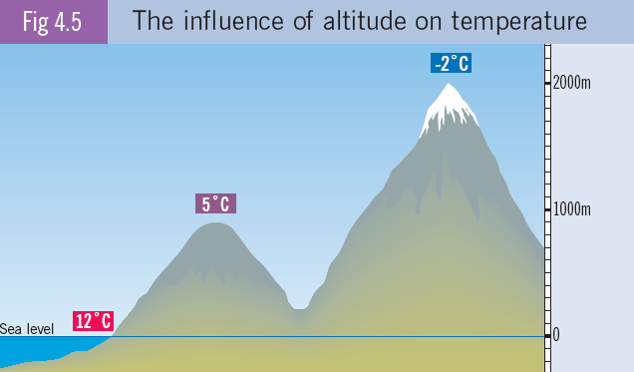

Slide 36
Cool temperate Oceanic Climate
Aspect
South facing slopes enjoy higher temperatures as they receive higher amount of solar radiation that north facing slopes. Wine can be successfully grown on the south facing slopes of Champagne even though it is beyond the usual northern limit for vine cultivation

Slide 38
Cool temperate Oceanic Climate
Distance from the sea
The sea moderates temperature change. Therefore, temperature range increases with distance from the sea.

Slide 40
3. Region of Industrial Decline

Slide 41
Regions of Industrial Decline
Sambre- Meuse Valley, Belgium
Sambre Meuse Valley in Belgium which is also known as the Charleroi-Liège valley. The valley is approximately 1000km2. This valley was the Industrial backbone of the Wallonian economy in the past as well as being the first Industrialised area in Continental Europe but has undergone Industrial decline in the past 50 years
The industrial revolution was built on coal. It was used both as a source of energy and as a raw material for industry. Industries based on coal were steel making, engineering, chemicals textiles, clothing and electrics.

Slide 42
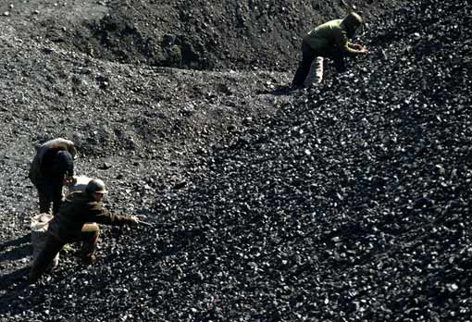
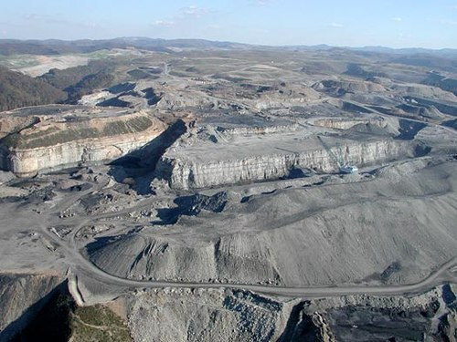

Slide 43
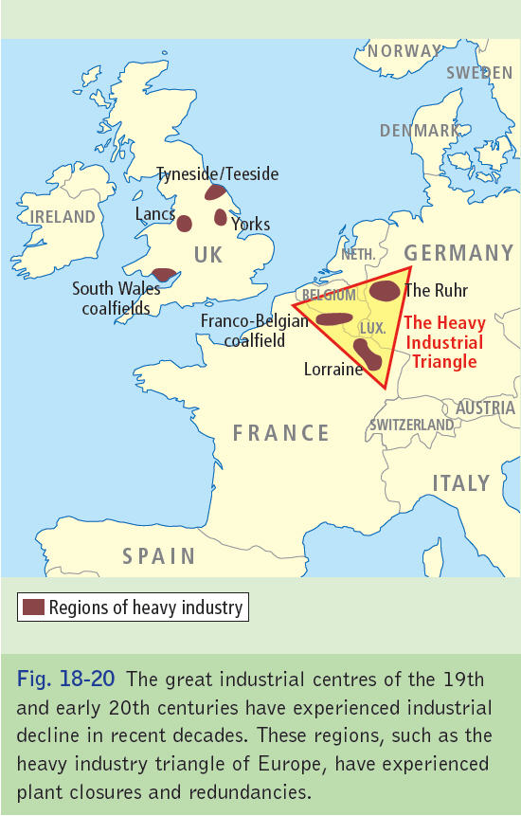

Slide 44
Regions of Industrial Decline
Sambre- Meuse Valley, Belgium
In the late 19th century, one of the most industrialised regions in the world developed along the coalfields of the Sambre- Meuse Valley in Belgium. At its peak 100,000 workers in 250 collieries in the Sambre Meuse region mined 100 million tonnes per year.
The steel making industry employed 50,000 directly in the region. Thousands of people had jobs building factories, homes and road and rail networks (Other Spin off industries). The main industrial cities in the region were Mons, Charleroi Namur and Liege.

Slide 45
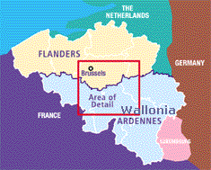

Slide 46
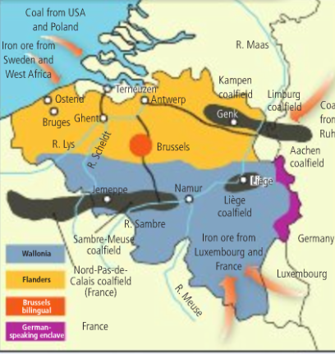

Slide 47
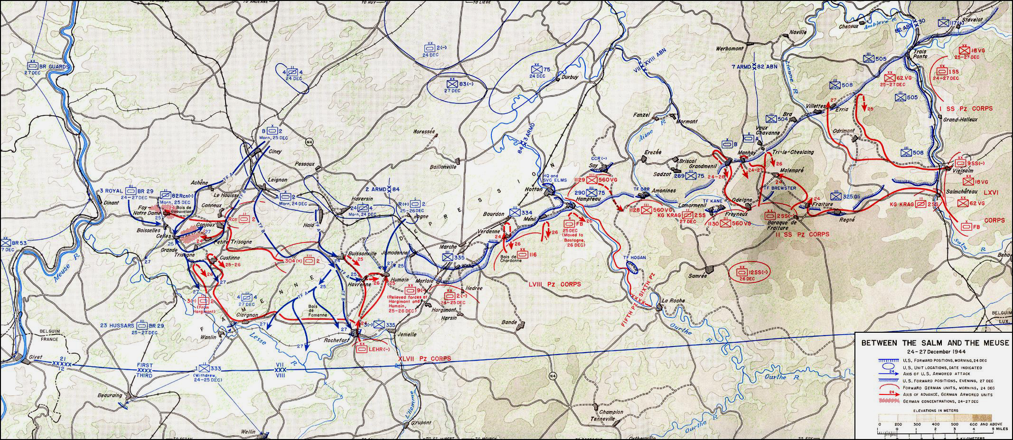

Slide 48
Regions of Industrial Decline
Sambre- Meuse Valley, Belgium
As coal is a non renewable resource, the best coal seams were used up by the 1960’s. Cheaper coal was imported from the USA and Poland. The last coal mines closed down in the Sambre Meuse in 1988. In the neighbouring region of Campine, coal mining finished in 1992.

Slide 49
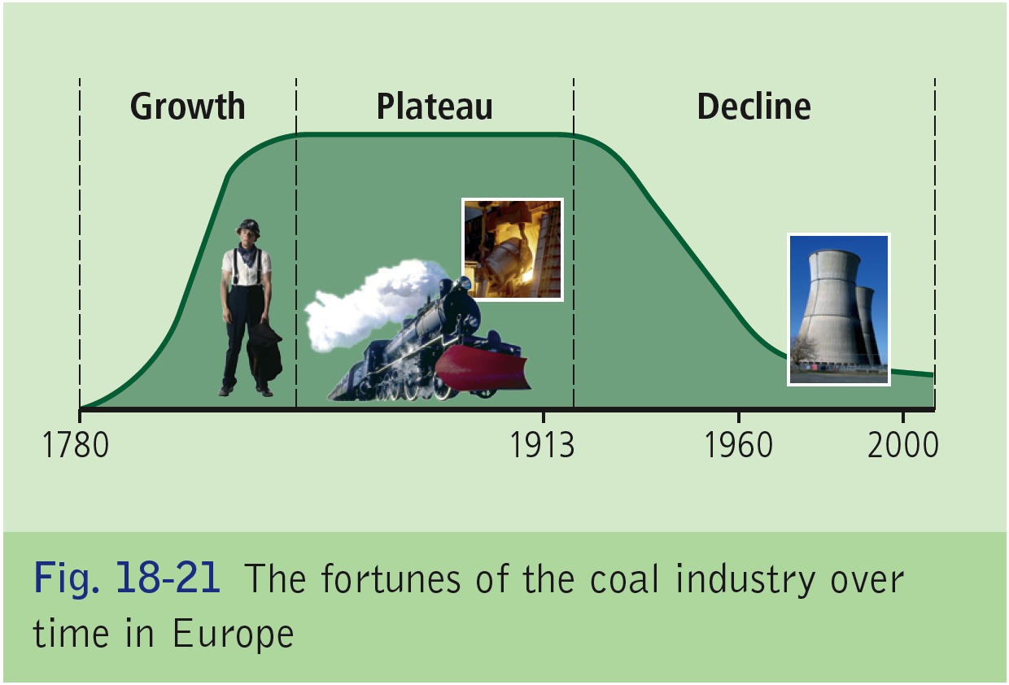

Slide 50
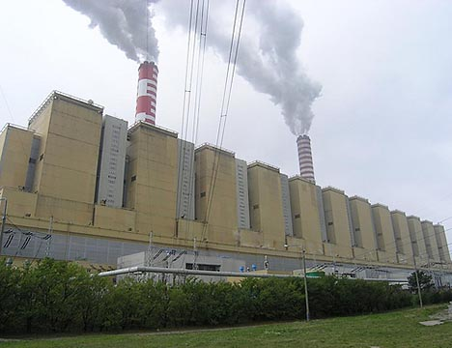

Slide 51
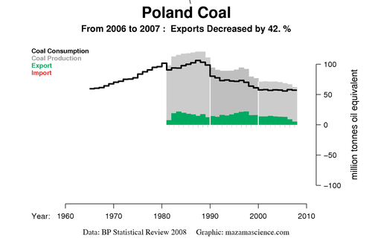

Slide 52
Regions of Industrial Decline
Sambre- Meuse Valley, Belgium
There are a number of reason for industrial decline.
-Oil was cheaper and cleaner.
-Modern integrated steel plants were built near the coast of Antwerp.
-Engineering factories in the Sambre Meuse region closed down as more efficient industries set up near steel mills.
-Oil and gas also replaced coal as a raw material for the chemical industry.

Slide 53
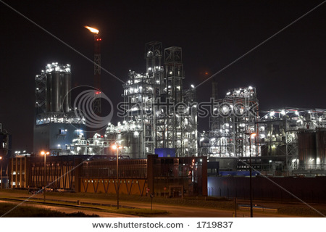

Slide 54
Regions of Industrial Decline
Sambre- Meuse Valley, Belgium
- New pharmaceutical industries in the Sambre- Meuse closed as they could not compete with lower cost factories in Flanders.
With closure of the large industries it also led to job losses in the building industry and other spin off industries.
Emigration soared
Turned into a industrial wasteland. The rusting collieries and abandoned factories made the region very unattractive to new investors.

Slide 55
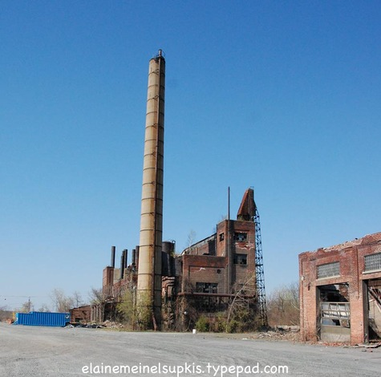

Slide 56
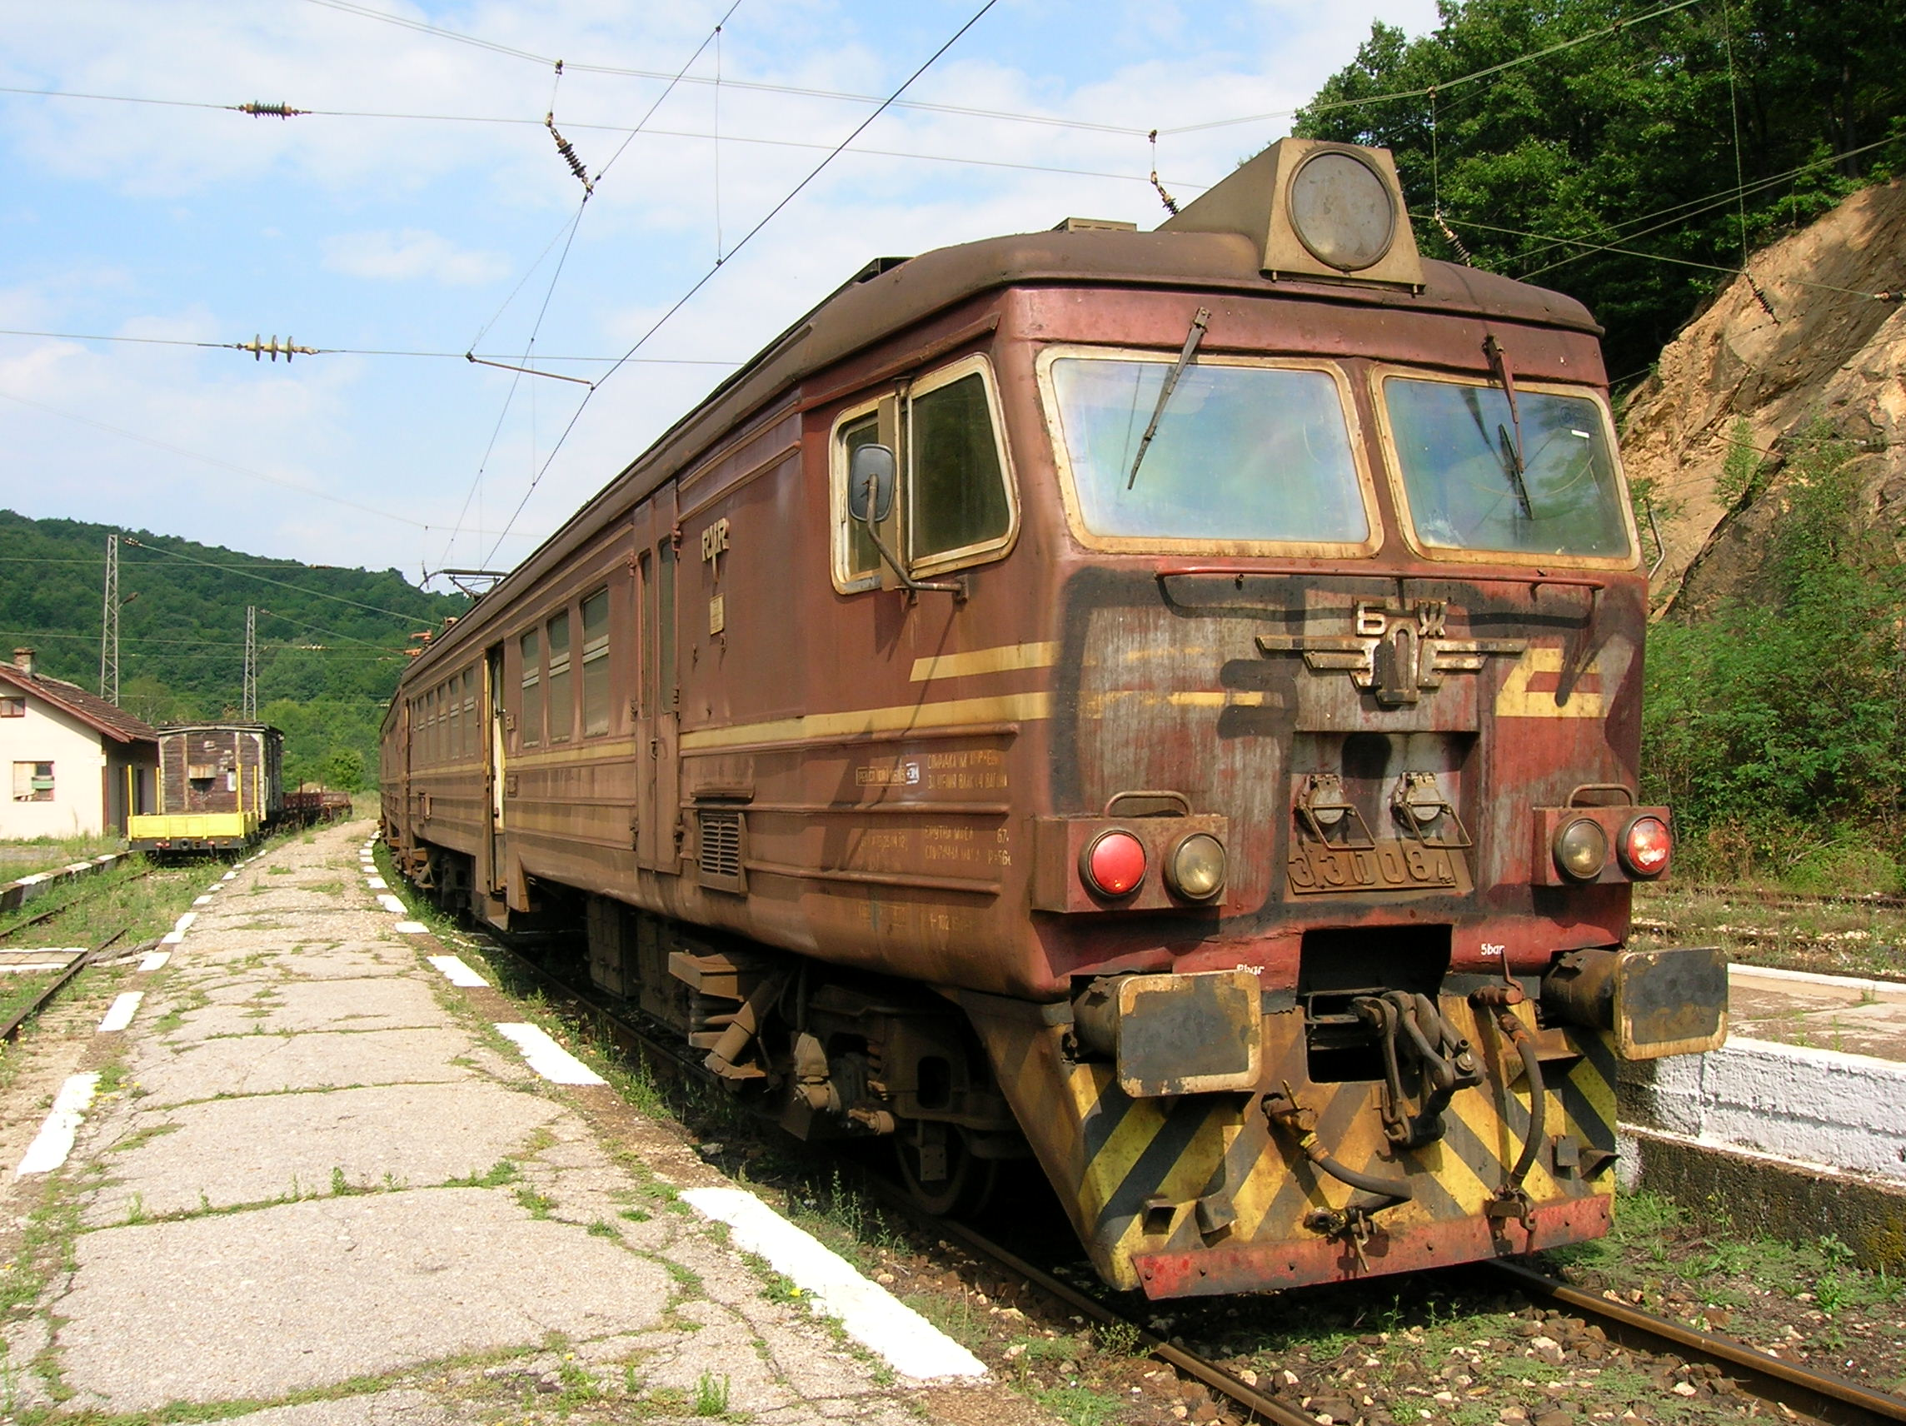

Slide 57
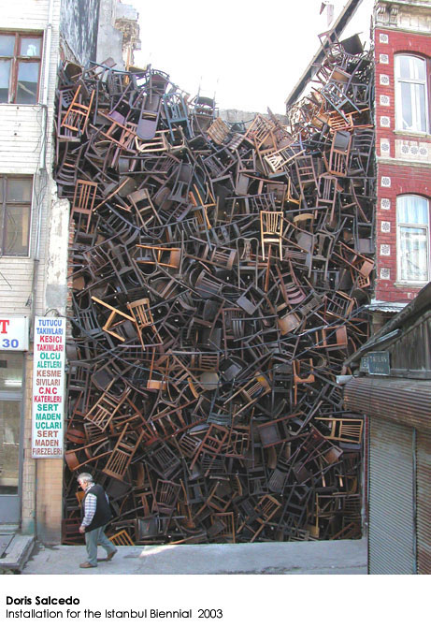

Slide 58
Regions of Industrial Decline
Sambre- Meuse Valley, Belgium
Now some of the region qualifies for Objective 1 or Objective 2 status under the Regional policy of the European Union because of its low GDP per capita. This is to encourage growth in the area. This is very rare in Western Europe.
Modern Communications links were improved, new industrial estates were built, air port was upgraded, cleaned up image, trained unemployed workers.
Flanders replaced Wallonia as Economic core.

Slide 59
4. A region of Cultural Divide

Slide 60
Cultural Regions Europe
The Flanders Wallonia divide
A cultural region is where people share a specific language, religion and way of life. The cultural region that we are looking at is Belgium and the Flanders, Wallonia divide.

Slide 61
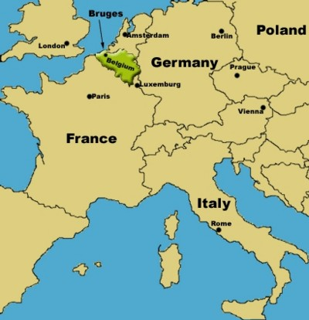

Slide 62
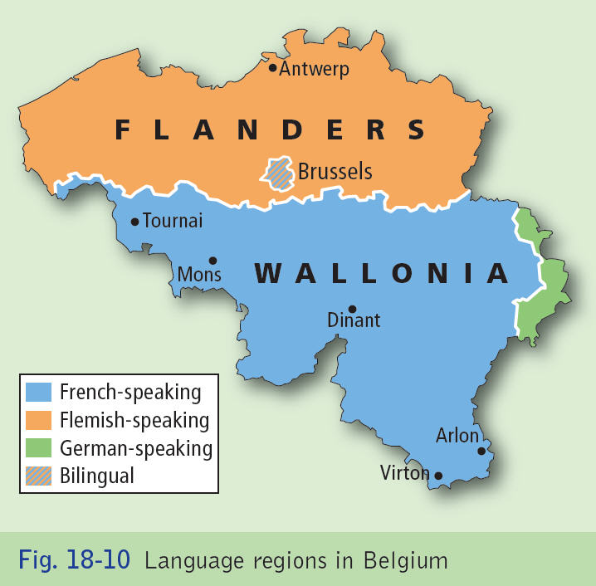

Slide 63
Cultural Regions Europe
The Flanders Wallonia divide
Belgium straddles the frontier between the Romance and Germanic cultures of western Europe. It is mainly divided between the Walloons, a French speaking people and the Flemings who speak Dutch. A third cultural group in the eastern part of Belgium speak German

Slide 64
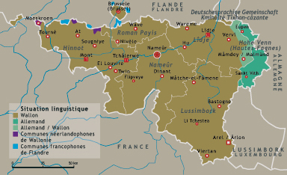

Slide 65
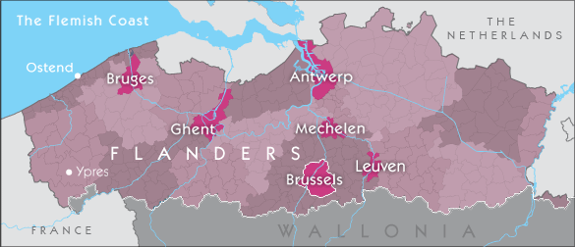

Slide 66
Cultural Regions Europe
The Flanders Wallonia divide
The Wallonia cultural region (Wallonia) consists of five southern and eastern provinces of Hainaut, Namur, Liege, Walloon Brabant and Luxenbourg. The Walloons are mainly Catholic. Politically they are either liberal or socialist and considered wealthy. Were elite and wealthy due to Sambre Meuse Valley.
However as the coal declined both in terms of quantity and in terms of its use in modern industry, so too did the region of Wallonia. Unemployment levels soared. Today the Walloons are a minority of the population and out-migration from the south to the north is a major problem.

Slide 67
Cultural Regions Europe
The Flanders Wallonia divide
The Flemings live in the five northern and north eastern provinces of West Flanders, East Flanders, Flemish Brabant, Antwerp and Limburg. They are also germanic, catholic but are more conservative in political opinion. 60% of the population live here (6 million). They were regarded as socially/ economically inferior due to sambre muse valley as were a rural agricultra society industrially underdeveloped. Due to discovery of oil and gas in North seat they are now the wealthy part of Belgium and attract migrants from the Wallonian regions

Slide 68
Cultural Regions Europe
The Flanders Wallonia divide
Up to the early 20th century, a person needed fluent French to get a job in law, medicine and management of government and industry. Thus Flemish speakers were largely excluded from important jobs. The Walloons were the political and social elite in Belgium

Slide 69
Cultural Regions Europe
The Flanders Wallonia divide
In 1932 a law was passed which drew a boundary between Flanders and Wallonia, known as the language line which acts as a cultural line. Brussels the capital region is located in the Flemish area. While it is officially bilingual, French speakers make up the majority of the population.
Political disputes continue to sour relations between the Dutch and French speaking Belgians. Cultural apartheid has developed as the twp groups attend different schools and universities, and marry, shop and socialise within their own cultural groups. The language frontier is reflected in place names Cities like Malines and liege by french speakers are Michelin and Luik by flemish

Slide 70
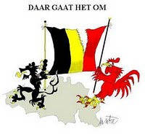

Slide 71
Cultural Regions Europe
The Flanders Wallonia divide
Cultural division has sharpened due to economic decline in the French speaking Sambre- Meuse region. Walloons complain that their region is not getting its fair share of government spending. Conversely, Flemings claim that too much money is being invested in attempting to rebuild the Sambre Meuse region

Slide 72
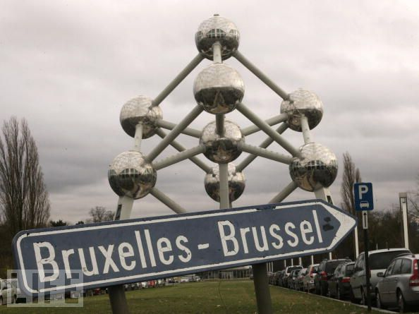

Slide 73
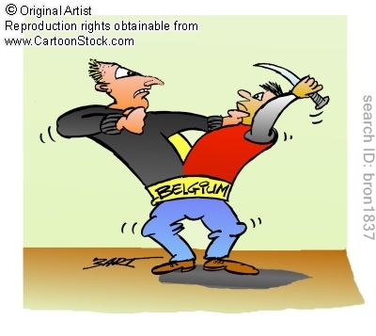

Slide 74
Cultural Regions Europe
The Flanders Wallonia divide
The suburbs of Brussels are spreading into Flemish territory. Some of the suburban expansion results from migration of French speakers from Wallonia. Dutch speakers resent the demand by Walloons for cultural rights in the Flemish region

Slide 75
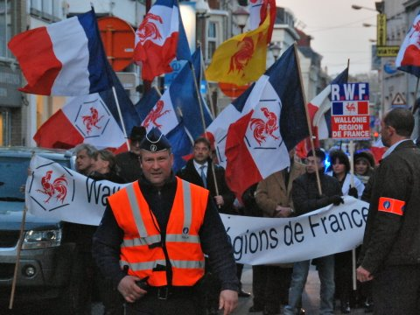

Slide 76
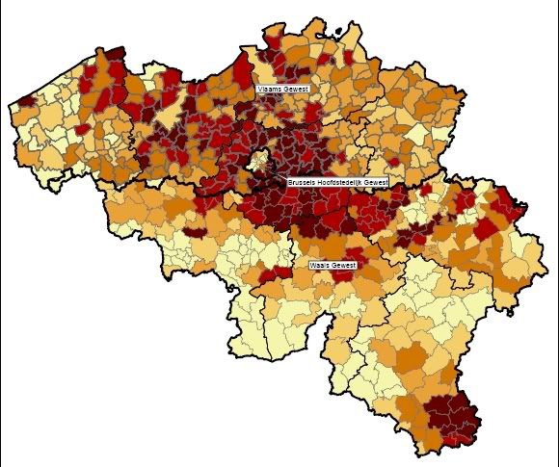

Slide 77
Cultural Regions Europe
The Flanders Wallonia divide
Signposts on each side of the line are monolingual with the only bilingual region located around the city of Belgium.
In 2007 it took more than 3 months to form a government as the Walloons and Flemish could not agree to power sharing.
Some French and Walloon newspapers suggest that Wallonia should become a province of France.

Slide 78


Slide 79
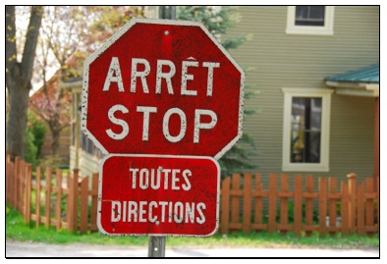

Slide 80
Region Defined by Religion

Slide 81
Regions Defined by Religion
The Islamic World
Islam is based on the teaching of the Prohpet Muhammad (571-632 AD). A Muslim is a person who practices Islam. The centre of Islamic worship is a mosque.
The core area of Islam is Mecca in Westeren Arabia. It has spread through the Middle East and Turkey and into Sub- Saharan Africa. The Islamic cultural region extends from West Africa to Malaysia, Indonesia and the Philippines as well as spreading to The USA and Europe through migration.

Slide 82
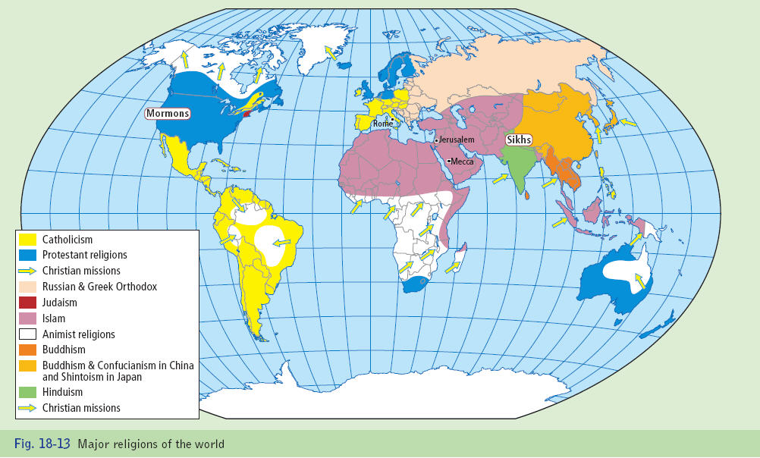

Slide 83
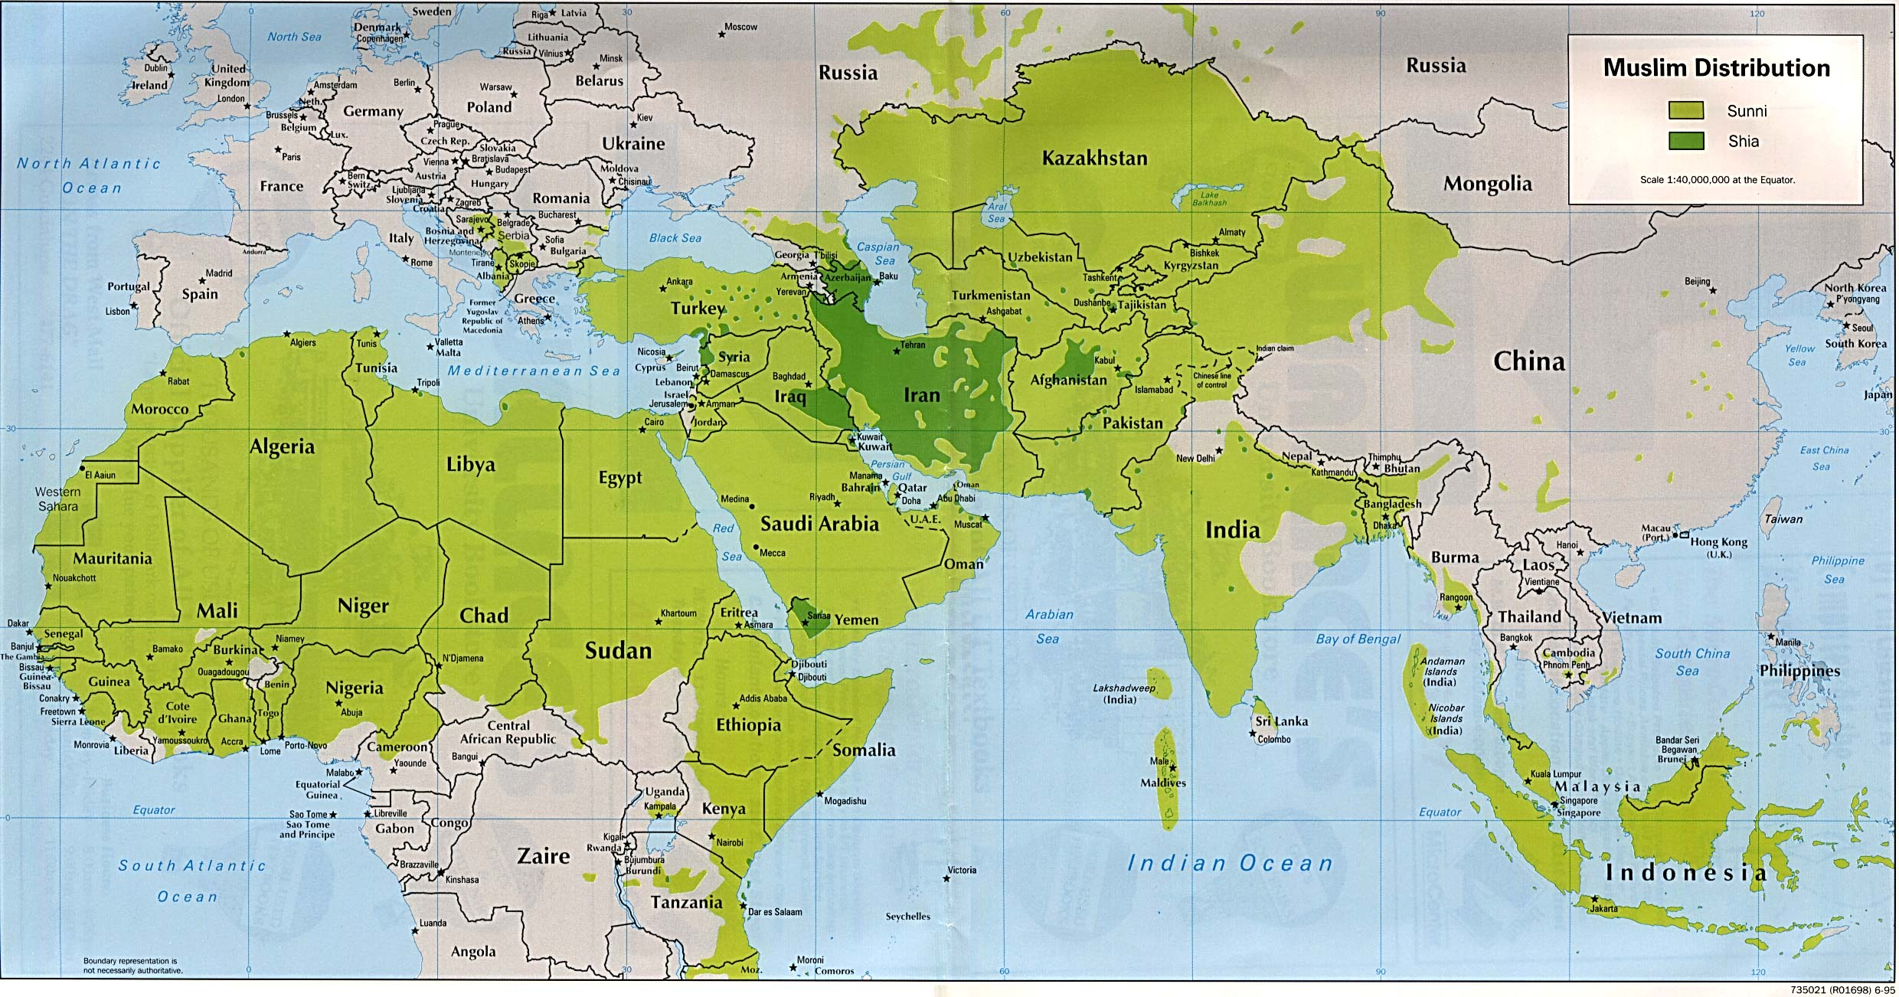

Slide 84
Regions Defined by Religion
The Islamic World
In societies that are strongly Islamic, the law is based on a series of strict interpretations of the Koran. This is known as Sharia Law. The Koran sets out Islamic doctrines and rules for worship and provides society with a code of conduct. The Koran orders Muslims to dress in “modest fashion”. The Taliban in Afghanistan enforced a very strict dress code. Woman have to wear a full length gown called a Burka.

Slide 85
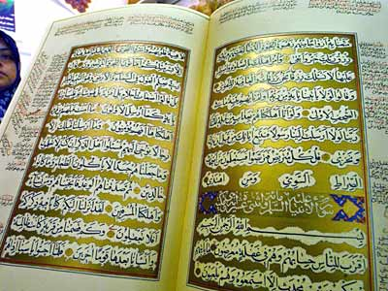

Slide 86
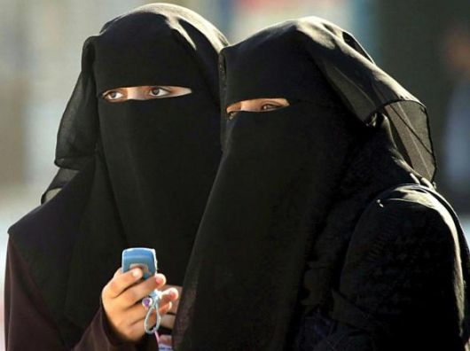

Slide 87
Regions Defined by Religion
The Islamic World
Muslims have to
Pray five times a day.
Visit Mecca on pilgrimage once in their lifetime if fit and able to afford it.
Give charity to the poor.
Fast from dawn to dusk during the month of Ramadan.
Abstain from alcohol, gambling and smoking.
Refrain from eating pork. The meat is slaughter is a special way known as Halal.

Slide 88
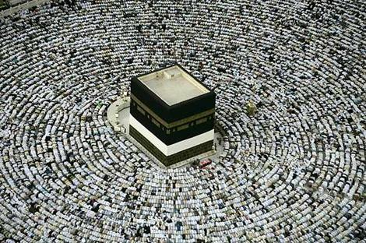

Slide 89
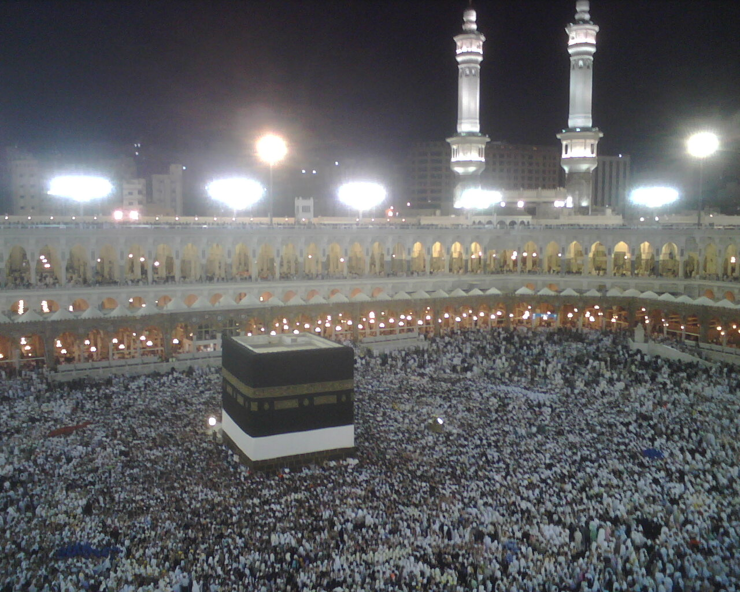

Slide 90
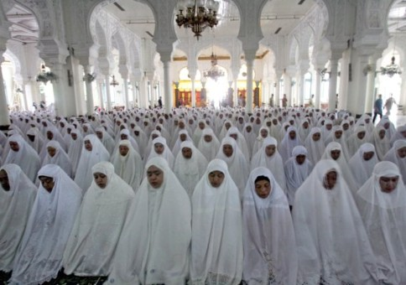

Slide 91
Regions Defined by Religion
The Islamic World
Islam provides a value system that influences all aspects of economic, social , cultural and political life in the Islamic cultural region. The value system unites the diverse ethnic groups that make up the Islamic world. The total number of Muslims globally is 1.3 billion.
Migration is the main reason for the spread of Islam. In 2009, there were around 84,000 Muslims in Ireland. Many worship at the mosque in Clonskeagh.

Slide 92
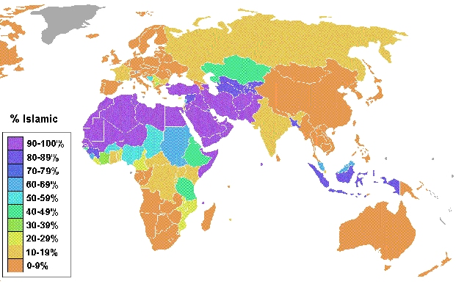

Slide 93


