Slide 1
Aerial Photographs
D Boland

Slide 2
By the end of this section you will know
Type of photo.
Locate features of a Photograph
Time of year
Draw a sketch map

Slide 3
Type of Photo

Slide 4
Vertical photo’s are taken looking straight down.
Oblique photo’s are taken at an angle looking across the landscape.

Slide 5
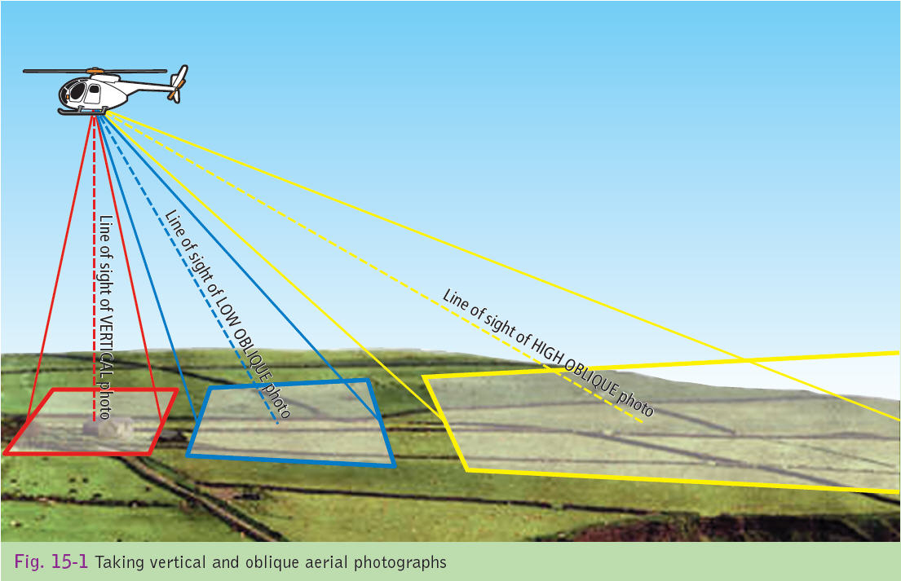

Slide 6
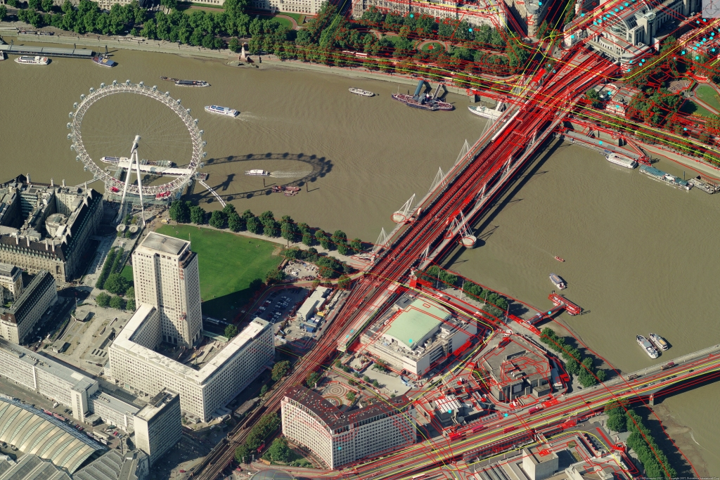

Slide 7
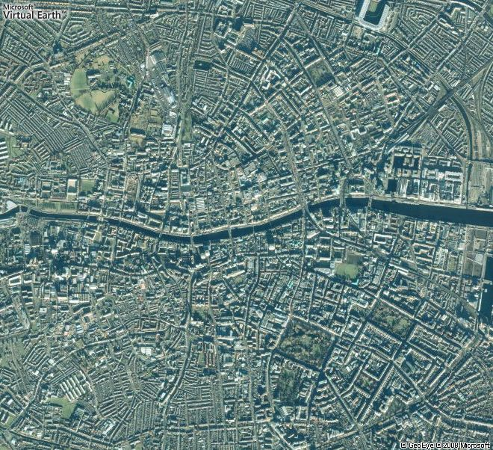

Slide 8
What is the Difference Between an Oblique and Vertical Photo??????

Slide 9
Locating Features of a Photo

Slide 10
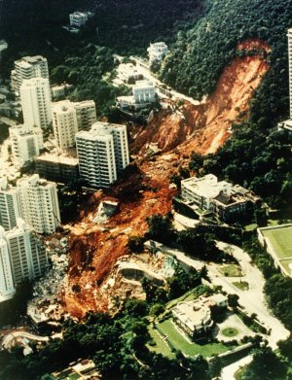
Describe this picture!!
Notes:
10

Slide 11
Oblique Photograph
Left background | Centre background | Right background
Left middleground | Centre middleground | Right middleground
Left foreground | Centre foreground | Right foreground
Notes:
11

Slide 12
Where is there a
1. A Crossroad(s)
2. A Lake
3. A Row of Houses
4. A Large Building
5. An area of dark shrubbery

Slide 13
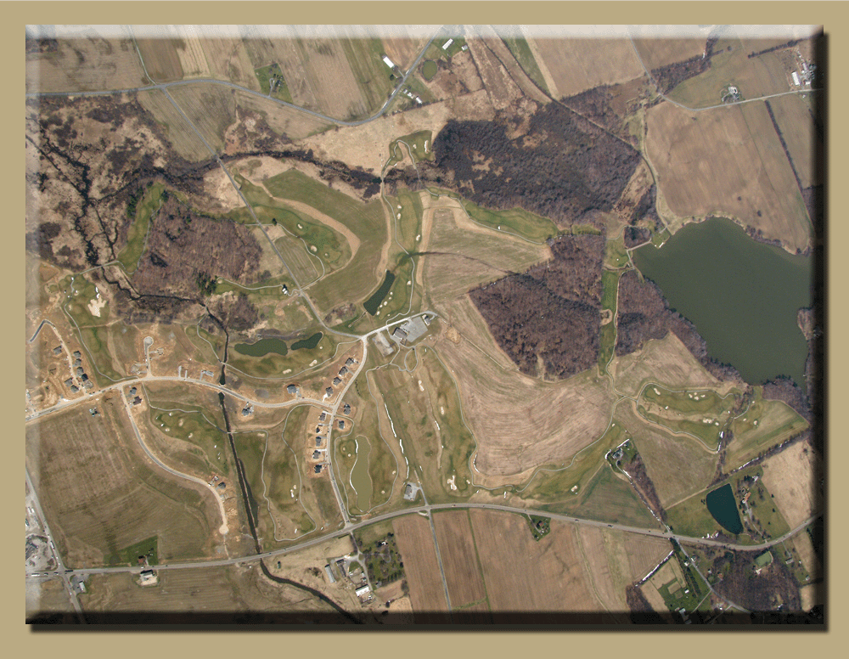

Slide 14
Left background | Centre background | Right background
Left middleground | Centre middleground | Right middleground
Left foreground | Centre foreground | Right foreground
Notes:
14

Slide 15
Where is there a
1. A Church
2. A Marina
3. A Headland
4. A Car Park
5. A Green Field
6. Terraced (attached) Housing

Slide 16
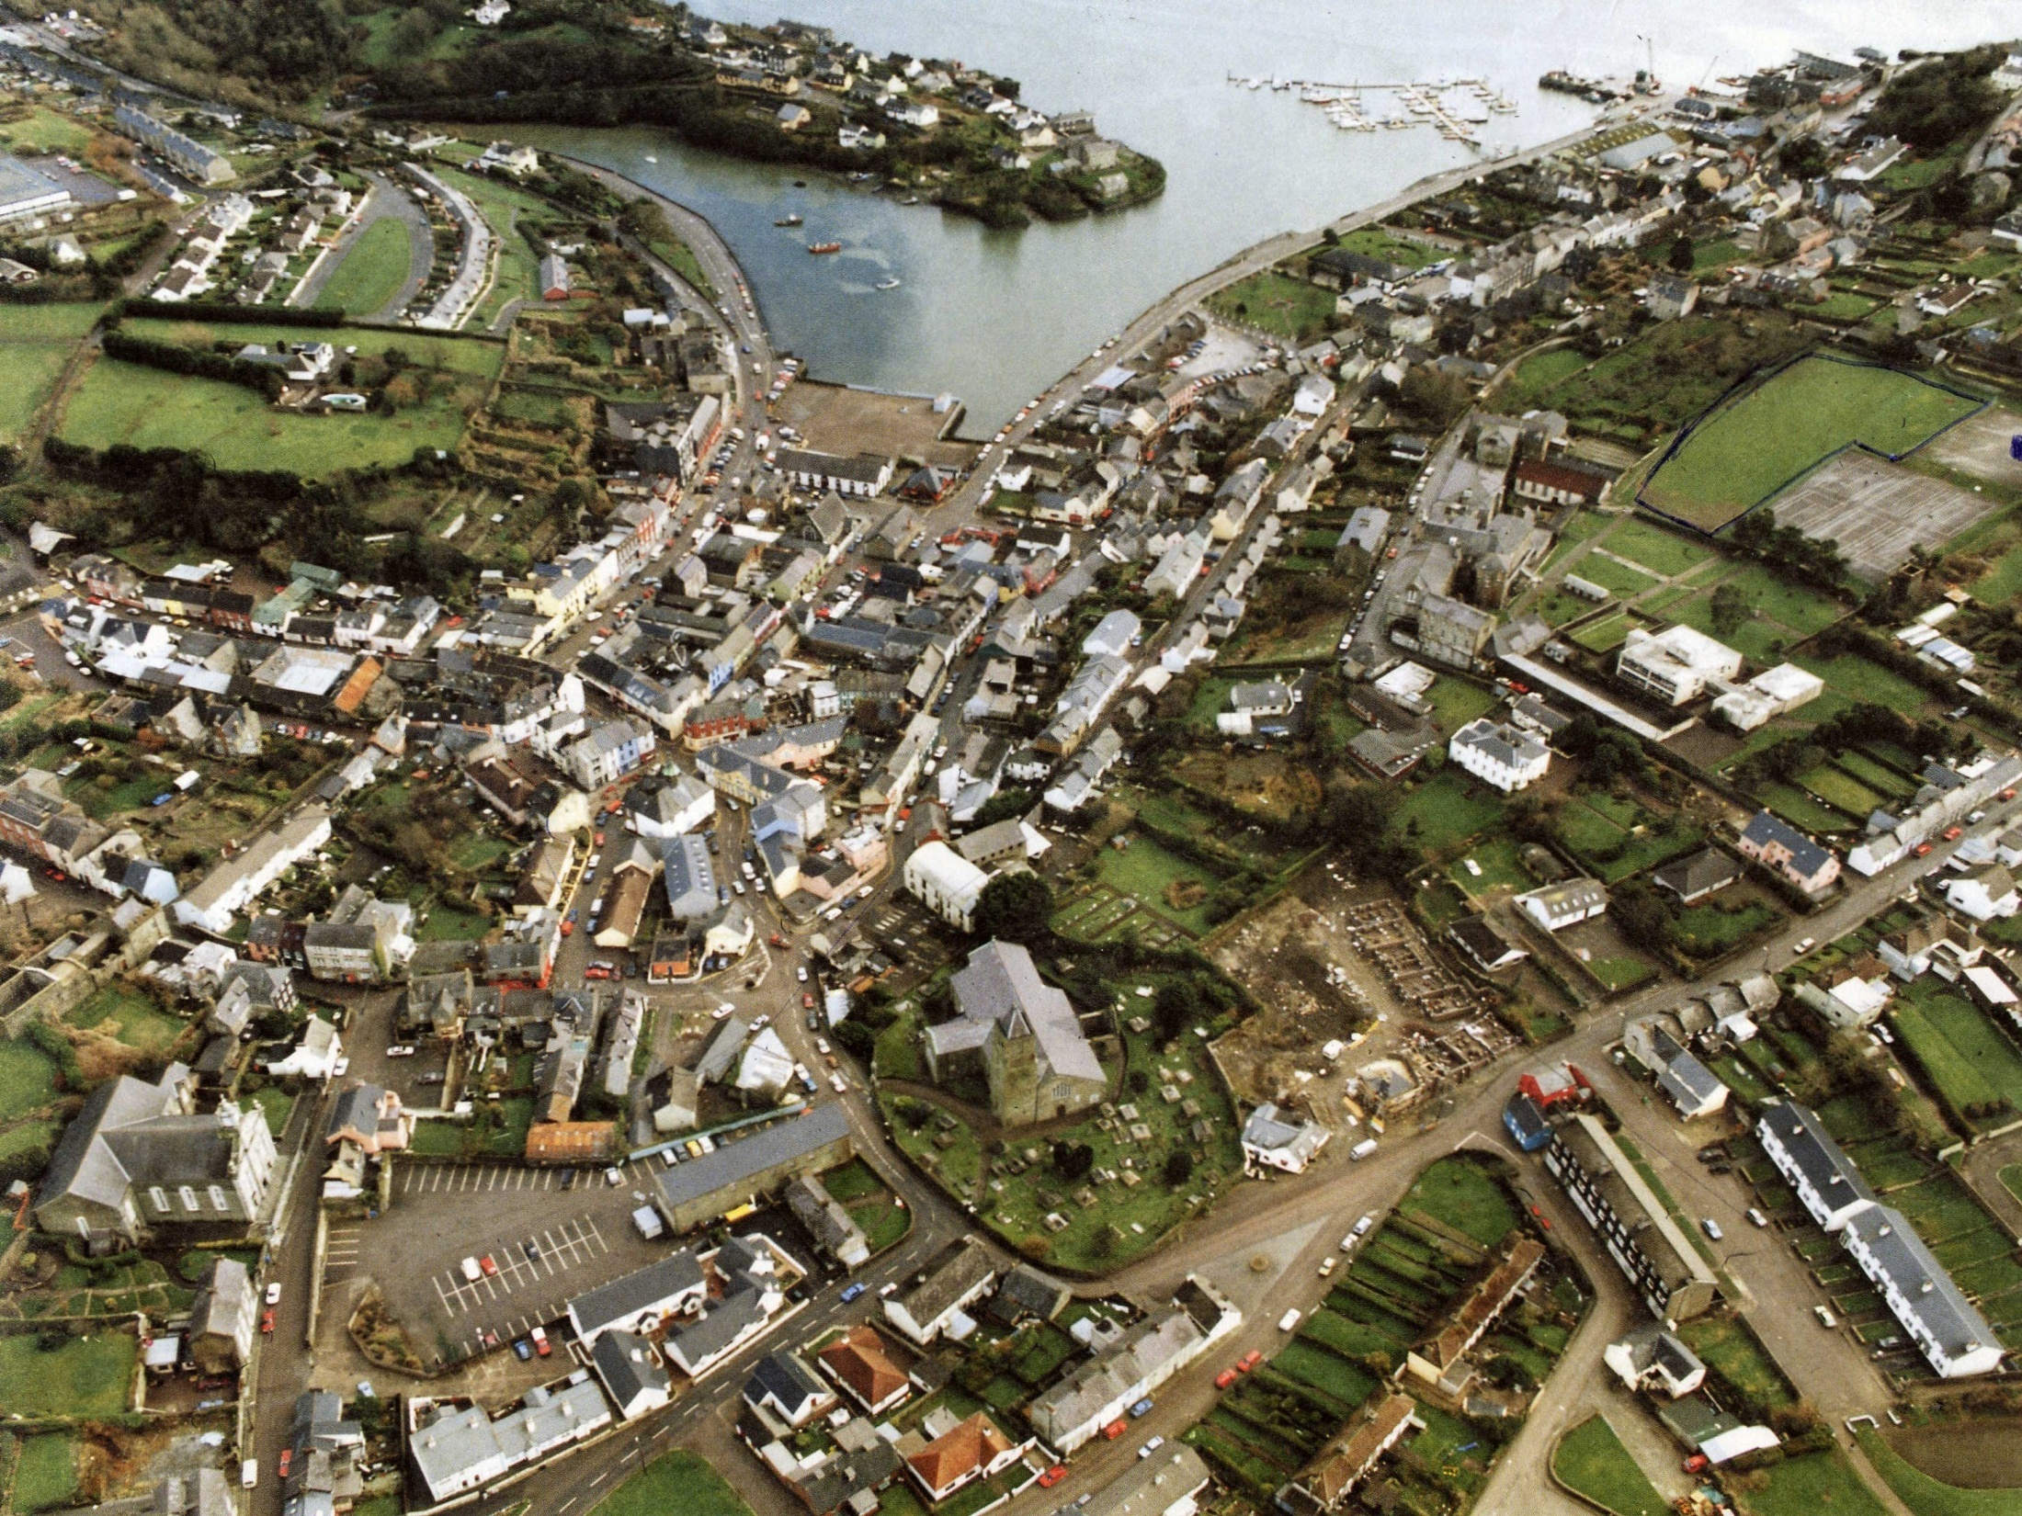
Notes:
16

Slide 17
When describing a photo.
Divide the photo in the foreground, middleground, background.
Then left, middle and right.
Always start in the left foreground when describing a picture.

Slide 18
Left background | Centre background | Right background
Left middleground | Centre middleground | Right middleground
Left foreground | Centre foreground | Right foreground

Slide 19
Now, in pairs
Sit back to back.
One person describes the following picture.
The other person draws it on an A4 page.
Use directions as if you were looking at an oblique photo………………………….

Slide 20
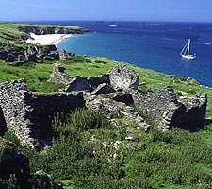

Slide 21
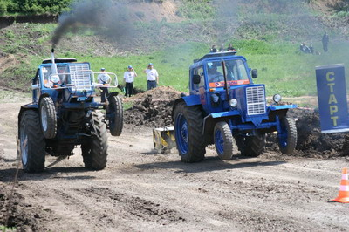
Now sitting back to back describe this picture to your partner.

Slide 22
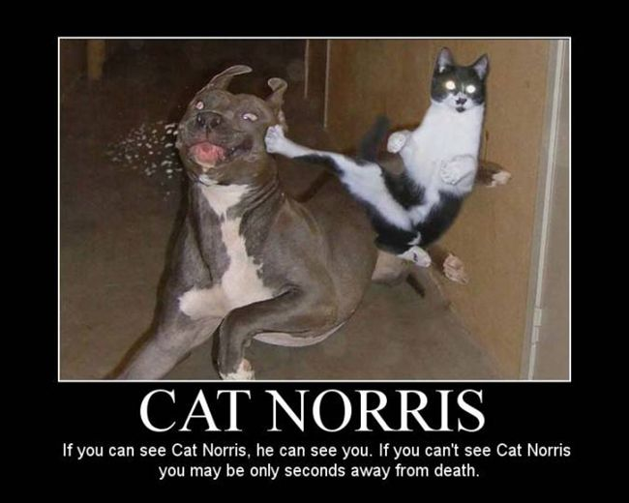

Slide 23
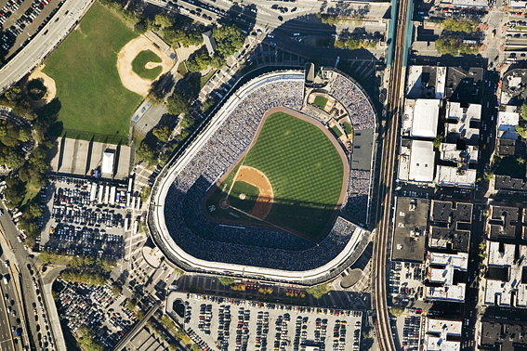

Slide 24
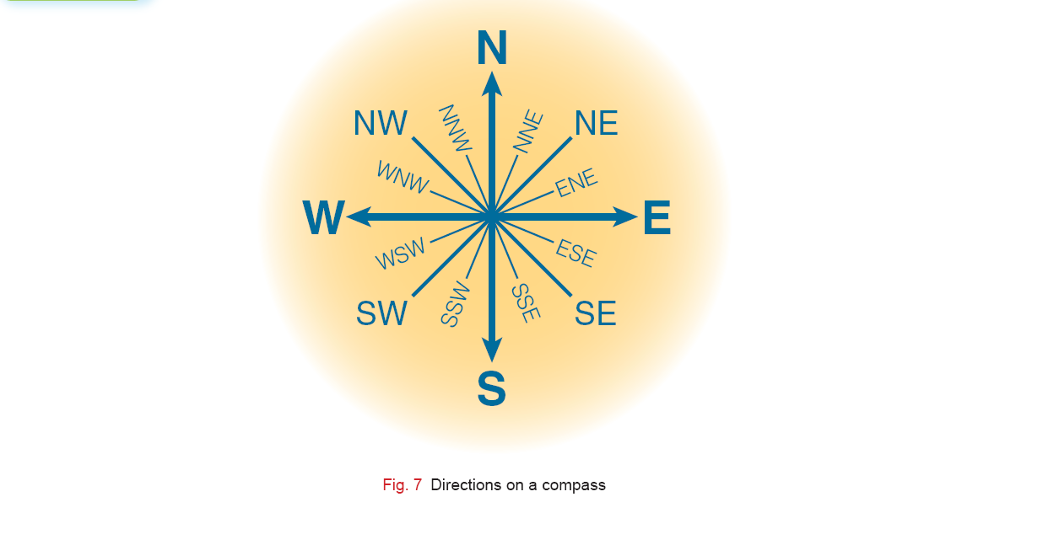
An arrow showing North

Slide 25
Vertical Photo with North Arrow
North West | North | North East
West | Centre | East
South West | South | South East
Notes:
25

Slide 26
Where is there a
1. A Stadium.
2. A Railroad with blue at the sides.
3. A Car Park.
4. A Main Road.
5. An Irregularly shaped building.

Slide 28
Photos and Seasons

Slide 29
Working out the season
Summertime
Wintertime
In summertime trees and bushes will be covered in foliage.
Ripe cereals or cut hay bales will be visible
Farm animals can be seen grazing on the fields
Short Shadows
Deciduous trees and bushes will appear to be without foliage.
Freshly ploughed fields may be common.
Chimney smoke would indicate cold weather
Long Shadows
No farm animals

Slide 30
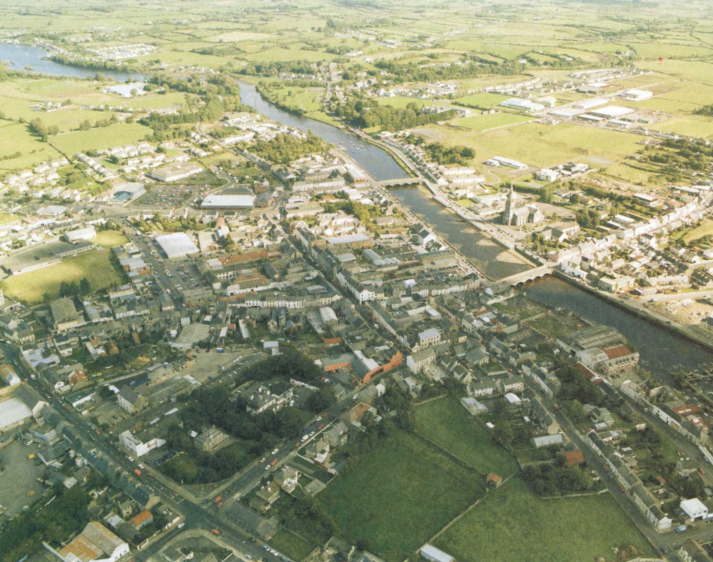
Notes:
30

Slide 31
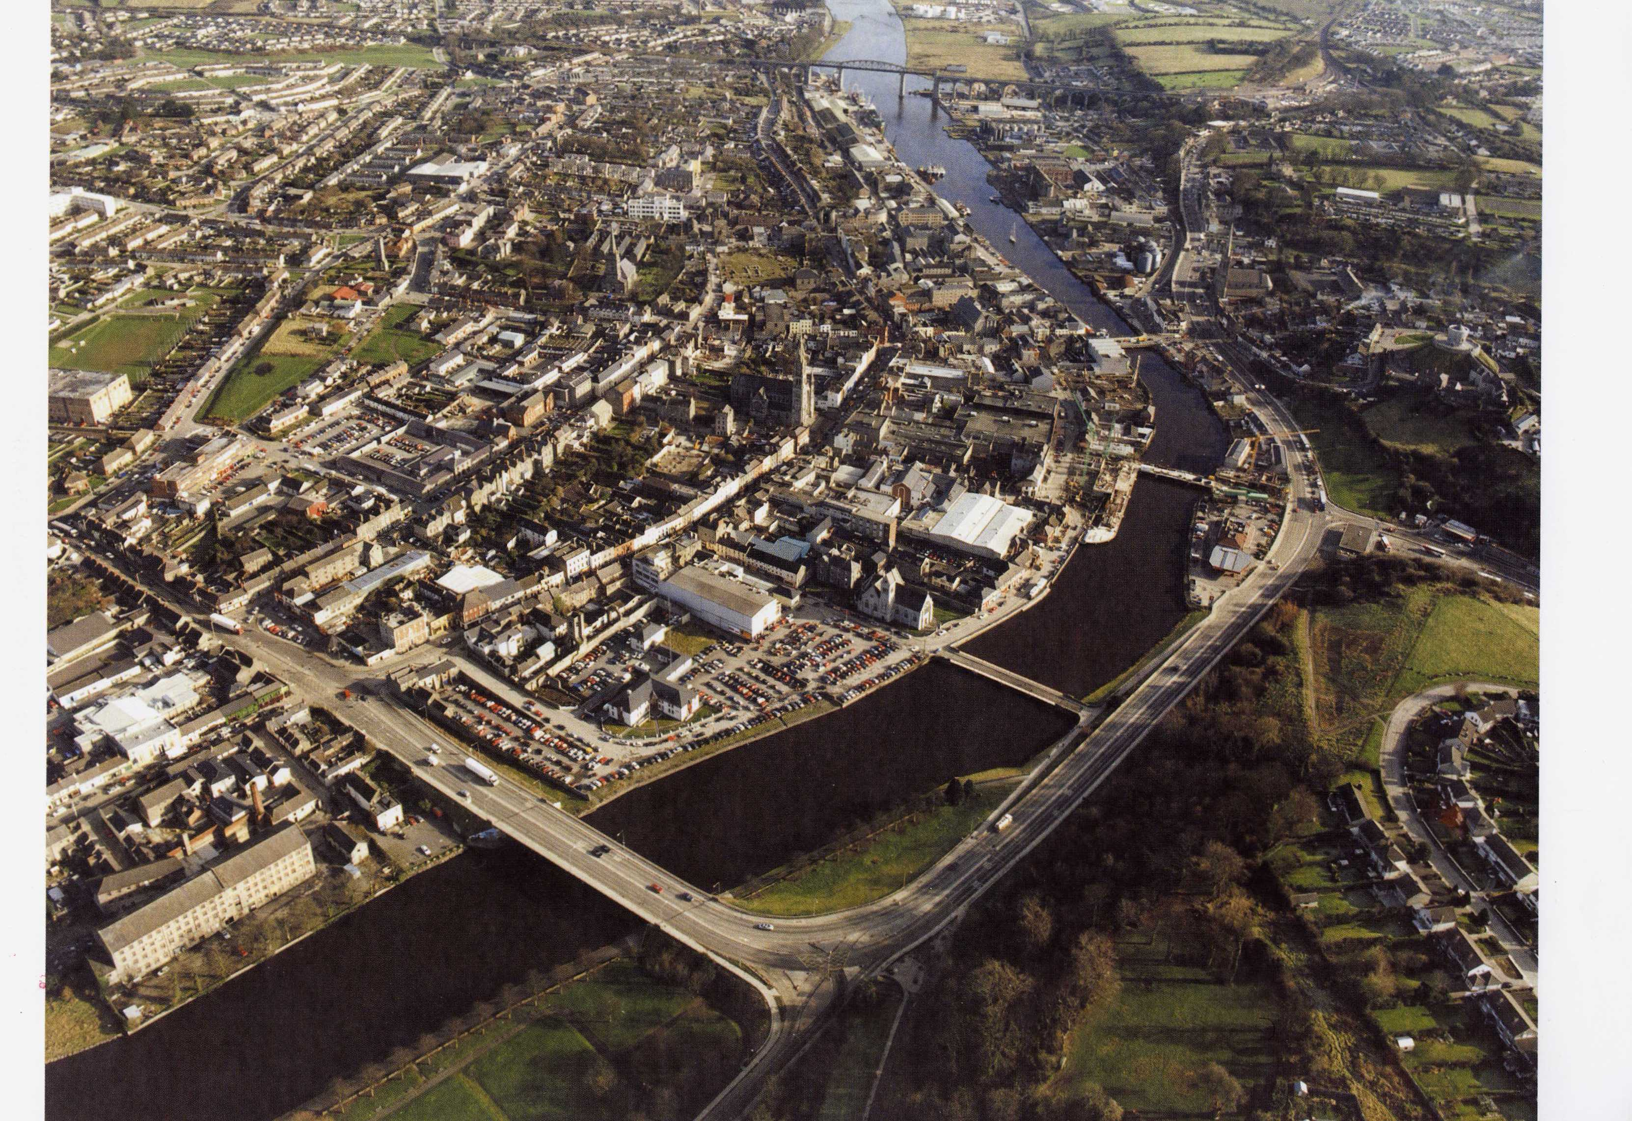

Slide 32
Sketching A photo

Slide 33
Sketching a photo
Measure photos length & width.
½ this measurement to draw your frame to the same size.
Divide photo up into 9 even sections.
Give photo a title (NAME OF TOWN).
Always draw Rivers/ Coast/ Lakes First.
Provide a key (legend).

Slide 34
Name Of Largest Town
Key

Slide 35
Sketch Map of Cavan
Key
 | Church
 | lake
 | Street
 | Pitch
 | Trees
 | Car Park

Slide 36
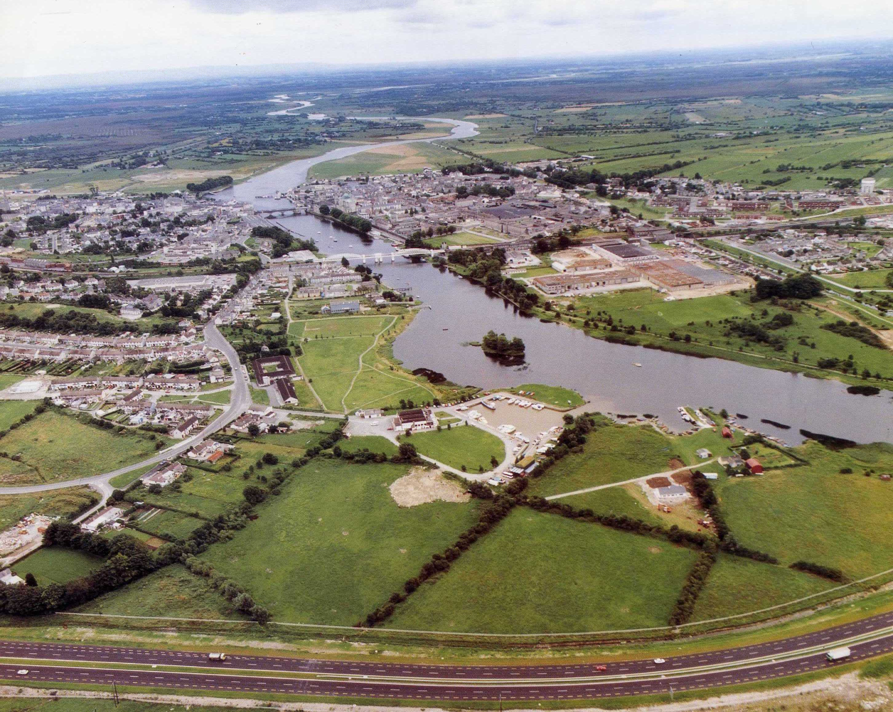

Slide 39
Functions within a Town

Slide 40
Town Functions
Towns have many functions or services. These are services that the town provides:
Residential- houses & apartments.
Transport- road, rail, and car parks.
Retail- Shops and bars.
Port- docks and cargo ships.
Recreational-Tennis courts,playing fields,golf courses.
Tourism-scenery, forest (walking), marina, sandy beach.
Medical- hospitals.
Defence- tower, castle.
Ecclesiastical (religious)–a church, cathedral
Educational- schools, colleges.

Slide 41
Decidious trees
covered in leaves
People in boats

Slide 43
Using maps and Photos

Slide 44
Distances & Photographs
In order to calculate distance on an Aerial photograph we need to use an O.S map of the same area:
1. Identify the 2 places on the O.S map.
2. Measure the distance between them on the map.

Slide 45
Calculating scale on a vertical Aerial Photograph
The scale on the photo is constant throughout the whole image & may be calculated by using the scale of an O.S map for the same area:
1.Identify 2 features on photo & map.
2.Calculate the straight distance (scale 1:50,000).
3.Calculate the distance between the 2 locations on the photo.

Slide 46
Camera Direction
1. Identify 2 distinct features common to the aerial photo & O.S Map. (Preferably ones running from bottom to top/foreground to background of photo)
2. Draw an arrowed line through both points on map & photo.
3. Relate the direction of the arrow on the photo to that on the O.S Map.

Slide 47
Field of Vision:
Oblique Photo
Identify cameras line of sight by drawing a line from fore ground to background through centre of photograph.
Note main features on the line.
Locate these on the O.S map & draw a line through them.
Identify some features along the photo edges & locate on map.
Draw lines from these to intersect with line of sight in photo foreground.....revealing location photo was taken from.

Slide 48
Field of vision
Vertical Photo
Identify part of O.S map shown on photo.
Locate the position on the map of features shown at the 4 corners of the photo.
Join the corners with straight lines.........revealing location above which the photo was taken.

Slide 49
Photos and Maps

Slide 52
Notes:
52

Slide 53
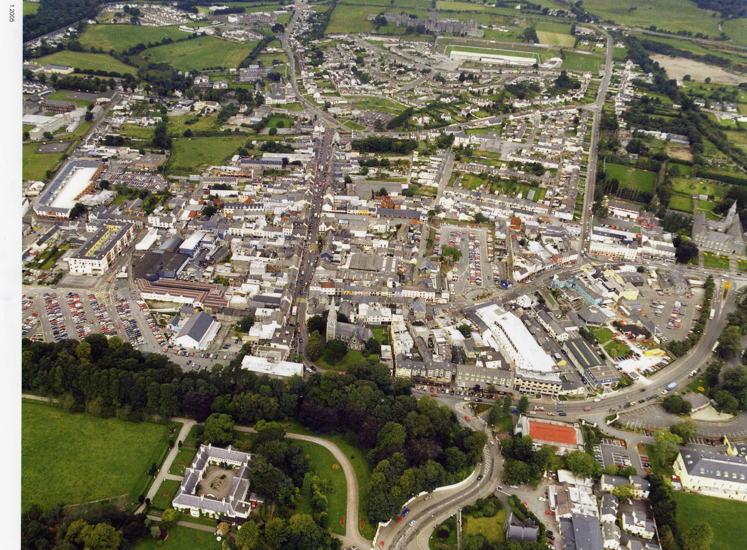

Slide 56
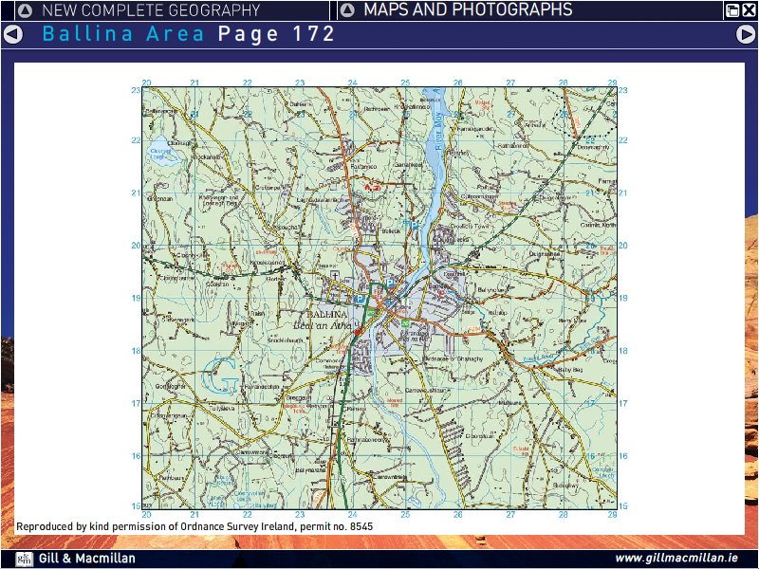

Slide 57
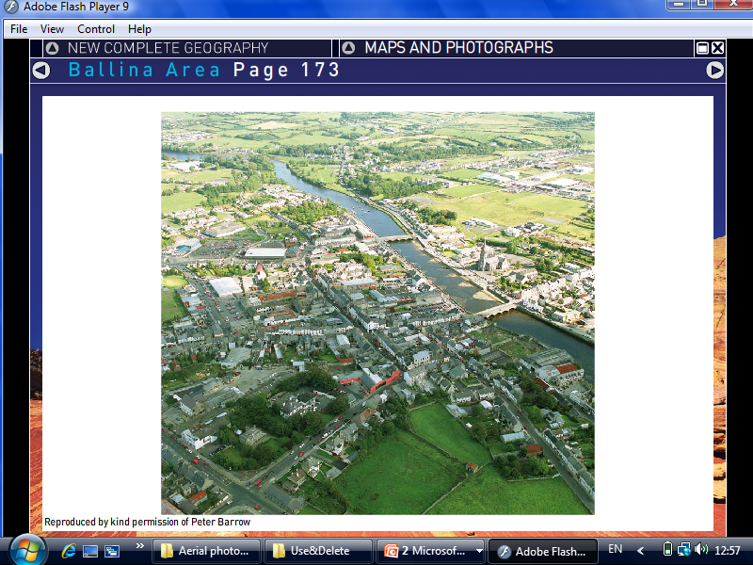
Ballina

Slide 58
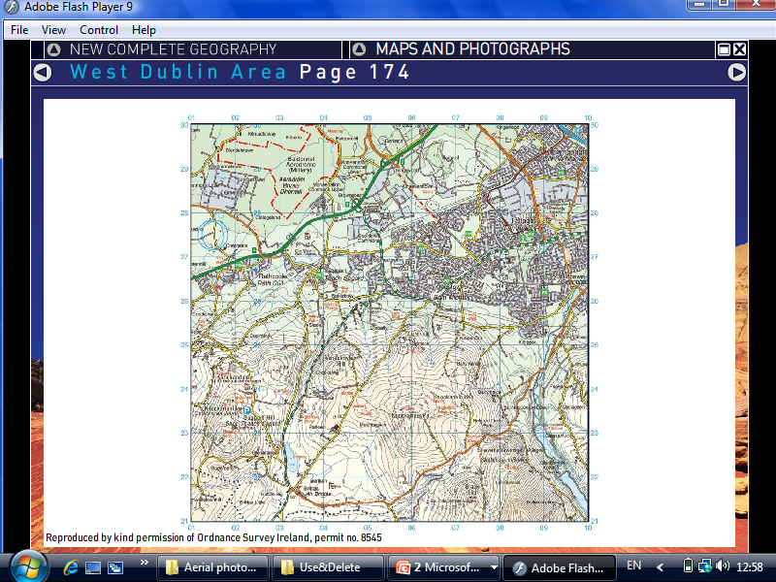

Slide 59
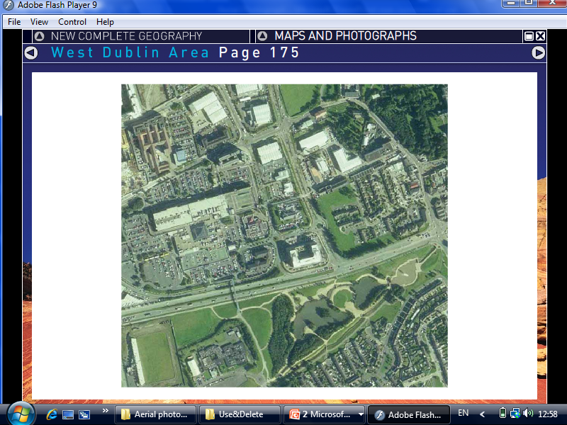
W.Dublin

Slide 60
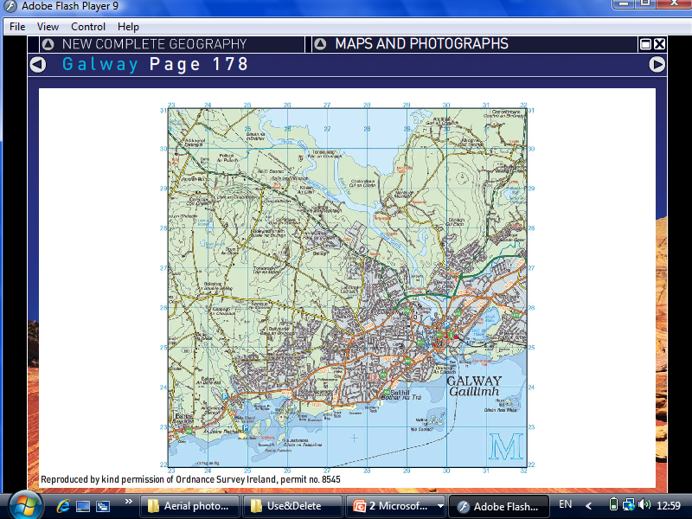
m

Slide 61
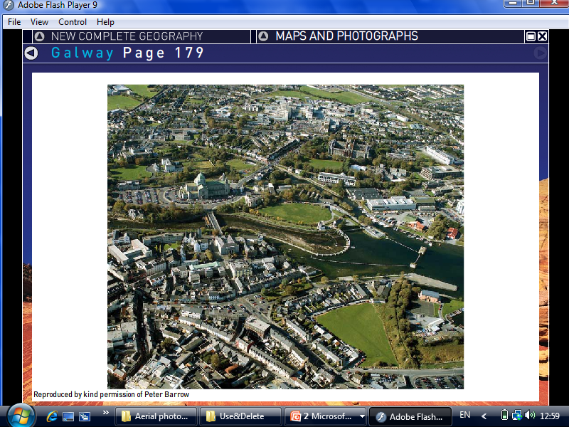
Galway

Slide 62
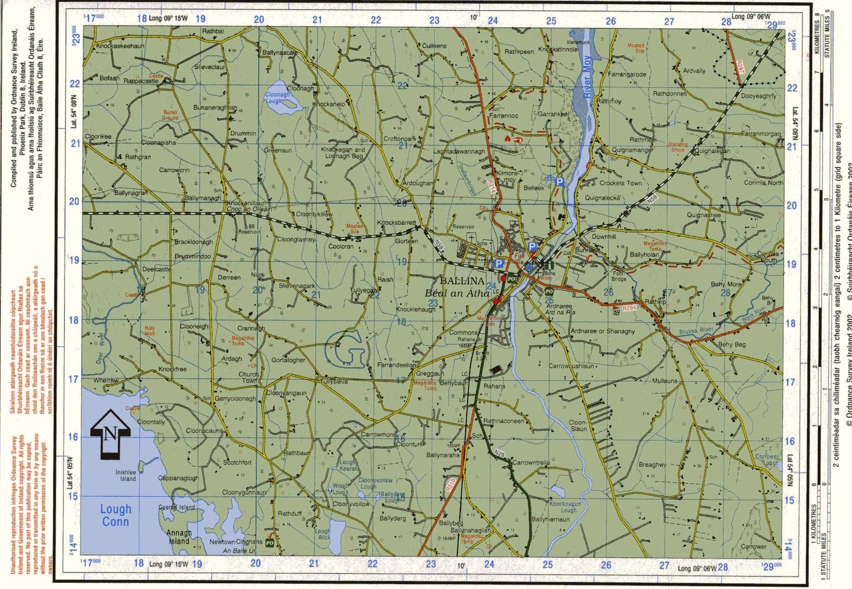

Slide 63
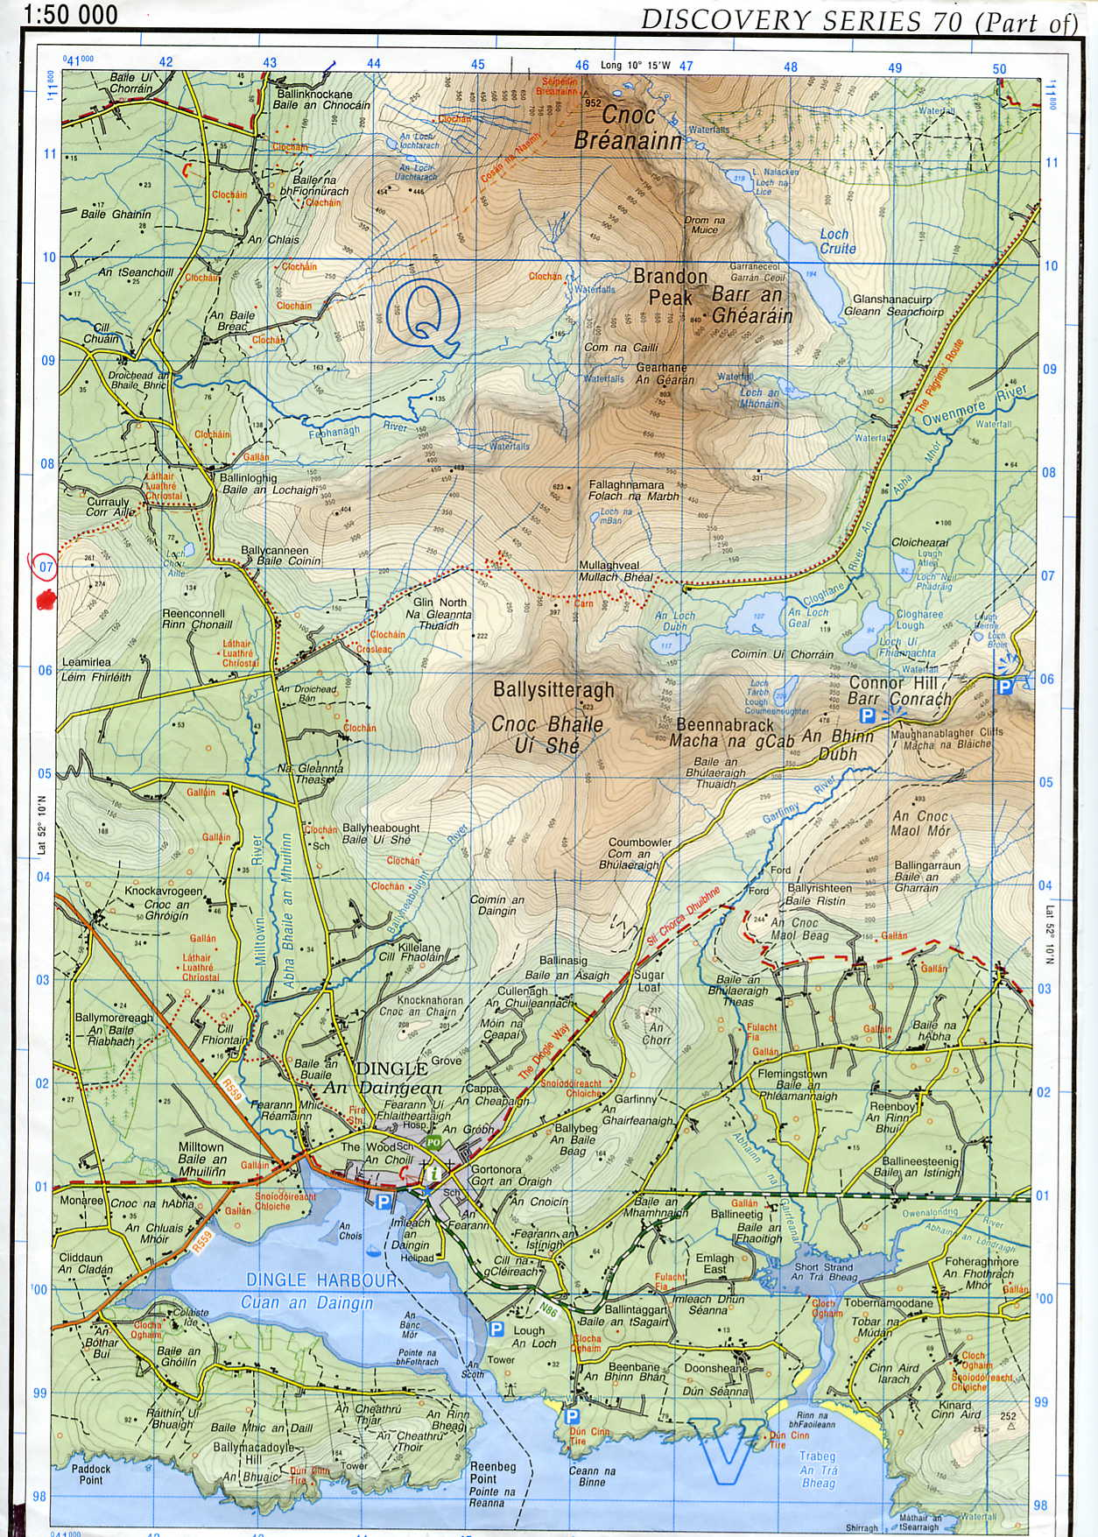

Slide 64
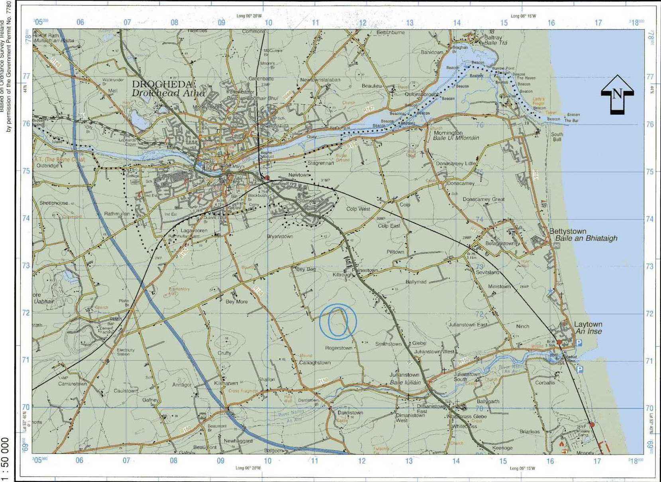

Slide 65
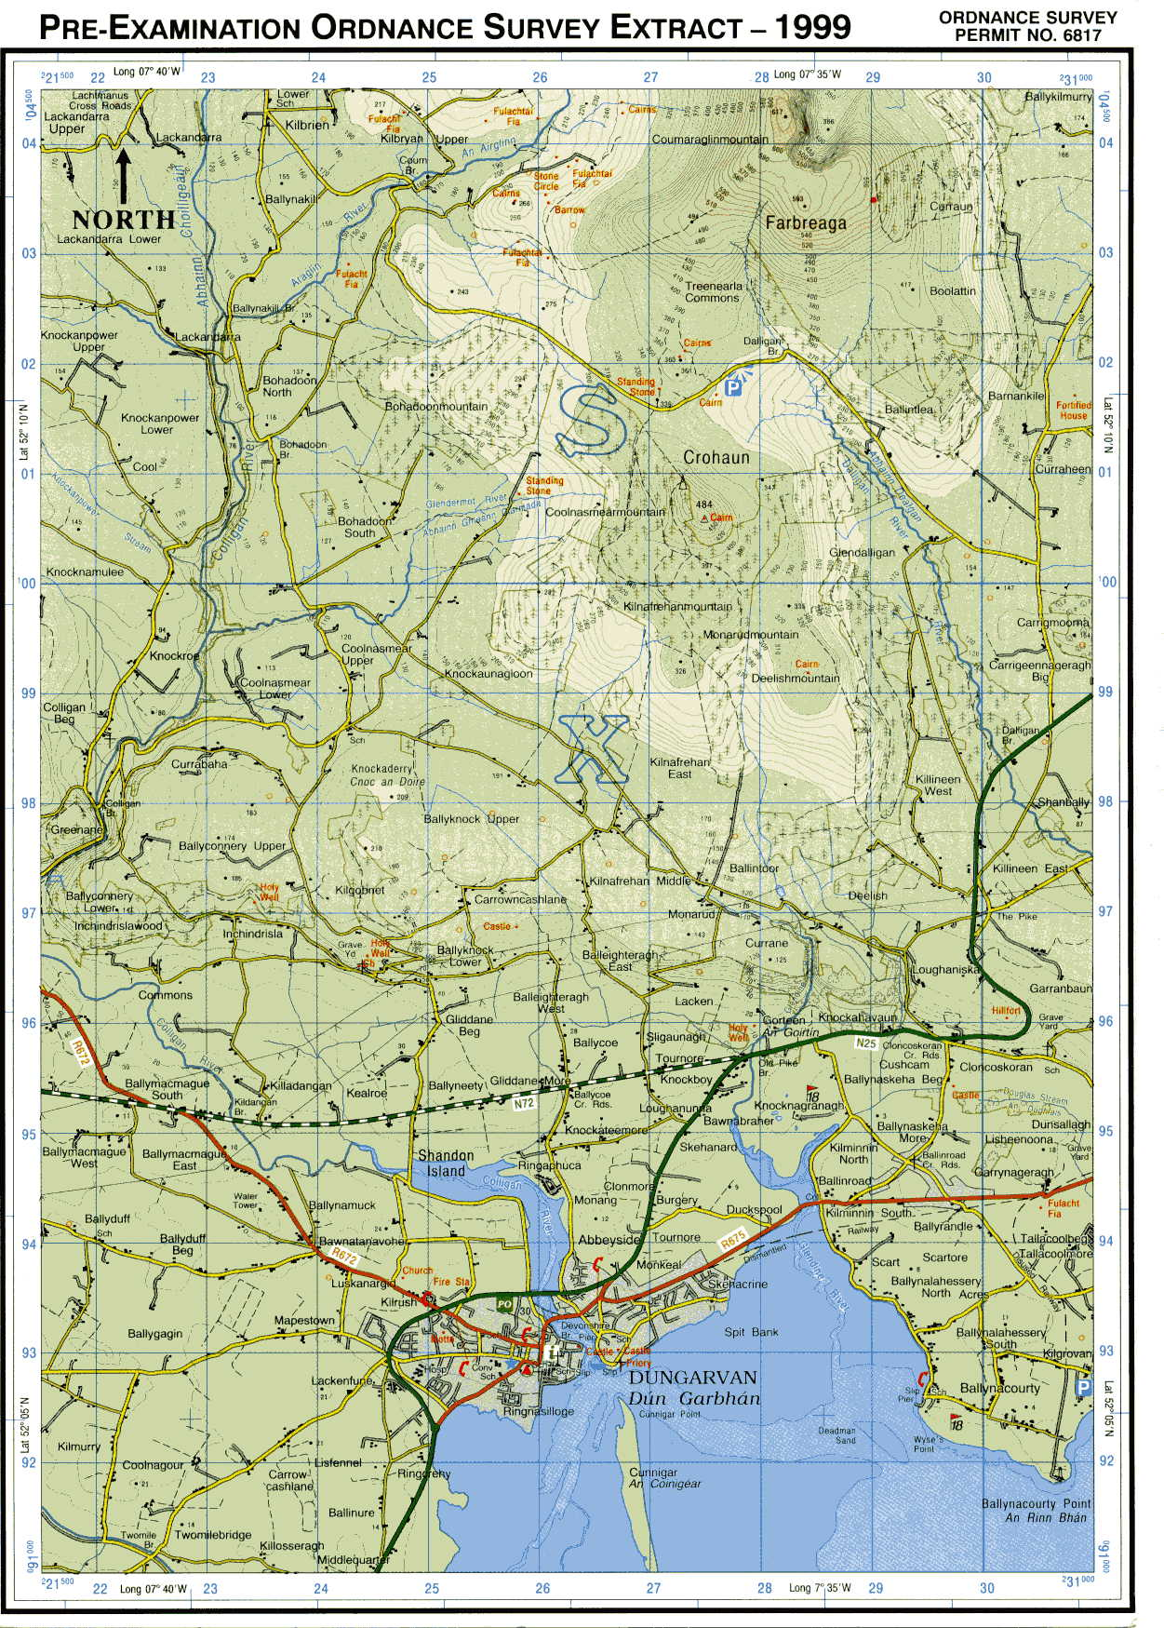

Slide 66
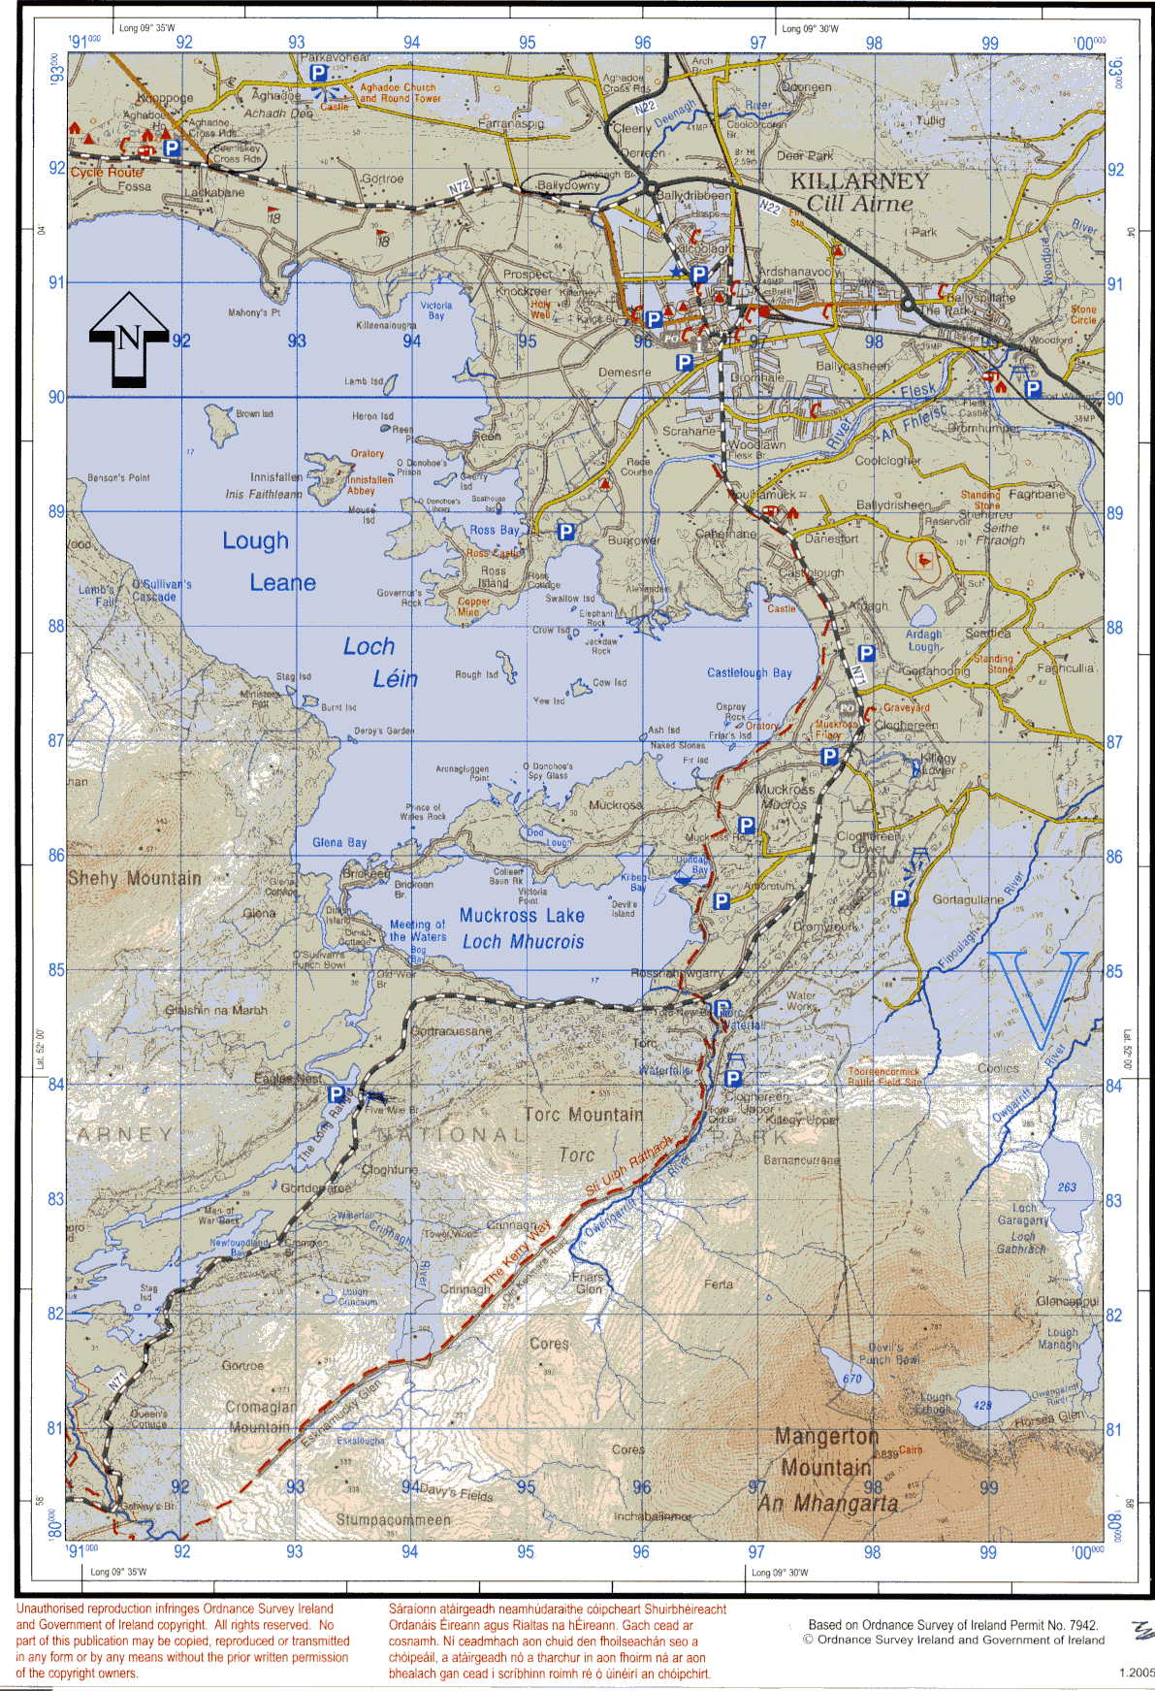

Slide 67
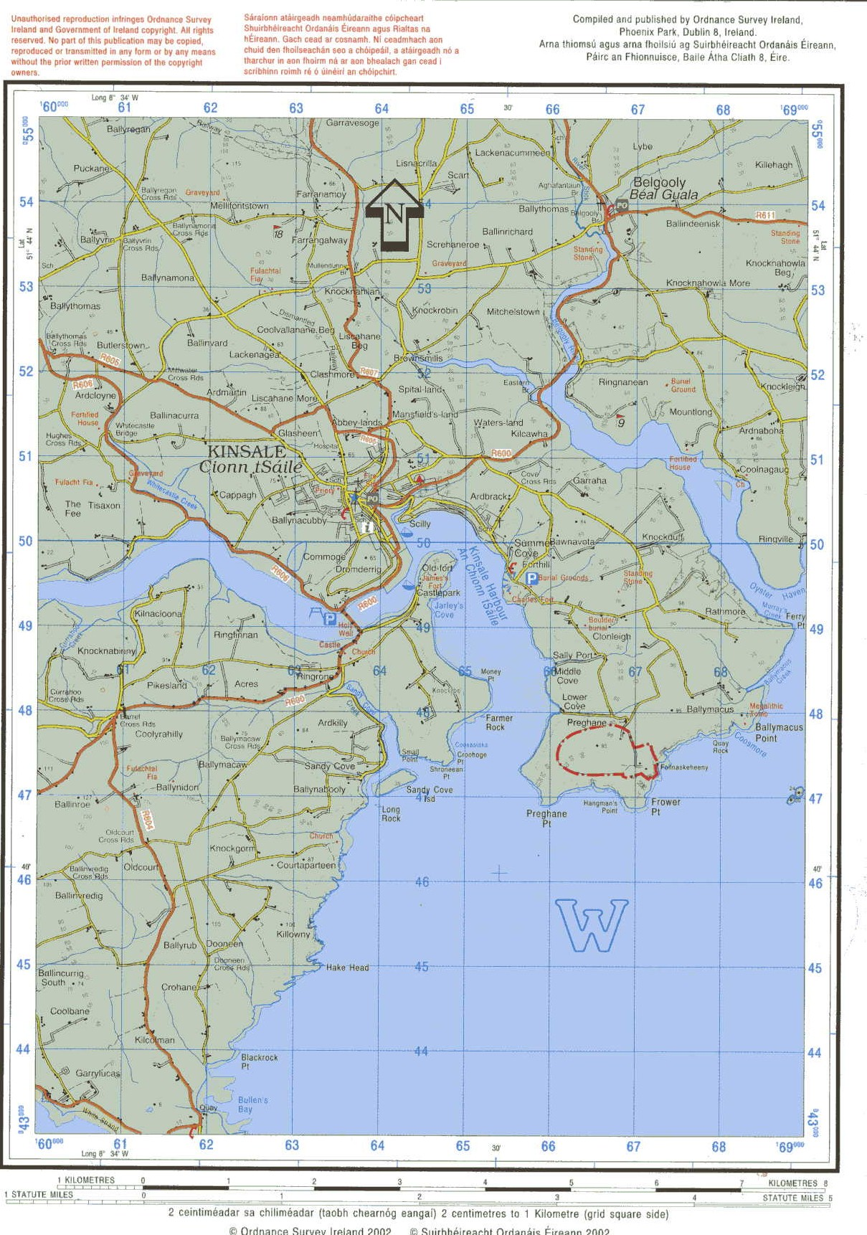

Slide 68
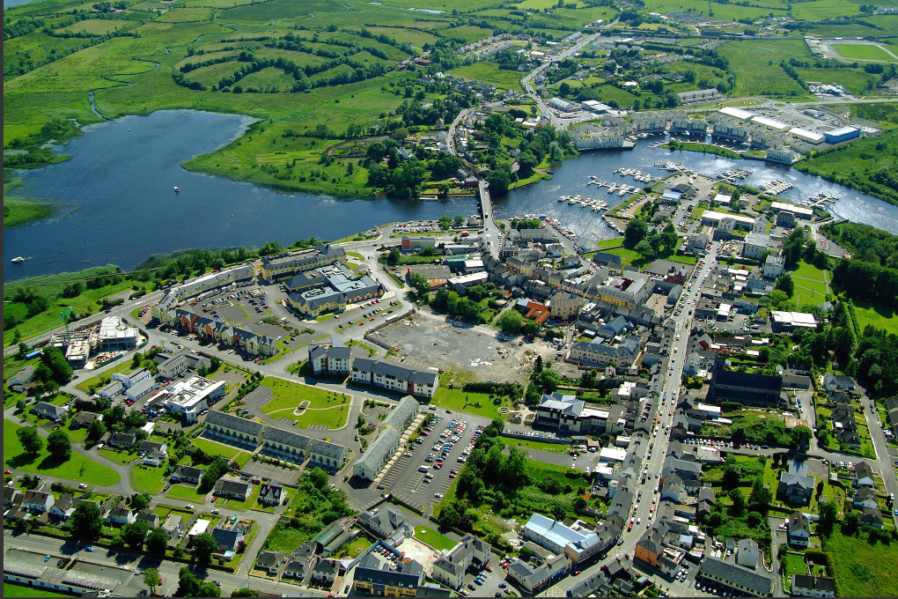

Slide 69
EXAM QUESTIONS

Slide 70
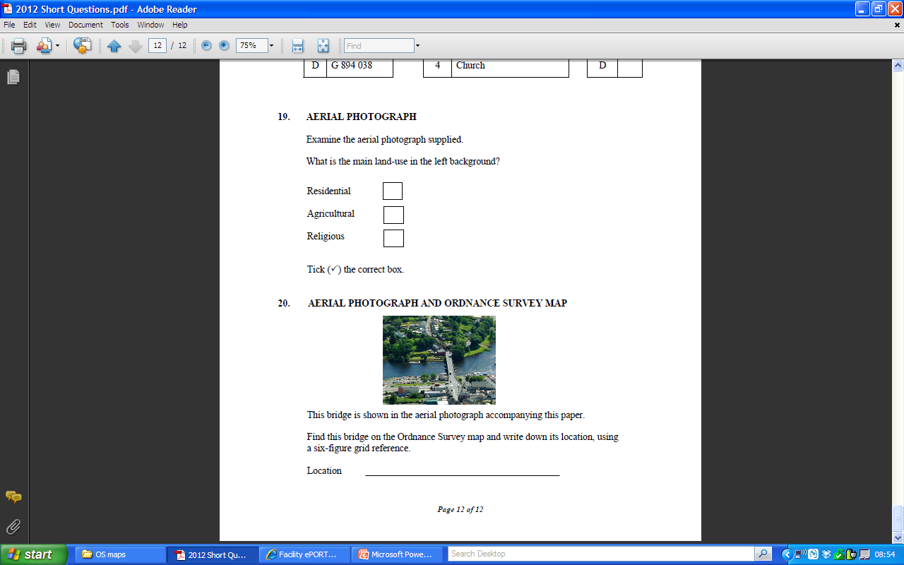
2012

Slide 71
2012

Slide 72
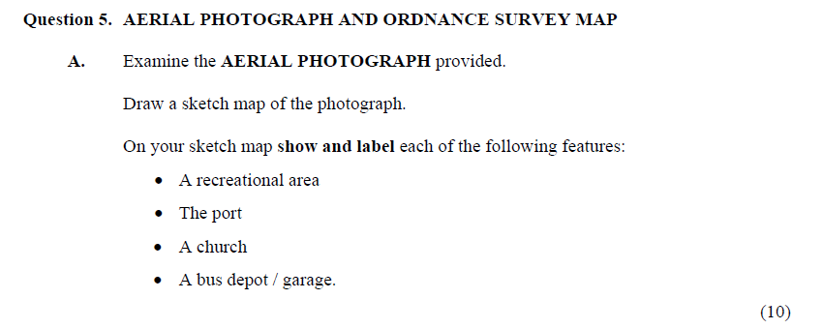
2011

Slide 73
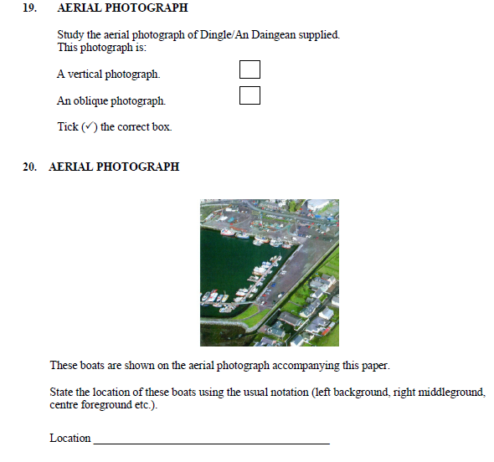
2011

