Slide 1
Humans and Soil Soil erosion and conservation

Slide 2
By the end of this section you will be able....
To name and explain the causes of soil erosion.
Describe in detail how human activities can cause soil erosion.
Name and explain the primary methods of soil conservation.

Slide 3
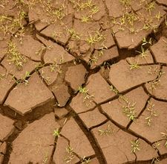
Soil Erosion
Soil is fragile. Once eroded it cannot be renewed.
Most soil erosion is caused by natural processes such as water flowing downhill or wind.
Human activities also cause and accelerate soil erosion.

Slide 4
Natural Causes of soil erosion

Slide 5
Natural Causes of Soil Erosion Rain and wind
Rain falls at 33 km/h. This breaks away soil grains.
The larger the raindrop the greater the rate of erosion.
During heavy rain sometimes water can no longer seep into the soil. This runoff erodes channels called rills and gullies into the soil.

Slide 6
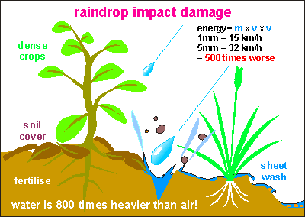
Erosion caused by raindrops on bare land

Slide 7
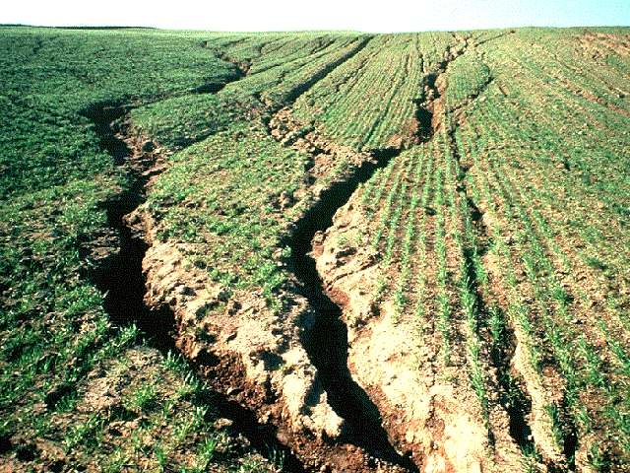
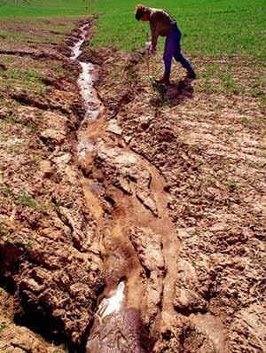

Slide 8
Natural Causes of Soil Erosion Rain and wind
Wind is also effective at eroding exposed soil.
Saltation- fine/medium particles are lifted a short distance dislodging more soil as they fall back to the ground.
Suspension- fine particles remain suspended in the air over long distances.
Surface creep- movement of large particles along the surface.

Slide 9
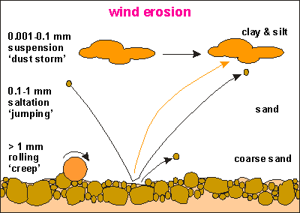
Erosion caused by wind

Slide 10
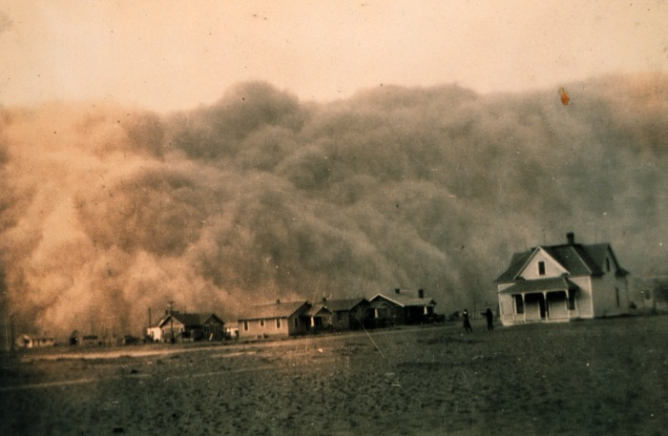

Slide 11
Natural Causes of Soil Erosion Rain and wind
The amount of soil erosion by wind/ rain depends on.
Quantity of water
Speed of water
Strength of wind
Steepness of slope
Condition of soil

Slide 12
Human Causes of soil erosion

Slide 13
Human causes of soil erosion
Human can trigger soil erosion due to poor farming methods and deforestation which can change soil structure.
In areas like the Sahel overgrazing, overcropping and deforestation have led to desertification, soil erosion and famine.

Slide 14
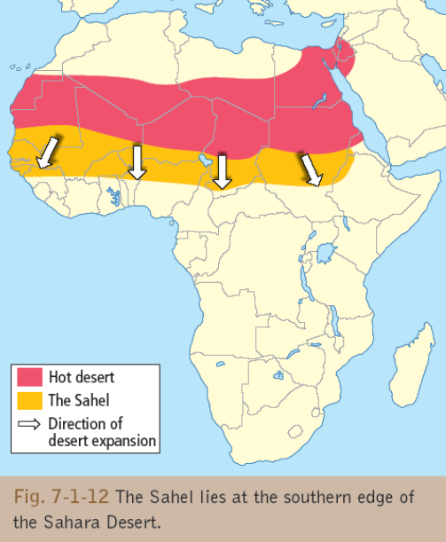

Slide 15
Human causes of soil erosion
The amount of soil erosion causes by human depends on
Type of cultivation.
Amount of vegetation removed.
Intensity of land use
Length of time land left fallow.

Slide 16
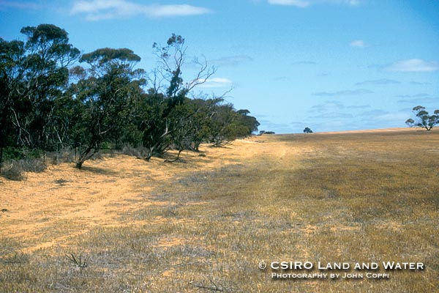
SOILS – Human Interference
Clearing Bush-land in Australia

Slide 17
Problems of soil erosion
Loss of valuable topsoil- soil particles, nutrients, water & water holding capacity.
Poor soil washed downhill can bury valuable farmland.
Damages to field by gully erosion reduces size of field and takes land out of production
Steady but slow plant productivity decline.
Desertification

Slide 18
Case Study- Soil erosion and desertification in the Sahel region of Africa

Slide 19
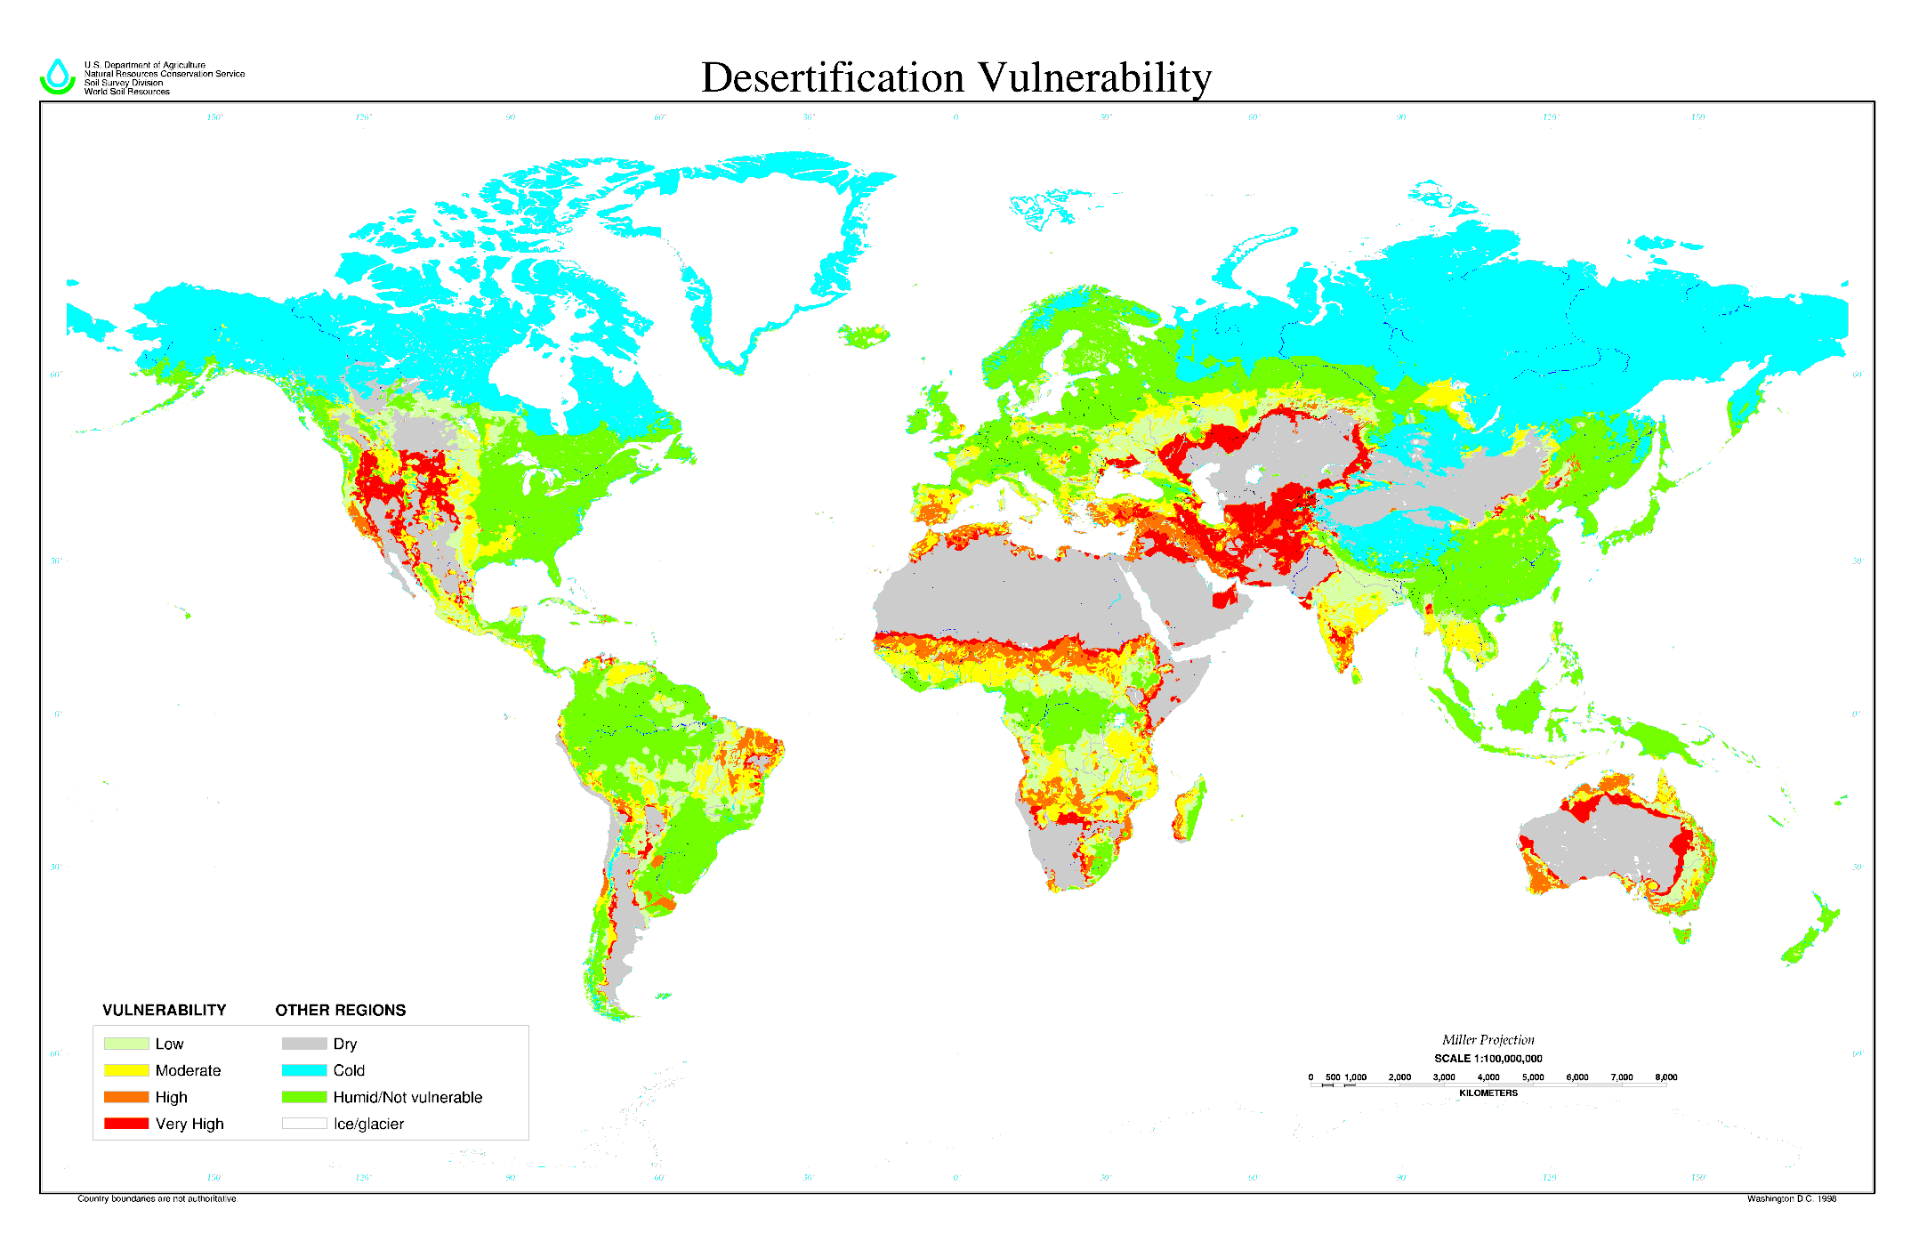
SOILS – Human Interference

Slide 20
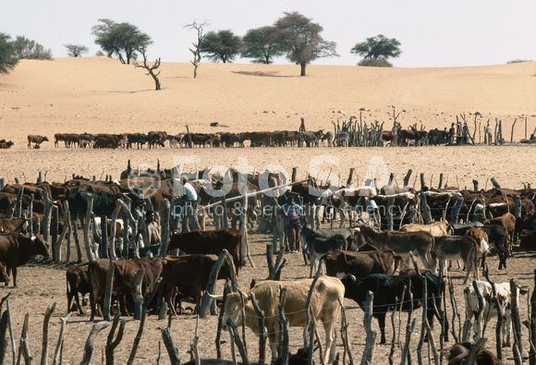
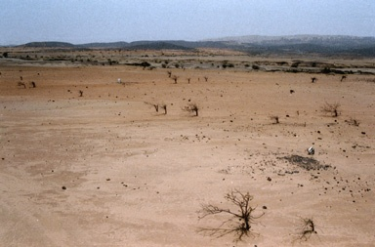
The Sahel Causes??? Solutions???

Slide 21
Desertification in the Sahel
Desertification refers to the reduction in vegetation cover, exposing the soil to wind and/or rain unable to provide for its wildlife or human populations, with desert conditions spreading into new areas.
The sahel is a narrow band of Africa that lies between the Sahara to the north and the savannah grassland and the equatorial rainforests to the south.
It receives rain during a short wet season from late June to september. Depending on which report you read the Sahara Desert is advancing southwads between 5km and 10 km.

Slide 22
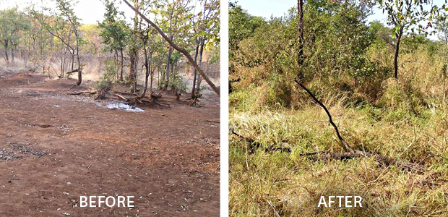

Slide 23
Desertification in the Sahel
Soil erosion and its resulting desertification have two main causes
Human activities-over grazing, over cropping and deforestation all triggered by population growth.
Climate change.

Slide 24
Population Growth- In the Sahel
Increased demand for food meant the fallow year was abandoned.
Over-cropping soon sapped the soil of its nutrients, reducing the size of the crop and finally the land became sterile.
More land was cultivated to maintain the same income.
Also a greater demand for fuel (90% wood) leading to deforestation.
People had little money to replant trees.

Slide 25
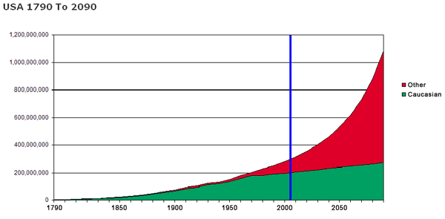

Slide 26
Human Activities- Overgrazing
Too many animals to graze an area of land as well at compacting it with their hooves- damages soil structure, removes plant cover allowing soil to blow away. This prevents grass growth and prevents water for percolating into the soil.
With Pop growth so have number’s of livestock damaging young trees and shrubs.
This reduces soil humus and removes roots necessary to anchor the soil.
Continued grazing also removes the protective cover of grasses increasing the risk of erosion.

Slide 27
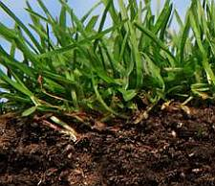
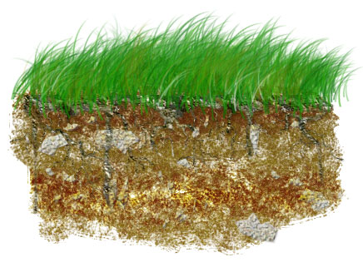

Slide 28
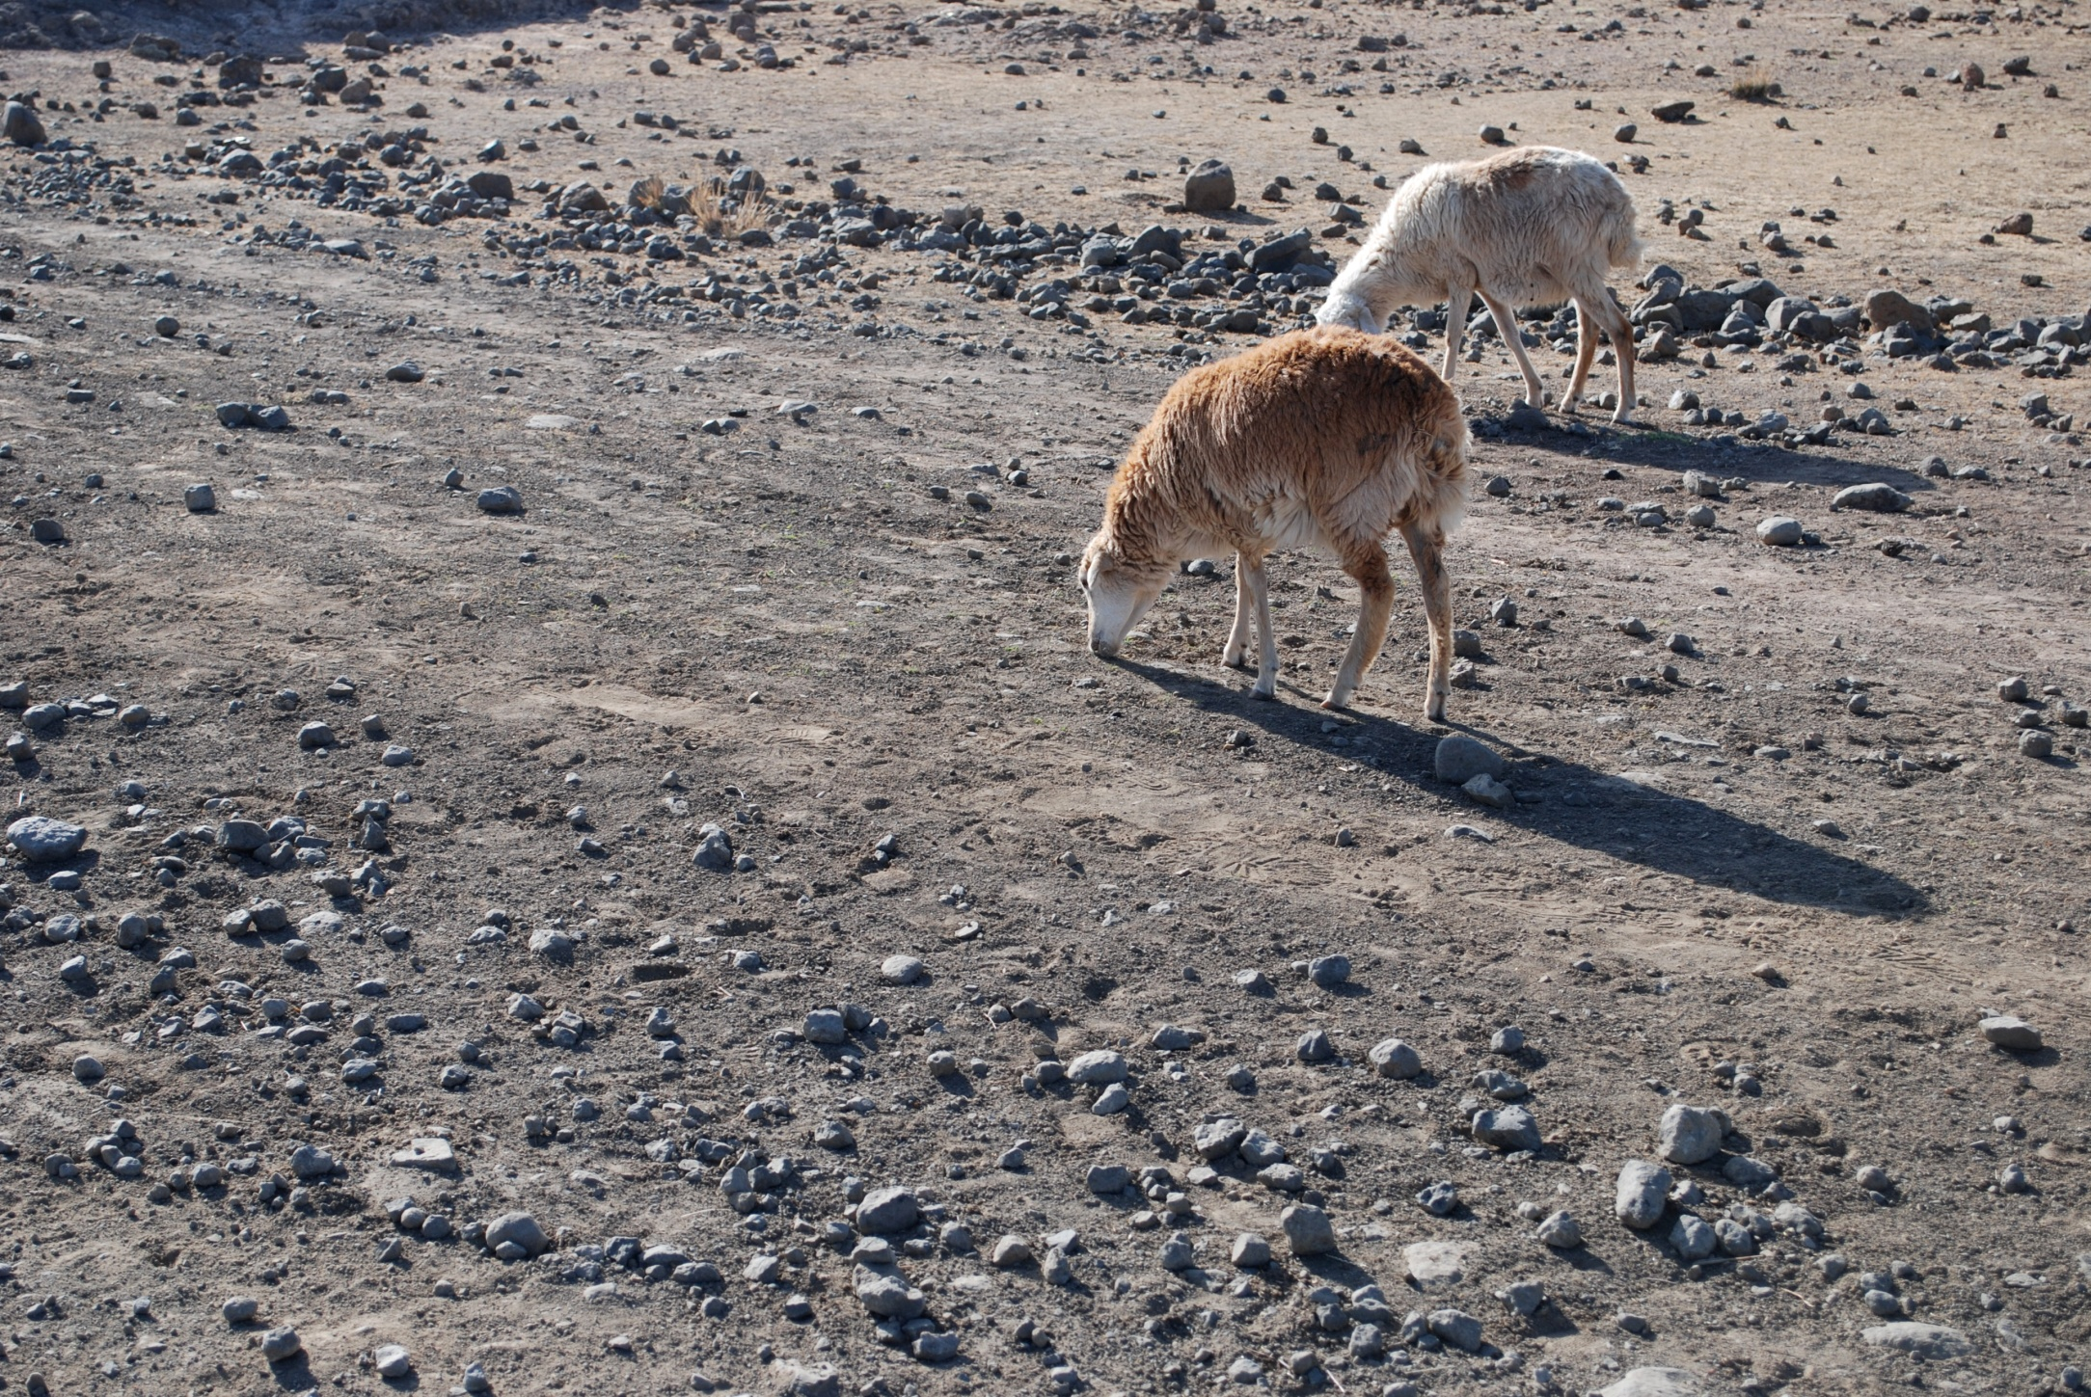

Slide 29
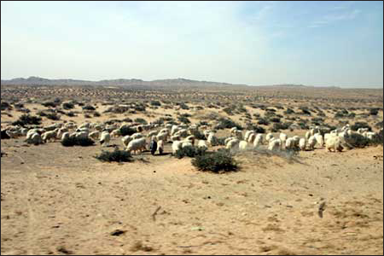
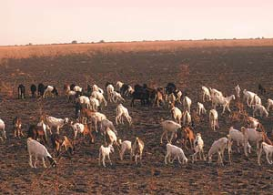

Slide 30
Human Activities- Overgrazing
Once the soil has been trampled and stripped of plants, its structure is damaged and its ability to hold water and nutrients is reduced.
Overgrazing can change the structure to a platy structure or destroy the structure completely. As a result it can be easily erodes by wind and rain and pasture growth is also reduced
As nomadic farming in the Sahel continues to be replaced with more settled farming, farmers have constructed enclosures for cattle and goats so the land becomes intensively grazed.

Slide 31
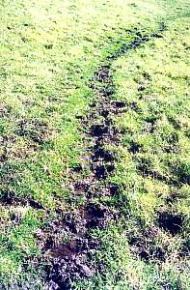
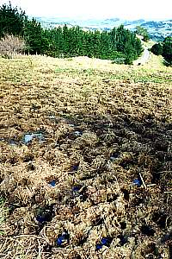
Livestock Damage

Slide 32
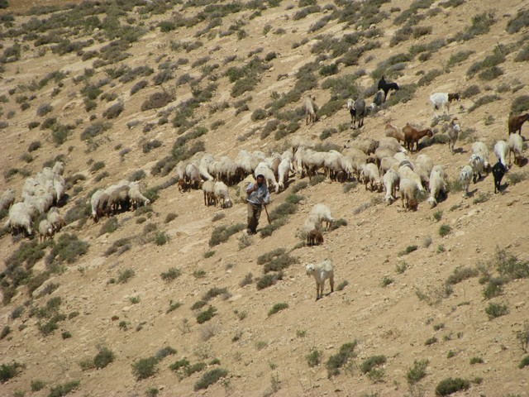

Slide 33
Human Activities- Over-cropping
Over-cropping occurs when the land is under continuous cultivation and not alowed to rest in between crops.
The effect of over-cropping on soils is to reduce its fertility. As nutrients are removed its structure is damaged . Over-cropping soils becone dry and very dusty because the humus content has been reduced.
Humus is important for improving the texture and structure of the soil and for keeping it moist.
Over cropping is also caused by population growth as more food is needed.

Slide 34
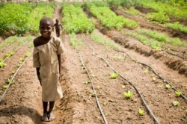

Slide 35
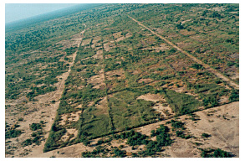

Slide 36
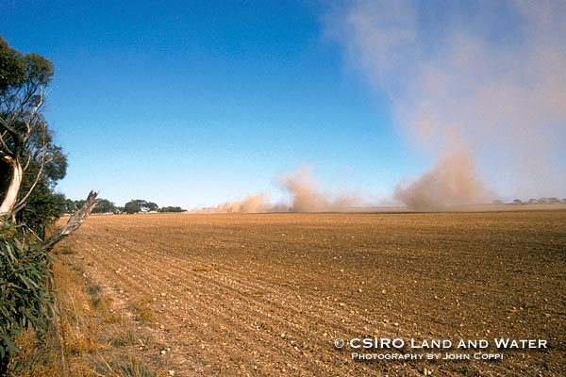
Erosion caused by tilling dry land

Slide 37
Human Activities- Over-cropping
As most countries in the Sahel region are Highly Indebted Poor Countries (HIPCs) they have to increase cash crops such as cotton to pay off national debts.
The same crop is grown each year depriving the soil of nutrients making it sterile and useless.
Farmers working on plantation farms also over cultivate there own land growing cash crops making the soil dry dusty and prone to desertification.
Mono-culture deprives soils of particular nutrients.

Slide 38
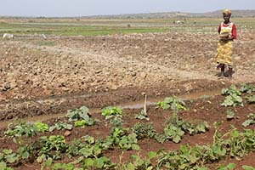
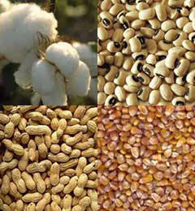

Slide 39
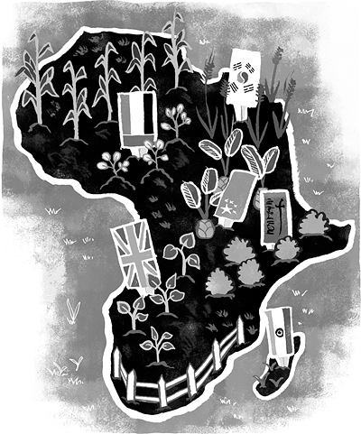

Slide 40
Human Activities-Deforestation
Large areas of trees are cut down leaving a bare landscape. Forests provide natural protection for soil from rain and wind while also preventing mass movement as roots anchor the soil.
With deforestation the soil dries out due to constant exposure to the sun and is easily blown away or washed away.
As population rises more tress are cut for building materials/ firewood and very few trees are replanted.

Slide 41
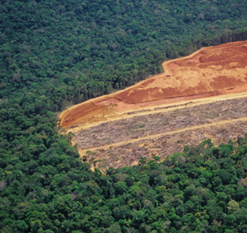

Slide 42
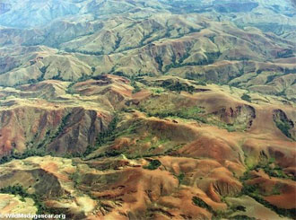

Slide 43
Human Activities-Results
The combination of overgrazing, overcropping and deforestation means that the lack of nutrients and destruction of soil structure renders the soil useless for future farming. Land is abandoned over time and the desert spreads onto these once productive farmlands.
With more wells being sunk along with climate change the water table begins to drop.
Due to the destruction of soil, the region is now classes as overpopulated as it cannot feed its population.

Slide 44
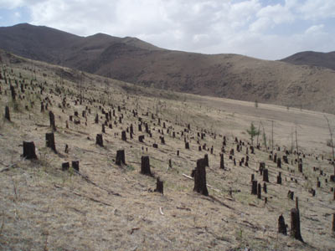

Slide 45
Climatic Change
Global warming, higher temperatures increased evaporation and reduces condensation. As a result there was a decrease in the amount of vegetation cover.
Decreased rainfall by at least 30% over the past 10 years.
Rise is air temperatures mean air can hold more moisture and precipitation is less likely.
Increased drought especially from 1968-73 and 1983-86.

Slide 46
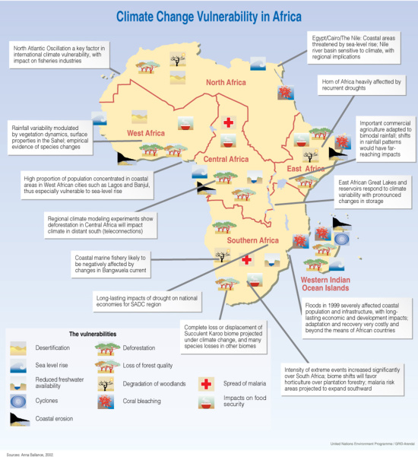

Slide 47
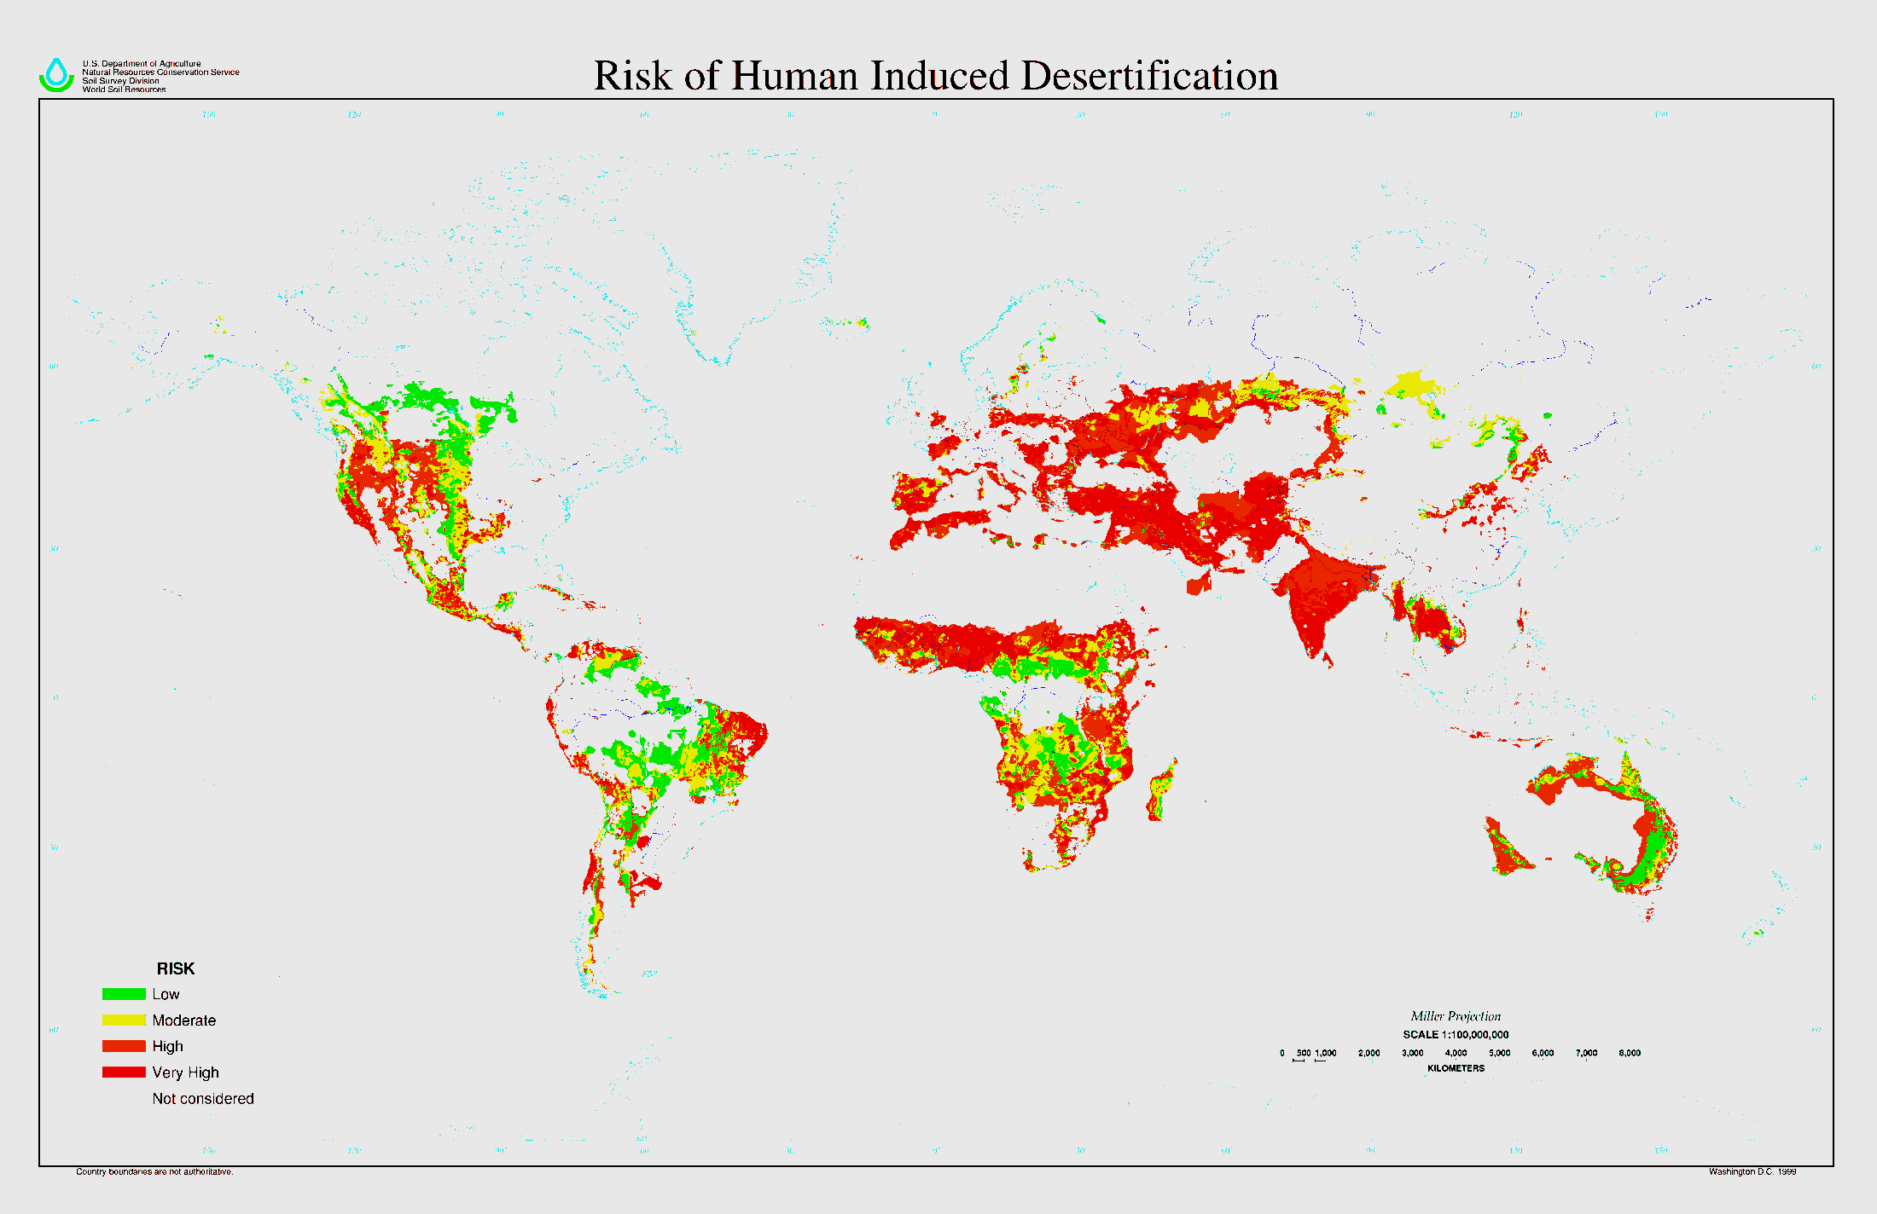
SOILS – Human Interference

Slide 48
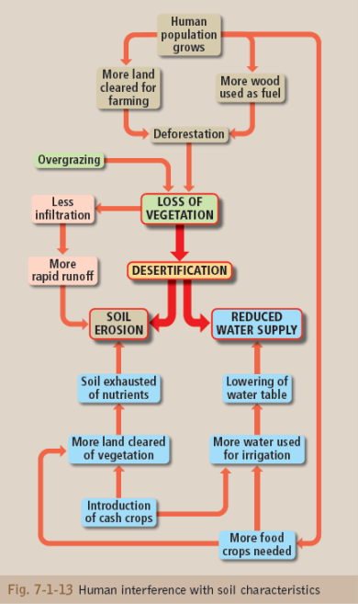

Slide 49
Methods of soil conservation

Slide 50
Soil Conservation
Measures are being taken to reduce soil erosion to a minimum and to reclaim land that has been eroded.
There are many methods used world wide. It must be taken into account that many of the regions suffering from soil degradation are LEDC’s and defense systems take into account local skills and resources.
Simple things like reducing ploughing in dry windy weather or having windbreaks are effective ways of stopping soil erosion.

Slide 51
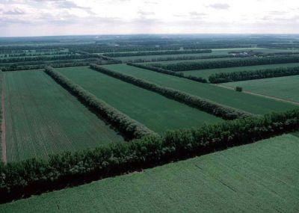
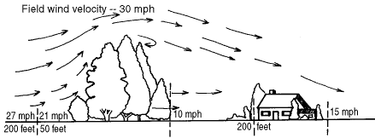

Slide 52
Soil Conservation
Other examples that we are examining are
Forest management
Stone limes
Contour ploughing
Terracing
Strip farming
New animal breeds and EU policies.

Slide 53
Soil Conservation-Forest management
All forests should be managed on a sustainable basis like those of Sweden. Here if for every tree cut another is planted.
Also clear felling (cutting of all trees in an area) is prohibiteed and shelter belts are used to protect soils which consits of a layer of trees or shrubs protecting the ground acting as a windbreaker

Slide 54
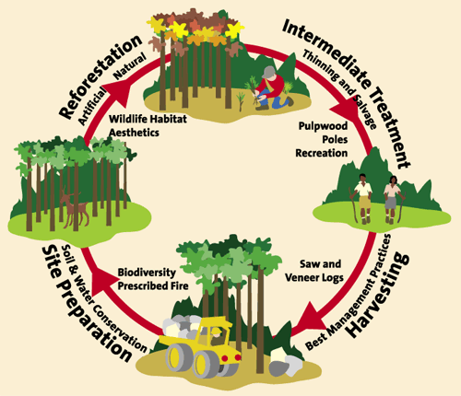

Slide 55
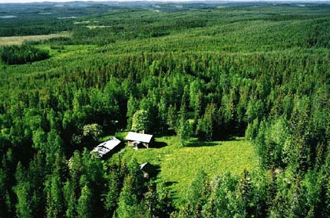

Slide 56
Soil conservation- Stone Lines
Stone lines. This involves putting small stones across slopes to reduce surface run-off, trapping the water and allowing it time to filter downwards into the soil rather than running down slope.
This is an example of appropriate technology-it is small scale using local skills.

Slide 57
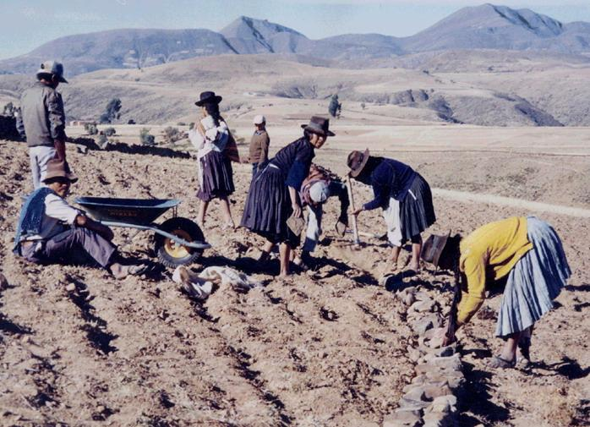
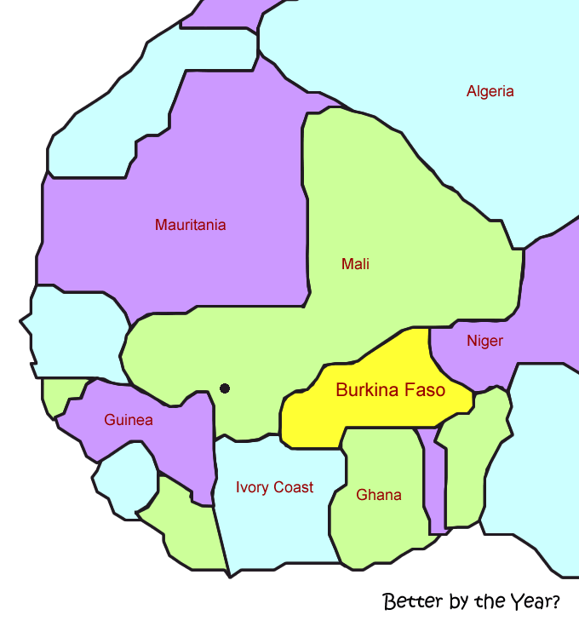

Slide 58
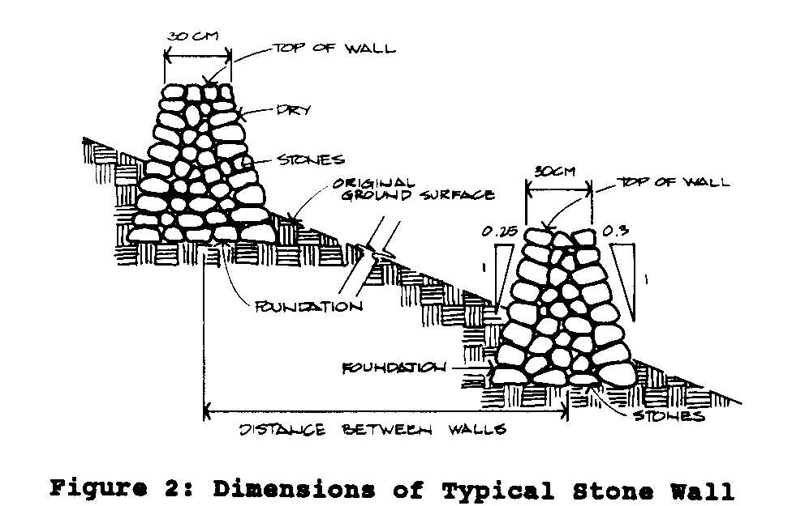

Slide 59
Soil Conservation- Terracing
Terracing-is best on very steep slopes where the soil is cut into a series of wide steps and each step is fronted with a mud or stone wall.
Stopping or slowing the downhill water flow of water allows the sediment drop out of the water onto the terrace adding soil to the terrace.
This prevent gully erosion.

Slide 60
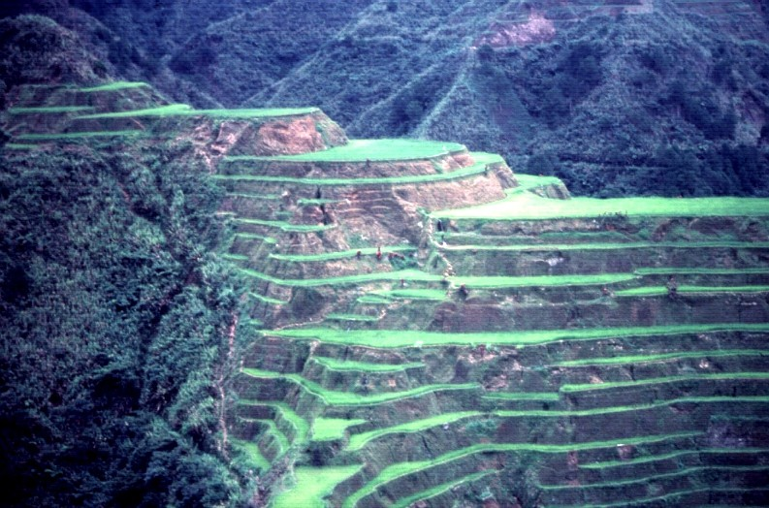

Slide 61
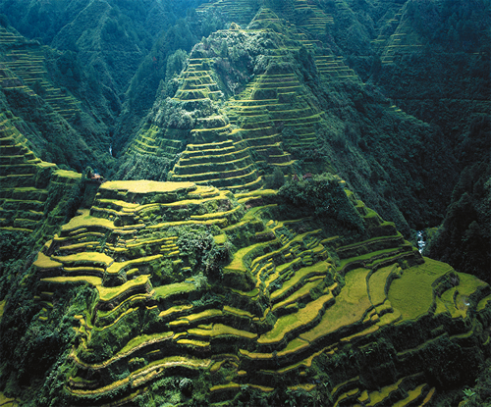

Slide 62
Soil Conservation- Contour Ploughing
Contour ploughing has the ability to reduce soil erosion by 50%.
It invloves ploughing the furrows along the contours.
If they were to go up and down they would act like gullies promoting surface run-off.
But going across they act as mini terraces holding the water and allowing it to percolate into the soil.

Slide 63
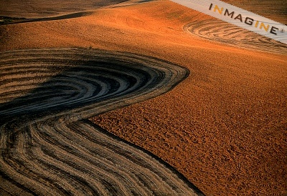

Slide 64
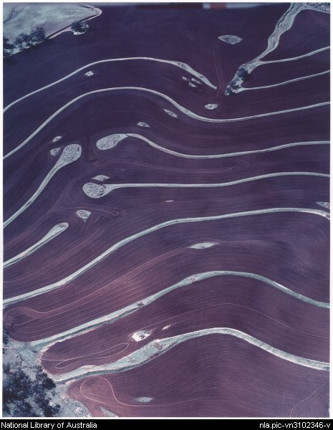
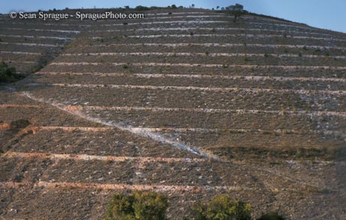

Slide 65
Soil Conservation- Strip farming
Strip farming involves planting crops that mature at different times in widely spaced rows.
The ideal situation is where crops are at different heights, harvested at different times and have different nutrient needs.
By varying the crops the soil in not exhausted and the entire field is not exposed at once.

Slide 66
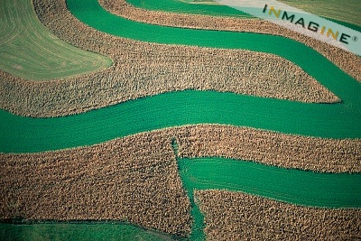

Slide 67
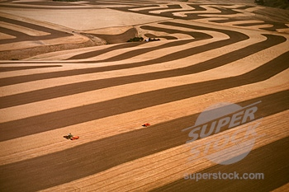

Slide 68
Soil Conservation-New animal breeds and Eu policy
New animals breeds have been introduced to the Sahel.
They included smaller better quality herds that fatten more quickly and produce more milk
So while production has increased the demand on grazing has decreased.
Sheep and goats have been introduced to areas of poor scrub that would otherwise go unfarmed.

Slide 69
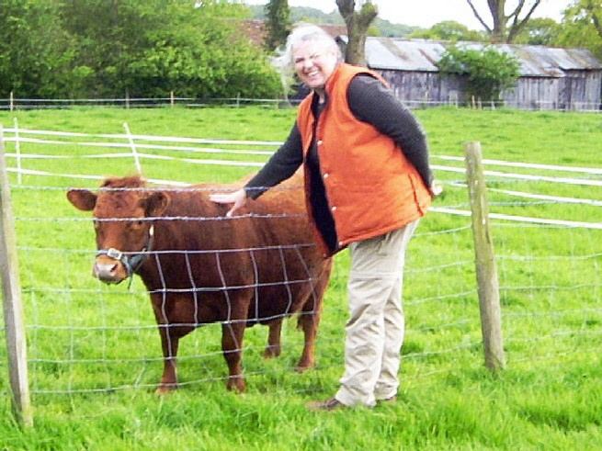

Slide 71
Questions
Discuss how human activities accelerate soil erosion.
Examine the causes of soil erosion and outline methods used to prevent it.
Examine how over cropping/ overgrazing and desertification can affect soil.

