Slide 1
Isostatic & Eustatic Processes
DENIS BOLAND

Slide 2
Isostatic & Eustatic Processes
In some Irish coastal areas (Donegal, Antrim) beaches and cliffs are visible in the landscape high above present day sea level.
In other areas, parts of the former coastline have been submerged beneath the sea (Shannon Estuary).

Slide 3
The formation of these coastal features is linked to the release of pressure on the land when huge ice sheets melted at the end of the last ice age and sea levels changed as a result.

Slide 4
Eustatic Changes
Eustacy is the process whereby the sea level rises or falls relative to the land.
Sea levels drop during an Ice Age with water being locked away as ice and not reaching the sea.
When the ice melts, large volumes of fresh water flow to the sea causing global rises in sea level.
Coastal areas are drowned by rising sea levels, they are known as submerged coastlines.

Slide 5
Isostatic Changes
Isostacy is the process whereby the land rises or falls relative to the sea level.
The earths crust floats on the semi-molten magma.
The release of pressure on the land when huge ice sheets melted at the end of the last ice age meant the land rose to its original, post Ice Age level above the sea.
These effects were local, not global.

Slide 6
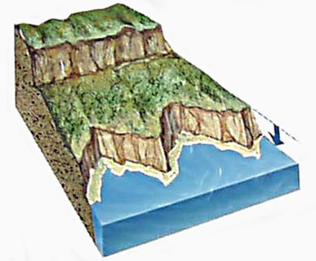
Isostatic Changes
Isostatic changes may also happen when tectonic plates collide and cause an uplift of the land (fold, block mountains).
Both of these processes create a raised or emerged coastline.

Slide 7
Isostatic Changes
In many parts of the world, the isostatic uplift is greater than the following rise in sea level caused by melting ice sheets.
For example around the Baltic Sea, Scandanavia and Hudson Bay, Canada, sea cliffs and beach ridges rise around 300 metres above present sea level.
Isostatic uplift is still happening along the northern Baltic Sea which rises 1cm per year or 1 metre per century, which can impact on port towns.

Slide 8
Landforms associated with drowned / submerged coastlines
Rias
A drowned river valley.
Fiords
A drowned glaciated valley.

Slide 9
Landforms associated with drowned coastlines Rias
A drowned river valley.
Form where sea levels rise relative to the land due to eustatic or isostatic change.
Happens when coastal valleys previously at sea level are submerged.

Slide 10
Landforms associated with drowned coastlines Rias
Results in a large estuary at the mouth of a relatively small river.
Common across south-western Ireland & Europe: River Severn (UK), Brittany coastline (France)
ex. Kenmare Bay, Kerry
Shannon estuary, Limerick
Bantry Bay, Cork

Slide 12
Landforms associated with drowned coastlines Fiords
A drowned glaciated valley.
Formed when a glacier cut a U-Shaped valley through plucking & abrasion.
When the ice sheets melted the meltwaters flows into the sea causing a rise in sea level.
This floods the valley.

Slide 13
Landforms associated with drowned coastlines Fiords
Fiords usually have a sill or rise at their mouth as a result of glacial deposition (terminal moraine).
This sill can cause extreme tidal currents and rapids at the fiord entrance.
Ex. Killary Harbour, Mayo.

Slide 14
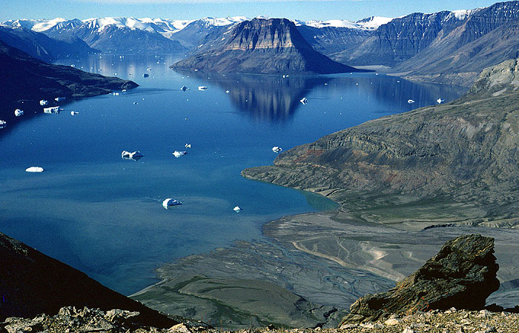

Slide 15
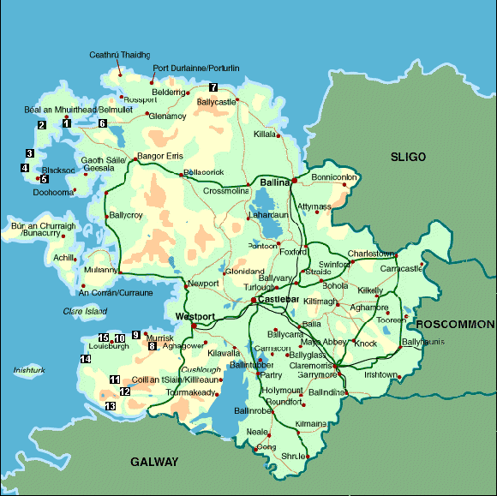
Killary Harbour

Slide 16
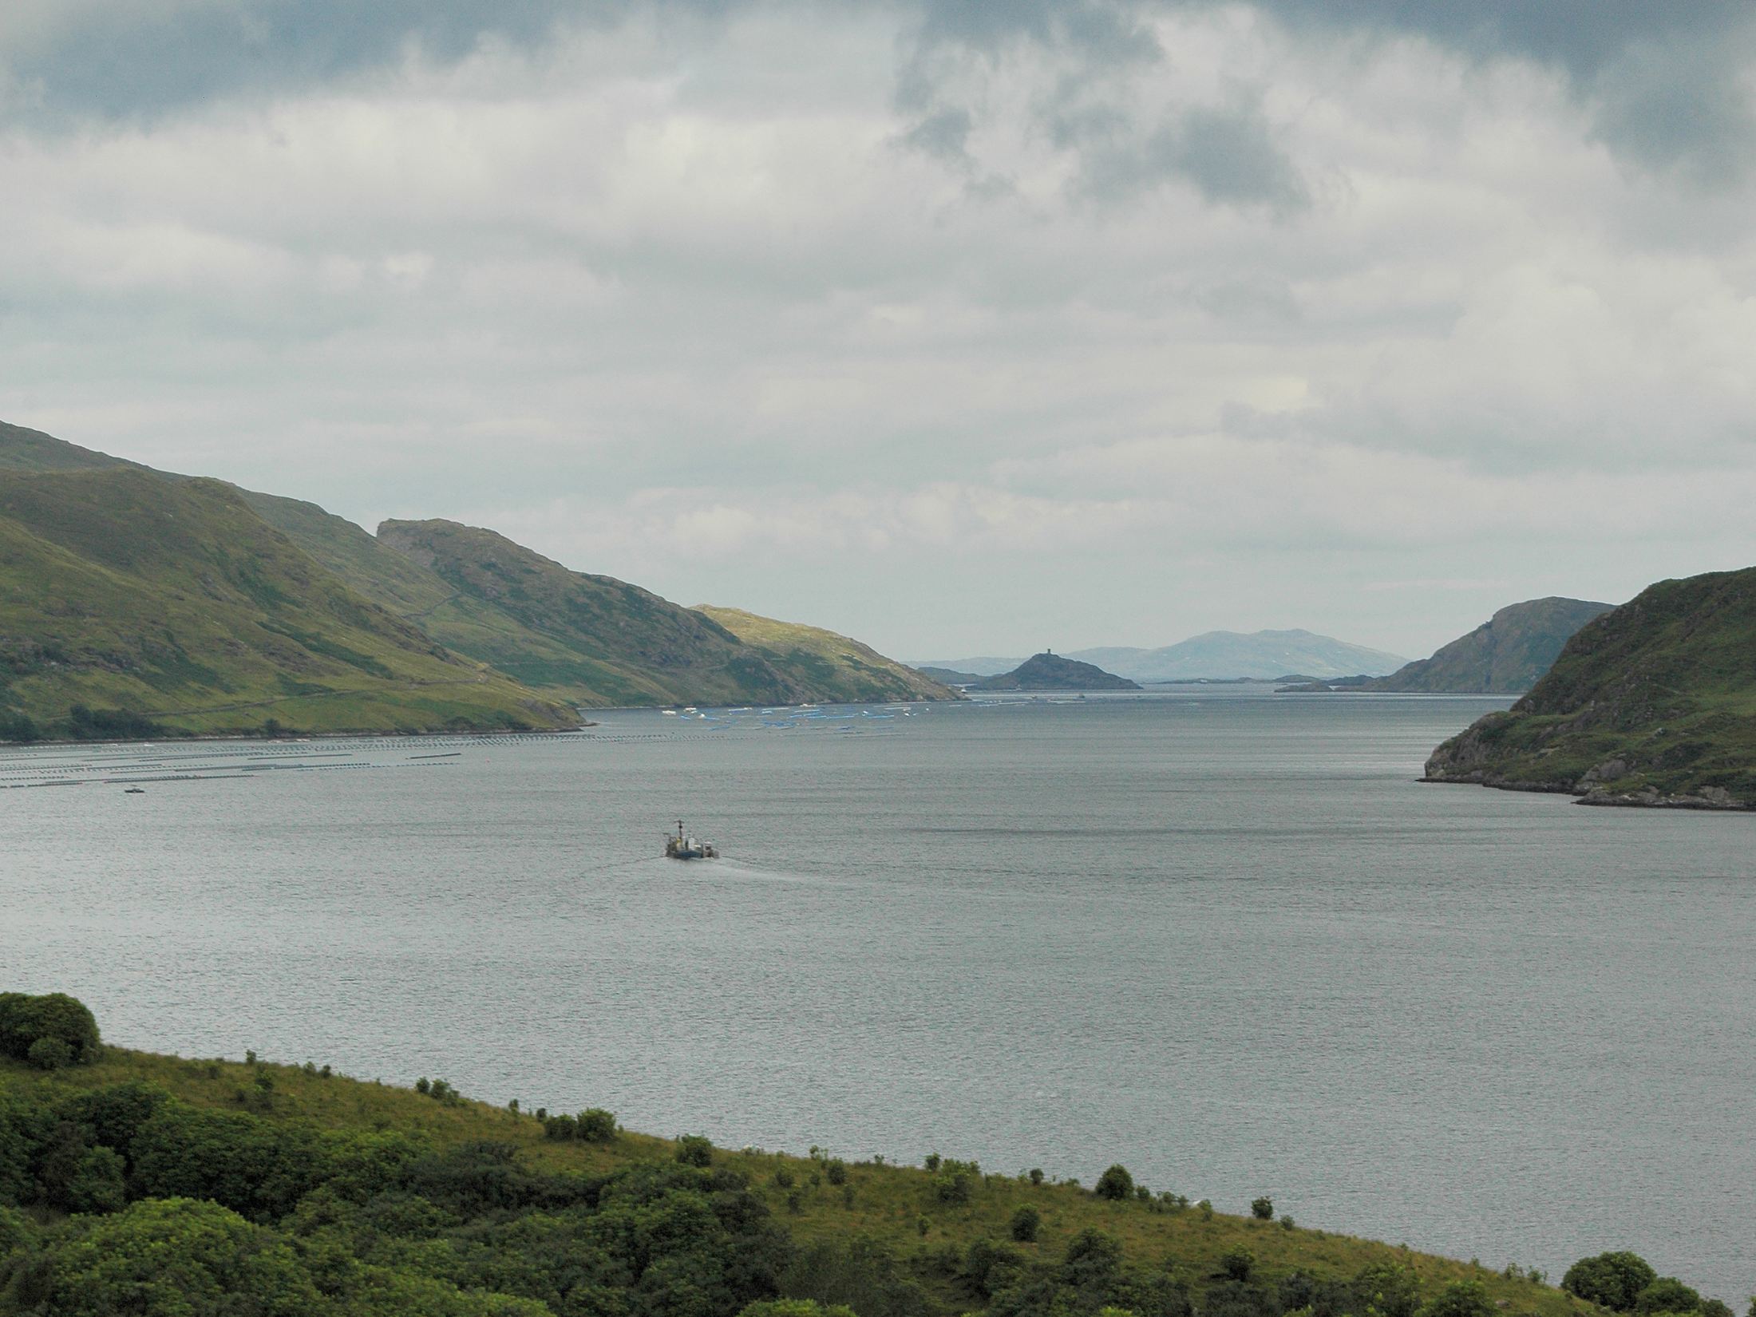

Slide 17
Differences between Rias & Fiords
Rias | Fiords
Shallower towards land. | Deeper towards land.
V-shaped & wider at their mouths with gently sloping sides. | U-shaped & are long and narrow with steeply sloping sides.
No submarine sill at their entrance | Have a submarine at their entrance.

Slide 18
Landforms associated with raised / emergent coastlines
Raised Beaches
An ancient shoreline now exposed above sea level.
Raised Cliffs & Wave-Cut Platforms Uplifted erosional coastal landforms.

Slide 19
Landforms associated with raised coastlines Raised Beaches/Marine Terraces
An ancient shoreline now exposed above sea level.
Form due to land rising because of isostacy.
During the Ice Age sheets of ice covered the land
Coastal landforms such as beaches continued to form by constructive waves in sheltered bays unaffected directly by the ice.

Slide 20
Landforms associated with drowned coastlines Raised Beaches/Marine Terraces
The ice melted and the weight was lifted gradually.
The beaches that marked the Ice-Age sea level were raised above present day sea level & form wide terraces.
New beaches formed at a lower level than before.
Ex. Ballyhillin, Malin Head, Donegal.

Slide 21
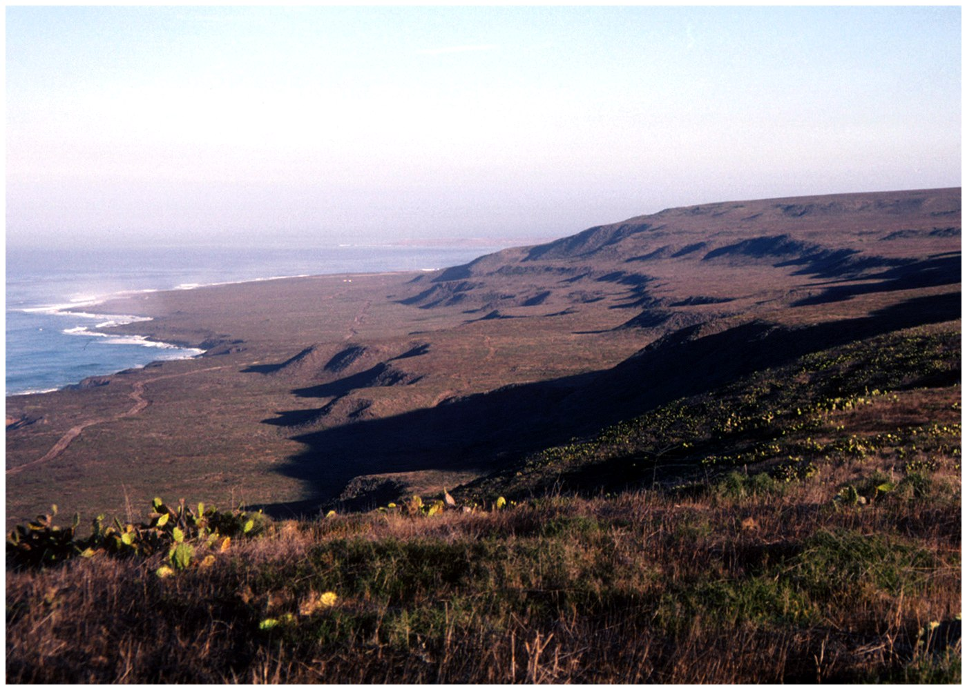

Slide 22
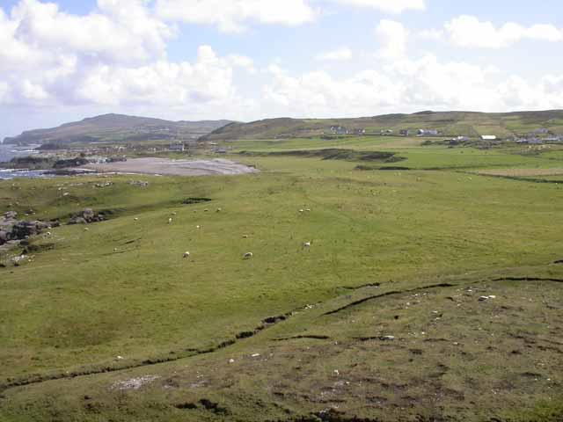
Ballyhillin, Donegal

Slide 23
Landforms associated with raised coastlines Raised Cliffs & Wave-Cut Platforms
Erosional landforms which existed during the last Ice-Age.
Formed in the same way as modern cliffs – compression, hydraulic action & abrasion etc.
After the ice melted & pressure was removed, the land was uplifted due to isostacy.
Cliffs & platforms were raised above the level of the sea.

Slide 24
Landforms associated with drowned coastlines Raised Cliffs & Wave-Cut Platforms
The ice melted and the weight was lifted gradually.
The beaches that marked the Ice-Age sea level were raised above present day sea level & form wide terraces.
New beaches formed at a lower level than before.
Ex. Portbradden, Co. Donegal.

Slide 25
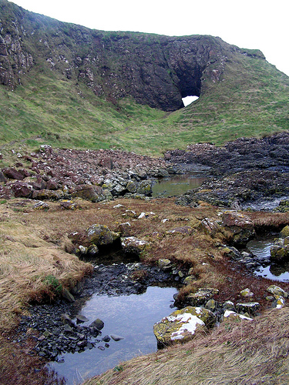
Portbradden, Donegal

Slide 26
Portbradden, Donegal

Slide 27
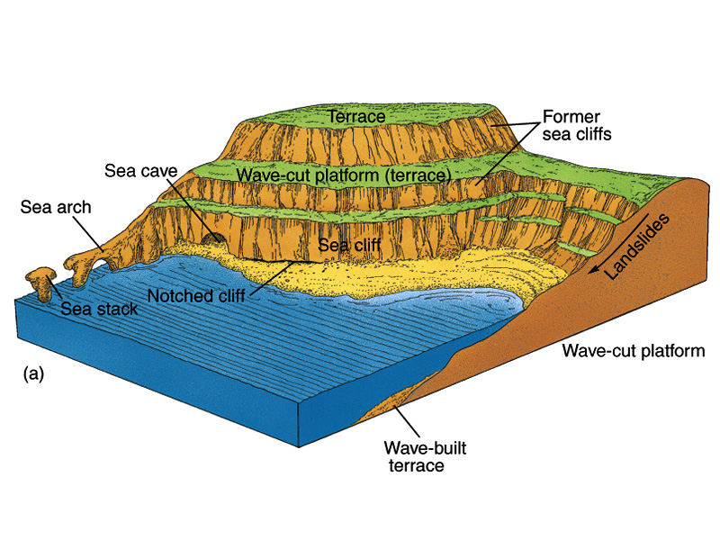

Slide 28
Changes in Sea Level

Slide 29
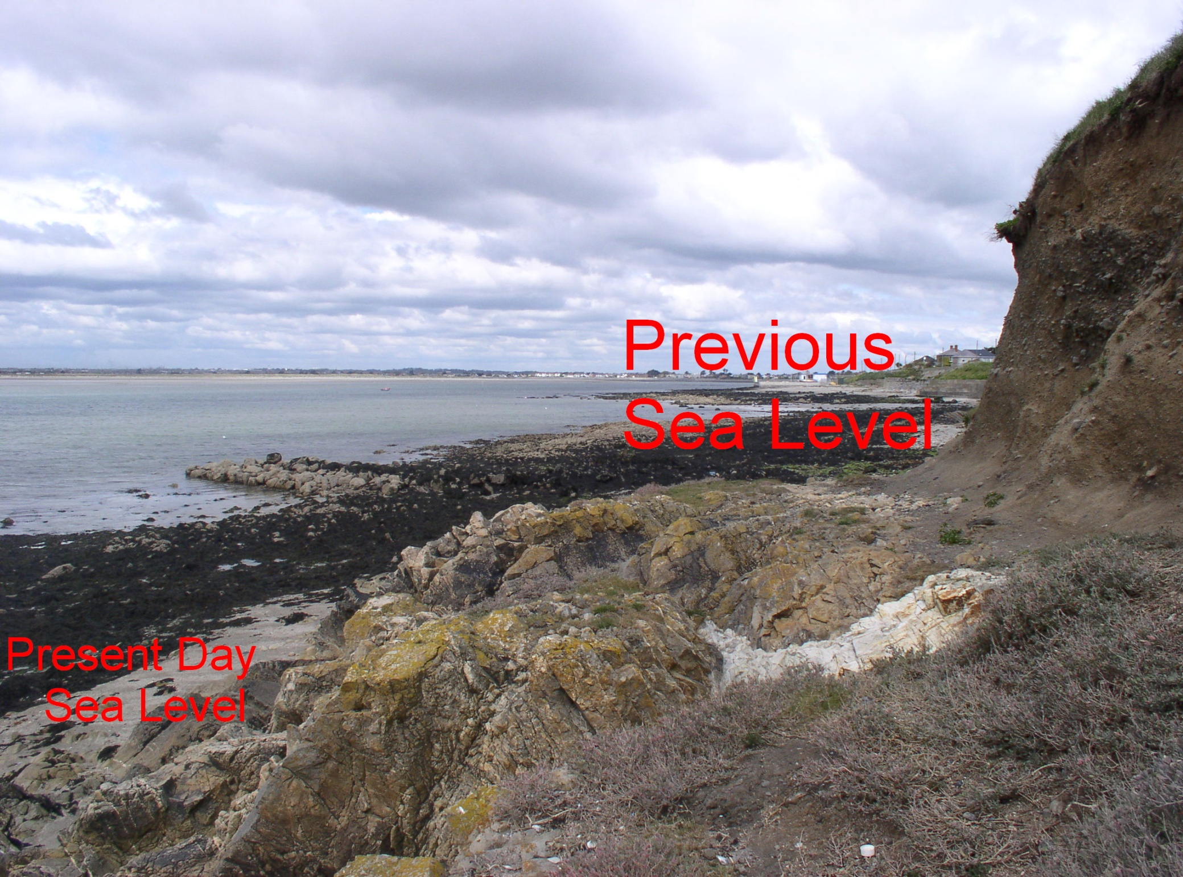

Slide 30
Changes in Sea Level
Wave cut platforms are found at different levels
above and below sea level suggesting changes in
sea level at different intervals.
These resulted from:
Eustastic Change – Sea Level (water in glaciers)
Isostatic change – Uplift (sponge)
Tectonic Activity – Faulting

Slide 31
Types of Coastline
Concordant Coastline ( Parallel)
Discordant Coastline (Right angles)
Coral Coast (Reef and Islands)

Slide 32
Types of Coastline
Concordant Coastline (parallel)
Def; When a coastline is roughly parallel to upland or to a mountain ranges located inland it is said to be concordant.
(1) Submerged Upland; Dalmatian Coastline
Eg Cork harbour, San Francisco.
Long coastal stretches.
Popular for water activities.

Slide 34
Types of Coastline
(2) Submerged Lowland Coastline
As levels rose immediately after the ice-age submerging lowland areas formed Concordant lowland areas.
Gentle slopes and slight depression allows sea flood a large area. Eg. Clew Bay.
Creates: off shore bars, spits, lagoons, marshes, tombolos, broad shallow estuaries.

Slide 35
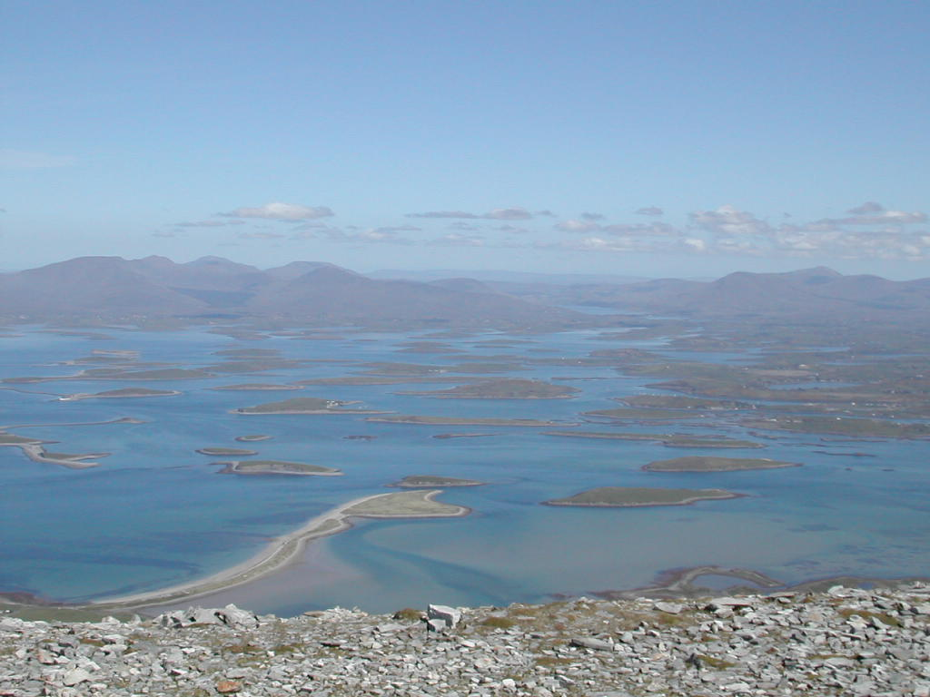

Slide 36
Types of Coastline
Discordant coastline
Def; When upland and lowland areas meet the coast more or less at right angles, resulting in long headlands and bays
Submerged Upland coastline
Rias (drowned river valley eg. Bantry Bay) and Fjords (drowned glacial valley eg. Carlingford Lough) represent a discordant coastline of submergence.

Slide 37
Types of Coastline -Ria

Slide 38
Types of Coastline - Fjord

Slide 39
Types of Coastline
(b) Emerged upland Coast
Experienced a fall in sea level or a rise or a rise in land.
Identified by raised beach and/or raised cliff.

Slide 40
Types of Coastline
(c) Emerged lowland coast
Forms when part of a Continental shelf from the sea and forms a coastal plain.
The coast has no bays or headlands and deposition takes place in shallow waters producing off shore bars, lagoons spits and beaches.
Eg. South East coast of America.

Slide 41
Types of Coastline
Coral reef
Limestone rock made up of skeletons of tiny marine organisms call coral polyps.
Grow upward and outward as old coral polyps die.
Formed under low tied, 21degrees C, Sunlit clear salt water, 55metres deep (180ft).
Generally forms under warm oceam current Eg. South east coast of Australia & South West Africa.

Slide 43
Types of Coastline
Types of Coral formation:
Fringing reef – Narrow coral ridge separated from coast by lagoon that may disappear at low tide – built out from the coast.
Barrier Reef – a wide coral ridge separated from coast by wide deep lagoon.
Atoll – A circular coral reef enclosed by a lagoon (sinking volcanic islands!!!).

Slide 44
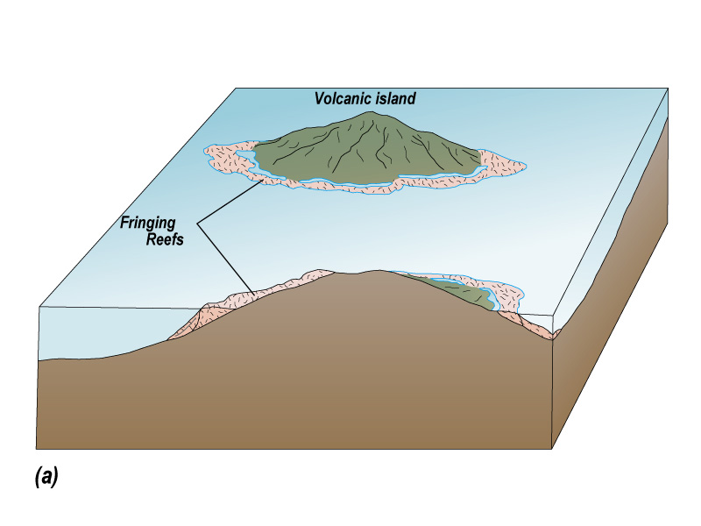

Slide 45
Barrier Reef

Slide 46
Atoll Reef

