Slide 1
The dynamics of population
D. Boland
Geography

Slide 2
Demography
The study of the human population is called demography. Populations numbers, distribution, density and movements are constantly moving.

Slide 3
The dynamics of population
Population distribution
Factors that affect population
Population distribution and density in Ireland.
Demographic Transition model (change in time).
Population structure.
Population growth.
Population change in Ireland
Overpopulation and underpopulation
Migration

Slide 4
1. Population Density and Distribution.

Slide 5
World Population
The world population is increasing. However the rate of increase is not evenly spread across the world. Developing economies have rapid population growth; while some have decreasing populations and rely on migration.
Give examples of developing Countries????
Which Countries could experience population decline-Why????

Slide 6
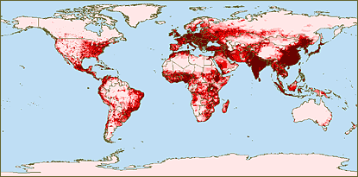
Population Density and Distribution

Slide 7
Population Distribution and Density
Population distribution refers to the way that people are spread out over the earths.
Population density refers to number of people in a square kilometre.

Slide 8
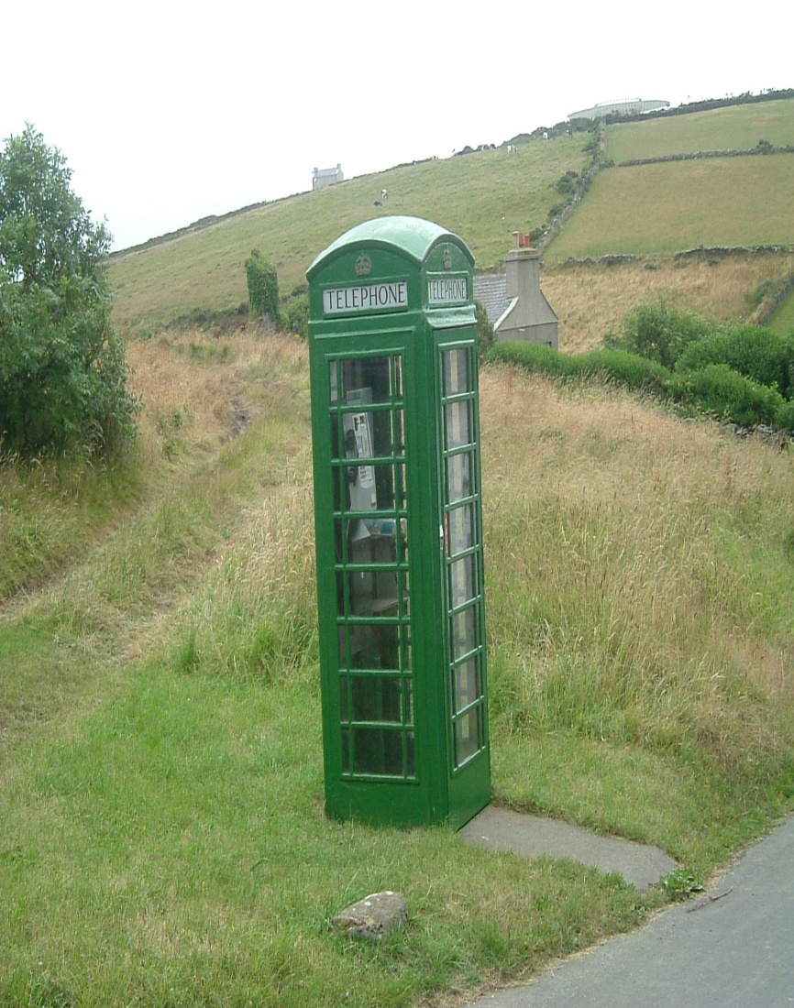
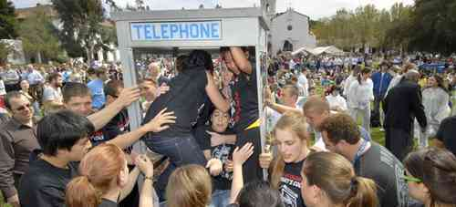
Low and High Population Density

Slide 9
Population Distribution and Density
The population of Ireland in 2010 was 4,470,700. The land area is 70,282 km2. Therefore the population density of Ireland is 63.61 km2.
How is the population density Spread around Ireland, is it even????

Slide 10
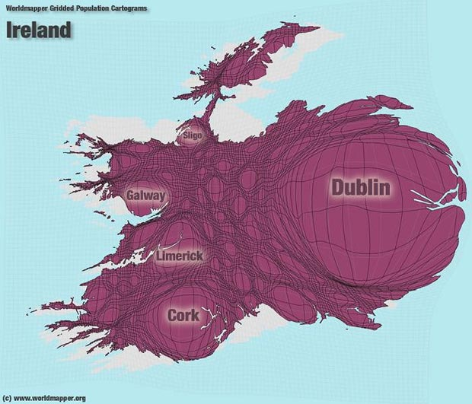

Slide 11
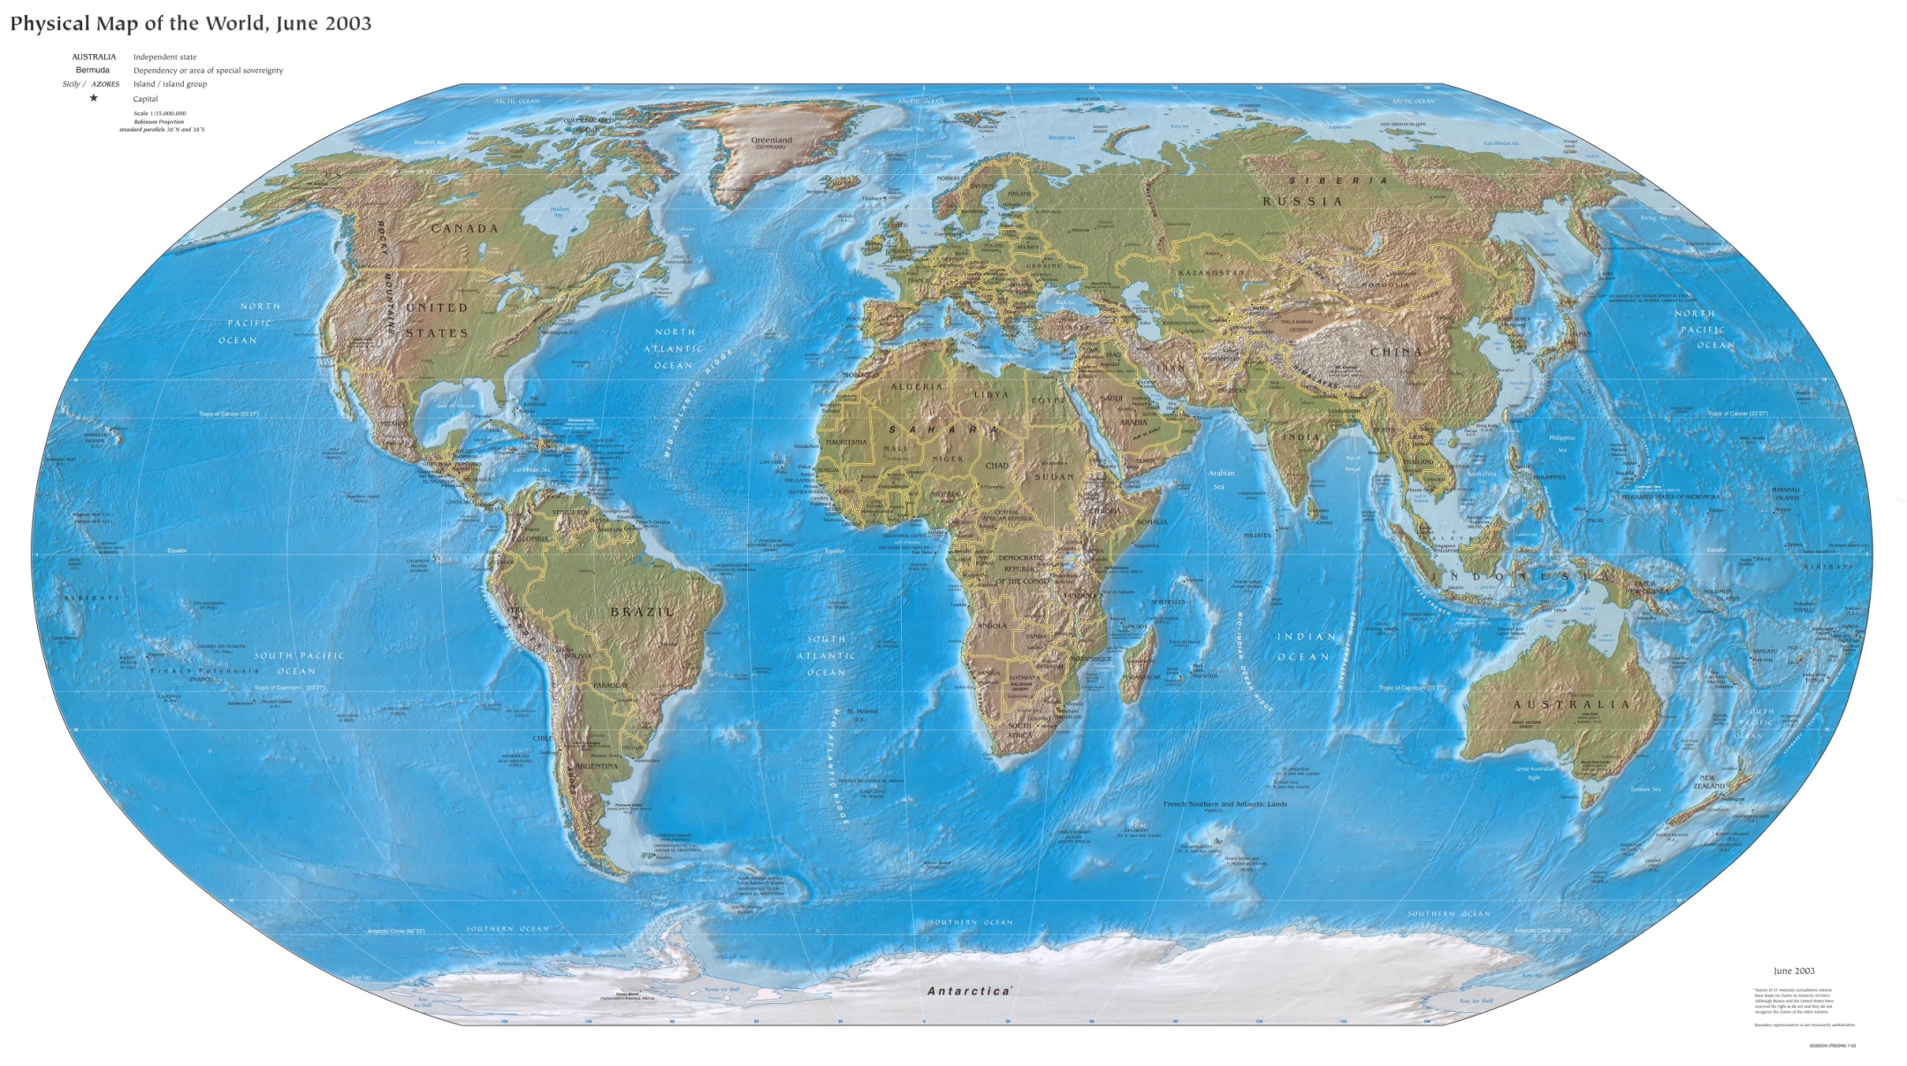
How is the population density spread around the world????

Slide 12
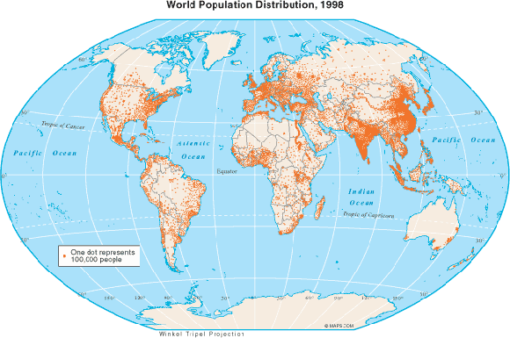
Looking at this map come up with reasons for the uneven population distribution

Slide 13
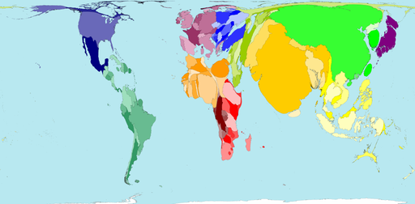

Slide 14
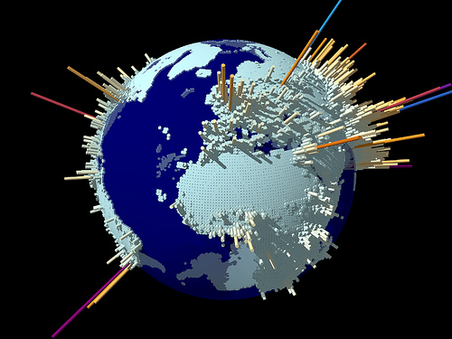
Explain how each of these factors could affect density and distribution.
The physical factors for this uneven distribution and density are relief, climate, soil, vegetation and resources.

Slide 15
Global Distribution.
70% of the worlds surface is covered by water, 30% land. Population is distributed unevenly 40-60 degrees north and south of the equator. EX India, China, Europe and East America.
80% of the worlds population occupies 10% of the land, with only 11% of the land presenting no constraints for cultivation. People are mainly attracted to warm, humid lowland areas less than 450m in height.
60% of people live in urban areas.

Slide 16
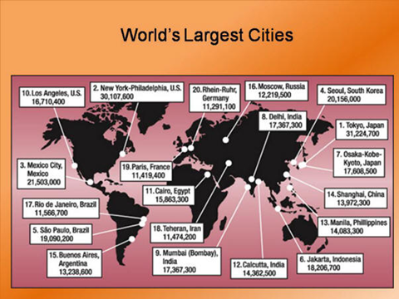

Slide 17
People, historically, are always attracted to land that can be farmed

Slide 18
Physical affects population density

Slide 19
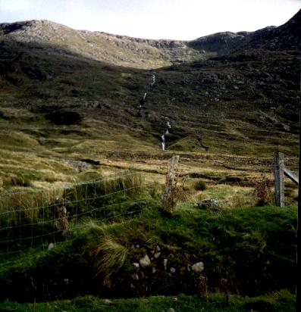

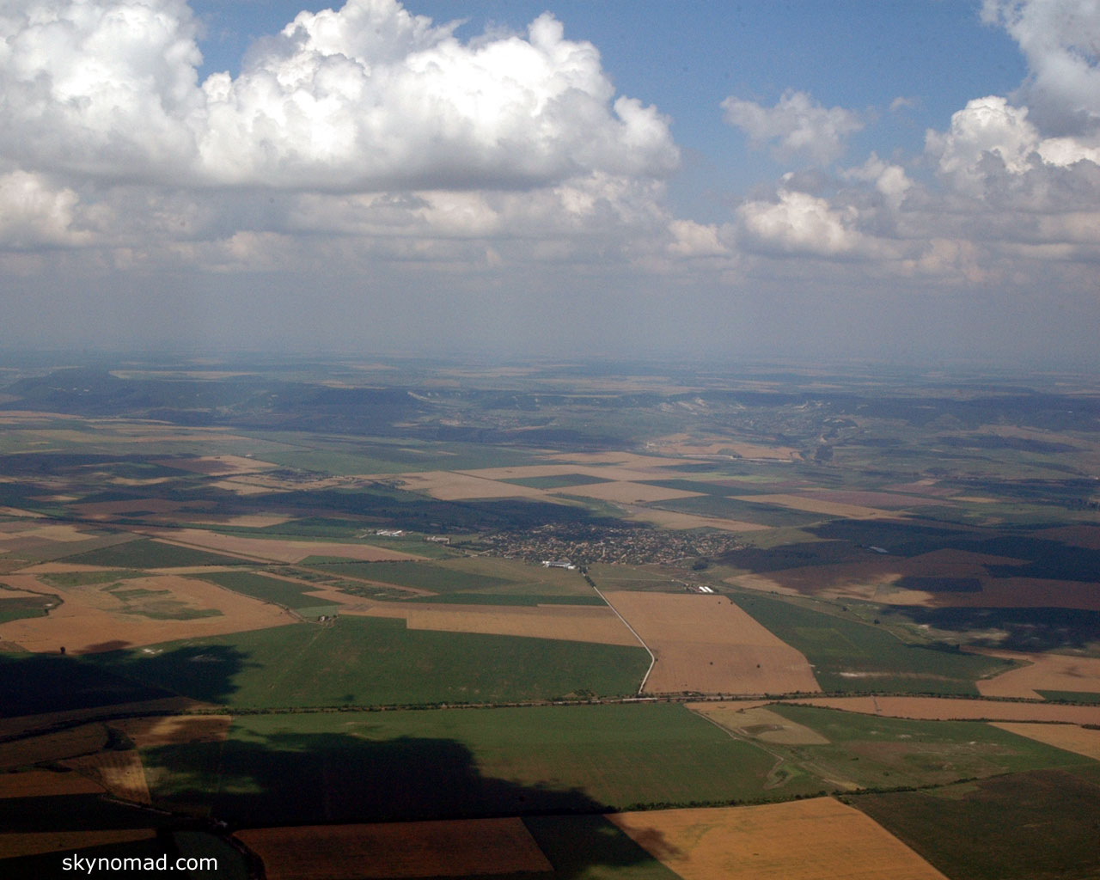

1.Physical.
Relief
Relief refers to the slope of the lands. People are attracted to low lying flat lands to live like in.
Paris Basin/ GDA
Population are less dense in mountainous areas like BMW/ Mezzogiorno.
Discuss

Slide 20
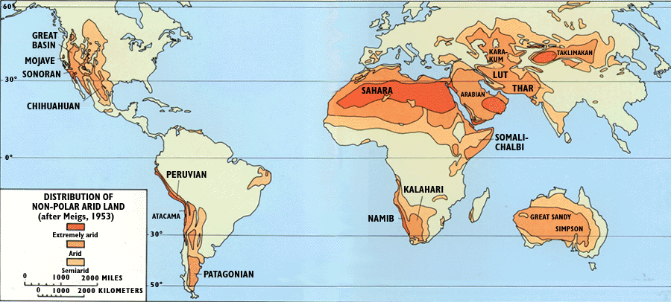
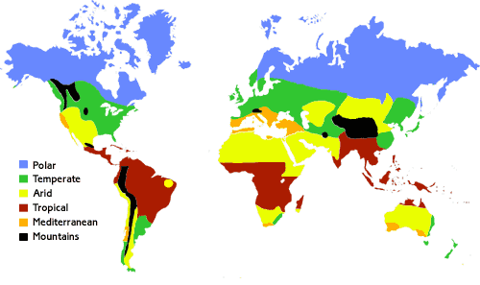
1. Physical
Climate
Regions with extremes of climates cold/ hot/ rain/ no rain are less densely populated because they are not suited to agriculture. Examples of this are the Mezzogiorno.
Regions with good growing seasons, with mild weather and reliable rainfall attract large densities. Examples of this are in Paris Basin.
Discuss

Slide 21
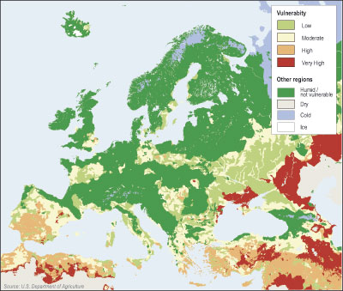

1.Physical Soil
Soil that are peaty, deforested, overgrazed and frozen will not attract people to these areas.
BMW
Soils that are humus rich, alluvial and fertile are good for intensive farming and have large populations. GDA
Discuss

Slide 22
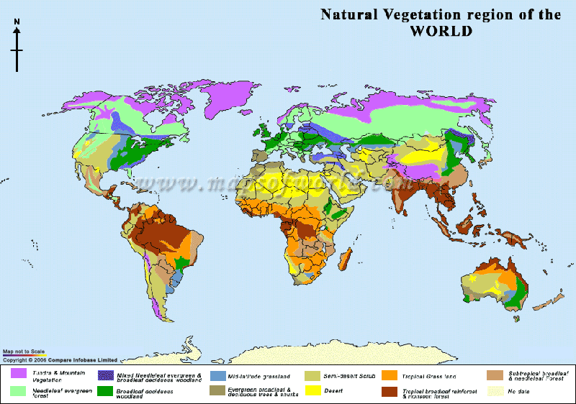
1. Physical
Vegetation
Areas where there are large rainforest, coniferous forests are sparsely populated. (BMW)
Areas covered by deciduous trees are cleared for settlements and are intensely farmed.
(GDA)
Discuss

Slide 23
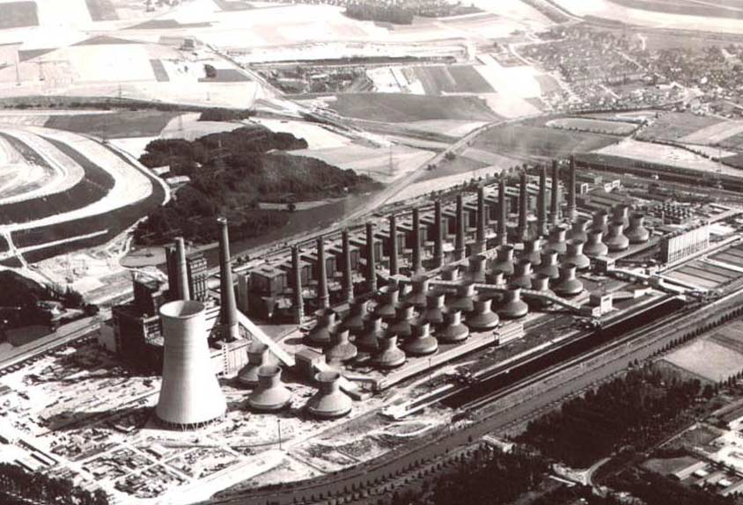
1.Physical
Resources
Regions with poor resources or lack of resources are sparsely populated.
Areas like the Ruhr and Sambre- Meuse with rich mineral deposits attract dense populations.
Discuss

Slide 24
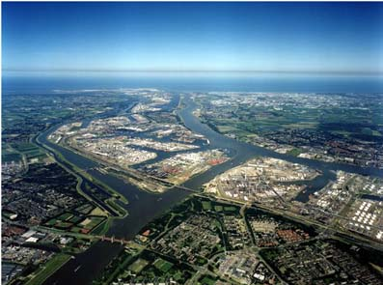
1.Physical
Communications
Areas that are not suitable for transport are sparsely populated such as the Alps.
Lowland flat areas are suited to the construction of roads and transport links.
Discuss

Slide 25
Other Factors
Other reasons for the difference in population density and distribution beside physical are besides for
Physical.
are
2. Socio- economic.
3. Historical and political.

Slide 26
2. Socio-Economic
The degree of economic development allows people to control their environments.
Areas with diverse economies with intensive agriculture, developed industries and service sectors help sustain densely populated region and also people to the area.
Areas will underdeveloped economies and societies do the opposite. Examples of this are the Tundra and desert regions

Slide 27
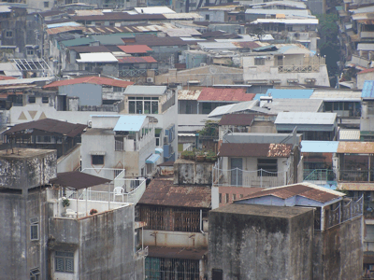
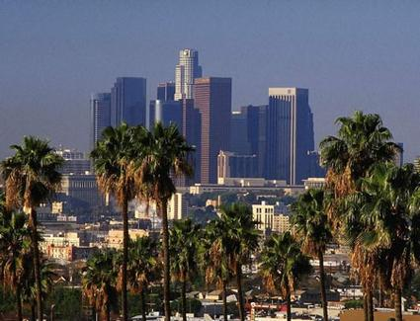

Slide 28
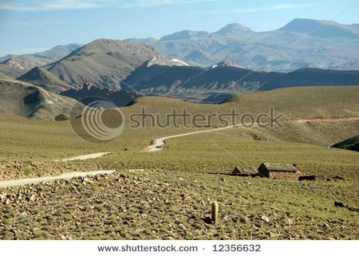
Low Economic Development

Slide 29
3. Historical and Political
In some parts of the earth historical and political decisions have impacted on global distribution.
Government planning, reclamation, colonisation and industrialisation have led to high population densities in South America and part of Europe.

Slide 31
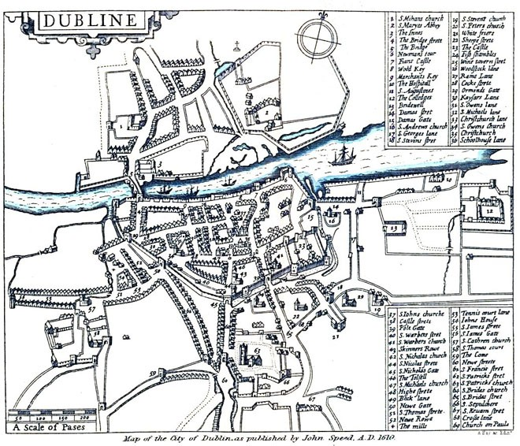

Slide 32
Questions.
What is the difference between population distribution and population density?
What factors affect population distribution and distribution?
List and explain the physical, socio- economic, historical and political factors and how they can affect population distribution and density.

Slide 33
Past Paper Question
Describe and explain, using examples which you have studied, the difference between the terms population density and population distribution? (30 marks)
The question is marked as follows.
2 marks each for definition of population density and distribution. (4 marks)
2 marks each for a named examples of each (4 marks)
Explanation work 22 marks, you need 11 SRPs talking about both terms

Slide 34
Population Distribution and Density in Ireland

Slide 35
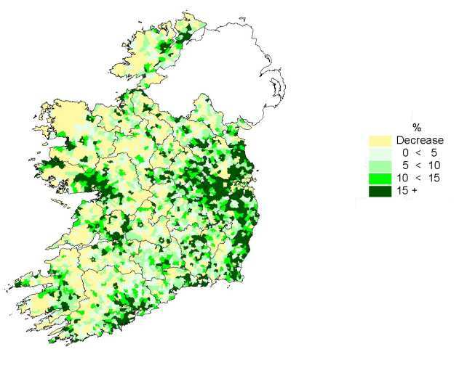

Slide 36
Ireland population is distributed unevenly across the country.
This is to do with physical, political and historical factors.
High population densities are located in large urban areas like Dublin, Cork.
Low population densities are found in physical unsuitable areas like Connemara.

Slide 37
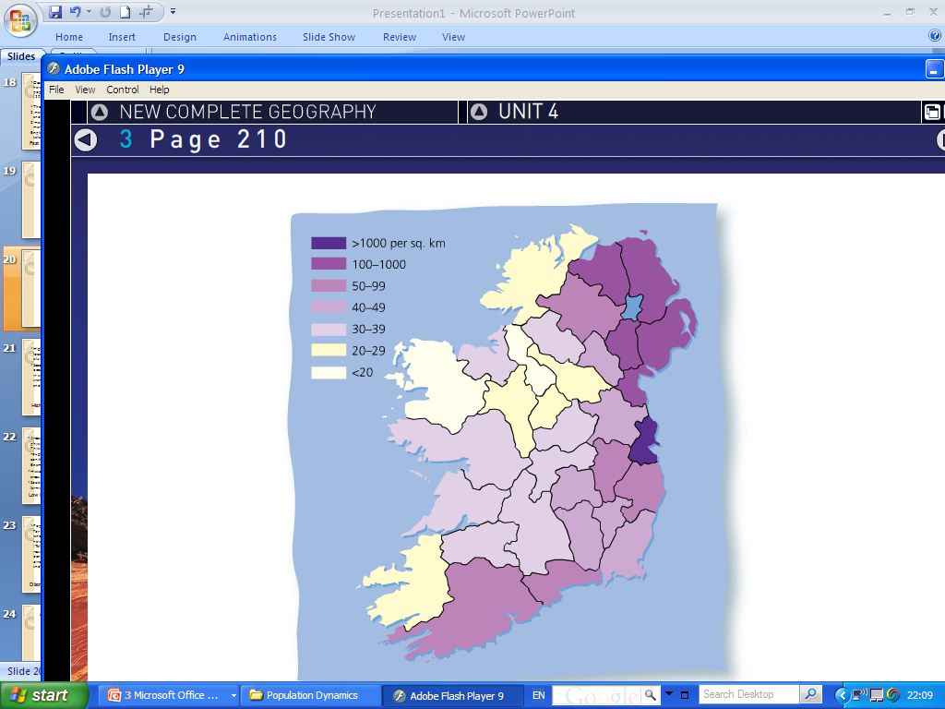

Slide 38
High Population Densities
High population densities in Ireland are firstly located where land is suitable for farming- flat, alluvial soil brown soils like in the East of Ireland.
Secondly in coastal lowland the population is high because of fertile land, farm subdivision resulting in small holdings, settlement locating along main transport routes resulting in ribbon development and the development of retirement homes.
Fertile land leads to developed secondary and tertiary activities attracting large numbers of people.

Slide 39
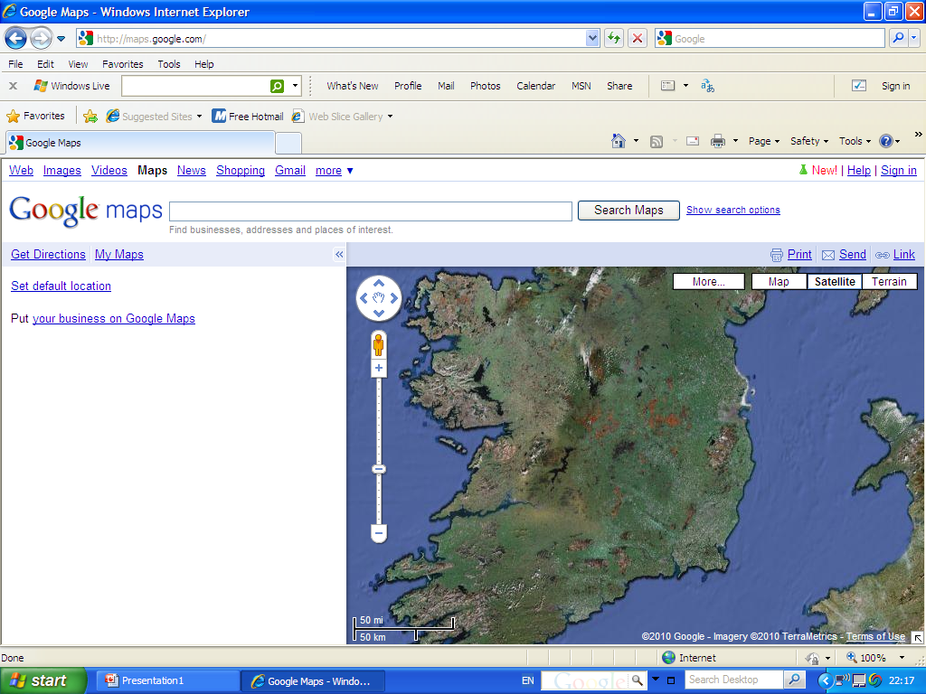

Slide 40
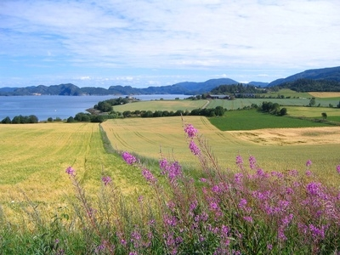

Slide 41
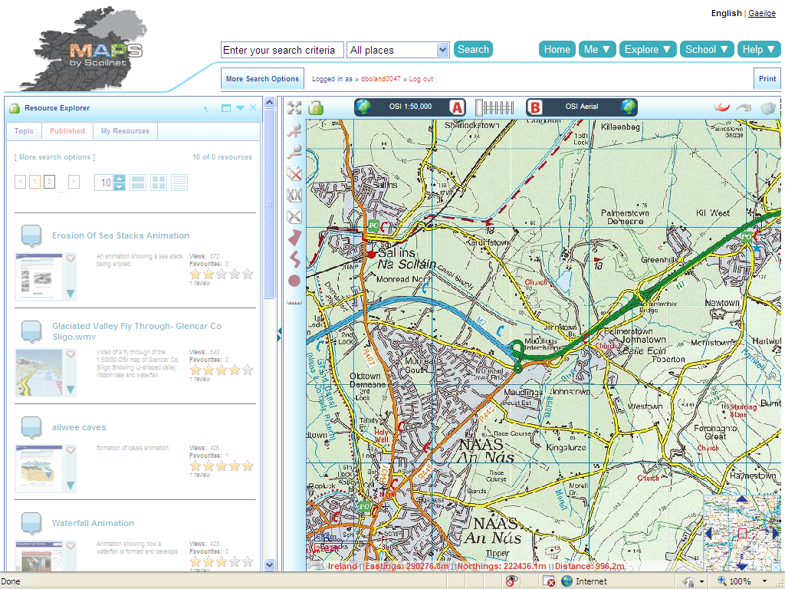

Slide 42
Low Population Densities
Areas of low population are where land is not physical suitable either for building or farming.
Physical features such as high relief (mountains rough terrain) extreme climates, peaty soils, coniferous trees and areas that lack minerals.
Example of this are in the West of Ireland and Monaghan.

Slide 45
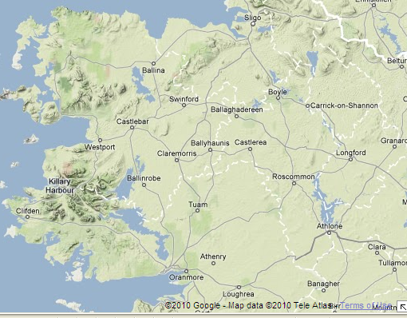

Slide 46
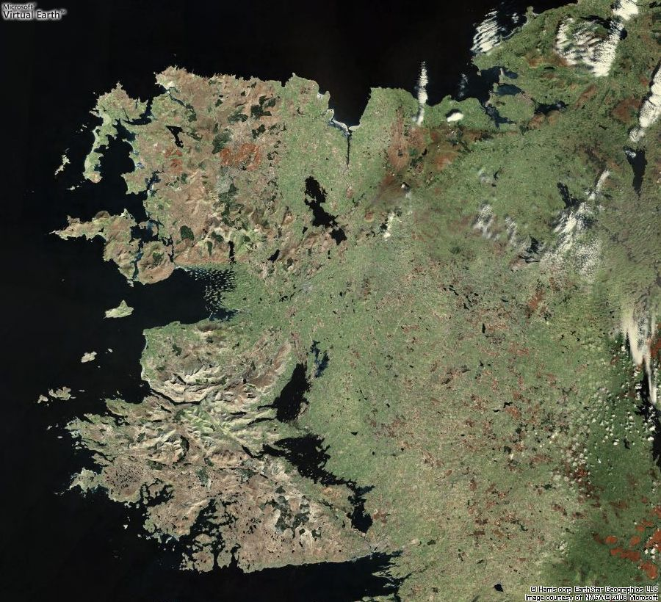

Slide 47
Low Population Densities
Historical factors such as landlords where large areas of fertile land was enclosed. (Kildare)
Social factor where large scale commercial farming means low population densities.

Slide 48
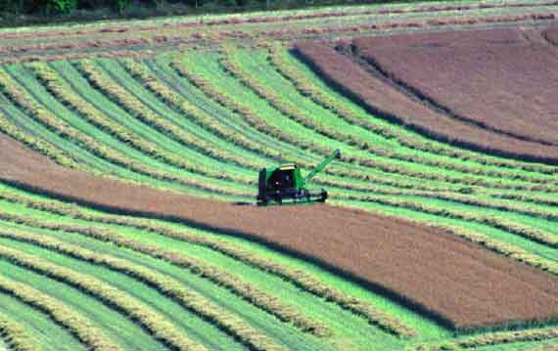

Slide 49
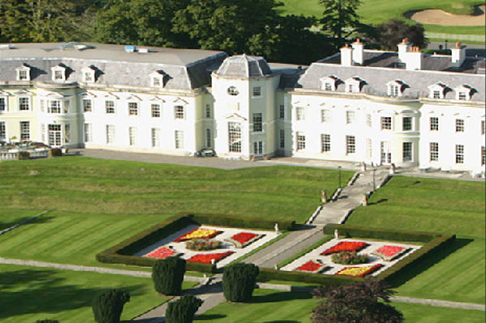

Slide 50
Distribution in Dublin/ city
Population densities can vary in cities like Dublin. For example industrial parks the CBD where the land is commercial, financial and administrative have low population densities.

Slide 51
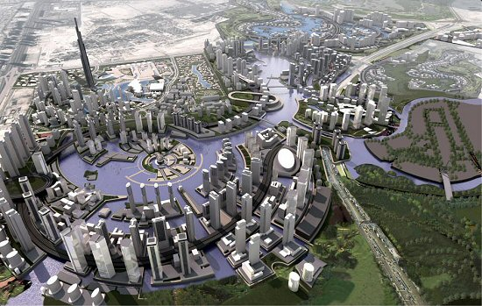

Slide 52
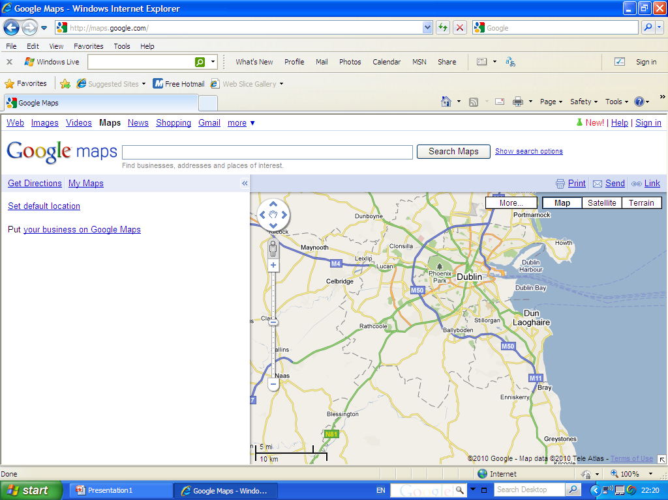

Slide 53
Distribution in Dublin/ city
New towns (Tallaght) and the suburbs (Templogue) have residential functions so have high population densities. Dublin can only develop in one direction because of the airport to the north and the Wicklow mountains to the South

Slide 54
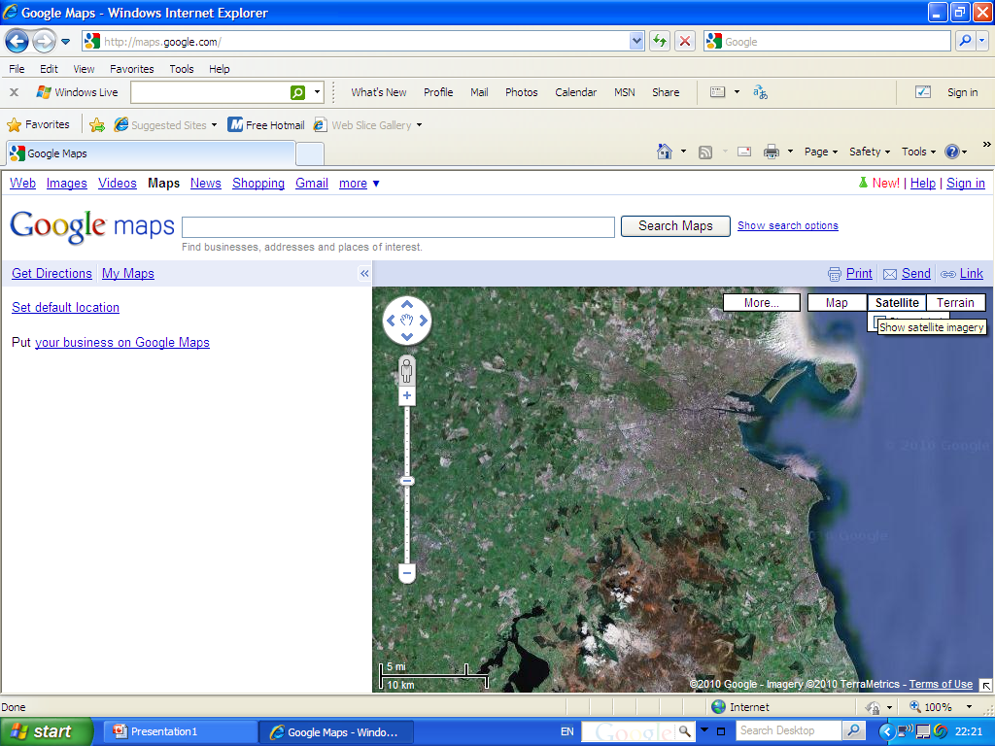

Slide 55
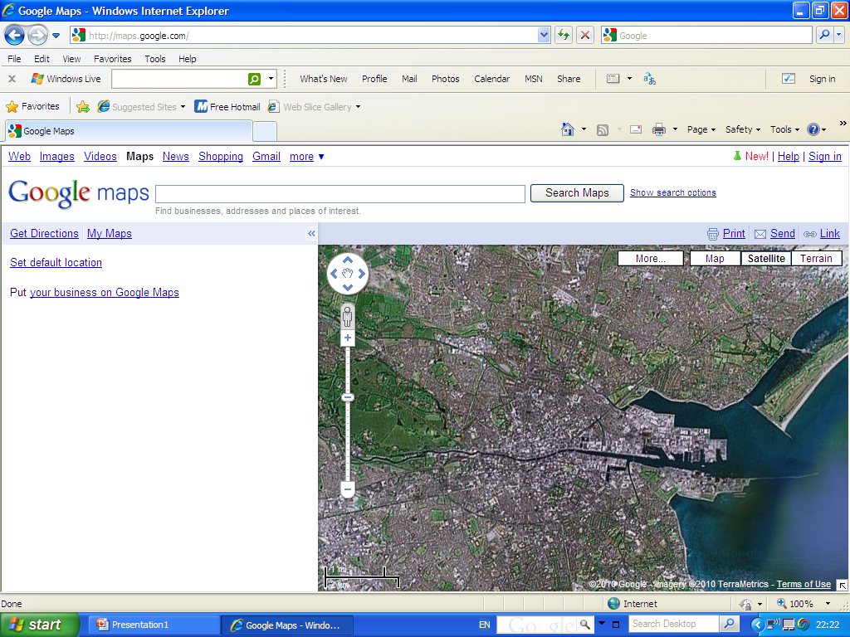

Slide 56
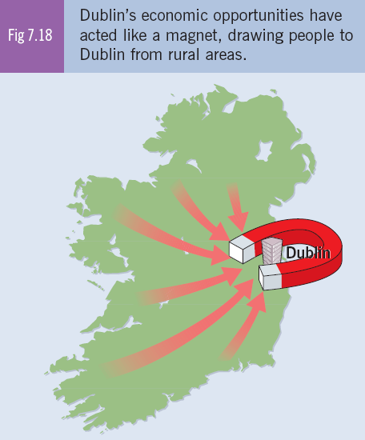

Slide 59
Questions
Outline the factors that influenced Ireland population distribution.
Account for the population variations within Dublin.
Where is the highest population densities in Ireland and give reasons for this?
Where is the lowest population densities in Ireland and give reasons for this?

Slide 60
3. Change of population over time

Slide 61
The population of the world increases if the birth rate is higher than the death rate.
The birth rate is the number of births per 1000 of the population
The death rate is the number of deaths per 1000 of the population

Slide 62
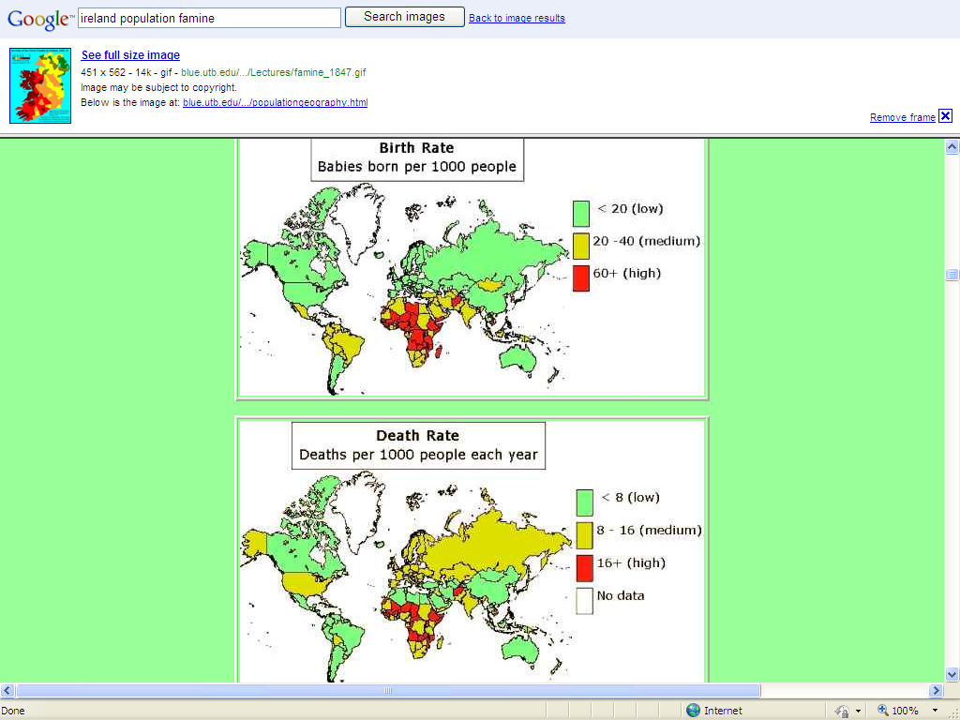

Slide 63
Fertility Rates
The total fertility rate (TFR) is defined as the average number of children born to women during their reproduction years.
For a country to replace its population it must have a TFR of 2.1 children per woman. Ireland has a TFR of 2.1.

Slide 64
Reasons for high low/ birth rates.

Slide 65
Factors influencing birth/death rates
Education and Status of women. (Social)
Standards of living (Economic)
Government policy (Social)
Religion, Society and customs

Slide 66
Factors affecting birth/death rates
1. Women in society
Education allows women to make informed decisions about their family size. In addition by staying in the education system a woman delays having children until her formal education is over.
Educating women about improvements in healthcare and nutrition also lower death rates.
Better job opportunities lead to family planning

Slide 67
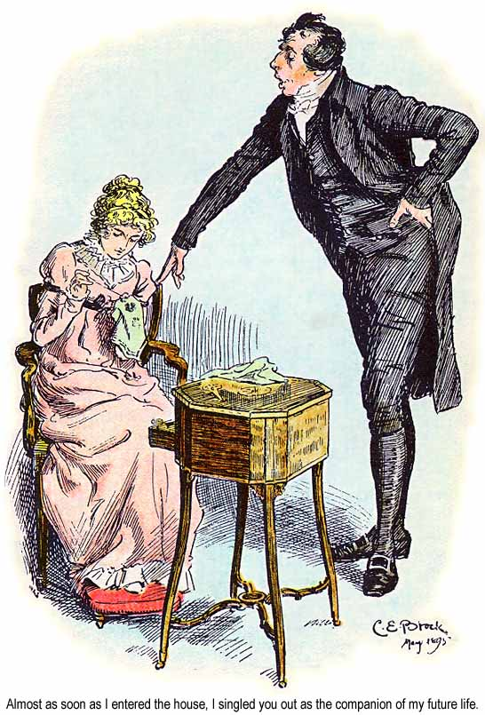


Slide 68
Factors affecting birth/death rates
2. Standard of living
Countries with a high standard of living tend to have low birth rates and death rates. The cost of raising a child in Ireland is approximately 10,000$ a year.
High levels of healthcare are associated with economic development as well as clean water and sewage systems. This means infant mortality rates are low.

Slide 69



Slide 70
Factors affecting birth/death rates
2. Standard of living
In less developed countries (LDC) where there is no government support for the elderly or sick, large families are an economic advantage as children look after parents and grandparents.
In LDC access to medical care is difficult and expensive.
Clean water and sewage facilities are often lacking. Infant mortality rates are high as well as adult death rates.
Hence birth rates are high as parents cannot be sure that their children will survive.

Slide 71
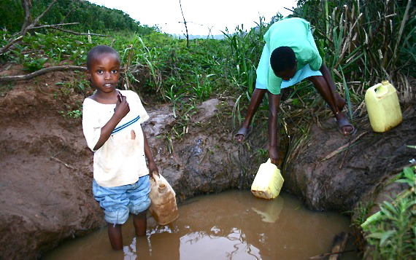
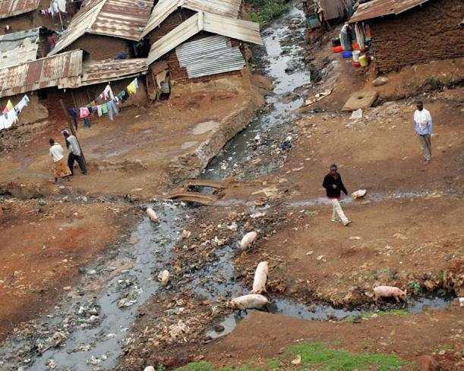

Slide 72
Factors affecting birth/death rates
3. Government Policy
China has a one child per family policy since 1974, which is to last 100 years. This policy is less strictly applied in rural areas where two children are allowed. Scans are banned in some areas.
In Romania during the 1960s low birth rates were a risk for future economic development. Romania outlawed abortion and banned the importation or manufacturing of contraceptives.

Slide 73
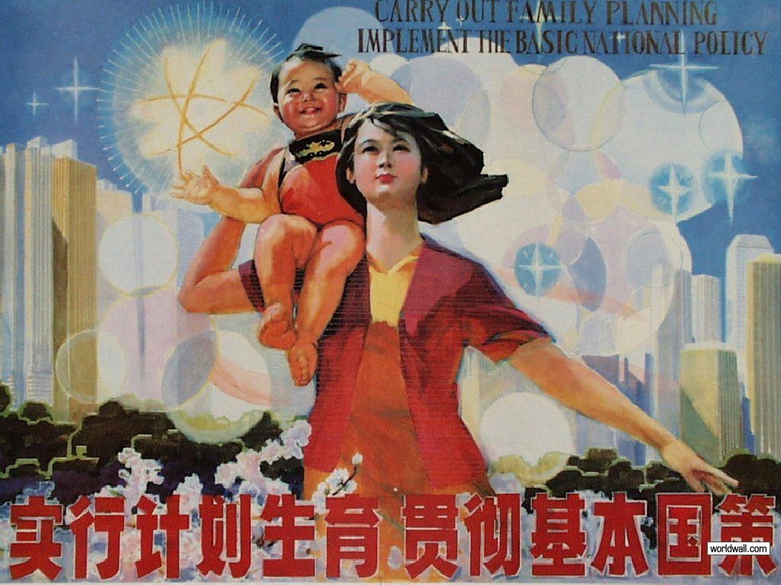

Slide 74
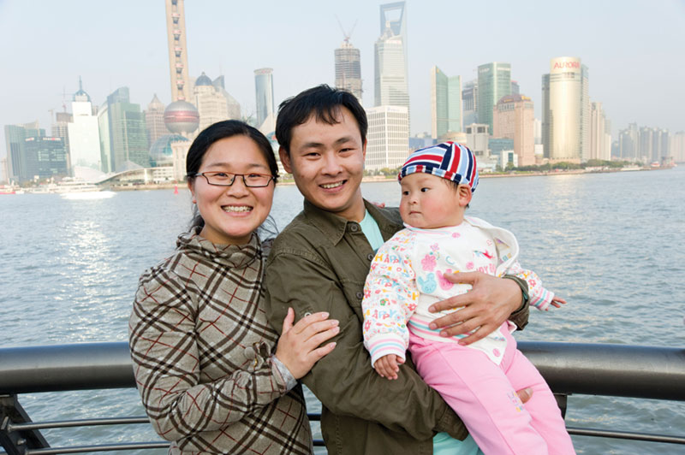
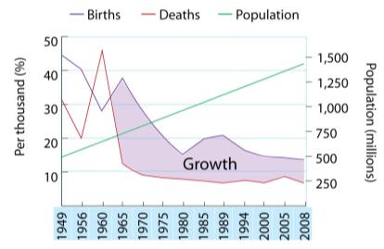
Chapter 1: The Dynamics of Population
China
  1949–76 fertility rate 6 per mother
  1979 one-child policy
  Imbalance of sexes: 106.7 to 100 girls
  Increased illegal abortions based on
  sex, female infanticide
  95.7% of abortions female
  90% of children in orphanages girls
  Moved from stage 2 to 4 in a short
  period of time
  Population still increasing 9 million
  a year as marrying young

Slide 75
Factors affecting birth/death rates
3. Government Policy
Romania-Men and woman who remained childless after the age of 25 had to pay tax amounting to 20% of their income. The government made it very difficult to divorce.
Child allowances were raised and financial rewards were granted to mothers upon the birth of their 3rd child- tax reduced by 30%.
Birth rates increased by 96% but standard of living was reduced.

Slide 76
Factors affecting birth/death rates
3. Government Policy
In Russia the birth rate is low 12.6 per thousand and the government is now offering to pay 7000$ for their second and third child- (a third of the annual wage).

Slide 77
Factors affecting birth/death rates
4. Religion, Society and Customs
Where Catholic religion is dominant, birth rates tend to be higher. This explains why S. America has high birth rates.
Some societies place pressure on women to have children- in India having a son is an economic benefit as sons will marry and bring the bride’s dowry or earning power to the family.

Slide 78
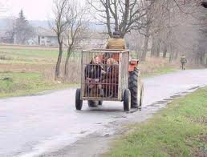

Slide 79
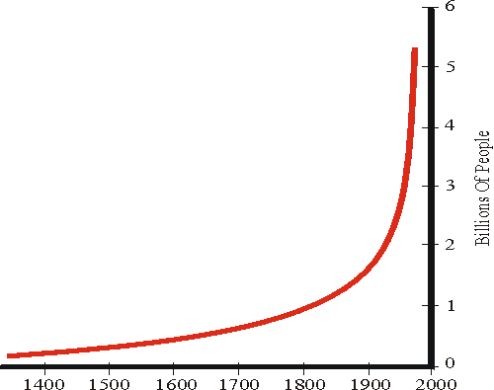
Global Population Increase.
If the death rate is higher the country is having a natural decrease, if the birth rate is higher then the country is having a natural increase.
The global population grew very slowly until the 18th century, where improved farming practices, the industrial revolution and improved medical care stemmed the deaths rates

Slide 80
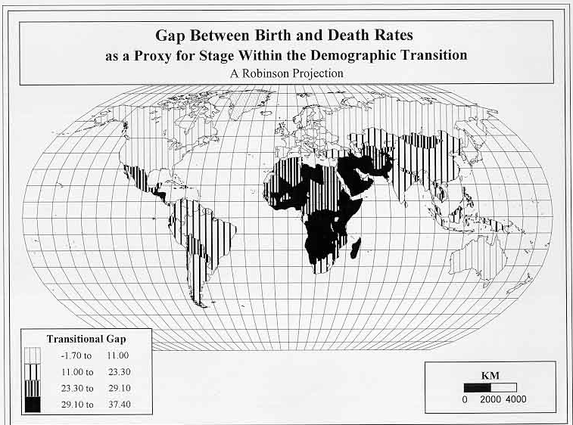

Slide 81
POP CLOCK

Slide 82
History of Population
Explain 1, 2 ,3
3
2
1

Slide 83
History of Population
1- population growing slowly because even though there was high birth rates there was also high death rates with wars, famines and plagues.
2- With better food and medicine the population of Europe grew steadily.
3- population explosion, reaching over 6 billion because of excellent healthcare and food supplies, people living longer having more children and less people dying at a young age.
3
2
1

Slide 84
1400-1800
High birth rates were cancelled due to high death rates because of wars, famines and the black death. This kept global population steady

Slide 85
1800- Present day
Population greatly increased because birth rates remained high but death rates lowered due to
Improved agricultural- crop rotation & selective breeding meant more food and famines were reduced. Period know as the Green Revolution.
Industrial revolution- chemical and cleaning agents were invented to combat unsanitary living conditions caused by the revolution in the first place so infections were reduced.

Slide 86
1800- Present day
Improved medicine-improved hygiene, water, anaesthetics, penicillin and antiseptics further reduced the death rates.
Thanks to charity organisation this also decreased death rate in undeveloped countries which were extremely high. New machinery was also introduced to improve farming practices (cut in death rate due to nutrition).

Slide 87
Question has not being asked on this area specifically but need to know graph and tie information into question on Demographic Transition Model
Remember in some countries they are experiencing no population growth because the death rate is higher than the birth rate, this can happen in developed countries such as Sweden.
Also developing countries are still undergoing a population explosion where births rates are a lot higher than death rates (can least afford this population increase). The population of the world in 1930 was 2 billion in 2006 it was 6.5 billion. This is known as the population explosion.

Slide 88
Demographic Transition Model
The changes that a country goes through population wise can be shown on a graph in the form of a demographic transition model

Slide 89
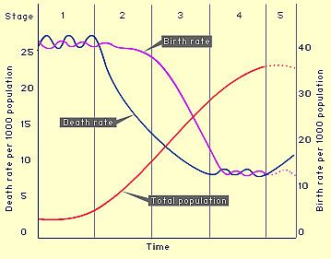
Need to be know different stages, what's happening at each stage, reasons for this and examples where this is happening.

Slide 90
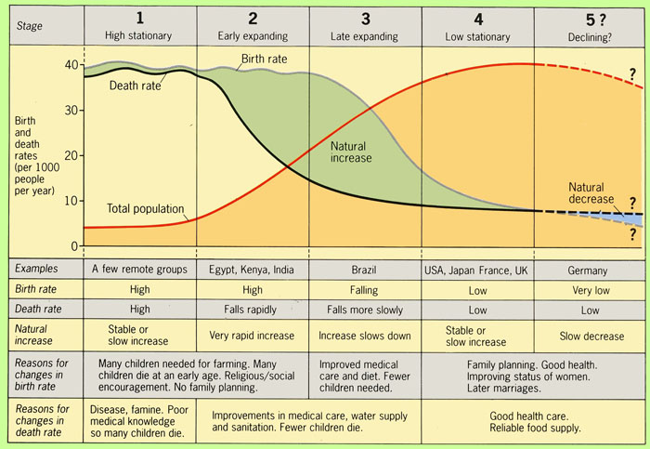

Slide 91
Stage 1- high stationary stage
Low population, population is slowly increasing, high birth rates(40/1000) because parents need large families to work the farm, support the elderly and compensate high child mortality. Lack of education, religion and inferior status of woman also.
High death rates due to poor hygiene, lack of medicine, war, famine and disease(cholera high among children)

Slide 92
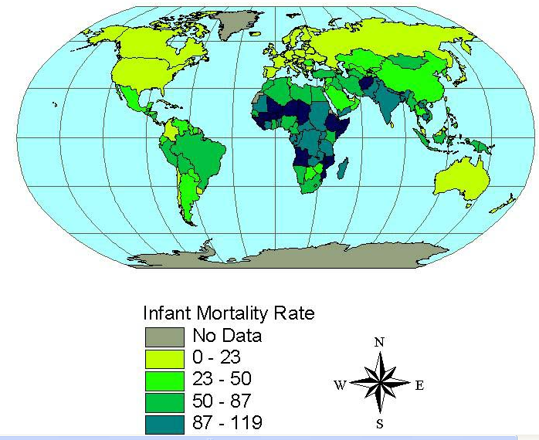

Slide 94
Stage 2-early expanding stage
Birth rate still high, declining death rate (20/1000) resulting in rising population. Reduced death rate due to industrialisation, improved sanitation, medical improvement and increased quality and quantity of food.
High birth rate reasons the same as stage one.

Slide 95
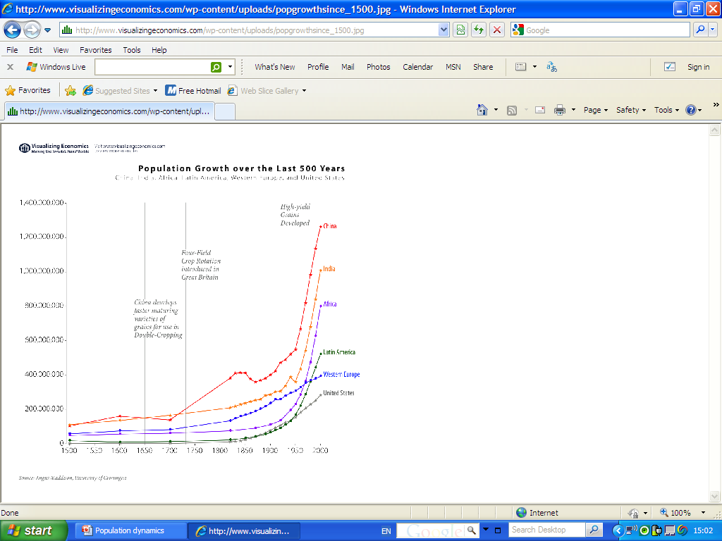

Slide 97
Stage three- late expanding stage.
Birth rate falling (20/1000), death rate falling slowly (15/1000). Gradual population increase. Economic development, the green revolution, improved government planning, no need for large families as lower infant mortality rate, higher living standards and population control programmes are reasons for these trends in the population.

Slide 98
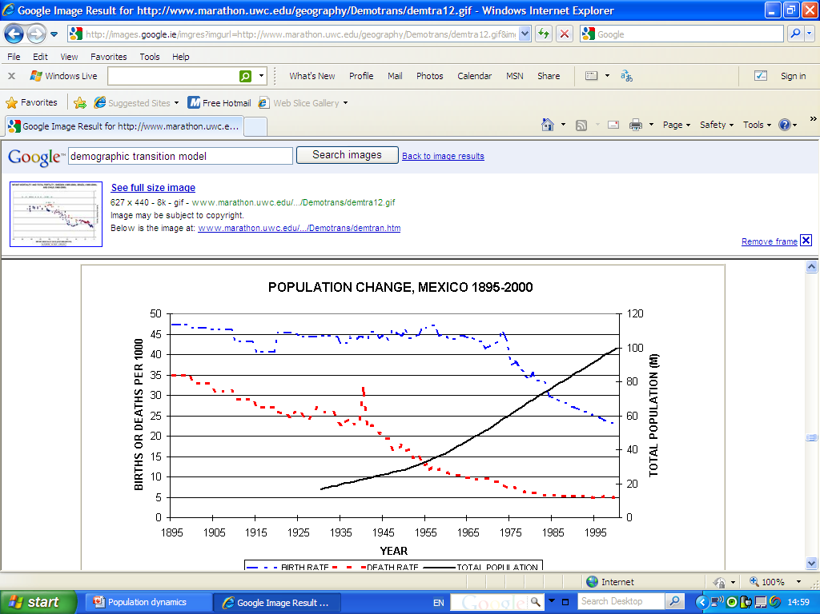

Slide 99


Slide 101
Stage four- low stationary stage,
low birth and death rate (12-15/1000). Slow increase of population. Later marriages, improved health care, smaller families, emancipation of woman, full time jobs, family planning are the reasons for these trends.

Slide 102


Slide 103


Slide 105
Stage five-the senile stage
Stage five-the senile stage, death rate higher than birth rate so the population is decreasing, this is a euro-centric model.
Population decreasing- in migration of economic migrants to maintain economic growth.

Slide 106


Slide 107
Limitations of the demographic transition model.
This model does not allow for variation at local levels such as shanty towns in under developed countries and the Chinese state law where they can have only one child per family.
A key example is the difference between India and Ireland.

Slide 108
Exam question 2008 Question 10 A
Marking scheme
Part 1 five marks...correct answer
Part 2 five marks...correct answer
Part 3a five marks...talk about the graphs for developed and developing countries from past to present day. NB talk about both, mention stages of model.
Part 3b five marks.... Talk about the future of population for developed and developing countries. NB talk about both, mention stage of the model

Slide 109
Population
Structure
The population structure is shown on a population pyramid.
It is essential for governments to know the structure of the population for the plan for future growth, economic development and social policy of a country.

Slide 110
Population Pyramid
The width of the top bars shows life expectancy.
The width of the bottom bars shows the birth rate.

Slide 111
The dependency ratio is the ratio of the working population compared to the non working population.
This is gotten by adding the population under 15 and over 65, multiplying this by 100 and dividing it by the population between 15 and 65

Slide 112

Describe the birth rate, life expectancy what is the dependency ratio?

Slide 113

Population Pyramid
This is a bell shaped pyramid. It is the population pyramid for a typical developed country.
We know this because it has a narrow base so a low birth rate, a wide top meaning longer life expectancy.
There is a higher female percentage compared to male over 65 also showing the population changing over time.

Slide 114

Germany
Two reason for the gender imbalance
1.The death of German soldiers during WW1
2. The fact that females generally live longer than males.

Slide 115
Germany
The wider bands in the middle are evidence of a post war baby boom.
The low birth rates of recent time show the zero population growth and with these numbers entering the reproduction age the population will decline in the future.

Slide 116

Population Pyramid under developed countries
The population pyramid has a wide base to show high birth rate, it has a narrow peak indicating a high death rate and low life expectancy.
Notice also the rapid decline in population as we go up. This shows a high child mortality rate. With the large youth population enters the reproductive age groups there is potential for this rapid growth to continue.

Slide 117
Ireland Population Pyramid
Narrow base
Small number of old people
Gender imbalance in older population
A decrease in the percentage of people in the middle age which relates directly to high emigration in the 1980s

Slide 118

Future population pyramid.
As can be seen from this graph. The dependency ration is quite small, with a large number of people not working.
This has got to do with a improved life expectancy which can be seen from the wide top of the pyramid.
This could put pressure on the government for pensioners, welfare, childcare and could cost the taxpayer.
This is an example of a very developed country.

Slide 119


Slide 120


Slide 121
Exam Question 2008 Question 12(A)
Draw a population pyramid for the information given.
The question is graded as follows.
Title (2 marks)
Use of graph paper (2 marks)
Scaled axis (2 marks)
5 items illustrated (2 marks for each)
Overall presentation (4 marks)

Slide 122


Slide 123
Projections of population growth

Slide 124
World Population Growth
1 billion- 1804
2 billion- 1927 (123 years later)
3 billion- 1960 (33 years later)
4 billion- 1974 (14 years later)
5 billion- 1987 (13 years later)
6 billion- 1999 (12 years later)
7 billion- 2011 (11 years later)
What next for the world population?

Slide 125
Future trends in world population
There are three future predictions for world population growth.
Low prediction- if efforts to reduce birth rates across the world are successful.
High prediction- if efforts are unsuccessful.
Medium- Seems the most likely as India and China are making efforts to reduce birth rate.

Slide 126
Futuristic population structure. What are the reasons behind this

Slide 127
The main difference in this graph to past graphs are a lower birth rate and a higher life expectancy.
The main reasons for a lower birth rate are urbanisation, improved sanitation, improved health care and improvement of the status of women.
Life expectancy increases due to improved sanitation, medicine and welfare

Slide 128


Slide 129
Number of young people.
In the 1970’s the number of people under 15 was 31%. Presently it stands at 21%.
If this continues there will be no young people to replace the older generation and the population will decline.

Slide 130
Declining fertility Rates
The total fertility rate (TFR) is falling (2.1 children a woman). This does not mean that the population is falling, due to the increased life expectancy and a high child bearing age population. Reasons for falling TFR are
1. Urbanisation- people moving to cities resulting in smaller families to fit small spaces, very expensive to have large families.

Slide 132
Declining Fertility rates
2. Improved sanitation(80% of world have access to clean water) and health- increased life expectancy and reduced infant mortality so no need for large families.
3. Woman's status- education and work mean that woman are marrying late and due to work commitments are having less children. In Brazil educated woman having 2.5 children while uneducated 6.5.

Slide 133


Slide 134
Economically active population
There has been an increase from 58% to 68% in the past 45 years. This is expected to grow 1.5 annually.
WHAT DOES THIS MEAN FOR A LOCAL POPULATION???

Slide 135


Slide 136


Slide 137
Consequences of an aging population
An increase in the old age dependency ratio will mean a greater demand for pensions, retirement homes and medical care.
It is estimated that the cost of state pensions will rise from 3% of GDP in 2011 to 8% of GDP in 2050.

Slide 138
Consequences of an aging population
This will all be paid for by a smaller group of the working population. This could mean a higher rate of tax and less money being made available for infrastructure and services with an inward migration of an active age group.

Slide 139


Slide 140

Population Change in Ireland

Slide 141
Ireland first settlers came around 9000 years ago from Britain and Europe.
Each group that came (Celts, Vikings, Normans, English,Eastern Europeans) have contributed to Ireland’s present population.
If present fertility, mortality and migration rates stay the same, Ireland’s population is projected to reach 5 million by 2015.
The recent recession could affect this

Slide 142


Slide 143
Ireland’s Population Density
Ireland’s population has changed greatly during the last 200 years- before the famine Ireland had an agricultural economy society and people lived in rural villages.
The population before the famine was around 8 million, with a density of 113km.
Famine/ migration reduced pop density especially in rural/ mountainous western regions.

Slide 144


Slide 145
Irelands Pop Distribution
Early 20th Century population moved eastwards into urban areas leading to a decrease in BMW population.
At the same time rural to urban migration increased because of economic development raised the number of people in urban areas.
Today 66% of pop lives in urban areas

Slide 146
Ireland 1845-1849
Emigration became an established part of Irish Social life as people moved to the UK, USA, Canada and Australia. This resulted in a distorted population balance as emigration was both age and sex selective (young Irish woman/ men worked on the farm).
This resulted in a reduced marriage rate and reduced birth rate.

Slide 147


Slide 148
Ireland1841- 1961
1841 and 1961 there was a natural increase (196,000) with the birth rates higher than the death rates but due to the high rates of emigration(597,235) the population decreased.
1951-1961 population declined by 4.8% due to economic recession.
1961 population of Ireland 2.82 million, down from a peak of 6.53 in 1841
Pop density was 39km

Slide 149


Slide 150
Ireland 1960’s and 1970’s.
Experienced an industrial revolution and emigration slowed with the first growth in the population in 120 years. The population balance changed as immigrants outnumbered emigrants.
1971-1981 there was a natural increase of 361,268 which was helped by net migration of 103,889 to produce a population increase of 456,157. (15%)

Slide 151


Slide 152
1980’s
Severe economic recession led to high unemployment and renewed emigration with many of the 200,000 young people becoming illegal immigrants in the US. The birth rate also declined reducing the population in Ireland

Slide 153


Slide 154
1990’s- 2000’S
The celtic tiger led to an economic expansion and the number of people employed in Ireland grew by 40% and the population rising to 3.92 million by 2002

Slide 155


Slide 156
2000’s
The Celtic Tiger was quickly followed by another recession which led to mass emigration of young people to Australia, Canada and America.
In 2008 the pop was 4.47 million, by 2020 it is expected to be 5.3 million.

Slide 157
Events that caused a change of Ireland’s population
Famine 1845 | 1 million emigrated 1million died of starvation
Economic recession 1951-61 | Population fell to 2.6 due to emigration
Industrial revolution 1960’s and 70’s | People came back
Economic recession 1980’s | Renewed emigration
Celtic tiger 1990’s | Immigration and more work
Present day recession | High emigration/ High birth rates

Slide 158
Ireland’s Population Growth
6 million before famine (1845)
2.6 million in 1960’s
Boom in 1990’s
4.13 million in 2006
Projected to be 5 million in 2015
Projected to be 5.3 million in 2020

Slide 159
Patterns in population change; these have varied within Ireland over space and time

Slide 160


Slide 161
Rural depopulation
From the 1920’s to 2000’s there has been a huge increase in the population living in the east 122% in Dublin while the west has seen a large decrease 32% in Mayo
1920’s-rural depopulation to east coast. Ex-In 2002 Leitrim had only 42.2% of its 1926 total while Kildare's increased by 183%. This is due to the availability of employment in urban centres.
Today 66% of the Irish population live in an urban area.

Slide 162


Slide 163


Slide 164
Counter Urbanisation
Since the 70’s small commuter towns (Carlow, Navan, Mullingar) have grown as with the desire to live in less densely populated area with improved infrastructure such as roads that are used to travel to work.

Slide 165


Slide 166


Slide 167


Slide 168
Future Irish Population Predictions
The number of young people (under 15) will decrease slightly (currently 21% of the total population).
The economically active (working population aged between 16-64) will grow steadily (currently 68%)
It should reach 70% in the next 15 years
Dependency ration will increase as population ages.

Slide 169
Dependency Ratio
In 1966 there were 1.4 people in the active age group to every dependent.
In 2020, it was 2.1 for every dependent.
By 2050 it will be 1 for every dependent.

Slide 170

Chapter 1: The Dynamics of Population
Ireland
  1990s boom, ‘Celtic Tiger’, inward migration, urbanisation
  Rapid ‘greying’ 11% over 65 years
  Under 15 years down 10% since 1970
  Economically active age group increased from 58% to 68% in 45 years
  Dependency ratio highest 74% in 1966, now 46% increasing
  TFR 1.98
  Life expectancy from 1926 to today:
  Men 57.4–76.8 years
  Women 57.9 –81.6 years

Slide 171

Overpopulation and underpopulation.

Slide 172
In this section you need to know
-what the difference between overpopulation and under population.
-examples of both
-reasons for both.
-a case study of unwise development of a natural resource- the Aral sea
-Describe how technology can influence population growth

Slide 173


Slide 174
Overpopulation and underpopulation
Overpopulation is where there are too many people in relation to the areas resources and technology.
The number of people that a region can support with its basic resources is called its carrying capacity.
Basic resources include clean water, food shelter and farmland.

Slide 175
Overpopulation and Underpopulation
If a region contains 10 people and only has enough food for 7 it is over populated.
Overpopulation areas generally are on the verge of famine and have high levels of emigration.
Main causes of overpopulation are
High birth rates
Migration
Overuse of a resource.

Slide 176




Slide 177
Overpopulation and underpopulation
Under population is where there are not enough people to utilise the resources and technology in an area. Canada is an example of this, with a surplus of food, rich resources and a high rate of immigration.

Slide 178
Factors which Increase Carrying Capacity
Decreasing population.-Reduces demand on resources
Fertilisers-Increase Food supply
New farming methods.
Irrigation
Land reclamation.

Slide 179
Factors which Decrease Carrying Capacity
Pop growth-Raises demand of Resources.
Soil erosion-Reduces food supply
Overgrazing
Deforestation
Flooding

Slide 180

Optimum Population
The optimum population is where an area has enough people to use the resources and have a good quality of life.
Population densities can be uneven also West V East Ireland and North V South Italy

Slide 181
Relationship between density and over/ under population
There are no direct relationships between population density and over/ under population. In the drought prone Sertao Brazil with a density of 2 per km this is overpopulated as the area cant support its population. While Rio de Janerio has high pop density but is not over populated

Slide 182



Slide 183
Relationship between economic development and over/under population
There is no direct link here either. North Italy has high GDP per captia and high pop densities.
Australia and Canada have low pop densities while high GDP per captia.
Bangladesh have high pop densities while low GDP per captia.

Slide 184


Slide 185


Slide 186


Slide 187
Cause and Affects of Overpopulation
An area can become overpopulated when its population is greater than the carrying capacity. This can be due to
1 High birth Rates
2. Migration
3. Overuse of resources

Slide 188
1. High birth rates
An increase in Pop increases the demand for basic resources. It these resources are not available the area is overpopulated and the standard of living is falling. Ex Sahel.

Slide 189
2. Migration
This can raise Pop in an area, and put an area under more stress in the land is depleted.
Areas that experience rural-to- urban migration like Calcutta and Bombay lead to the building of shanty town, homelessness, congestion and crime.

Slide 190
3. Overuse of Resource
Careful use of resources can increase the population of an area. E.g. precious minerals mean that inhospitable areas such as northern Sweden can attract people. In Spain, the tourist resource of the Spanish coast supports what once was a peripheral area.

Slide 191


Slide 192
3. Overuse of Resource
However if the resources are overused it cannot support the population. In east Canada 30,000 people were left jobless when Cod was overfished.
The aral sea is another example of a resource that is overused

Slide 193

The Aral Sea- The overuse of a Resource.

Slide 194
Overuse of resources
Case study: the Aral Sea Kazakhstan
The misuse of resources can lead to overpopulation of an area, which was previously well able to support its population.
The Aral Sea project in the former Soviet Union is an example of this.
The Aral Sea was the 4th largest lake in the world

Slide 195


Slide 196


Slide 197
The Aral Sea
The Aral Sea is located in central Asia, it flows through the Thar desert.
In 1950, its natural resource of fresh water supply supported mixed agriculture around its shores and a flourishing fishing industry.
The Aral Sea Project was set up to irrigate 7 million hectares of cotton “White gold” as the Soviets diverted rivers that fed the lake

Slide 198


Slide 199
The Aral Sea
The lake formally 68,000 km², (Ireland is 70,000km) the Aral Sea has been steadily shrinking since the 1960s after the rivers that fed it were diverted by Soviet Union irrigation projects.
By 2007 it had declined to 10% of its original size, splitting into three lakes– the North Aral Sea and the eastern and western basins of the once far larger South Aral Sea.

Slide 200

Aral sea 2009

Slide 201
The Aral Sea
By 2009, the south-eastern lake had disappeared and the south-western lake retreated to a thin strip at the extreme west of the former southern sea.

Slide 202


Slide 203
Consequences
Only tiny amounts of fresh water now reaches the Aral Sea.
Muynak a fishing/tourist town of 30,000 is now deserted and 100km away from the lake
The ecosystem of the fresh water sea was destroyed and changed to a salt water sea.

Slide 204

Muynak

Slide 205


Slide 206
Consequences
Industrial and sewage pollution was left concentrating on the lake bed.
Drinking water reduced and contaminated as sewage pollution was concentrated in a smaller area.
All twenty fish species were destroyed
delta farmland, forestry and swampland were destroyed.

Slide 207


Slide 208


Slide 209


Slide 210
Consequences
Coastal fishing industries and communities were destroyed, jobs lost and ships stranded.
High levels of population have led to public health problems.
Cancer, liver and kidney disease are five times the national average.
Climates have even changed with summers being hotter and winters colder.
This resulted in huge migration away from the area.

Slide 211


Slide 212
Overpopulation
As people moved away because there was not enough resources (water, fish for food etc.) the area became overpopulated.
Note there was less people there but it was still overpopulated.

Slide 213


Slide 214
Solutions
There is now an ongoing effort in Kazakhstan to save and replenish the North Aral Sea.
A dam project completed in 2005 has raised the water level of this lake by two metres.
Salinity has dropped, and fish are again found in sufficient numbers for some fishing to be viable.
The outlook for the remnants of the South Aral Sea remains bleak as water table is dropping

Slide 215
Exam questions
2006 Leaving Cert.
Examine one cause and one effect of over-population, with reference to example(s) you have studied.
2007 Leaving Cert.
Overpopulation could be defined as the condition whereby the number of people in area is to great to be supported by the available natural resources. Examine one cause and one effect of over population, referring to examples that you have studied

Slide 216
Marking Scheme
Cause stated 2marks
Effect stated 2 marks
Example(s) 2 marks
Discussion 10 SRP’s
Overall coherence 4 marks graded

Slide 217
Exam questions
Explain how the unwise development of a natural resource has created overpopulation in a region which you have studied. (30 Marks)

Slide 218

The Effect of Overpopulation on Resources

Slide 219
The effect of overpopulation on resources
Overpopulation lead to an overuse and decrease on resources.
This leads to competition for resources which may generate conflict and further the causes of overpopulation

Slide 220

Chapter 2: Human Development & Overpopulation
Overpopulation & development of resources
Causes of overpopulation in the Sahel
Global warming: increased temperatures & evaporation
    Unsustainable farming methods
    Population growth
    Healthcare improvements
    Increase in refugees: 1 million (Ethiopia)

Slide 221




Slide 222
The effect of overpopulation on soil resources in the Sahel
Sahel is south of Sahara.
A country in the Sahel is Sudan.
It is the biggest country in Africa. It has a large plain bordered on three sides by mountains.
Much of Sudan is barren (95%) and its people are unevenly distributed across the country.
About 66% of pop lives with 200 km of khartoum its capital

Slide 223


Slide 224


Slide 225


Slide 226
Factors contributing to overpopulation and overuse of soil resources.
1. Birth Rates
Birth Rate is 33 per 1000, death rate is 10 per 1000 (stage 2 of pop cycle)
Pop= 43 million.
Child mortality= 88 per 1000
41% under age of 15.
Low life expectancy- 58.
No family planning/ education
High dependency ratio

Slide 227


Slide 228


Slide 229


Slide 230
Factors contributing to overpopulation and overuse of soil resources.
1. Birth Rates
Cattle a symbol of wealth as well as survival. Increase in pop= increase in cattle. 80% of pop are farmers
Cattle increase has led of overgrazing, reducing soil cover and damaging soil.
Higher pop= demand for wood (fuel/ housing)= deforestation 20%+
Deforestation= loss in tree= expensive wood to burn= people burn manure depriving land of fertiliser.

Slide 231



Slide 232


Slide 233


Slide 234
Factors contributing to overpopulation and overuse of soil resources.
1. Birth Rates
Higher birth rates= areas becoming more crowded and land not left to rest between crops= over cultivation.
Higher birth rates= higher international debt with cash crops continuously grown land becomes barren

Slide 235
Factors contributing to overpopulation and overuse of soil resources.
2. Migration and Conflict
War and Civil war due to underdevelopment of Dafur and not protecting farmers.
Government responded with violence, bombing rural villages. This lead to one million people being internally displaced.
Political division between N & S.
At the same time one million + refugees are fleeing from conflict and famine in Ethiopia.
Huge demand on soil= desertification

Slide 236




Slide 237


Slide 238
Factors contributing to overpopulation and overuse of soil resources.
3. Environmental Degradation
Rainfall decreasing as much as 30% leading to 20 years of droughts.
More wells being sunk, which leads to the water table lowering and drying the soil
Sudan needs to double its food production to feed its future population, which is impossible considering its social and climatic conditions.

Slide 240


Slide 241

Chapter 2: Human Development & Overpopulation
Influence of society & culture on population
Status of women
  Developing world: low status
  Less education: India, 62% illiterate
  Marry very young, role = produce sons
  High rate of child malnutrition
  India: 20% world’s maternal deaths,
  25% child deaths

Slide 242
Chapter 2: Human Development & Overpopulation
Influence of society & culture on population
Religion
  Strong religious influence = high birth rates
  Oppose artificial birth control & abortion
  Ireland 1970s, Catholic;
  Muslim countries, Saudi Arabia; South America
  Catholic influence declining –
  Italy, 1.3 births per mother per year

Slide 243
Chapter 2: Human Development & Overpopulation
Influence of society & culture on population
Local customs
  India: no. of children indicates virility
  Desire for sons
  Larger families –
  economic advantage, insurance

Slide 244

Technologies Impact on Population

Slide 245

Chapter 2: Human Development & Overpopulation
Impact of technology on population growth
Agricultural Revolution
GM foods & the Green Revolution
Medical improvements
Ecological footprint
Impact of income levels on population
South Korea
  Population: 49 million; population density 487 per km²
  Large & profitable export-orientated economy
  Good standard of living
Kenya
  Population: 39.8 million; population density 69 per km²
  Overpopulated – resources cannot sustain the people

Slide 246
Impact of technology on population growth
With the worlds pop expected to increase by three billion in the next 50 years it is believed that cereal production needs to be increased by 35% and meat production by 55%
We now have the technology to feed 1000 people for a year on an area the size of a soccer pitch.
This has to be improved.

Slide 247
Impact of technology on population growth
Technology can help to reduce the effects of overpopulation. By creating a sustainable word we can support our population.
Contraceptive technologies.
Composite materials
Renewable energies.
Fuel cells
Recycling
Irrigation.

Slide 248
Advances in Agriculture
Improved fertilisers
New stain of plants
Chemicals
Glasshouse/ Polytunnels
Machinery
Selective animal breeding
Iririgation

Slide 249
Advances in Agriculture
Improved fertilisers
New stain of plants
Chemicals
Glasshouse/ Polytunnels
Machinery
Selective animal breeding
Iririgation
Increases yields
To grow in dry conditions
Allow plants to grow
Grow plants year round in artificial conditions
Increase yields
Increase meat/ milk yields from each animal.
Able to farm dry land

Slide 250
Advances in Medical Technology
Primary healthcare improvement
Access to family planning.
More education= starting families later + having smaller families.
Health conditions improve, more children are surviving; parents choosing to have less children

Slide 251
Advances in Technology; Aids
47% of all deaths in S. Africa are due to Aids.
Rich countries use antiretroviral drugs (AVR) to treat HIV but only available to the wealthy.
Government very slow to treat people, but were forced to under court orders.

Slide 252
Advances in Technology; Aids
Up until 2001 MNC prevented cheap AIDS drugs to be sold as they got royalties.
Government took legal action defending the rights of the poor.
Generic drugs now available.

Slide 253

Migration

Slide 254
What you need to know.
Types of migration.
Reason for some migration (PUSH AND PULL FACTORS).
Impacts on the Donor Regions. (DEMOGRAPHIC/SOCIO/ECONOMIC)
Impacts on the Receiver Regions.
(DEMOGRAPHIC/SOCIO/ECONOMIC)
Asylum seekers

Slide 255

International
Intra-national
Daily
Permanent
Forced
Temporary
Types of Migration
Voluntary
Rural/urban
Short term
Seasonal
Regional

Slide 256
Migration
Migration is the movement of people to a different country, state, city or region for a period of time. Migration can be long terms (overseas) or short term (commuters).
Migration affects the distribution and structure of a population in an area.

Slide 257


Slide 258
Migration
Intra-national (internal) Migrant- movement within the country.
International Migrant- moves between countries
Economic Migrant- one who migrates for economic reasons such as to increase one’s standard of living or to avoid poverty.

Slide 259


Slide 260


Slide 261
Migration
Emigration is the movement out of an area while immigration is the movement into an area.
Migration balance is the difference between number of immigrants and emigrants

Slide 262


Slide 263
Migration
Migration has played a major role in the distribution of population over time. For example, since the 16th century, migrants from European countries have colonised great parts of the globe, notably Australia and America. The native or aboriginal population were conquered, dispossessed and decimated and the total is presently population is presently estimated at less than 10% of what it was before the arrival of Europeans.

Slide 265


Slide 266
Classification of migration types
Length of stay | International/ Intra national | Example
Permanent | Voluntary | Irish to UK, US and Canada
Permanent | Forced | Slave trade, jews during world war 2
Permanent | Intra-national | West to East Ireland
Permanent | Rural to Urban | Ireland, developing countries
Permanent | Urban Depopulation | From inner cities to new suburbs
Permanent | Regional | From West Connacht to Galway
Semi-permanent | Returning Economic Migrants | Contract Medical Staff in Irish hospitals from Philippines
Seasonal | Short Term | University students, tourists
Daily | Commuters | Residents of dormitory towns serving Dublin and cork

Slide 267
Push Factors- are circumstances that encourage a person to leave their native country – unemployment, poverty, war, famine, crime, natural disaster, persecution, social and environmental problems.
Pull factors- are factors that attract people to an area-economic improvement, freedom from oppression, better social and environmental conditions.
Give example in the world for both-Georgia/USA
Give example in Ireland for both- West Vs East

Slide 268






Slide 269






Slide 270
Impacts of Migration
Migrants have an impact on both Donor Regions (areas that the migrants come from) and receiver regions (areas that the migrants go to).
These can be divided into demographic (meaning population), social and economical.

Slide 271
Advantages for receiver/host region
Continued growth of economy may depend on migrant workers such as France and Germany where there are labour shortages.
France encourage Algerian to work in France. (Media)
Irish had labour shortage or IT and engineering in 1990- highly skilled migrants filled these vacancies- 1000 Brazilians live in Gort brazil

Slide 272
Advantages for receiver/host Countries
Increase in population plus Increased birth rate as child bearing age increases.
Boost to manufacturing & services industries, increased skilled jobs
Increased socio/economic activity.
Migrants also contribute tax and introduce competition to the market place eg Polish Newspapers etc.
Awareness of different races and cultures leading to greater diversity

Slide 273
Disadvantages for receiver/Host
Pressure of health education and transport, housing and medical services.
Language barriers.
Lack of integration
Racism and discrimination increase (Xenophobia/ sterotypes).
A number of workers are expolited and lack of local language decreases job prospects.

Slide 274
Advantages for donor regions
Money migrants send home to relatives. 357Billion is sent home each year globally-this is three times the amount of development aid that some countries get.
Migrants gain important skills which they bring back to their original country.
Reduces pressure on services

Slide 275
Disadvantages on Donor Country
People with higher education/ business skills most likely to emigrate.ie (Brain Drain)
Investment made in educating people is lost when they leave a country as are their potential tax contributions and spending power on good and services.

Slide 276
Impact of Migration on Donor Country
Age imbalance – drop in independent sector
Sex imbalance – males leaving
Society ages as young people leave
Increased youth and age dependency
Reduced marriages – lower birth rates
Rural depopulation.
Socio-economic decline.
Decline in public services (health, transport etc)
Less appeal to investment and job creation

Slide 277





Slide 278


Slide 279





Slide 280
Exam Question
Examine the positive and negative potential of human migration.

Slide 281
Racial
Tension;
France
Case Study

Slide 282
Rioting in France
1960’s Government schemes targeted French colonies on North Africa. Hundreds of thousands of migrants settled in Areas such as Paris, Lyon and Marseille.
Mostly Algerian Migrants
High numbers employed in low paid service jobs, lived in poor suburbs with high levels of unemployment

Slide 283
Rioting in France
In Nov 2005 violent clashes occurred involving North African youths leading to strong debates on integration and discrimination.
This was caused by two kids who kid in a power station being chased by the police being electrocuted.
This sparked the underlying tensions caused by unemployment and lack of opportunities.

Slide 284
Rioting in France
Unemployment rates are 2% higher compared to indigenous peoples.
Long waiting lists for social housing
Police harassment and brutality.
The estimated cost of damage caused was 250million affected 275 towns.
3000 people arrested

Slide 285
Rioting in France-Solutions
French announced 30billion aid package for 240 riot “Hot zones” aimed at helping young people.
Studied went on to show that job applications from people with Arab sounding names were rejected five times more than French names

Slide 286
Ireland and migration

Slide 287




Slide 288





After the Famine, 1845–9
The Irish Free State, 1922
Emigration, 1950s
Economic prosperity, late 1960s & ’70s
Recession, 1980s
Celtic Tiger era, 1997–2007
The current recession

Slide 290
Migration Ireland
With economic growth in the 90’s Ireland for the first time experienced immigration for the first time.
The number of work permits grew from 6000 in 1999 to 86,000 in 2008.
Ireland has a liberal immigration policy and allows all members within the EU (excluding Romania/Bulgaria).
Now government policies target skilled workers with increasing restrictions from outside EU countries.

Slide 291
Migration Ireland1840-1950
Since the Famine Irish people have migrated(proportionately) greater than any other European country.
Mostly from poor, western communities.
Majority went to other Enghlish speaking countries.
480,000 emigrated during the 1950’s to the US and UK due to an economic boom.
This was considered Ireland’s main social problem.

Slide 293
Migration Ireland 1960
World economic boom- net out-migration fell sharply as new jobs allowed people stay in Ireland.

Slide 294
Migration Ireland 1970
First time in 150 years there was net immigration. 110,000 returned to Ireland.
Ireland became a member of the EEC and money was pumped to improve Irelands infrastructures.

Slide 296
Migration Ireland 1980
Huge Government debt- emigration which was a thing of the past rose sharply.
Different from previous emigration as it was predominantly highly educated people emigrating.

Slide 298
Migration Ireland1990-2009
“The Celtic Tiger” “The Boom Years”
Economic growth meant an increase in labour migration both skilled and unskilled.
Inflow of EU migrants.
Net immigration instead of out migration we were the second highest in the EU
Increase then decrease in Asylum applications.- this could be due to the removal of the automatic right to permanent residence for foreign national parents of Irish born citizens

Slide 300
Migration Ireland 2010- “The doom years”
Out migration has increased 35,000 in 2010 the highest since 1989.
Despite Irelands increasing birth rate (16.6 per thousand) the rate of emigration is slowing down the overall growth of Irelands population

Slide 301
Asylum Seekers and Immigration Policies

Slide 302

Chapter 4: Migration
Migration policy in Ireland
2007: stricter laws
Focus on skills in short supply
Green Card, Work permit,
Intra-company transfer permit,
Spousal & dependent permits
Migrant & Irish workers = same rights
5+ years permanent citizenship
possible
Asylum seekers can apply for
refugee status
Irish-born children of
non-nationals & their parents
not automatic citizen

Slide 303

Chapter 4: Migration
Migration policy in the EU
Migrants needed – labour shortages
1995 Schengen Agreement
– free movement
EU common laws: share immigration
between member states
‘Fortress Europe’, xenophobia,
asylum fatigue
2000: 3% migrants; 63% in North

Slide 304
Irish Migration Policy
At present Migrants from outside the EEA (European Economic Area) have to apply for a work permit.
High skilled workers are usually targeted (Doctors, IT etc) to generate high value if there are no suitably qualified Irish workers.

Slide 305
Irish Migration Policy
There are four categories of permits:
Green Card.
The Work Permit.
Intra Company Transfer.
Spousal and Dependent.

Slide 306
Irish Migration Policy
1. Green Card-targets skills sectors (60,000£+) Issued for 2 years but can lead to long-term residency. Allowed bring their spouses and families.
Work Permit-Granted for 2years-can be extended to 3. 30,000-60,000£
Intra Company Transfer- MNC transfer senior managers etc with particular skills knowledge and expertise to Ireland on a temporary basis.
Spousal/ dependent-Allows the family of Permits holders to apply for work permits.

Slide 307
Rights of Migrant workers
Migrant workers have the same employment rights and protection as Irish workers.
Must be living in Ireland for 2years to be eligible for social welfare.
It is possible to become an Irish citizen after five years of legal residence.

Slide 308
Asylum Seekers
A Refugee or asylum seeker is a person “who owing to a well founded fear of persecution for reason or race, religion, nationality, membership of a particular social or political opinion, is outside the county of their nationality and is unable to or, owing to such fear is unwilling.... To avail of the protection of that country.
(UN Convention)

Slide 309
Rights of asylum seekers
In 2010 260,730 sought asylum in Europe. 2000 sought this in Ireland
Asylum seekers may arrive in Ireland seeking refuge status.
They are not permitted to work or leave the state.
They are entitled to accommodation, healthcare, education.
If refuge status is not granted, the person may be deported.

Slide 310
Asylum Seekers
Though law shows that people have a right to seek asylum it is not law to give it. In war torn countries like Georgia migrants flee to other parts of their country; this is known as “internally displaced persons”.
This generally happens in less developed countries (70% of refugees) where basic need and service are not efficient, and live in extreme poverty.
Many asylum seekers are not granted citizenship hence denied basic civil, political and cultural rights.

Slide 311


Slide 312


Slide 313
Refugee someone who flees owing to a well founded fear of persecution for reasons of race, religion, nationality or political opinion.
Asylum Seeker are refugee who seeks permission to live in another state and is having their situations examined by the government or state.
Illegal immigrant is someone who has entered a country without permission and whose presence in the host country is undocumented.

Slide 314
Refuge in the EU
With the aging population, by 2025 30% of population will be over 60 of Europe and the predicted shortage of labour in many sectors, immigration would be a good method of tackling this problem in the future. Unfortunately the EU does not have an immigration policy.
Countries like Greece, Ireland and Italy that experienced net emigration in the past is suddenly experiencing net immigration.
The only way an immigrant can enter the EU is to claim asylum status.
Procedures for dealing with refugees consider from country to country

Slide 315


Slide 316


Slide 317
Refuge in the EU
The EU aims to develop a common system for immigration and a single external border control strategy. (
The Dublin Convention 1997 states that the member state where an applicant arrives is responsible for processing the application. It also creates sanctions on those charged and found guilty of trafficking refugees.

Slide 318


Slide 319

EU plans uniform policy on asylum seekers
MARTIN BANKS
October 23, 2009
BRUSSELS: “The European Union has drawn up plans to create a Europe-wide common asylum policy with uniform criteria for deciding cases.”
“European Commission officials said on Wednesday that the ''final building blocks'' had been put in place to ''harmonise'' immigration across the EU's 27 member states”
“The plans would ensure asylum seekers had the same chance of being accepted or rejected in all EU countries”

Slide 320
EU plans uniform policy on asylum seekers
MARTIN BANKS
October 23, 2009
“Of the 65,596 refugees who were resettled worldwide last year, only 4378 were relocated in the EU”
“Deutsche Welle said the United Nations High Commissioner for Refugees recorded more than 67,000 people crossing the Mediterranean last year”
''Britain stands to lose its central pillar of its sovereignty - the ability to decide who can and can't enter the UK

Slide 321
Refugee Status in Ireland
Refugees Apply to the Commissioner for Refugees in Mount St. Dublin.
Refugee Appeals Tribunal are in charge of appeals.
In January 2001, 10,127 applications were made – 456 were accepted and 4,532 were rejected. Application is laborious and time consuming.
Ireland have agreements with Bulgaria, Nigeria and Romania to which rejected applicants may be deported.

Slide 322
Application for Refugee Status in Ireland
1993 – 91
1994 – 362
1995 – 424
1996 - 1179
1997 - 3883
1998 - 4624
1999 - 7724
2000 – 10,938
2001 – 10,325
2002 – 11,634
2003 – 7,939
Notice the drop from 2002 to 2003. This may reflect the difficulty of having one’s application accepted as well as the referendum on residency.

Slide 323
Refugee Status in Ireland
Since June 2003 birth in Ireland does not entitle anyone to national status. This is to counteract anyone becoming pregnant in order to stay in Ireland.
Though controversial to human rights activists EU states have agreed common rules on deporting rejected applications.
In 2004 600 people were deported, while 611 left voluntarily

Slide 324


Slide 325
Exams Question 2006 12 (a)
Examine graph and complete questions.
Five marks for each correct answer

Slide 326


Slide 327
EU Immigration Policy
As before with a declining EU fertility rate (1.5) migrants are important of replace the population. A fertility of 2.5 is needed to replace this population.
The EU has set up an immigration policy (Dublin Convention) to control illegal trafficking of people.
The emphasis is on
1.Getting refugees to apply from their home states before being accepted.
2. The EU providing financial and technical aid to the countries of origin.
3. Refugees could be deported to their countries.
This cost 250 million to implement.

Slide 328
The Accession States
When the 10 new states joined the EU in 2004 Ireland along with Sweden and the Uk were the only country to give full freedom to work. This caused a huge increase in immigration, and also helped the economy by filling in the gaps in the population from the declining fertility rates. In is estimated that 10% of Ireland workforce is foreign.
Though in 2007 Bulgaria and Romany were not given such freedom of movement

Slide 329
The Accession States
Other EU countries were not so generous fearing loss of jobs to low paid migrants from the 10 new member states.
Germany, Italy and Austria will not permit immigration from these states till 2011
France, Belgium and Denmark will allow immigration only for the economic sectors that they are short of labour.
Before 2004 free movement was a basic right for citizens of the EU. But now the member states have not developed a common immigration policy with the new states, and is also seems very unlikely that there will be a common policy for immigration with the 27 member states,

Slide 330
EU Migration Policy-Why
Migration Policy is need as some countries are stricter than others, as some receive more migrants and have a bigger impact in the country.

Slide 331
EU Migration Policy-Benefits
Reduce illegal trafficking
Reduce pressure for countries like Italy and Spain who take in large number of migrants.
Make processing applications for asylum quicker.
Easier to get permits

Slide 332
EU Migration Policy-Problems
Create a “fortress Europe”
Encourage “Us” and “them” attitude among EU citizens.
Rights of genuine migrants may be weakened.

Slide 333


Slide 334
Exam Question
Describe two problems faced by refugees when they seek asylum in a new country such as Ireland.
Examine two measures that governments could take to help refugees solve these problems?

Slide 335
Impact of Rural to Urban Migration in developed and developing regions
Over 60% of worlds population is now urban.
By 2015 there will be 28 mega cities (10 million +)

Slide 336
Impact of rural to urban migration
Developed (Dublin)
Urban Sprawl
Air pollution
Traffic Congests
Water and air quality
Services pressurised
Dublin (1 million)
Developing (Bombay)
Shanty towns/slums
Air pollution
Traffic congestion
Waste disposal
Lack of services.
Bombay (13 million)

Slide 337
Rural to Urban Migration
Leads to unequal economic development.
Rural depopulation-Countryside has small aging population/ Peripheral regions. Cities are Core economic regions
Provision of services/ industry difficult in low pop densities.
Industries attracted to core areas
Dormitory/ Shanty towns grow with lack of services for growing populations

Slide 338
Case Study: Bombay, India
One of the biggest cities in India over 30 million due to rural to urban migration
Pull factors to city-50’s +60’s add campaigns targeted poor rural areas. Health and Education. Following families
Push Factors from country-High unemployment. Poor health and education. Periodic droughts

Slide 339
Rural to Urban Migration
Problems Bombay
Slums housing millions of people are overcrowded with lack of basic services (water/ electricity etc).
Pressure on services like transport/ health/ waste disposal
High pop densities lead to high unemployment, crime, diseases and risk of fires.
Dharavi has 1million living in 1sq km.

Slide 340
Rural to Urban Migration
Problems Bombay
Though a low % of people have cars(1/1000) in Bombay traffic congestion is a serious issue. Average speed in city is less than 20km/h. This lead to air pollution.
Land and water pollution is also a concern as landfills and sewage often goes untreated.
Hidden economy adds to further levels of pollution.

Slide 341
Rural to Urban Migration
Solutions- Bombay
Dharavi now occupies prime development land at its centre. State officials have plans to demolish the slum and move residents to apartments elsewhere.
An 800m euro development of business parks, hotels, restaurants and a university is planned for the site.
Before this happens, however, new suburbs are being built to ease congestion and provide space for new industrial parks elsewhere in Mumbai.

Slide 342
Rural to Urban Migration
Solutions- Dublin
Build new towns on edge of city
Follow the National Spatial Strategy (NSS)- invest in gate ways and hubs.
Develop rural areas

